Slide 1
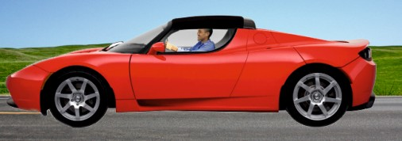
REVISION CARDS - TESLA AND ELECTRIC CARS
WORLD ASSOCIATION OF TECHNOLOGY TEACHERS https://www.facebook.com/groups/254963448192823/
www.technologystudent.com © 2023 V.Ryan © 2023
TESLA
Tesla is one of the best known automotive manufacturers in the world, founded in January 2003 , in California. The c o m p a n y i s a l s o k n o w n f o r i t s development of energy storage systems and solar panels.
ELON MUSK CEO MARTIN EBERHARD MARC TARPENNING
The Chief Executive Oﬃcer (CEO) is the charismatic Elon Musk, although the original company was founded by Martin Eberhard and Marc Tarpenning . Musk was one of the original major investors, having made his money, as a cofounder of PayPal.
TESLA - BACKGROUND
Tesla’s approached to electric cars set them aside as innovative. Their ﬁrst commercial electric car, was a sports car called the ‘Roadster’(2008). Followed in 2013 by the sports sedan called the ‘Model S’, - aluminium construction - a range of 200 miles - 75 minute recharge. It has a responsiveness that surpasses conventional sports cars.
ROADSTER
SPORTS SEDAN - MODEL S
TESLA - FACTORY SYSTEM
Tesla’s factory in California, is one of the largest in the world operating an automated manufacturing system. Tesla invest heavily in developing and maintaining a skilled workforce, speciﬁc to their specialised manufacturing needs. By the end of 2018, they aim to be manufacturing 500,000 cars at their Californian plant.
Governments around the world are turning their attention to pollution, caused by the internal combustion engine and ways of reducing it. Electric vehicles are one of the most likely solutions.
The electricicity supply grid is becoming greener, due to the increased use of wind power and solar power, making electric cars a much greener choice of vehicle.
USEFUL LINK SCAN HERE
USEFUL LINK CLICK HERE
Link
When was Tesla founded ? 1 mark
Most electric cars are small and lack style. Why are Tesla electric cars regarded as diﬀerent? Include names of the cars they manufacture. 4 marks
2. Describe the factory / manufacturing system used by Tesla.
4 marks

Slide 2
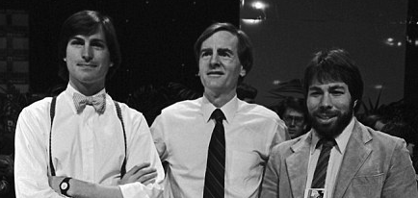
REVISION CARDS - APPLE
WORLD ASSOCIATION OF TECHNOLOGY TEACHERS https://www.facebook.com/groups/254963448192823/
www.technologystudent.com © 2023 V.Ryan © 2023
APPLE
APPLE, INNOVATION AND ICONIC DESIGNS
Apple Incorporated, is probably the most successful and best known international company. It’s success is based on the development of innovative software and especially consumer electronics, setting a h i g h s t a n d a r d f o r c o m p e t i n g technology companies to reach. Their corporate logo is one of the most recognisable, along with the Nike logo. Apple have developed a variety of innovative products and over the years, have built up a brand, based on both quality and innovation. Many of their products are now recognised as iconic designs, such as the iPhone, iPod, iPad and their intuitive software operating system, not to mention iTunes.
REASONS FOR SUCCESS
TRACK RECORD OF INTRODUCING TREND SETTING ELECTRONIC CONSUMER PRODUCTS
STYLISH AND FUNCTIONAL PRODUCTS.
OBSESSION FOR DETAIL, SOMETIMES OVERLOOKED BY OTHER MANUFACTURERS.
EACH PRODUCT IS A BRAND IN IT’S OWN RIGHT (iPod, iPad,
iPhone)
DESIGNED TO BE INTUITIVE AND EASY TO USE
A LOYAL AND GROWING CUSTOMER BASE
USEFUL LINK SCAN HERE
USEFUL LINK CLICK HERE
Link
STEVE JOBS STEVE WOZNIAK RONALD WAYNE
Founded in 1976 by Steve Jobs, Steve Wozniak and Ronald Wayne, the company developed one of the ﬁrst personal computers, called the Apple 1. The early Apple computers, led the way in terms of their user-friendly graphical operating systems, at a time when computers were dominated by IBM and their ‘less than intuitive’ operating system, called MS-DOS.
1. When was Apple founded and who were the founders ? 4 marks
2. Describe the type of products that Apple design and manufacture.
4 marks
3. Write three reasons, for the success of Apple products.
3 marks

Slide 3
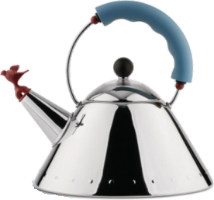
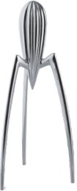
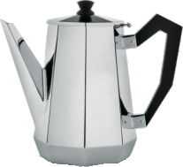
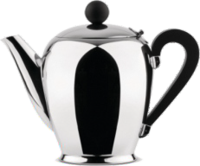
REVISION CARDS - ALESSI
WORLD ASSOCIATION OF TECHNOLOGY TEACHERS https://www.facebook.com/groups/254963448192823/
www.technologystudent.com © 2023 V.Ryan © 2023
ALESSI
Italian company founded in 1921 by Giovanni Alessi and concentrated on metal kitchenware. His products and designs of coﬀee pots became so popular, that by 1924 the brand name ‘Alessi’ was established.
In the1930s, Giovanni’s son Carlo, joined the family company, which quickly progressed to the use of stainless steel and away from utilitarian designs, to more adventurous ones, mass producing desirable, high quality, everyday household products.
OTTAGONALE COFFEE POT, 1935 COFFEE POT BOMBÉ, 1945 BY CARLO ALESSI BY CARLO ALESSI
ALESSI - 1950s ONWARDS
1950s: The company broadened it’s approach, collaborating with well-known designers. The aim was to break away from modernism and even traditional designs and to try a more unconventional design ideas, including those from groups such as, Studio Alchima (Alessandro Mendini) and Memphis (Ettore Sottsass). Other designers associated with Alessi include Aldo Rossi, Philippe Starck and Michael Graves.
WHISTLING BIRD KETTLE, 1985 JUICY SALIF - CITRUS SQUEEZER 1990 BY MICHAEL GRAVES. BY PHILIPPE STARCK
CHARACTERISTICS OF ALESSI
QUALITY PRODUCTS, REFLECTING A VERY HIGH STANDARD OF CRAFT WORK AND MANUFACTURING.
OFTEN DESIGNED BY FAMOUS, WELL-KNOWN DESIGNERS, WHO APPLY THEIR OWN STYLE AND EXPERIENCE TO EACH PIECE. DESIGNS EVOKE EMOTIONS AND MEMORIES AND ARE OFTEN FUN. UNUSUAL, STYLISH AND FUNCTIONAL PRODUCTS. DESIGNED TO BE DIFFERENT. OBSESSION FOR DETAIL, SOMETIMES OVERLOOKED BY OTHER MANUFACTURERS. DESIGNS THAT STAND OUT AND BECOME THE FOCUS OF DISCUSSION.
USEFUL LINK SCAN HERE
USEFUL LINK CLICK HERE
Link
1. When was Alessi founded as a company and what type of products did they manufacture? 3 marks
2. Name two designers who have collaborated with Alessi and the products they designed for Alessi. Include dates.
4 marks
3. Write three characteristics of Alessi products
3 marks

Slide 4
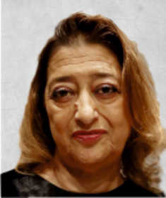
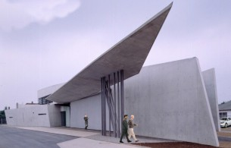
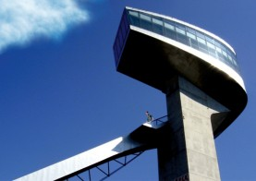
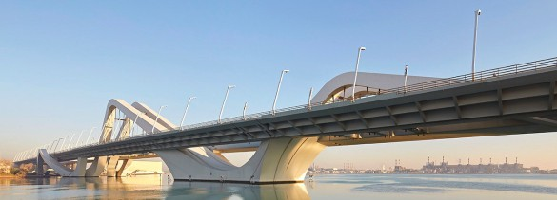
REVISION CARDS - ZAHA HADID (1950-2016)
WORLD ASSOCIATION OF TECHNOLOGY TEACHERS https://www.facebook.com/groups/254963448192823/
www.technologystudent.com © 2018 V.Ryan © 2018
ZAHA HADID
1950 - 2016
Zaha Hadid was an internationally recognised Iraqi-British Architect, responsible for a variety of outstanding buildings and other structures, often based on unusual geometrical shapes.
She received a number of prestigious awards for her innovative architectural designs, including on two occasions, the Stirling Prize. She was the ﬁrst female architect to receive the Royal Gold Medal (awarded by the Royal Institute of British Architects).
ZAHA HADID - EARLY CAREER
She came to London to study architecture in 1972, at the highly respected Architectural Association School of Architecture. After graduating, she worked in the Netherlands, although she started to build her reputation teaching Architecture in England, the USA and Germany, promoting an innovative and imaginative approach to the design of buildings. Many of her early designs were not built, undoubtedly due to the lack of foresight and ambition of potential clients, who selected more conservative and less imaginative architects.
She established her own company - Zaha Hadid Architects, in 1979.
ZAHA HADID - SAMPLE OF HER WORK
VITRA FACTORY FIRE BERGISEL SKI STATION - 1993 JUMP 2002
SHEIKH ZAYED BRIDGE, ABU-DHABI - 2010
LONDON AQUATICS CENTRE - 2012
USEFUL LINK SCAN HERE
USEFUL LINK CLICK HERE
Link
1. Who was Zaha Hadid and what did she achieve in the world of architecture?
6 marks
2. Research Zaha Hidid’s architectural work. Select one piece of her architecture. Carry out further research on your selected building / structure. Then, on the back of this sheet, attach an image of the building / structure. Why does this piece of architecture impress you?
8 marks

Slide 5
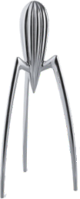
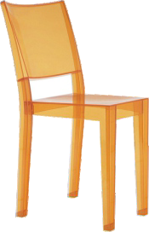
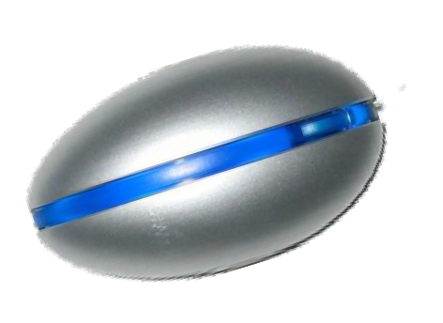
REVISION CARDS - PHILIPPE STARCK
WORLD ASSOCIATION OF TECHNOLOGY TEACHERS https://www.facebook.com/groups/254963448192823/
www.technologystudent.com © 2017 V.Ryan © 2017
PHILIPPE STARCK - 1
A recognised designer since the 1980s. In the l a t e 1 9 6 0 s , h e e s t a b l i s h e d a n inﬂatable furnishings company.
By the 1970s, Starck had set up his own design studio in Paris ( Starck Products), building a reputation as a pioneer in the world of design. He initially concentrated on interior designs and later products.
His designs can be regarded as post modern and include elements of the Memphis design movement, pop art and surrealism, with a hint of humour, environmental awareness, not to mention, invention.
PHILIPPE STARCK - 1
Starck ﬁrst achieved international attention by refurbishing French President François Mitterrand’s, private apartment in the Elysee Palace, in 1982.
He has designed products for well- known companies such as Alessi, Kartell, Microsoft and Puma. Starck designed the interiors for night clubs (La Main Bleue 1976), hotels (Royalton 1988 and Paramount hotels 1990, in New York) and restaurants (Café Costes 1984).
Starck is an idealist and designs products, that are aﬀordable and desirable to a mass market. Starck calls this ‘democratic design’, the aim being to improve life, for the greatest number of people.
SAMPLE PHILIPPE STARCK DESIGNS
‘Juicy Salif’ - Citrus Squeezer (1990) is a design classic and an iconic product.
www.technologystudent.com
USEFUL LINK SCAN HERE
www.technologystudent.com
www.technologystudent.com
T h e w o r l d s ﬁ r s t polycarbonate chair, the ‘La Marie Chair’ in 1998, for Kartell of Italy.
S t a r c k ’ s c o m p u t e r mouse, commissioned by Microsoft in 2004. Ergonomically designed, being comfortable in the right or left hand
USEFUL LINK CLICK HERE
Link
1. Who is Philippe Starck and why do his designs attract attention? 3 marks
2. How did Starck ﬁrst gain international attention?
2 marks
3.Select one of Starck’s designs and explain why you think it is iconic / a design classic.
3 marks

Slide 6
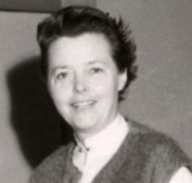
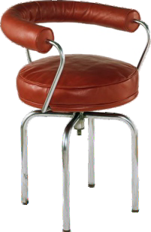
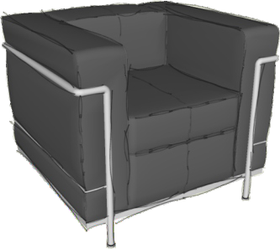
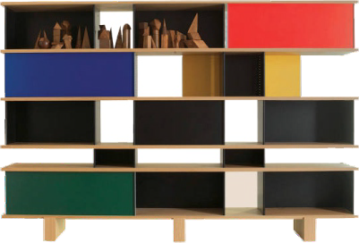
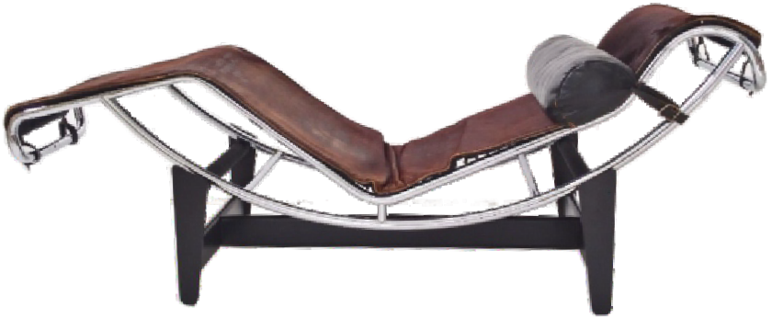
REVISION CARDS - CHARLOTTE PERRIAND (1903 to1999)
WORLD ASSOCIATION OF TECHNOLOGY TEACHERS https://www.facebook.com/groups/254963448192823/
www.technologystudent.com © 2018 V.Ryan © 2018
CHARLOTTE PERRIAND 1903 to1999
Charlotte Perriand was a d e s i g n e r a n d architect. Her work is regarded as modern and stylish today, as it was in the ﬁrst half of the twentieth century.
As a student, she studied furniture design at the ‘School of the Central Union of Decorative Arts’, in Paris. She aimed to design aﬀordable furniture, that could be mass produced for a wide and varied customer base. Her early designs were regarded as radical and initially, were not commercially successful. She became one of the most inﬂuential, innovative designers, of the twentieth century.
CHARLOTTE PERRIAND
Charlotte often worked with Pierre Jeanneretan and another famous French designer, Le Corbusier, in the late 1920s and early 1930s. They co- designed a number of commercially successful pieces of furniture, largely manufactured by a company called Cassina. The LC4 Chaise Longue (Lounge) Chair of 1928, was an innovation in design.
LC4 CHAISE LONGUE (LOUNGE) CHAIR MODEL B306 - 1928
SOME OTHER PERRIAND DESIGNS
LC7 SWIVEL
USEFUL LINK SCAN HERE
USEFUL LINK CLICK HERE
Link
ARMCHAIR - 1928
LC2 ARMCHAIR - 1929
NUAGE BOOKCASE RANGE - 1950s
1. Who was Charlotte Perriand and where did she study? Were her early designs successful ?(explain your answer).
3 marks
2. Charlotte Perriand often collaborated with two other designers. What are their names?
2 marks
3. Research the work of Charlotte Perriand. Then, select one design you like. Paste an image of your selected design, on the back of this sheet. Add notes, explaining the features / characteristics of the design.
6 marks

Slide 7
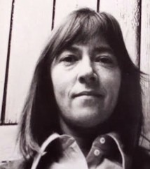
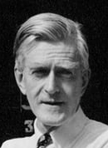
REVISION CARDS - JOCK KINNEIR and MARGARET CALVERT
WORLD ASSOCIATION OF TECHNOLOGY TEACHERS https://www.facebook.com/groups/254963448192823/
www.technologystudent.com © 2018 V.Ryan © 2018
JOCK KINNEIR and MARGARET CALVERT
Margaret Calvert is best known for her work with her colleague Jock Kinneir (1957 to 1967).
Margaret Calvert
They designed many of the road signs that we see today, in a style that has been used widely around the world. Before the ground breaking work of Kinneir and Calvert, road signs followed a variety of styles and not standardised, often making it perplexing for drivers.
They were commissioned to design the ﬁrst motorway signage and later, signage for other roads throughout the UK.
JOCK KINNEIR and MARGARET CALVERT
K i n n e i r a n d C a l v e r t decided on the use of standard colours and a new font called ‘Transport’, which would be easy to understand, at a glance.
Jock Kinneir
For Motorways - A colour scheme of reﬂective white lettering, against a non- reﬂective blue background was adopted.
The signs were used in 1958, along the UK’s ﬁrst motorway, the M6.
S i n c e t h e i n t r o d u c t i o n o f t h e standardised signage, Kinneir’s and Calvert’s innovative style has been used around the world.
SIGNAGE IN THE STYLE DEVELOPED BY JOCK KINNEIR AND MARGARET CALVERT
The NORTH
Leeds Sheﬃeld
USEFUL LINK SCAN HERE
USEFUL LINK CLICK HERE
Link
Aylesbury
A 34
Mansﬁeld
A 38
Matlock
(A 615)
Leigh
A 43
SOME OF THE SIGNAGE DESIGNED BY MARGARET CALVERT
MEN AT WORK FARM ANIMALS
CHILDREN CROSSING
SYMBOL SYMBOL
1. Why was it necessary to design standardised road signs, for the motorways and other roads?
2 marks
2. Describe two characteristics of Kinneir’s and Calvert’s signage. What was the reasoning behind the characteristics?
4 marks

Slide 8
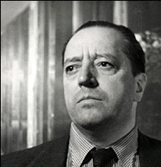
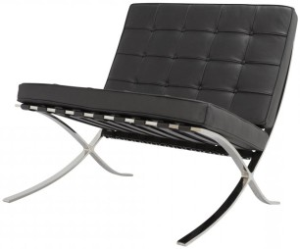
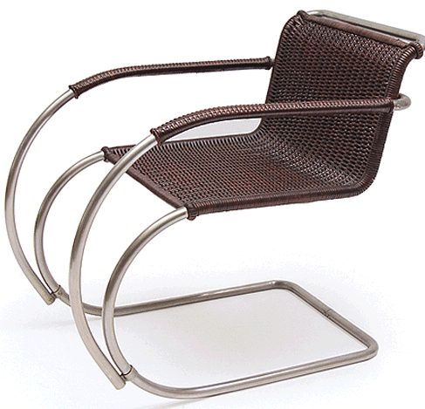
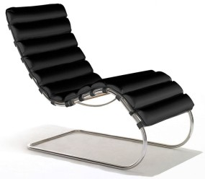
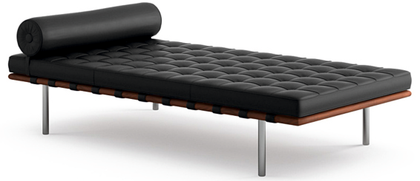
REVISION CARDS - LUDWIG MIES VAN DER ROHE 1886 – 1969
WORLD ASSOCIATION OF TECHNOLOGY TEACHERS https://www.facebook.com/groups/254963448192823/ www.technologystudent.com © 2018 V.Ryan © 2018
LUDWIG MIES VAN DER ROHE - 1
The German architect Ludwig Mies Van Der Rohe, designed the pavilion (exhibition stand) for the 1929 Barcelona world fair.
The pavilion was to house manufactured German products, to promote German design, engineering and technology, in the same way trade fairs do today. His ‘Barcelona Chair’ (also called the Pavilion Chair) was designed between 1928 and 1929. It was one of the German exhibits at the Barcelona world fair. It quickly became known as a classic modernist design.
He became director of architecture at the Bauhaus in 1930.
THE BARCELONA CHAIR
The original chair - each side frame was manufactured from two pieces of steel welded together and then ‘bolted’ together. In the 1950s stainless steel, a new material in furniture manufacture, was used for the construction of the frames. The adoption of stainless steel meant that the f rame could be manufactured in one piece, without joint lines. It was mass produced in 1950s by ‘Knoll’ furniture manufacturers and this continues today.
OTHER DESIGNS BY LUDWIG MIES VAN DER ROHE
CANTILEVER CHAIR LOUNGE MR20, 1927 CHAIR 1932
BARCELONA DAYBED 1930
USEFUL LINK SCAN HERE
USEFUL LINK CLICK HERE
Link
1. Ludwig Mies Van Der Rohe became the director of a famous Design School. What was it called? 1 marks
2. The Barcelona Chair was designed by Ludwig Mies Van Der Rohe. It has another name, what is it?
1 marks
3. Write a description of the Barcelona Chair
3 marks
4. Name two other pieces of furniture designed by Ludwig Mies Van Der Rohe. Include the date of their design.
2 marks

Slide 9
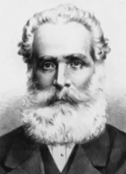
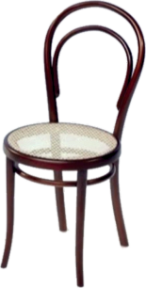
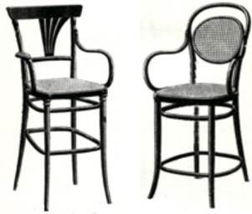
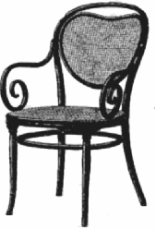
REVISION CARDS - MICHAEL THONET - THE No14 CHAIR
WORLD ASSOCIATION OF TECHNOLOGY TEACHERS https://www.facebook.com/groups/254963448192823/
www.technologystudent.com © 2017 V.Ryan © 2017
MICHAEL THONET - (1796-1871)
H e w a s a d e s i g n e r specialising in ‘bentwood’ furniture, manufactured from veneers of natural woods, normally beech, which were softened by steam.
His chair designs contrasted with the
hand crafted chairs of the day. His No 14 Chair was the ﬁrst chair to be mass produced in thousands, on a production line.
Thonet saw that there was a opportunity to use his innovative industrial production technology, to mass manufacture new designs. The production line was staﬀed by semi and unskilled workers. There was no longer a need to have skilled craftsmen at every stage of production.
THE No 14 CHAIR
T h e N o 1 4 c h a i r w a s manufactured as separate parts and simply screwed together (six ‘steam bent’ wood parts, ten screws and two nuts). This construction technique was a precursor to t h e w a y f u r n i t u r e i s constructed in our modern
world, as ﬂat packs. This meant that thirty six completed but disassembled chairs, could be packaged safely, in a one cubic metre ‘sea crate’, for transport around the world.
The No14 Chair was composed of solid beech, not veneers. Thonet had perfected steaming solid wood and bending it to form unusual shapes.
THE THONET PHILOSOPHY
The Arts and Crafts Movement of the 1 9 t h C e n t u r y b e l i e v e d i n t h e manufacture of hand crafted products, made by craftsmen, often as single items / one oﬀs.
T h o n e t b e l i e v e d i n t h e m a s s manufacture of quality furniture, on a production line, using semi and unskilled w o r k e r s . T h e T h o n e t C o m p a n y manufactured for a world market and ﬁfty million No 14 Chairs were sold before 1930.
OTHER THONET CHAIRS
USEFUL LINK SCAN HERE
USEFUL LINK CLICK HERE
Link
1. What type of product did Michael Thonet design and manufacture? 2 marks
2. The Thonet No14 Chair was supplied in disassembled form (in parts). What was the advantage of this approach ?
2 marks
3. How did the philosophy of the Thonet Company diﬀer from that of the Arts and Crafts Movement ?
3 marks

Slide 10
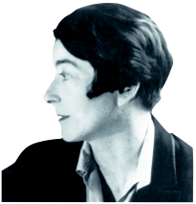
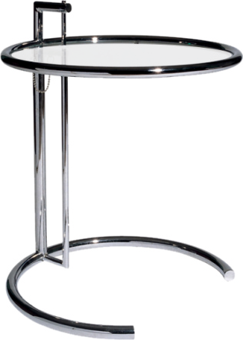
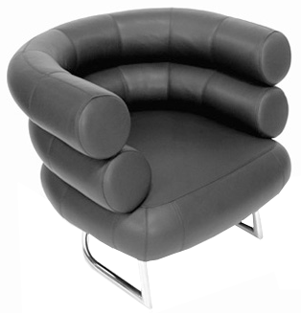
REVISION CARDS - EILEEN GRAY
WORLD ASSOCIATION OF TECHNOLOGY TEACHERS https://www.facebook.com/groups/254963448192823/
www.technologystudent.com © 2017 V.Ryan © 2017
EILEEN GRAY - DESIGNER
Eileen Gray, a modernist designer, born in, Ireland in 1878. She was an artist, interior designer and architect. Trained in London, but spent most of her time in France.
Very few women worked in design during the early twentieth century, as this profession was male dominated.
Her work can be regarded as both functional and artistic. Much of her work was at the leading edge of the modernist movement and was inﬂuenced in particular, by the Art Deco design movement.
EILEEN GRAY THE BIBENDUM CHAIR
In a modernist in style, very diﬀerent to traditional designs of the same period. It has a simple and functional form and is a timeless design, still popular today and regarded as a classic, iconic design. Chromed steel frame and curved leather tubing, giving rise to an extremely comfortable seating position.
The name for the chair was taken from the Michelin man, a character developed to sell tyres.
EILEEN GRAY THE E1027 TABLE
Designed in 1929 - still manufactured today. It is another Eileen Gray piece of furniture that has become a design icon/classic.
Height adjustable. The stand is composed of two ‘telescopic’ sliding tubes, with a pin on a chain, used to lock them in position.
High grade tubular stainless steel and tempered glass, provide a quality ﬁnish.
USEFUL LINK SCAN HERE
USEFUL LINK CLICK HERE
Link
1. Write a few facts about Eileen Gray.
4 marks
2. Select one of her iconic designs. Name and describe the design. Sketch it on the back of this paper. 6 marks

Slide 11
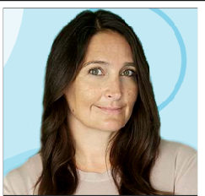
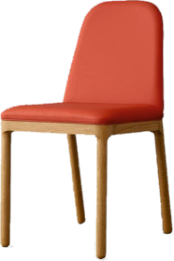
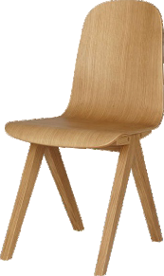
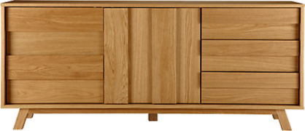
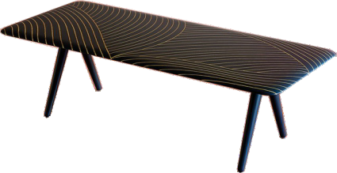
REVISION CARDS - BETHAN GRAY
WORLD ASSOCIATION OF TECHNOLOGY TEACHERS https://www.facebook.com/groups/254963448192823/
www.technologystudent.com © 2018
V.Ryan © 2018
BETHAN GRAY
A Welsh Designer, with a Persian ancestry, from an Artistic and creative family. She studied 3D Design at De Montford University (Leicester) and tends to focus mainly on contemporary furniture. She forged her early career with Habitat and became head of Habitat's furniture department, leading a design team, that was extremely successful, in designing a number of furniture collections, between 2004 to 2008.
DESIGN CHARACTERISTICS
Deceptive simplicity.
Contemporary nature, embracing a range of styles.
A very high standard of manufacture, blending high quality ‘luxury’ natural materials, with craft skills and modern industrial processes.
Elegant outcomes.
Often inspired by culture, having travelled extensively in Asia, the Middle East, Africa and America.
Aesthetically pleasing, stylish and tactile.
CARVE CHAIR
OAK, PLYWOOD DINING CHAIR
USEFUL LINK SCAN HERE
USEFUL LINK CLICK HERE
Link
SOME BETHAN GRAY PRODUCTS
NOAH SIDEBOARD
DHOW COFFEE TABLE
1. Describe Bethan Gray’s early work as a designer. 3 marks
2. List ﬁve characteristics of Bethan Gray’s designs.
5 marks

Slide 12
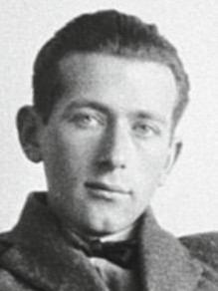
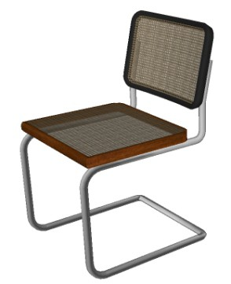
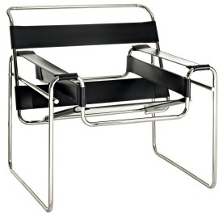
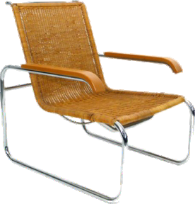
REVISION CARDS - MARCEL BREUER
WORLD ASSOCIATION OF TECHNOLOGY TEACHERS https://www.facebook.com/groups/254963448192823/
www.technologystudent.com © 2017 V.Ryan © 2017
MARCEL BREUER (1902-1981)
Breuer was an inﬂuential modernist designer and made a signiﬁcant contribution to the Bauhaus. He was an architect and a designer. Breuer was a student at the Bauhaus, where his ability as a designer was recognised. After a short time working in a Paris architectural practice, he moved back to the Bauhaus in 1925, as Head of the Carpentry Shop, working with his ‘mentor’ Walter Gropius (the founder of the Bauhaus).
CHARACTERISTICS OF BREUER’S DESIGNS
SIMPLICITY, FUNCTION AND AESTHETICS INNOVATIVE DESIGNS
NEW MATERIALS APPLIED TO PRODUCTS (TUBULAR STEEL)
NEW MANUFACTURING TECHNIQUES
PRODUCTS MASS PRODUCED AFFORDABLE PRODUCTS
PRODUCTS FOR THE GENERAL PUBLIC
WASSILY OR B3 THE B35 CHAIR CLUB CHAIR 1928
1924
A WELL KNOWN BAUHAUS DESIGN
USEFUL LINK SCAN HERE
USEFUL LINK CLICK HERE
Link
MB-118 CHAIR 1928
BY MARCEL BREUER
Marcel Breuer designed this famous chair and manufactured it from one piece of tubular steel. It typiﬁes the Bauhaus philosophy - simple design, mass produced, modern, aesthetically pleasing and for the general public.
1. Write three facts about Marcel Breuer.
3 marks
2. What are the characteristics of Marcel Breuer’s designs?
4 marks
3. Name and describe a product designed by Marcel Breuer.
4 marks

Slide 13
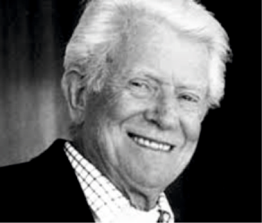
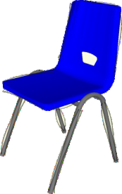
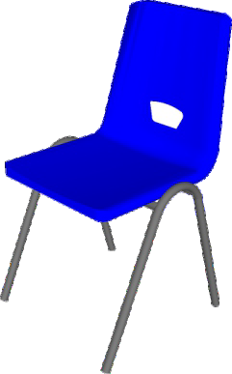
REVISION CARDS - ROBIN DAY - THE POLYPROP CHAIR
WORLD ASSOCIATION OF TECHNOLOGY TEACHERS https://www.facebook.com/groups/254963448192823/
www.technologystudent.com © 2017 V.Ryan © 2017
DESIGNER - ROBIN DAY
Robin Day, trained at the Royal College of Art in the 1930s. He was a furniture designer, best known for his innovative design of the Polyprop Chair in 1963. This was manufactured from polypropylene, through injection moulding. This design became a trend setter for cheap, quality, mass manufactured, stackable chairs. Over 30 million have now been sold.
THE POLYPROP CHAIR - 1
Probably one of the most used chairs in the world is Robin Day’s Polyprop Chair of 1963, which continues to be manufactured to this day.
Although the design has slowly evolved over the years, it is very popular as a stackable chair in schools, universities, canteens and conference venues.
Revolutionary design, with a one piece seat and backrest, manufactured through injection moulding. Required extensive research into ergonomics, before the manufacturing process could begin.
THE POLYPROP CHAIR - 2
High impact resistant polypropylene, is used for the seat and tubular steel for the frame. This means that the chair is cheap and can be mass produced.
POLYPROPYLENE
GAS WELDED
STEEL TUBE
USEFUL LINK SCAN HERE
USEFUL LINK CLICK HERE
Link
1. Who was the designer Robin Day?
3 marks
2. Why was the Polyprop Chair innovative, in the 1960s?
5 marks

Slide 14
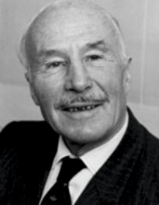
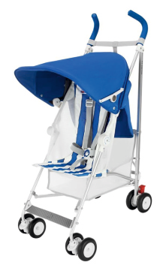
REVISION CARDS - OWEN MACLAREN AND THE B01 FOLDING PUSH CHAIR
WORLD ASSOCIATION OF TECHNOLOGY TEACHERS https://www.facebook.com/groups/254963448192823/
www.technologystudent.com © 2018 V.Ryan © 2018
OWEN MACLAREN
Owen Maclaren is best known for his innovative design of a lightweight folding baby carrier. In addition, he designed the undercarriage of the famous Spitﬁre. The new undercarriage d e s i g n , a l l o w e d t h e p l a n e t o manoeuver whilst on the ground and the wheels to fold into the wings, creating an aerodynamic shape. He applied his knowledge of folding lightweight tubular structures, to that of children’s push chairs.
A MACLAREN CHILD’S PUSH CHAIR
B01
THE MACLAREN B01 FOLDING PUSH CHAIR AN ICONIC DESIGN
The B01 was the ﬁrst folding push chair and it inspired other designers to follow suit. It set a high bench mark, that other designers tried to meet.
Maclaren’s use of aluminium tube, was new. After the introduction of the M a c l a r e n B 0 1 , a l u m i n i u m w a s considered, as the main material for many other products.
The Maclaren B01 ‘stood out’ from other similar products, in the 1960s and is still in production today (albeit, an improved version). It has stood the test of time, which is another characteristic of an iconic product.
USEFUL LINK SCAN HERE
USEFUL LINK CLICK HERE
Link
FOLDED BUGGY
Patented - 1965 On sale - 1967
The Maclaren BO1, is lightweight due to its aluminium structure. It folds to a manageable size because of innovative design and can be carried by one hand. Ideal for getting on and oﬀ buses or folding and placing in a car boot.
1. What was Owen Maclaren’s background, in the ﬁeld of engineering ?
2 marks
2. Why can the Maclaren B01 Folding Push Chair, be regarded as an iconic design?
4 marks

Slide 15
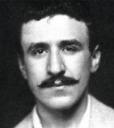
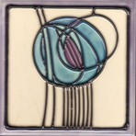
REVISION CARDS - CHARLES RENNIE MACKINTOSH
WORLD ASSOCIATION OF TECHNOLOGY TEACHERS https://www.facebook.com/groups/254963448192823/
www.technologystudent.com © 2017 V.Ryan © 2017
CHARLES RENNIE MACKINTOSH(1868 to 1928)
Renowned Scottish designer
/ architect, who contributed significantly to design in the
early twentieth century. He designed inspirational buildings, such as the Glasgow School of Art (1899). He also produced f loral and landscape watercolours, textile designs and interior designs. His furniture was innovative in design, at a time of change from Art Nouveau to Modernism.
He was influenced by the Japanese style and design, recognising Japanese simplicity, style, functionality and their use of natural materials .
Died in 1928 with only 6 pounds to his name. His original designs, artwork and furniture now sell for hundreds of thousands of pounds.
SELECTION OF DESIGNS CHARLES RENNIE MACKINTOSH
Mackintosh Rose
ANALYSIS OF A MACKINTOSH CHAIR
USEFUL LINK SCAN HERE
USEFUL LINK CLICK HERE
Link
TALL BACK
SIMPLE SHAPE AND FORM
EARLY MODERNIST DESIGN
MINIMAL DECORATION
NATURAL WOOD
Ingram Chair (1903)
JAPANESE INFLUENCE
GEOMETRICALLY ARRANGED SQUARES / SHAPES
Argyle Chair High Back Chair Hill House Chair 1897 1899 1903
1. Write a brief description of the contribution made by Charles Rennie Mackintosh, to design.
4 marks
2. Charles Rennie Mackintosh’s designs are famous. His chairs are distinctive and easy to recognise. What are the key features of his chair designs? 5 marks

Slide 16
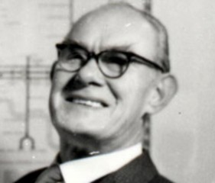
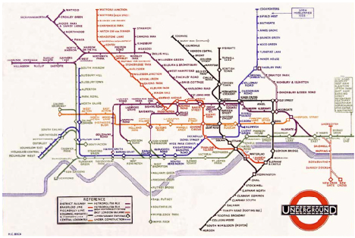
REVISION CARDS - HARRY BECK AND THE LONDON UNDERGROUND MAP
WORLD ASSOCIATION OF TECHNOLOGY TEACHERS https://www.facebook.com/groups/254963448192823/
www.technologystudent.com © 2017 V.Ryan © 2017
HARRY BECK (1902-1974)
Harry Beck was an Engineering Technical Draftsman and he worked for the London Underground Signals Oﬃce. He developed an interest in the way rail transport maps were graphically presented. Maps of the London U n d e r g r o u n d , w e r e g e o g r a p h i c representations, although there were attempts by map designers to simplify the route maps. Beck’s iconic London Underground Map was ﬁrst published in 1932. It was very well received by travellers and commuters.
MAP CHARACTERISTICS
The distance between the stations is not important, as passengers are interested in the order of the stations and how they connected to each other. The busy central area of the map, has been expanded to show more detail. Stations on the periphery of the geographical map are drawn closer to the centre. Straight lines connect the stations, ensuring the map is easy to understand.
WHY IS IT AN ICONIC DESIGN?
The map was designed in Beck’s own time and without a commission from the London Passenger Transport Board. His original sketch was drawn in a school exercise book, whilst he was ‘laid oﬀ’.
Beck’s London Underground Map, is now regarded as an iconic design, as it has inspired other map layouts throughout the world. The style of map that he introduced has been adapted for a vast range of diagrammatic presentations. It set a high benchmark for other map designers to follow . The map provides all the necessary information required by a traveller and no unnecessary detail or decoration. It is strictly functional and yet can be regarded as piece of art, reﬂecting a modernist philosophy. It is aesthetically pleasing.
USEFUL LINK SCAN HERE
USEFUL LINK CLICK HERE
Link
1. Write three facts about Harry Beck, including one about his iconic London Underground Map. 3 marks
2. List four characteristics of the underground map.
4 marks
3. Why can Beck’s map be regarded as an iconic design?
3 marks

Slide 17
REVISION CARDS - ETTORE SOTTSASS - MEMPHIS DESIGN GROUP
WORLD ASSOCIATION OF TECHNOLOGY TEACHERS https://www.facebook.com/groups/254963448192823/
www.technologystudent.com © 2017 V.Ryan © 2017
THE MEMPHIS GROUP
Established in the 1980s. Composed of designers based in Italy. Memphis designers, regarded aesthetics as the most important aspect of a product, not its function. Memphis designs/products can be regarded as pieces of art or exhibition pieces, not useable, practical items.
The best known ‘Memphis’ designer was, Ettoire Sottsass.
ETTORE SOTTSASS
Ettore Sottsass led the Memphis design group. He designed products that were unusual, with bright colour schemes, producing imaginary designs for everyday objects.
H i s d e s i g n s w e r e controversial and unusual.
This Ceramic Totem was designed by Sottsass, as p a r t o f t h e M e m p h i s Group.171cm in height. The ceramic ﬁnish is coated in p o l y c h r o m e g l a z e s , p r o d u c i n g a c o l o u r f u l reﬂective surface.
ETTORE SOTTSASS DESIGNS
ASHOKA LAMP - 1981
THE ARTICOLO 6000 VASE
USEFUL LINK SCAN HERE
USEFUL LINK CLICK HERE
Link
171cm
77cm
DRESSER LAMP
1. In what decade was Memphis design most popular ?
1 marks
2. For a Memphis designer, how important is a product’s aesthetics compared to it’s functions?
3 marks
3. Who was Ettore Sottsass?
1 marks
4. Name and describe one of Ettore Sottsass’s designs?
3 marks

Slide 18
CHRISTOPHER DRESSER (1834-1904) - REVISION CARDS
WORLD ASSOCIATION OF TECHNOLOGY TEACHERS https://www.facebook.com/groups/254963448192823/
www.technologystudent.com © 2019 V.Ryan © 2019
TEAPOT 1878
1. CHRISTOPHER DRESSER
(1834-1904)
www.technologystudent.com
An important name, from the history of design, not only as a designer, but also as a philosopher of design. Born in Glasgow and attended the Government School of Design in London, from the age of thirteen. He became one of the most inﬂuential designers of the nineteenth century, with his inﬂuence extending into the twentieth century.
Christopher Dresser was a prominent writer on the subject of Design. He help to popularise the Japanese style, that was further developed by designers such as Charles Rennie Mackintosh.
2. 3.
USEFUL LINK SCAN HERE
USEFUL LINK CLICK HERE
Link
CHRISTOPHER DRESSER
Dresser believed in three important principles, when designing a product:
TRUTH
The use of natural materials, not imitations.
BEAUTY
A design that is perfect, lasting the test of time. A design that will always be aesthetically pleasing and interesting to view.
POWER
Strength, energy, and force, through simpliﬁed decoration and ornament, taking a geometrical form, derived from the study of natural forms.
www.technologystudent.com
TOAST OR LETTER RACK 1884
1. Who was Christopher Dresser and why is he held in high esteem, by the world of design? 3 marks
2. Describe the three design principles promoted by Dresser. 3 marks

Slide 19
REVISION CARDS - RON ARAD
WORLD ASSOCIATION OF TECHNOLOGY TEACHERS https://www.facebook.com/groups/254963448192823/
www.technologystudent.com © 2023 V.Ryan © 2023
RON ARAD
Born in Israel in 1951. Studied Art, Design and Architecture in Jerusalem and London, in the 1970s. Formed Ron Arad Associates in 1989, specialising in product design and architecture.
In 2008 he established Rod Arad Architects. Ron Arad was the Head of the Design Products Department, at the Royal College of Art, between the years 1997 to 2009. His style is often a mix of technology, experimentation and ‘fun’. He has collaborated with many of the best known furniture makers and design companies, including Alessi.
THE ROVER CHAIR
Ron Arad’s early acclaimed work began in 1981 with the Rover Chair. The basic car seat was salvaged from a Rover 2000, in a scrap yard and updated with a metal tubular frame.
The basic car seat was salvaged from a Rover 2000, in a scrap yard and updated with a metal tubular frame.
ARCHITECTURE
Ron Arad has designed buildings around the world. The Nobu Hotel and the Holon Design Museum are just two examples of his innovative style.
The Holon Design Museum
Dedicated to ‘design’. Its design is based on an interlocking combination of curves and rectangles. A concrete structure, clad in ﬁve rings of weathered steel, carefully coloured to achieve the right tones.
USEFUL LINK SCAN HERE
USEFUL LINK CLICK HERE
Link
1. Where was Ron Arad born and where did he train as a Designer and Architect?
2 marks
2. Describe Ron Arad’s style of design? Which companies has he collaborated with? 4 marks
3. Name and describe one of his well-known designs.
4 marks

Slide 20
REVISION CARDS - PATRICIA URQUIOLA
WORLD ASSOCIATION OF TECHNOLOGY TEACHERS https://www.facebook.com/groups/254963448192823/
www.technologystudent.com © 2023 V.Ryan © 2023
PATRICIA URQUIOLA
Patricia Urquiola is a Spanish designer with an international reputation. She studied at the Universidad Politécnica de Madrid (Spain) and Politecnico di Milano (Italy).
In 2001 she established her own design studio, working on product design, interior design and architecture. She has an individual and experimental approach to design, using carefully chosen premium materials.
She worked closely with Vico Magistretti, in the design of the Flower Armchair in 1996 and with the De Padova Furniture Company.
FJORD ARMCHAIR RELAX
The Fjord Armchair Relax, was designed by Patricia Urquiola, for Moroso in 2002. A distinct design, with its asymmetrical back rest, in a distinguished, elegant, Scandinavian style. The design is inspired by a broken sea shell.
SEA SHELL
FLO CHAIR
The minimalist, Flo Chair, design by Patricia Urquiola for the furniture company Driade, in 2004. A steel frame with hard wearing brown wicker material. Suggests an African cultural inﬂuence. The wicker is hardwearing and helps to hold the framework in position. It is a material often used in African furniture.
USEFUL LINK SCAN HERE
USEFUL LINK CLICK HERE
Link
1. Who is Patricia Orquiola and where did she train as a Designer ?
2 marks
2. Describe her approach to design? Who did she collaborated with when designing the Flower Armchair?
4 marks
3. Name and describe one of his well-known designs.
4 marks

Slide 21
REVISION CARDS - SIR DAVID ADJAYE
WORLD ASSOCIATION OF TECHNOLOGY TEACHERS https://www.facebook.com/groups/254963448192823/
www.technologystudent.com © 2023 V.Ryan © 2023
DAVID ADJAYE
Sir David Adjaye is a Ghanaian, British architect, one the leading architects of his generation. Born in Dar es Salaam, Tanzania, in1966.
He achieved a Bachelor of Architecture degree from the South Bank University, London in 1990, followed by a Master of Architecture degree in 1993, awarded by the Royal College of Art.
He has a reputation for combining imaginative use of materials, innovative use of light and inspired designs, with cultural / historical reference.
He has a reputation for combining an imaginative use of materials, innovative use of light and inspired designs, with cultural / historical reference.
He is an internationally recognised architect, with architectural work spanning several continents. These include; Ruby City Museum in San Antonio, 130 William, in Manhattan, New York, USA and National Museum of African American History and Culture in Washington D.C.
In 2007, Adjaye was awarded an OBE for services to architecture and in 2017 he was Knighted. He became the RIBA Royal Gold Medal winner in 2021, which is recognised as the UK’s most prodigious award for architecture.
NATIONAL MUSEUM OF AFRICAN AMERICAN HISTORY AND CULTURE WASHINGTON D.C.
A Smithsonian museum dedicated to African American life, history, and culture. Opened in 2016, costing ﬁve hundred million dollars. The outer bronze coated decorative framework, represents the iron lattice work of slaves.
USEFUL LINK SCAN HERE
USEFUL LINK CLICK HERE
Link
1. Who is David Adjaye and where did he train as an Architect ?
2 marks
2. He has a reputation in the architectural world for.......?
4 marks
3. Name and describe one of his well-known architectural designs.
4 marks

Slide 22
REVISION CARDS - MARC NEWSON CBE
WORLD ASSOCIATION OF TECHNOLOGY TEACHERS https://www.facebook.com/groups/254963448192823/
www.technologystudent.com © 2023 V.Ryan © 2023
MARC NEWSON
LOCKHEED LOUNGE CHAIR
He designed the ﬁrst version of the famous Lockheed Lounge Chair in 1986. This has become an iconic design, manufactured from sheet aluminium, with sections rivetted together, the same technique as aircraft wings / fuselage. The chair is often described as the most expensive lounge chair in the world, having achieved high prices at auctions.
Marc Newson designed the stylish ‘Super Guppy’ lamp in 1987, and the Orange Lounge and Table manufactured from moulded ﬁbre glass in1989, when working in Tokyo.
The Newson Aluminium Chair 2018, was inﬂuenced by the style of the Bauhaus MB 118 Chair, by Marcel Breuer. The Newson chair is a modern, stylish adaptation, of the cantilever chairs of the past.
Super Guppy and Orange Lounge / Table
USEFUL LINK SCAN HERE
USEFUL LINK CLICK HERE
Link
Marc Newson is an
internationally recognised Australian designer. He works across various disciplines, including furniture, clothing / textiles, jewellery, watches,
cookware, glass products and aerospace.
He graduated in 1984 from the Sydney College of Arts.
He has worked in several countries, for well known companies / brands, such as Nike, Qantas Airways and Apple.
He has his own Design Company. Marc Newson is regarded as one of the most inﬂuential designers of our time.
1. Who is Marc Newson and which disciplines has he worked with ? 2 marks
2. Describe the Lockheed Lounge Chair. Include the main construction technique.
4 marks
3. Name and describe one more of his well-known designs.
4 marks

Slide 23
REVISION CARDS - DAISUKE KITAGAWA
WORLD ASSOCIATION OF TECHNOLOGY TEACHERS https://www.facebook.com/groups/254963448192823/
www.technologystudent.com © 2023 V.Ryan © 2023
DAISUKE KITAGAWA
Daisuke Kitagawa graduated from the Kanazawa College of Art in 2005. In 2011, he established his company ‘Daisuke Kitagawa Design’.
A year later he was named by ‘The New York Times’, as one of most prominent new designers. His background in home appliance design with NEC, He keeping to the tradition of Japanese design, characterised by simplicity, a minimalist philosophy, functionality, ingenuity and aesthetically pleasing products. His designs are both elegant and contemporary.
THE STRUT CHAIR
The Strut Chair is comfortable, stylish and minimalist. The beautifully formed natural wood and chrome steel frame, are carefully proportioned. The materials complement each other. The chair is self-assembly, ergonomically designed and understated.
‘TRIFLE’ STORAGE UNIT
The ‘Triﬂe’ storage unit is a contemporary Daisuke design, with a dual purpose. It can be a storage unit or a table. The lightweight, thin sheet steel construction, gives structural strength and is 100% recyclable.
USEFUL LINK SCAN HERE
USEFUL LINK CLICK HERE
Link
1. Who is Daisuke Kitagawa and what is his design background ?
2 marks
2. Describe the characteristics of Daisuke’s designs ?
3 marks
3. Name and describe one more of his well-known designs.
4 marks

Slide 24
REVISION CARDS - FUMIE SHIBATA
WORLD ASSOCIATION OF TECHNOLOGY TEACHERS https://www.facebook.com/groups/254963448192823/
www.technologystudent.com © 2023 V.Ryan © 2023
FUMIE SHIBATA
Fumie Shibata graduated from Musashino Art University and went on to work for manufacturers of electrical goods, including the Toshiba Design Centre in 1994.
She is a professor at the same university. Fumie founded ‘Design Studio S’, a studio that focusses on industrial design and a broad spectrum of product design. Fumie is known and respected for her design of electrical goods, health care products and capsule hotels. She draws on traditional Japanese design as an inspiration for many of her designs. She prioritises the environment when designing.
THE BONBORI LAMP
The Bonbori Lamp, was inspired by traditional Japanese lamps, found at shrines and temples. The modern version is manufactured from stainless steel and is ‘powered’ by an LED light.
It emits a soft, warm glow, which shines through the laser cut perforations at its centre. The wiring comes through the base and is unseen.
THE VERTEBRA03
The Vertebra03 is a deceptively simple chair. Its ergonomic design, results in a comfortable and functional chair, suitable for a range of environments, from the oﬃce to home.
The back of the seat can be inclined from 0 to 25 degrees. In addition, the seat slides forward, giving more support and promoting a healthy and restful sitting posture.
USEFUL LINK SCAN HERE
USEFUL LINK CLICK HERE
Link
1. Who is Fumie Shibata and what is her design background ?
2 marks
2. Describe the characteristics of Fumie’s designs ?
3 marks
3. Name and describe one more of her well-known designs.
4 marks

Slide 25
REVISION CARDS - DIETER RAMS
WORLD ASSOCIATION OF TECHNOLOGY TEACHERS https://www.facebook.com/groups/254963448192823/
www.technologystudent.com © 2023
V.Ryan © 2023
DIETER RAMS
Dieter Rams was born in Germany in 1932. He developed an interest in carpentry at an early age, due to watching the work of his grand father, a carpenter.
His interest in skilled practical work, led to architecture and product design. He is associated with innovative product design, especially electrical / electronic consumer goods. The quality and innovation of Dieter’s designs, have led to international awards. He was one of the early voices against the wasteful use of materials (‘less, but better’), consequently drawing attention to sustainability.
DIETER RAMS
TEN PRINCIPLES FOR GOOD DESIGN
Braun TP 2 Pocket Radio And
Record Play
USEFUL LINK SCAN HERE
USEFUL LINK CLICK HERE
Link
Good design is innovative.
Good design makes a product useful.
Good design is aesthetic.
Good design makes a product understandable.
Good design is unobtrusive.
Good design is honest.
Good design is long lasting.
Good design is thorough down to the last detail.
Good design is environmentally friendly.
Good design is as little design as possible.
His ten principles are often used as a reference by designers, during the evolution of a design and product development.
er
World Receiver T 1000 Radio - 1963
Braun SK4 Record Player and Radio
1. Who is Dieter Rams ? What design work is he associated with ?
2 marks
2. Who uses Dieter Rams ‘Ten Principles for Good Design’ ? Why?
2 marks
3. Name three of his well-known designs.
3 marks

Slide 26
REVISION CARDS - CHARLES AND RAY EAMES - LOUNGE CHAIR
WORLD ASSOCIATION OF TECHNOLOGY TEACHERS https://www.facebook.com/groups/254963448192823/
www.technologystudent.com © 2023 V.Ryan © 2023
CHARLES AND RAY EAMES
Charles and Ray Eames were married couple, working in design and architecture. They developed a successful creative partnership
The classic chair seen opposite, was designed by Charles and Ray Eames in the 1950s. It is probably one of the most successful chair designs of all time. It was ﬁrst manufactured for sale in 1956 by the Herman Miller Furniture Company of Michigan, USA. The angle of recline cannot be adjusted, as it is set in one position permanently.
THE EAMES LOUNGE CHAIR
THE EAMES LOUNGE CHAIR
New materials and techniques were used in its construction, such as the use of laminated plywood (layers of veneers) which was extensively developed during the Second World War, for military purposes. The metal supports / frames were manufactured from lightweight aluminium. Rubber spacers between the laminated veneers and aluminium supports, allows slight ﬂexibility, especially in the headrest. They also absorb ‘shock’, especially when the chair is initially sat on.
The cushions, aluminium frames and veneer forms, combine to form an interlocking chair and a stunning innovative design.
USEFUL LINK SCAN HERE
USEFUL LINK CLICK HERE
Link
V.Ryan © 2011
1. Who were Charles and Ray Eames?
2 marks
2. Name the manufacturer of this famous chair and the year it was ﬁrst produced.
2 marks
3. What made the lounge Chair so innovative?.
4 marks

Slide 27
REVISION CARDS - JORN UTZON - SYDNEY OPERA HOUSE
WORLD ASSOCIATION OF TECHNOLOGY TEACHERS https://www.facebook.com/groups/254963448192823/
www.technologystudent.com © 2023 V.Ryan © 2023
JORN UTZON
Jorn Utzon was a relatively unknown Danish architect in the 1950s, until he won the competition to design the National Opera House in Sydney Australia, in 1956.
He studied architecture at the Copenhagen Royal Academy of Arts and much of his early work was in Sweden. He travelled widely and met many of the best known designers of the era. These included Mies van der Rohe and Charles Eames. In 1950 he opened his own Architectural business.
The design of the Sydney Opera House was inspired by nature, its forms, functions and colours.
Utzon was inﬂuenced in his designs by bird wings, the shape and form of clouds, shells, walnuts and palm trees.
He looked upon nature for guidance when designing, as nature over time combined both eﬃciency and beauty, hand in hand.
The roof structures of the Opera House are called ‘shells’. The design of the ‘shells’ was one of the most diﬃcult aspects of the building’s design. Jorn Utzon claimed that the ﬁnal design of the shells, was inspired by peeling an orange. It is said that the shells of the 14 separate roofs, form a sphere if combined.
Jorn Utzon was one of the pioneers in the use of prefabricated modular forms and designing for sustainability.
The Sydney Opera House was opened in 1973 by Queen Elizabeth
USEFUL LINK SCAN HERE
USEFUL LINK CLICK HERE
Link
1. Who was Jorn Utzon?
2 marks
2. What inﬂuenced Utzon when he designed the Sydney opera House?
2 marks
3. The roof structures are called ‘shells’. What inspired their design?
2 marks

Slide 28
DAVID CONSTANTINE - MOTIVATION – MULTISPORT WHEELCHAIR
WORLD ASSOCIATION OF TECHNOLOGY TEACHERS https://www.facebook.com/groups/254963448192823/
www.technologystudent.com © 2023 V.Ryan © 2023
DAVID CONSTANTINE
David Constantine was a student in 1989, when he entered a competition to design a wheel chair (along with a colleague Simon Gue).
The wheel chair could be used in a range of terrains, such as those found in the third world/developing countries.
David had already been a wheel chair user for several years. The wheelchair had to be manufactured from locally sourced materials, which helped to ensure that it’s manufacture was sustainable and employed local technicians. The wheelchair had to be aﬀordable. They won the competition (the Frye Memorial Prize) and formed a non-proﬁt making organisation called ‘Motivation’, in 1991.
THE MULTISPORTS WHEELCHAIR
Form, aesthetics and particularly function, are applied to their designs. The organisation aims to raise the self- esteen of the disabled user. Motivation has sent designers, physiotherapists and engineers to developing countries, working with local companies to design and manufacture wheel chairs.
Each wheel chair is adjusted to ﬁt the individual user, at the point of distribution. The chair’s ‘empower’ the user to be mobile and to earn incomes, becoming active and valued members of society.
Motivation’s design philosophy, is one that aims to motivate the user, through the freedom and independence that their chairs deliver.
MULTISPORTS WHEELCHAIR
USEFUL LINK SCAN HERE
USEFUL LINK CLICK HERE
Link
V.Ryan © 2017
1. Describe the competition David Constantine entered in 1989.
2 marks
2. What is ‘Motivations’ design philosophy?
2 marks
3. Explain the importance of the Multisports Wheel Chair to the user / client.
3 marks

Slide 29
REVISION CARDS - LELLA AND MASSIMO VIGNELLI
WORLD ASSOCIATION OF TECHNOLOGY TEACHERS https://www.facebook.com/groups/254963448192823/
www.technologystudent.com © 2023 V.Ryan © 2023
LELLA AND MASSIMO VIGNELLI
Lella Vignelli (1934 - 2016) was a successful, internationally recognised Italian
designer, specialising in interior design, product design and furniture.
She graduated from the School of Architecture in Venice in 1953 and went on to study at Massachusetts Institute of Technology, School of Architecture. She often worked in collaboration with her designer husband, Massimo Vignelli (1931 - 2014), with whom she established ‘Massimo and Lella Vignelli Oﬃce of Design and Architecture’, in Milan in 1960.
They made a signiﬁcant contribution to design, bringing contemporary Italian design to the USA.
By 1965 they established Unimark International Corporation for Design and Marketing (with seven other designers), working mainly from New York. Lella and Massimo often worked for established companies such as Knoll International, IBM, American Airlines, New York City Subway, Blooming Dales Department Store, Lancia, Ducatti and the Ford Motor Company.
HIGH BACK CLUB LOUNGE CHAIRS
THE TUB CHAIR
The ‘Tub Chair’ - manufactured in black resin. Designed in the same modernist tradition, as many of the cast / injection moulded chairs of the modern era (2000).
USEFUL LINK SCAN HERE
USEFUL LINK CLICK HERE
Link
1. Who was Lella Vignelli ? What ‘oﬃce’ did she form with her husband in Milan?
2 marks
2. Name some of the companies Lella and Massimo worked with.
4 marks
3. Name and describe one of their furniture designs.
3 marks

Slide 30
REVISION CARDS - FLORENCE KNOILL
WORLD ASSOCIATION OF TECHNOLOGY TEACHERS https://www.facebook.com/groups/254963448192823/
www.technologystudent.com © 2023 V.Ryan © 2023
LELLA AND MASSIMO VIGNELLI
Florence Knoll (USA) was an architect and product designer, who concentrated on the ‘oﬃce’.
She favoured modernist and functional designs and aimed to make oﬃce work more comfortable and eﬃcient. She worked closely with her husband Hans Knoll. In the 1930s, she studied architecture at Cranbrook Academy of Art and town planning at Columbia University. She was inﬂuenced by Bauhaus design, especially the work of Le Corbusier and Mies van der Rohe. She studied under Mies van der Rohe, at the Illinois Institute of Technology, in the late 1930s.
Knoll Associates furniture design, was inﬂuenced by Florence. She was able to call upon her connections with international designers and some designed furniture for Knoll. She also collaborated with Lella Vignelli.
The Florence Knoll modernist style, became established and popular in post war USA. She is remembered for her collections of designs, “in the style of Florence Knoll”.
She asked Eero Saarinen to design a chair that was like a ‘basket full of pillows’. The iconic Womb Chair was the result. The chair has a ﬁbre glass shell, with chromed steel legs and frame. The small ‘glides’ / ‘feet’ under each leg, are manufactured from stainless steel and allow the chair to be pushed and pulled across the ﬂoor.
WOMB CHAIR, DESIGNED BY EERO SAARINEN, FOR KNOLL
USEFUL LINK SCAN HERE
USEFUL LINK CLICK HERE
Link
1. What style of design did Florence Knoll ‘favour’?
2 marks
2. How did Florence inﬂuence Knoll Associates furniture design?
3 marks
3. Florence Knoll asked Eero Saarinen to design a chair. Name and describe the chair he designed.
3 marks

Slide 31
REVISION CARDS - VERDA ALEXANDER
WORLD ASSOCIATION OF TECHNOLOGY TEACHERS https://www.facebook.com/groups/254963448192823/
www.technologystudent.com © 2023 V.Ryan © 2023
VERDA ALEXANDER
Verda Alexander was born in Nicaragua and moved to the USA to develop her career. She graduated with a Bachelors Degree in Fine Art and a Masters in Landscape Architecture.
She is the Co-founder of an international interior design company called, ‘Studio O+A’ (co-founder Primo Orpilla), in San Francisco. Studio O+A have designed ground breaking oﬃce interiors for major companies. Studio O+A received the International Interior Design Association’s 2010 Northern California Award, for their work on Facebook’s headquarters in California.
Verda’s approach to design and research, involves consideration of social and environmental issues. These include climate activism, the environment, social justice and art. She believes in putting people and the planet at the forefront of design philosophy. Careful thought and research is put into selecting sustainable materials and reducing the carbon footprint of designs. Her designs strive to minimise the use of materials and to ensure that they have been ‘produced’, with ethical and fair treatment of the workforce.
She engages with the public and seeks their opinions, in a novel way. This is through a mobile oﬃce (a converted food truck) called, ‘Food for Thought Truck’.
OFFICE DESIGNS BY VERDA ALEXANDER
USEFUL LINK SCAN HERE
USEFUL LINK CLICK HERE
Link
1. Describe Verda’s early background in design?
2 marks
2. What is Verda’s approach to design and research?
3 marks
3. What is the ‘Food for Thought Truck’?
2 marks

Slide 32
REVISION CARDS - NORMA MERRICK SKLAREK
WORLD ASSOCIATION OF TECHNOLOGY TEACHERS https://www.facebook.com/groups/254963448192823/
www.technologystudent.com © 2023 V.Ryan © 2023
NORMA MERRICK SKLAREK
Norma Merrick Sklarek, was the ﬁrst African American woman to be licensed as an architect in New York and California, in 1954.
This achievement cannot be understated, as there were no female role models to follow. It was a time of racial discrimination and racial tension. In 1959 she became a member of the American Institute of Architects (AIA), becoming the ﬁrst woman to be elected as a Fellow of the AIA, in 1980. She was instrumental in the establishment of Siegel, Sklarek, Diamond of California, a company owned by three women, which was ground breaking, at the time.
She had several noted architectural achievements and collaborations with other architects, including the United States Embassy in Tokyo (1976) and the Terminal One station (Los Angeles International Airport - 1984). She collaborated in the design of San Bernardino City Hall (California), the Paciﬁc Design Centre, Fox Plaza (San Francisco), Commons - Courthouse Centre (Columbus), the Leo Baeck Temple (Los Angeles) and the Mall of America (Minneapolis). Her role in the development of the American Shopping Mall, cannot be understated.
Norma has been called "The Rosa Parks of Architecture”, named after an African-American activist in the civil rights movement, the ‘First Lady of Civil Rights’.
San Bernardino City Hall (California)
USEFUL LINK SCAN HERE
USEFUL LINK CLICK HERE
Link
1. How did Norma ‘blazed a trail’ for other African American women?
6 marks
3. Name four of Norma’s noted architectural achievements and collaborations with other architects.
2 marks

Slide 33
REVISION CARDS - HELLA JONGERIUS
WORLD ASSOCIATION OF TECHNOLOGY TEACHERS https://www.facebook.com/groups/254963448192823/
www.technologystudent.com © 2023 V.Ryan © 2023
HELLA JONGERIUS
Hella Jongerius is a designer from the Netherlands. Born in 1963, she specialises in blending traditional craft skills with up to date manufacturing techniques.
She believes in the importance of ethical, sustainability and societal considerations, when designing and in the production process.
She taught at the Design Academy Eindhoven and was Head of the Living/Atelier Department from 1988 to 1993. In 1993 she founded the Jongeriuslab Studio in Rotterdam.
Since its formation she has worked with important international clients / companies. These include, Vitra, IKEA and the Airline KLM.
Her studio designs a vast range of products and collections, including textiles, crockery and furniture.
Hella’s work has been exhibited in galleries and museums in New York, Paris, Rotterdam and London, culminating in the Sikkens Prize.
A good example of her work is the Polder Sofa, an asymmetrical sofa is based on a wood structure / frame, with polyurethane cushions. In Holland, ‘polder’ is a reference to agricultural lands, that have been reclaimed from the sea. The reclaimed land has been divided into ﬁelds surrounded by drainage canals. The design of the Polder Sofa was inspired by this geographical image.
East River Chair
Polder Sofa
PLATFORM CAN BE USED AS AN OTTOMAN
USEFUL LINK SCAN HERE
USEFUL LINK CLICK HERE
Link
1. Hella specialises in blending two aspects of Product Design. What are they?
2 marks
2. List three of her international clients.
3 marks
3. Name and describe one of her designs for furniture.
2 marks

Slide 34
ALESSANDRO MENDINI AND STUDIO ALCHIMIA - REVISION CARDS
WORLD ASSOCIATION OF TECHNOLOGY TEACHERS https://www.facebook.com/groups/254963448192823/
www.technologystudent.com © 2023 V.Ryan © 2023
ALESSANDRO MENDINI
By the 1960s, many designers were becoming disillusioned with the lack of change and progress in architecture and product design.
In 1976, Studio Alchimia was formed by the Italian Architect Alessandro Guerriero. Alessandro Mendini was one of the leading forces, behind the new design movement. The aim was to move away from Modernist design principles to a new style. Studio Alchimia was composed of designers, whose aim was to design and manufacture exhibition pieces, rather than consumer orientated products.
Their products were to be regarded as prototypes / one-oﬀs.
Studio Alchimia products were manufactured from cheap, readily available materials. Their designs included bright colours and decoration, and there was a move away from the symmetry of modernist designs, to asymmetrical characteristics. In many ways, Studio Alchimia was the stepping stone from the Modernist design movement, to the Memphis Group of the 1980s.
The Kandissa Mirror, designed by Mendini, is composed of geometrical shapes, arranged randomly. ‘Eye catching’, vivid colours are also prominent. The Atropo Occasional Table, is another Mendini design. The Proust chair, is a typical colourful Mendini design. A blend of Baroque style and Studio Alchimia.
KANDISSA MIRROR
PROUST CHAIR
USEFUL LINK SCAN HERE
USEFUL LINK CLICK HERE
Link
1. What were the aims of Studio Alchimia ?
4 marks
1. What were the characteristics of Studio Alchimia designs ?
3 marks
3. Name and describe one of Alessandros Mendini’s furniture designs.
3 marks

Slide 35
JULIA KRANTZ (BRAZIL) - REVISION CARDS
WORLD ASSOCIATION OF TECHNOLOGY TEACHERS https://www.facebook.com/groups/254963448192823/
www.technologystudent.com © 2023 V.Ryan © 2023
JULIA KRANTZ
Julia works with sustainable laminated natural wood, from Brazil.
Her work is both artistic, ecological and quite amazing.
She combines laminates of natural wood and skilfully forms them into furniture. Her work is not only stunning, but also technically demanding. Her furniture is hand made. Each piece of furniture has been carefully designed and has real meaning.
She aims through her sculptural work, to make a connection with the environment from which the wood was sourced. E.G., the way the wood grain falls and is enhanced by her carving, reﬂecting the rain and rivers of Brazil.
The Mesa Baum Table has a beautifully carved ‘trunk’ as a base and an elegant plywood table top. Looking carefully at the top, you will see a carved bowl in its surface. This is a reminder of a Krantz family story from the Second World War, when her grandfather carved a bowl shape into the family table, as they did have not enough to eat from, due to shortages.
Julia Krantz uses wood responsibly, relying on sustainable suppliers. Her work is made from stack-laminated plywood, approved by the Forest Stewardship Council. The stack laminated process is superior to more common production methods. Individual thin layers of natural wood are glued and compressed forming large blocks, ready for carving and routing.
MESA BAUM TABLE
'POLTRONA SUAVE' LOUNGE CHAIR
USEFUL LINK SCAN HERE
USEFUL LINK CLICK HERE
Link
1. Describe the style of work carried out by Julia Krantz ? 4 marks
1. How does Julia ensure that she uses wood responsibly ?
2 marks
3. Name and describe one of Julia’s furniture designs.
3 marks

Slide 36
REVISION CARDS - FRANK LLOYD WRIGHT - DESIGNER AND ARCHITECT
WORLD ASSOCIATION OF TECHNOLOGY TEACHERS https://www.facebook.com/groups/254963448192823/
www.technologystudent.com © 2023 V.Ryan © 2023
FRANK LLOYD WRIGHT
Frank Lloyd Wright was one of the most prominent members of the Arts and Crafts movement.
He advanced the design of interiors and exteriors of buildings, establishing a sought after style. He believed in ‘organic architecture’ (a phrase coined by Wright), whereby the design of furniture within a building, its decor, the buildings exterior appearance and the environment it all sat in, were in harmony. The building and the landscape are blurred into one uniﬁed natural scene.
As an architect he designed houses, oﬃces, churches, schools, skyscrapers, hotels and museums.
The ‘Fallingwater’ house, constructed in 1935 in Pennsylvania, was designed for a successful Pennsylvanian family. Its ‘organic’ cantilever design, allows it to sit eﬀortlessly in its environment. The natural features of the landscape are integrated into its interior. This includes boulders from the site, which are an integral part of the sandstone ﬁreplace.
The chair seen opposite, is one of a set of four chairs designed by Wright in 1902, for the Ward W. Willits House in Illinois, which is identiﬁed as the ﬁrst outstanding ‘Prairie house style’, by Wright. His furniture is often characterised by straight lines and rectangular forms.
Wright is remembered as one of the USA’s most famous and inﬂuential designers / architects.
FALLINGWATER HOUSE 1935
USEFUL LINK SCAN HERE
USEFUL LINK CLICK HERE
Link
1. Who was Frank Lloyd Wright ?
2 marks
1. What is meant by the term ‘organic architecture’ ?
2 marks
3. Describe the ‘Fallingwater’ House. Why is it an example of organic architecture?
5 marks

Slide 37
Reginald Joseph Mitchell (1895-1937)
WORLD ASSOCIATION OF TECHNOLOGY TEACHERS https://www.facebook.com/groups/254963448192823/
www.technologystudent.com © 2023 V.Ryan © 2023
1. Reginald Joseph Mitchell
R. J. Mitchell was one of the most talent aeronautical designers of the Twentieth Century. He excelled in the design of fast sea planes, capable of competing in, and winning the Schneider Trophy, in the 1930s.
He is best remembered for his role, as leader of the team, that designed the legendary Spitﬁre, a ﬁghter aircraft that combined speed, agility and beauty.
As a young boy, he developed an interest in the designing and making model planes. When he left school, he became a locomotive apprentice at ‘Stuart and Company’, in Stoke.
2. Reginald Joseph Mitchell
By 1917, he was an assistant at the ‘Supermarine Aviation Works Limited’, of Southampton. Designing ﬂying boats throughout World War One. The company had a serious interest in winning the Schneider Trophy.
At the age of 27, R.J. Mitchell lead the design team that produced the Sea Lion II, which won the trophy in 1922.
3. Reginald Joseph Mitchell
R.J Mitchell died in 1937, but his innovative work, meant that the ground had been set for the Spitﬁre, a plane that became a design icon, helping to win World War Two. Pilots were amazed at its ﬂying capabilities and the beauty of its design.
USEFUL LINK SCAN HERE
USEFUL LINK CLICK HERE
Link
1. Who was Reginald Joseph Mitchell and what did he design?
4 marks
2. What was the Schneider Trophy? (you may need to search the internet)
3 marks
3. What was the name of the iconic plane Mitchell designed ?
1 marks

Slide 38
REVISION CARDS - THE ‘DE STIJL’ DESIGN MOVEMENT (NEOPLASTICISM) - FOUNDED 1917
WORLD ASSOCIATION OF TECHNOLOGY TEACHERS https://www.facebook.com/groups/254963448192823/
www.technologystudent.com © 2023 V.Ryan © 2023
WHAT IS THE
‘DE STIJL’ DESIGN MOVEMENT ?
The De Stijl Design Movement (also called Neoplasticism) originated in Holland in 1917 .
It promoted a style of design based on a limit range of colours (primary colors, red, yellow, and blue), used in conjunction with a combination of horizontal and vertical lines.
De Stijl’s true origin can be traced back to Cubism. Also, the artwork of Piet Mondrian greatly inﬂuenced the De Stijl colour scheme and style.
COMPOSITION WITH RED, YELLOW, BLUE AND BLACK.
By Piet Mondrian
CHARACTERISTICS OF DE STIJL
A limited range of colours (primary colours, red, yellow, and blue) are used.
The colours are used in conjunction with a combination of horizontal and vertical lines.
Each part is regarded as a single aspect of the design / product, one of several parts. Each part should stand out.
The materials used in the manufacture of a product, are likely to be ‘modern’, rather than traditional.
Study Gerrit Rietveld’s ‘Red Blue’ chair (1917-
1918).
DE STIJL AND ARCHITECTURE
De Stijl inspired architecture. For example; ‘The Rietveld Schröder House’ (built in 1924), designed by Gerrit Rietveld, which also included furniture and ﬁttings in the De Stijl style. UNESCO World Heritage Listed.
A radical design for the 1920s, similar to a Bauhaus style, although asymmetrical. The two storey building has separate rooms downstairs. Upstairs it is an open space, with moveable panels to allow the layout to be altered.
USEFUL LINK SCAN HERE
USEFUL LINK CLICK HERE
Link
When was the De Stijl Design Movement founded? 1 mark
Explain how the ‘Red Blue Chair’ OR ‘The Rietveld Schröder House’ by Gerrit Rietveld, follow De Stijl design characteristics? 4 marks

Slide 39
ALEXANDER ARNOLD CONSTANTINE ISSIGONIS - THE AUSTIN MINI - AN ICONIC DESIGN
WORLD ASSOCIATION OF TECHNOLOGY TEACHERS https://www.facebook.com/groups/254963448192823/
www.technologystudent.com © 2023 V.Ryan © 2023
ALEXANDER ARNOLD CONSTANTINE ISSIGONIS
The Austin Mini ﬁrst rolled oﬀ the production line in 1959 and was the brain child of Alexander Arnold Constantine Issigonis.
It was manufactured by the British Motor Company and was developed as a result of the shortage of petrol during and after the Suez crisis of the 1950s. It had a production run of 5.3 million cars and was the best selling British car, between 1959 to 2000. During the 1960s, it became popular with celebrities and was seen in ﬁlms and on TV across the world, ensuring that it became a design icon.
The Mini was at the forefront of design and engineering innovation. It was the ﬁrst small car to have front wheel drive and had small 10 inch wheels. It had a traverse engine, which saved space and allowed a reasonable sized engine to ﬁt into a small engine cavity. The sump was designed so that the same engine oil also lubricated the gears system. The radiator was on the left side of the engine cavity, again saving space. It had a suspension system, based on rubber cones, not conventional springs. This saved further space, allowing the car to be lower down than other similar cars of its day. Sliding windows were a feature, developed with this small car in mind. This innovative design also included storage space, in the doors.
One of its most famous appearances, was in the ﬁlm ‘The Italian Job’, driven by famous actors including Michael Cane.
USEFUL LINK SCAN HERE
USEFUL LINK CLICK HERE
Link
1. When did the ﬁrst Austin Mini role of the production line?
1 marks
2. Why was th Austin Mini considered innovative?
5 marks
3. It appeared in a famous ﬁlm with a very famous actor. Name the ﬁlm and actor.
2 marks

Slide 40
ARTS AND CRAFTS MOVEMENT - REVISION CARDS
WORLD ASSOCIATION OF TECHNOLOGY TEACHERS https://www.facebook.com/groups/254963448192823/
www.technologystudent.com © 2023 V.Ryan © 2023
THE ARTS AND CRAFTS MOVEMENT 1880 to 1910
The Arts and Crafts Movement was one of the most inﬂuential design movements of all. During the industrial revolution, skilled craftsmen saw the increased use of machines, replacing their skills.
Before the industrial revolution, craftsmen trained for many years, perfecting their skills and this was reﬂected in the products they made. The industrial revolution changed all this.
Members of the Arts and Crafts Movement, saw the industrial revolution r e m o v i n g c r a f t s k i l l s f r o m t h e manufacturing process, making workers less creative.
WILLIAM MORRIS
William Morris (1843 - 1896) was one of the leaders of the Arts and Crafts Movement.
He said, ‘We do not reject the machine, we welcome it. But we would desire to see it mastered’.
His company Morris, Marshall, Faulkner and Co, manufactured a range of products including furniture, wallpaper, stain glass and even carpets. These were all handcrafted with the use of machines rejected. The Arts and Crafts Movement believed in social and economic reform, supporting skilled workers.
ARTS AND CRAFTS PRODUCTS
USEFUL LINK SCAN HERE
USEFUL LINK CLICK HERE
Link
HAND MADE CHAIR
HAND PRINTED WALL PAPER
WROUGHT IRON TABLE
STAIN GLASS
1. What was the Arts and Crafts Movement and how did its members view the industrial revolution?
4 marks
2. Who was William Morris? What types of products did his company manufacture ?
4 marks

Slide 41
GEORGE NAKASHIMA - DESIGNER, WOODWORKER AND ARCHITECT
WORLD ASSOCIATION OF TECHNOLOGY TEACHERS https://www.facebook.com/groups/254963448192823/
www.technologystudent.com © 2023 V.Ryan © 2023
GEORGE NAKASHIMA
George Nakashima (1905-1990), said when he was designing furniture, he was having a ‘dialogue with a tree’.
He preferred to be called a ‘woodworker’ rather than a ‘designer’ and set high standards, not only in furniture design, but also in his mastery of techniques used in their manufacture. George was from a Japanese family and studied Architecture at the University of Washington. As a Japanese-American, he is acknowledged as one of the founders of the American Studio Craft movement. His work has been praised by fellow designers and is studied by students around the world.
His early career was in architecture, including working for a company, helping Frank Lloyd Wright in the design of the Imperial Hotel in Tokyo.
His interest in traditional Japanese furniture began to develop, whilst working in Japan.
He developed his high level crafts skills whilst imprisoned in an Internment Camp, in the USA, during the Second World War. He was taught by Gentaro Hikogawa, a Japanese carpenter, mastering traditional skills and the use of Japanese tools.
After the war he continued designing and making furniture in his signature Japanese style. Walnut was his favoured timber, often using one large piece as the top / main surface. His work reﬂects Japanese values of balance, harmony, and simplicity.
Conoid Bench
USEFUL LINK SCAN HERE
USEFUL LINK CLICK HERE
Link
Grass Seated Chair
Conoid Chair
1. What did George Nakashima say when he was designing?
1 mark
1. Name three pieces of furnituture by George Nakashima.
3 marks
3. Brieﬂy, describe George Nakashima’s career?
5 marks

Slide 42
REVISION CARDS - CHRISTOPHER COCKERELL - THE HOVERCRAFT
WORLD ASSOCIATION OF TECHNOLOGY TEACHERS https://www.facebook.com/groups/254963448192823/
www.technologystudent.com © 2023 V.Ryan © 2023
CHRISTOPHER COCKERELL
British inventor Christopher Cockerell carried out experiments during the early 1950s with a device that later became known as the hovercraft.
The basic principle is that a vehicle can rest on a cushion of air and propellers can provide forward motion. He built a prototype in 1955, but the air force claimed it was a ship and the navy claimed it was a plane.
The British Government provided funding and in 1959 a prototype hovercraft was unveiled. A month later the prototype crossed the English Channel, which showed the technical durability of early hovercrafts.
The basic operating principle is as follows; A propeller drives air down a hollow skin. The air inﬂates a rubber skirt with some air escaping through holes to produce a cushion of air underneath the hovercraft. The early prototypes did not have the rubber skirt and this meant they were diﬃcult to direct and they could not get over obstacles greater than ten inches in height.
The SRN4 was the largest passenger hovercraft in the world, capable of carrying over 380 passengers and 40 cars. It was 91 feet wide and 185 feet in length and weighed 300 tons. The propellers were 20 feet in diameter and with its power it could cruise at 70 mph.
It was the fastest ferry in the world.
1950s Prototype
1980s - Military version
USEFUL LINK SCAN HERE
USEFUL LINK CLICK HERE
Link
S R-N1
HOVERCRAFT
N R D C
V.Ryan © 2022
V.Ryan © 2022
1. Who was Christopher Cockerell?
2 mark
1. Name and describe the largest hovercraft in the world.
3 marks
3. Explain the basic operating principles behind the hovercraft? 4 marks

