Slide 1
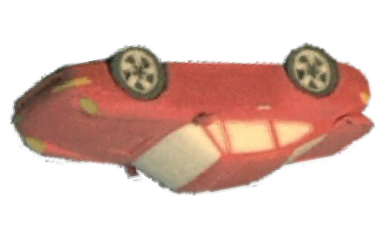
RAPID PROTOTYPING - 3D PRINTING
WORLD ASSOCIATION OF TECHNOLOGY TEACHERS https://www.facebook.com/groups/254963448192823/
www.technologystudent.com © 2020 V.Ryan © 2020
USEFUL LINKS:
https://technologystudent.com/cam/prn3d1.htm https://technologystudent.com/cam/prn3d2.htm https://technologystudent.com/cam/prn3d3.htm https://technologystudent.com/cam/prn3d4.htm
1. Explain why rapid prototyping, in particular 3D printing, is becoming more common in manufacturing industry. The key words / phrases below, may help you answer this question.
7 marks
QUICK
REALISTIC 3D MODELS PROTOTYPING
FOCUS GROUPS ENGINEERING
POTENTIAL CLIENTS AEROSPACE
2. The diagram below, shows a 3D model slowly taking shape, as it is manufactured on a 3D Printer. With reference to the diagram, describe how a 3D model is manufactured using this type of machine. 4 marks
RESIN FEED
PRINT HEAD
LAYERS OF POWDER
_{PROTOTYPE} MODEL TRAY
SLOWLY BUILDING
SIDE VIEW OF PRINTING PROCESS

Slide 2
RAPID PROTOTYPING - 3D PRINTING
WORLD ASSOCIATION OF TECHNOLOGY TEACHERS https://www.facebook.com/groups/254963448192823/
www.technologystudent.com © 2020 V.Ryan © 2020
USEFUL LINKS:
https://technologystudent.com/cam/prn3d1.htm https://technologystudent.com/cam/prn3d2.htm https://technologystudent.com/cam/prn3d3.htm https://technologystudent.com/cam/prn3d4.htm
3. List six advantages of producing a prototype model using a 3D printer.
6 marks
A.
B.
C.
D.
E.
F.

