Slide 1
SECTION ONE
GOOD or BAD IDEAS?

Slide 2
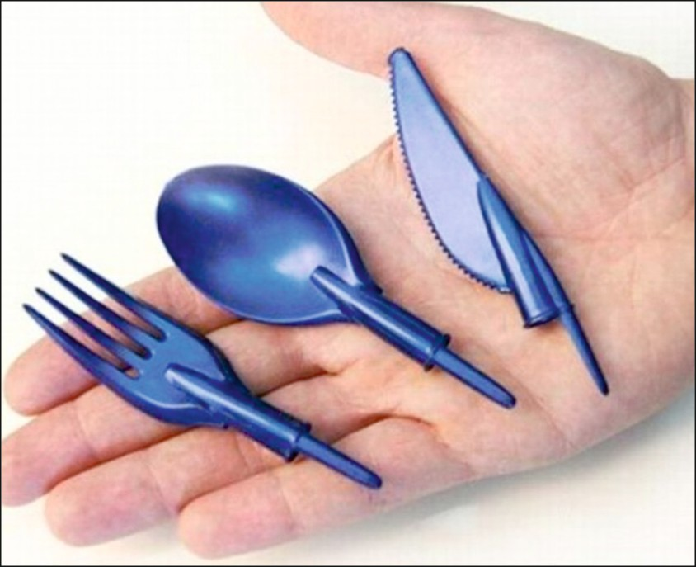
GOOD or BAD PRODUCT?
1
The World Association of Technology Teachers
GOOD:
BAD:

Slide 3
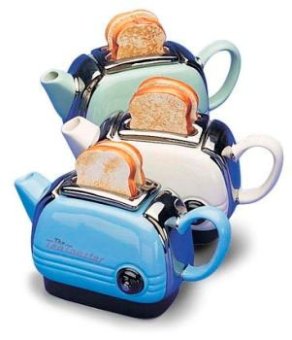
2
GOOD or BAD PRODUCT?
The World Association of Technology Teachers
TOASTER AND KETTLE COMBINED
GOOD:
BAD:

Slide 4
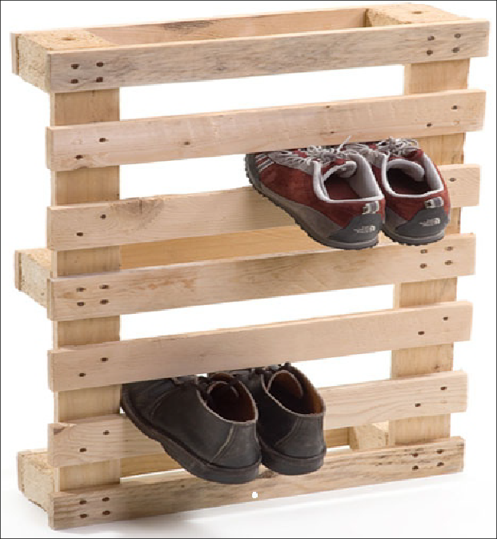
GOOD or BAD PRODUCT?
3
The World Association of Technology Teachers
GOOD:
BAD:

Slide 5
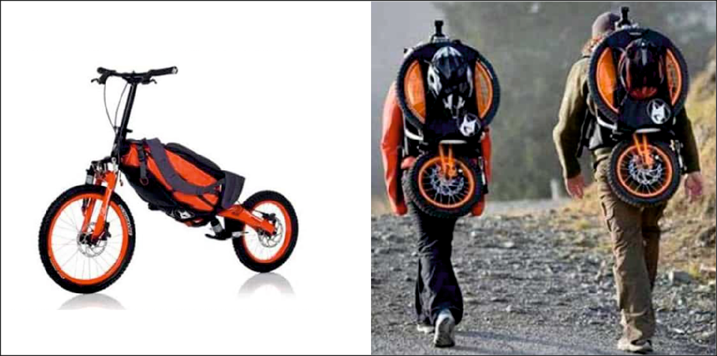
GOOD or BAD PRODUCT?
4
The World Association of Technology Teachers
GOOD:
BAD:

Slide 6
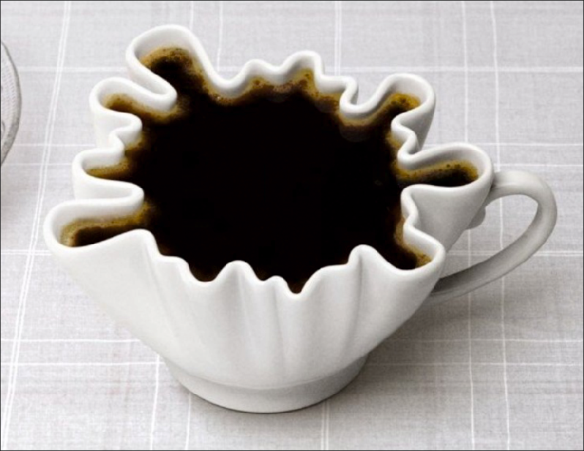
GOOD or BAD PRODUCT?
5
The World Association of Technology Teachers
GOOD:
BAD:

Slide 7
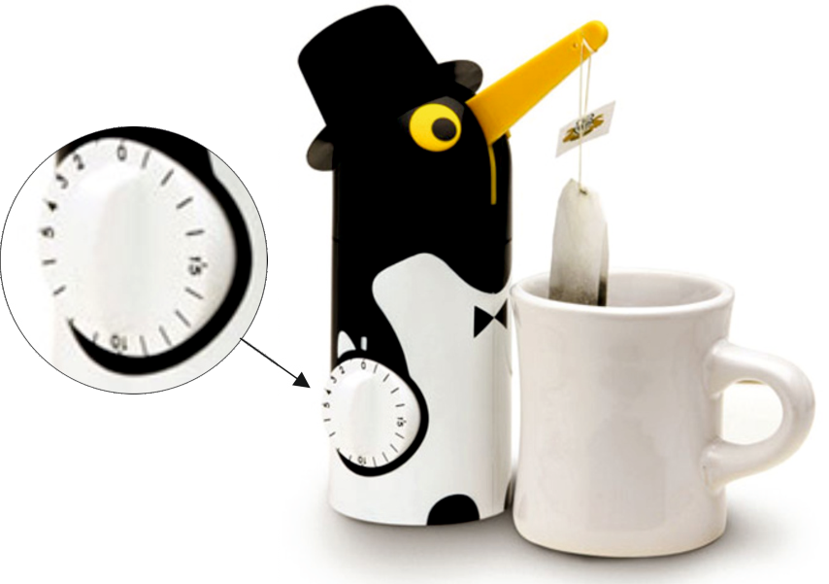
GOOD or BAD PRODUCT?
6
The World Association of Technology Teachers
GOOD:
BAD:

Slide 8
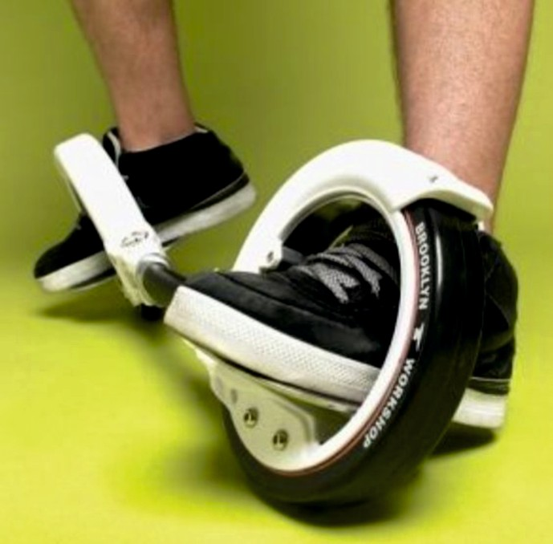
GOOD or BAD PRODUCT?
7
The World Association of Technology Teachers
GOOD:
BAD:

Slide 9
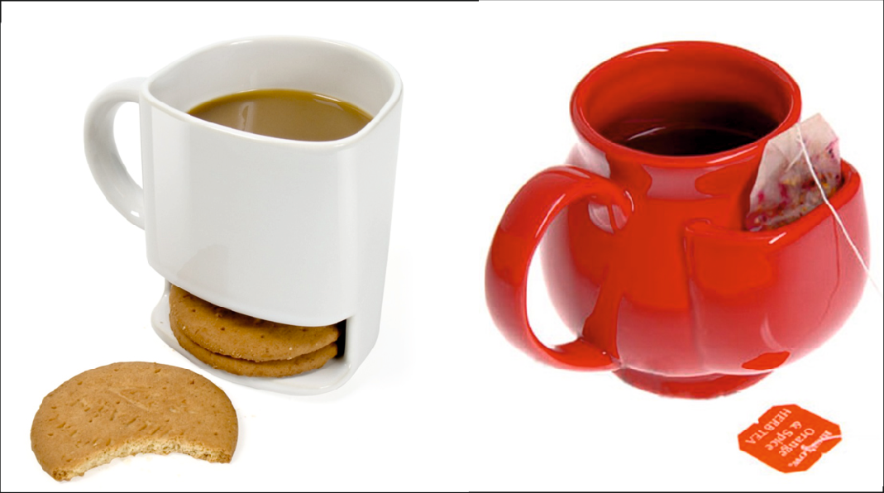
GOOD or BAD PRODUCT?
8
The World Association of Technology Teachers
GOOD:
GOOD:
BAD:

Slide 10
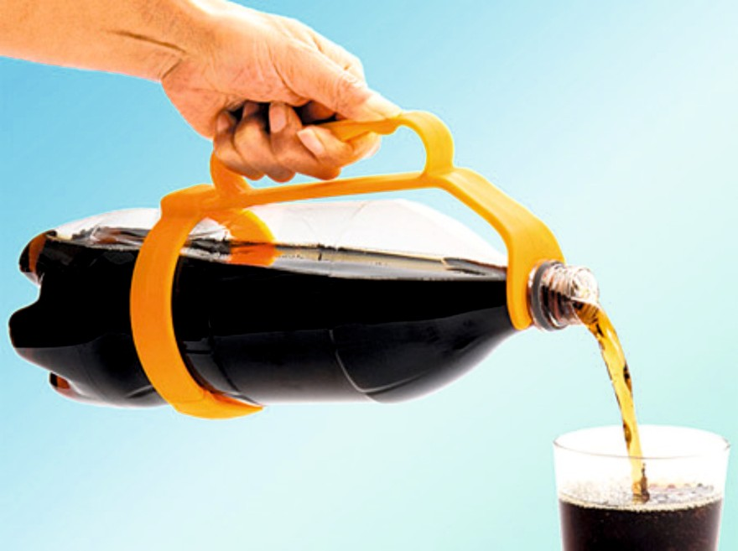
GOOD or BAD PRODUCT?
9
The World Association of Technology Teachers
GOOD:
BAD:

Slide 11

GOOD or BAD PRODUCT?
10
The World Association of Technology Teachers
GOOD:
BAD:

Slide 12
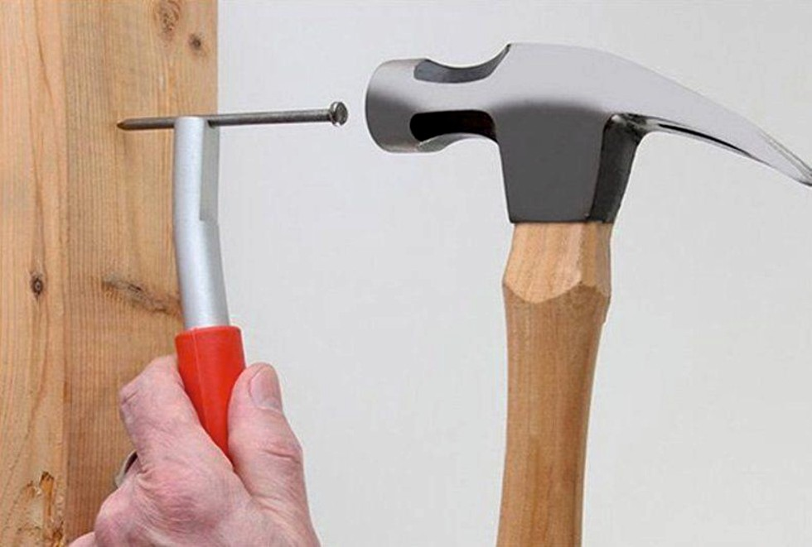
GOOD or BAD PRODUCT?
11
The World Association of Technology Teachers
GOOD:
BAD:

Slide 13
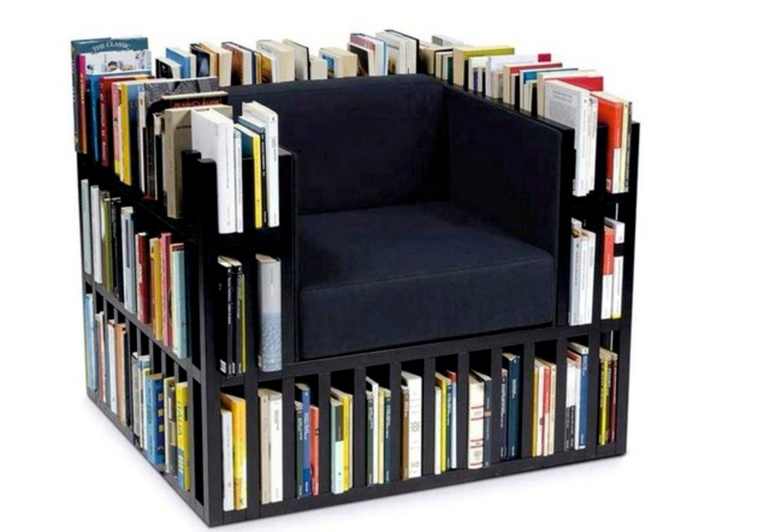
GOOD or BAD PRODUCT?
12
The World Association of Technology Teachers
GOOD:
BAD:

Slide 14
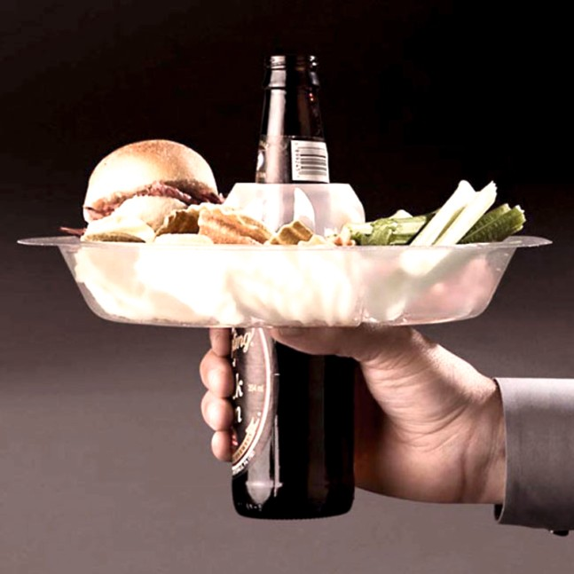
GOOD or BAD PRODUCT?
13
The World Association of Technology Teachers
GOOD:
BAD:

Slide 15
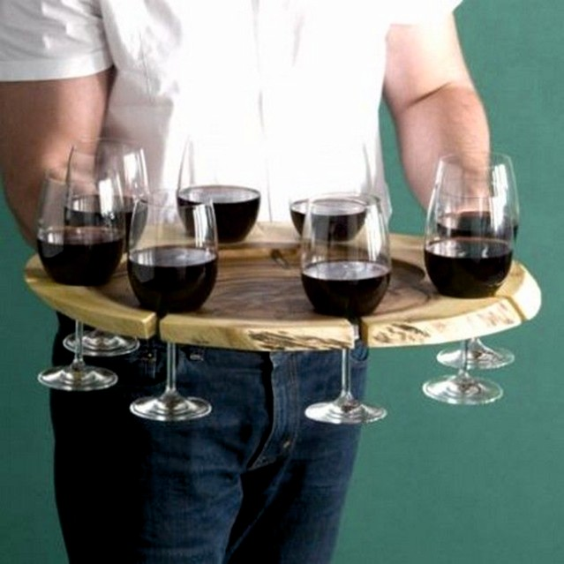
GOOD or BAD PRODUCT?
14
The World Association of Technology Teachers
GOOD:
BAD:

Slide 16
SECTION TWO
PRODUCT ANALYSIS AND DEVELOPMENT EXERCISES

Slide 17
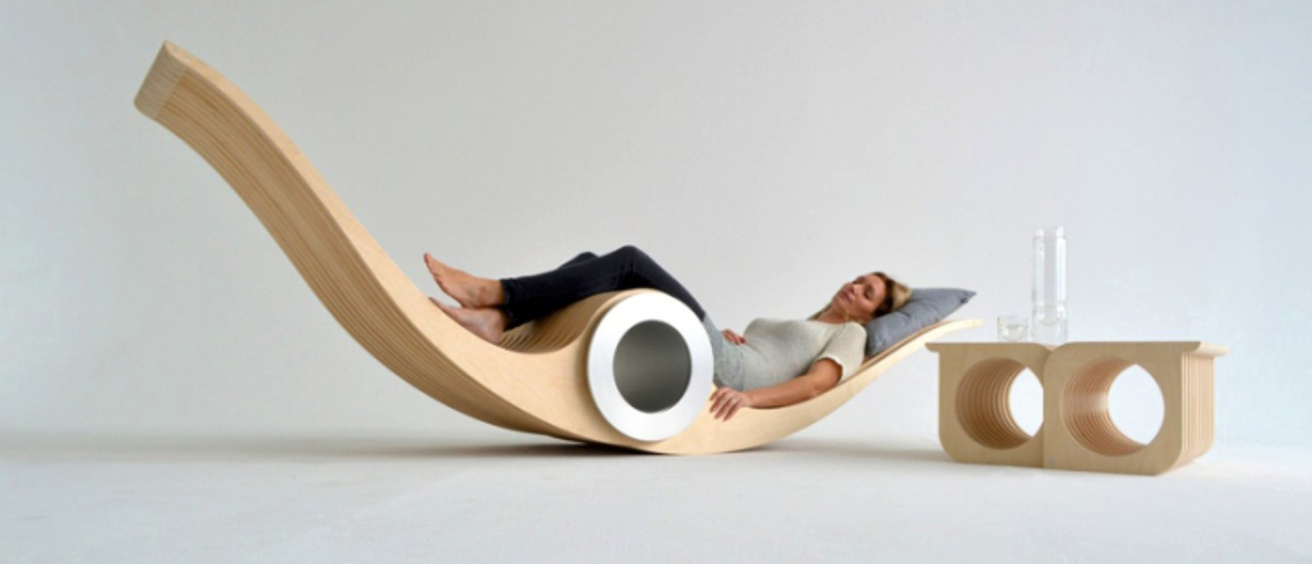
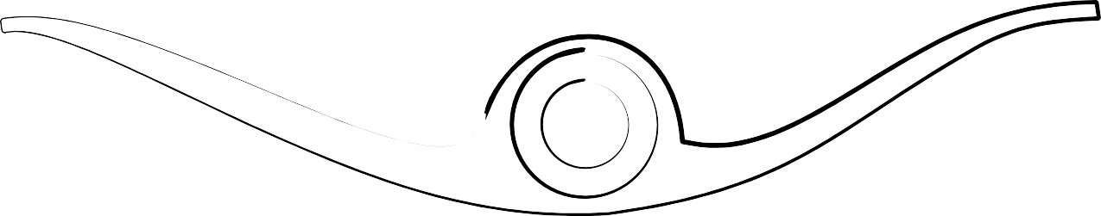
1. RESTFUL LOUNGER
WORLD ASSOCIATION OF TECHNOLOGY TEACHERS https://www.facebook.com/groups/254963448192823/
www.technologystudent.com © 2018 V.Ryan © 2018
What do think about this product? Consider - ergonomics, size, materials, style and any other interesting aspects.
Sketch one or more improvements. Include labels, notes and colour / shade.
Use the back of this sheet for developing your improvements.
HELPFUL http://www.technologystudent.com/despro_ﬂsh/graphics_shade1.html
LINKS
http://www.technologystudent.com/designpro/thumbnail2.html

Slide 18
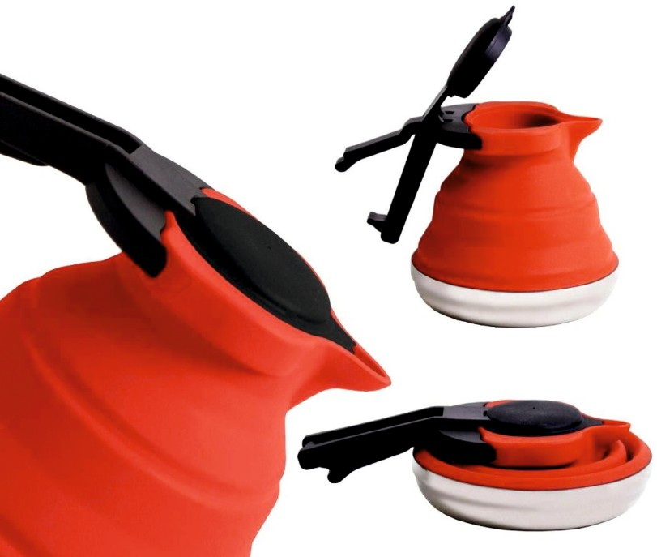
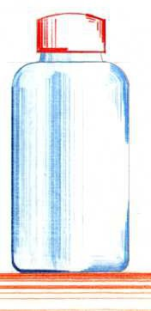
2. COMPACTABLE JUG
Identify one of this products important features. Why is it an important feature?
WORLD ASSOCIATION OF TECHNOLOGY TEACHERS https://www.facebook.com/groups/254963448192823/
www.technologystudent.com © 2018 V.Ryan © 2018
A basic sketch of the main body of the jug is drawn below. Add shade / colour, using the thick and thin line technique as shown on the sketch of the bottle.
Use the back of this sheet for practising the technique.
HELPFUL LINKS
http://www.technologystudent.com/designpro/drawtec4.htm http://www.technologystudent.com/despro2/drawtec3a.htm
SAMPLE BOTTLE MAIN BODY OF JUG

Slide 19
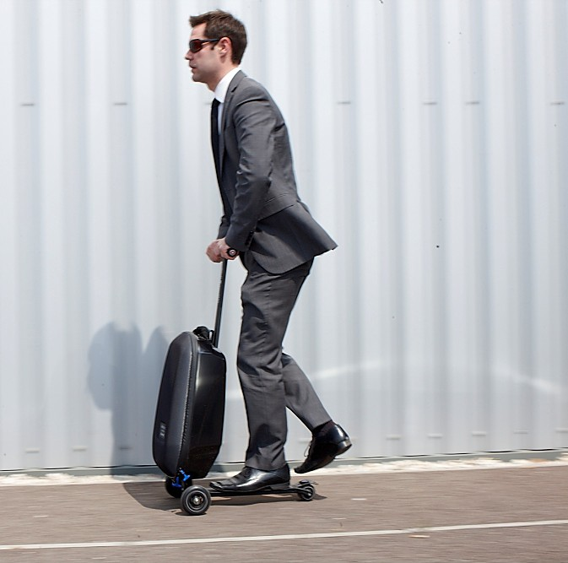

3. CASE AND SKATE
WORLD ASSOCIATION OF TECHNOLOGY TEACHERS https://www.facebook.com/groups/254963448192823/
www.technologystudent.com © 2018 V.Ryan © 2018
What are the positive features of this product?
A simple diagram of the case is seen below. Add an improvement / improvements. Label, include notes and add colour /shade.
Use the back of this sheet for developing your improvements.
HELPFUL http://www.technologystudent.com/despro_ﬂsh/graphics_shade1.html
LINKS
http://www.technologystudent.com/designpro/thumbnail2.html

Slide 20
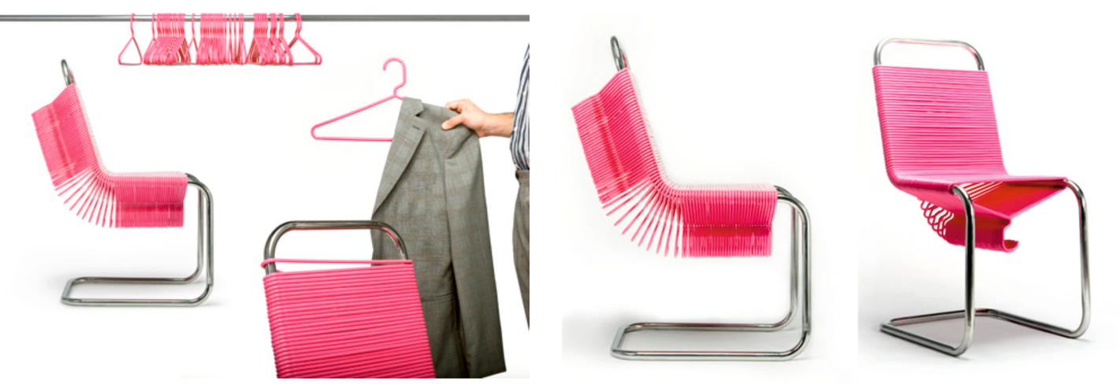
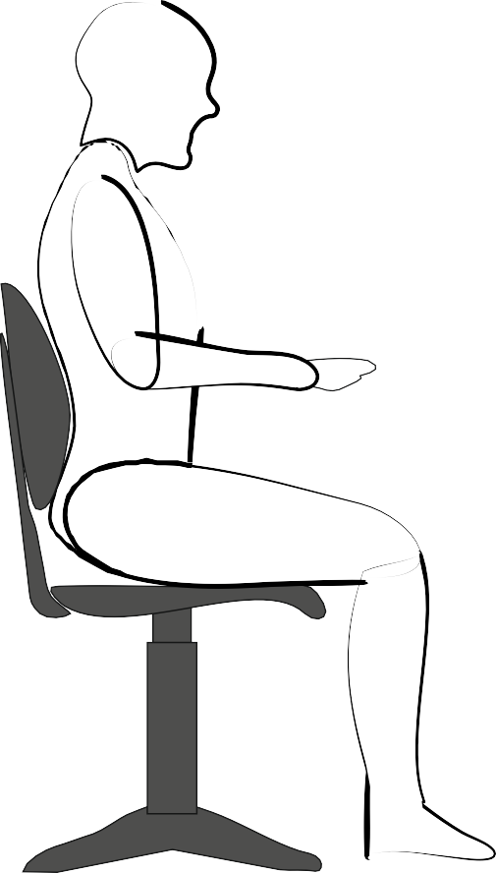
4. HANGERS AND CHAIR
WORLD ASSOCIATION OF TECHNOLOGY TEACHERS https://www.facebook.com/groups/254963448192823/
www.technologystudent.com © 2018 V.Ryan © 2018
Describe a negative / positive feature of this product?
Sketching is an important skill for designers to master. You are to sketch an outline of a person sat on the chair. A sample sketch is seen below. Use the back of this sheet for practising your sketching skills.
SAMPLE YOUR DRAWING

Slide 21
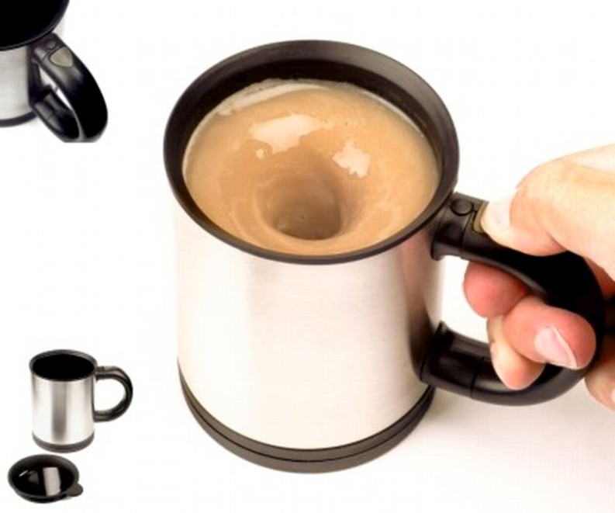
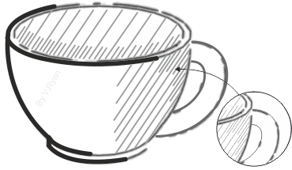
5. CUP WITH BUILT-IN ELECTRIC STIR
Is this potentially a successful commercial product? Explain your answer.
WORLD ASSOCIATION OF TECHNOLOGY TEACHERS
https://www.facebook.com/groups/254963448192823/ www.technologystudent.com © 2018 V.Ryan © 2018
In this space, sketch the cup seen in the photograph above.
Then, add shading (called ‘hatching’) in a similar style to the example opposite.
Use the back of this sheet for practising the technique.
HELPFUL LINKS
http://www.technologystudent.com/despro_ﬂsh/thickline3.html http://www.technologystudent.com/despro_ﬂsh/thickline4.html

Slide 22
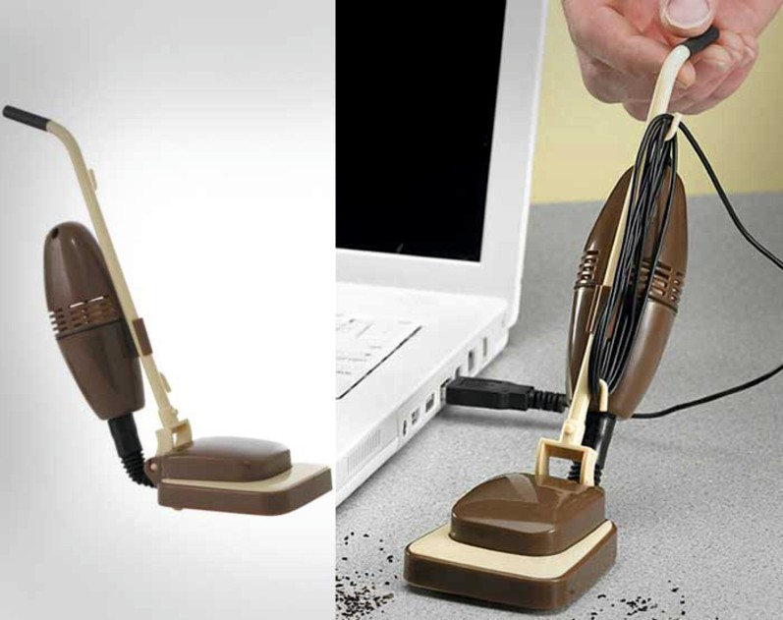
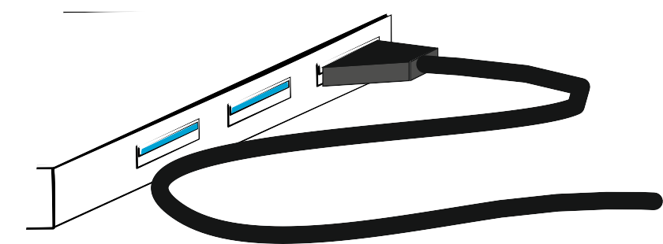
6. USB DESKTOP VACUUM CLEANER
WORLD ASSOCIATION OF TECHNOLOGY TEACHERS https://www.facebook.com/groups/254963448192823/
www.technologystudent.com © 2018 V.Ryan © 2018
Is this a serious product or a ‘fun’ product? Justify your answer.
Using the incomplete diagram below, sketch an innovative device (your design), that is connected to a computer via a USB connector. Add notes and labels.
Use the back of this sheet for developing your idea.
HELPFUL LINK http://www.technologystudent.com/despro_ﬂsh/basic_dev2.html

Slide 23
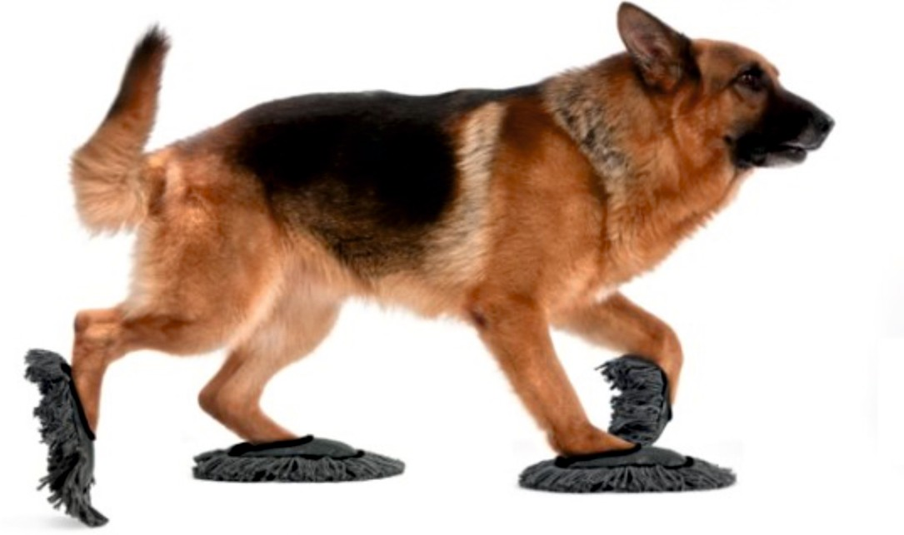
7. PET PAW MOPS FOR CLEANING THE FLOOR
WORLD ASSOCIATION OF TECHNOLOGY TEACHERS https://www.facebook.com/groups/254963448192823/
www.technologystudent.com © 2018 V.Ryan © 2018
Is this a realistic product? Explain your answer.
The manufacturer of ‘pet paw mops’, need a simple logo, that will be applied to the packaging. In the space below, sketch a suitable logo.
Draw a rough version and a ﬁnal colour rendered version.
Use the back of this sheet to develop your logo
HELPFUL LINK http://www.technologystudent.com/despro2/symsp1.htm
ROUGH VERSION FINAL VERSION

Slide 24
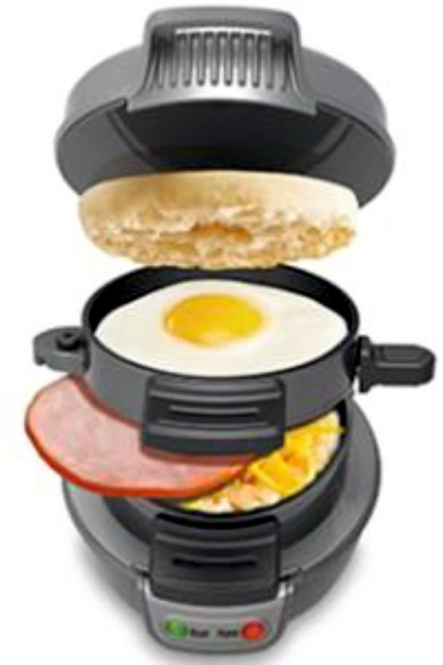

8. FIVE MINUTE BREAKFAST MAKER
WORLD ASSOCIATION OF TECHNOLOGY TEACHERS https://www.facebook.com/groups/254963448192823/
www.technologystudent.com © 2018 V.Ryan © 2018
What do you like / dislike about this product?
Justify each point you make.
HELPFUL LINKS
http://www.technologystudent.com/despro_ﬂsh/theme1.html http://www.technologystudent.com/despro_ﬂsh/theme3.html
The word ‘sun’ (opposite) has been stylised to reﬂect the meaning of the word, the sun in the sky, holidays, lazy days and everything else that reminds us of sunny holidays.
The ‘Five Minute Breakfast’ gadget has been given the name, “Fast ‘n’ Tasty”
On the back of this sheet, develop a style of writing suitable for the product and reﬂecting its use, fast breakfast, easy to make hot breakfast, bacon and eggs...........
Use the back of this sheet to develop your design.
PLAIN VERSION
FAST ‘n’ TASTY

Slide 25
SECTION THREE
PRODUCT ANALYSIS AND DEVELOPMENT EXERCISES

Slide 26
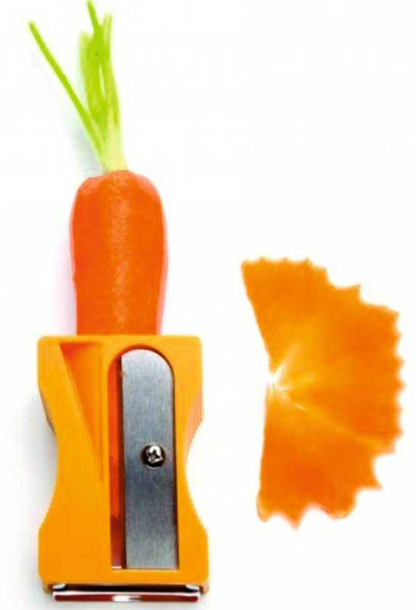
1. CARROT PEELER
WORLD ASSOCIATION OF TECHNOLOGY TEACHERS https://www.facebook.com/groups/254963448192823/
www.technologystudent.com © 2018 V.Ryan © 2018
What do you think of this product ? Is it likely to work ? Is it likely to sell in the shops?
Has the designer of this product suﬀered from ‘design ﬁxation’ ?
HELPFUL LINK: https://technologystudent.com/joints_ﬂsh/design_ﬁxation1.html
Sketch a potato peeler, based on the carrot peeler shown above.
HELPFUL LINK: https://technologystudent.com/despro_ﬂsh/graphics_shade1.html

Slide 27
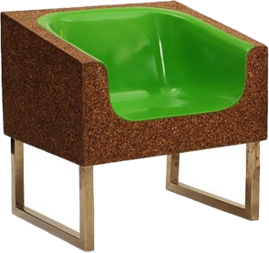
2. SUSTAINABLE CHAIR
WORLD ASSOCIATION OF TECHNOLOGY TEACHERS https://www.facebook.com/groups/254963448192823/
www.technologystudent.com © 2020 V.Ryan © 2020
Chair manufactured from natural wood, polylactide (PLA) and compressed dry leaves.
POLYLACTIDE
What do you think of this product ?
DRY LEAVES
NATURAL WOOD
What is a sustainable natural wood?
HELPFUL LINK: https://technologystudent.com/prddes1/susenv1.html
Draw a diagram that describes the life cycle of polylactide
HELPFUL LINKS:
https://technologystudent.com/joints/pla1.html https://technologystudent.com/joints/poly2.html

Slide 28
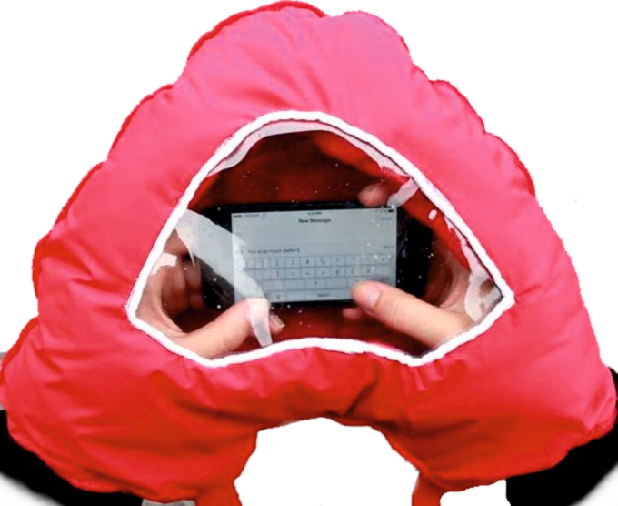
3. USEFUL HAND WARMER
WORLD ASSOCIATION OF TECHNOLOGY TEACHERS https://www.facebook.com/groups/254963448192823/
www.technologystudent.com © 2018 V.Ryan © 2018
Would you be happy to be seen in the school yard, with this product ?
Explain your answer.
This product is manufactured from polyethylene terephthalate, also known as PET or PETE. Why is it a good choice of material?
_{HELPFUL LINKS:} https://technologystudent.com/joints/pet1.html https://technologystudent.com/joints/pety2.html
In the space below, paste images of other products manufactured from PET / PETE.

Slide 29
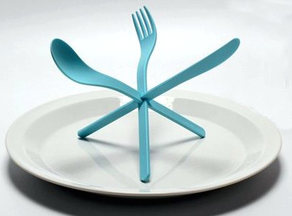

4. COMBINATION KNIFE, FORK AND SPOON
WORLD ASSOCIATION OF TECHNOLOGY TEACHERS https://www.facebook.com/groups/254963448192823/
www.technologystudent.com © 2018 V.Ryan © 2018
What is your opinion of this product?
This product is manufactured from environmentally friendly Biopol.
What is biopol?
HELPFUL LINK: https://technologystudent.com/prddes1/biopola.html
In the space below, sketch a combination pencil - pen (pen at one end and pencil at the other). Include shade, in the style of the sample felt pen.
_{HELPFUL LINK:} https://technologystudent.com/designpro/feltpen2.htm https://technologystudent.com/designpro/feltpen3.htm

Slide 30
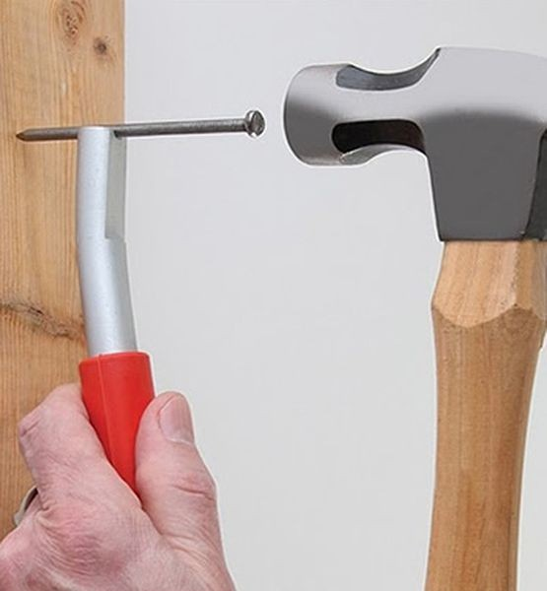
5. SAFETY NAIL HOLDER
WORLD ASSOCIATION OF TECHNOLOGY TEACHERS https://www.facebook.com/groups/254963448192823/
www.technologystudent.com © 2018 V.Ryan © 2018
This product holds a nail while hammering it into a surface. Is it a good idea. Explain your answer.
The hammer shown in the photograph, is called a Cross Pein Hammer. What material is the handle made from? Why is it used for the handle?
HELPFUL LINK: https://technologystudent.com/equip_ﬂsh/hammers1.html
In the space below, sketch a Cross Pein Hammer.
HELPFUL LINK: https://technologystudent.com/equip_ﬂsh/hammers1.html

Slide 31
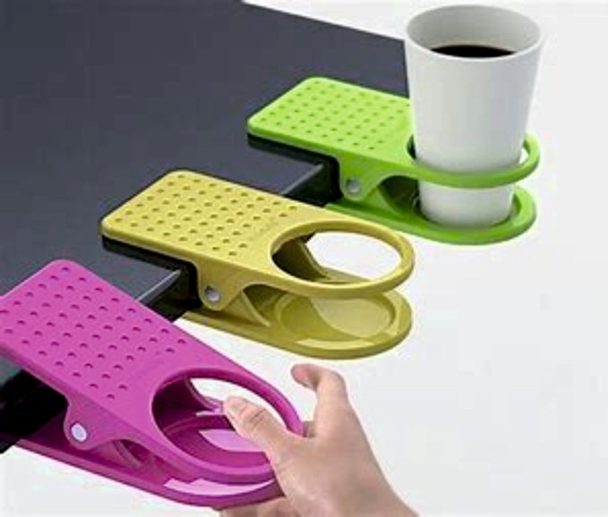
6. CUP HOLDER
WORLD ASSOCIATION OF TECHNOLOGY TEACHERS https://www.facebook.com/groups/254963448192823/
www.technologystudent.com © 2018 V.Ryan © 2018
What is your opinion of this design?
The two main parts of this product are manufactured by Injection Moulding. Using brief notes and a sketch, what is injection moulding?
HELPFUL LINK: https://technologystudent.com/equip1/inject1.htm

Slide 32
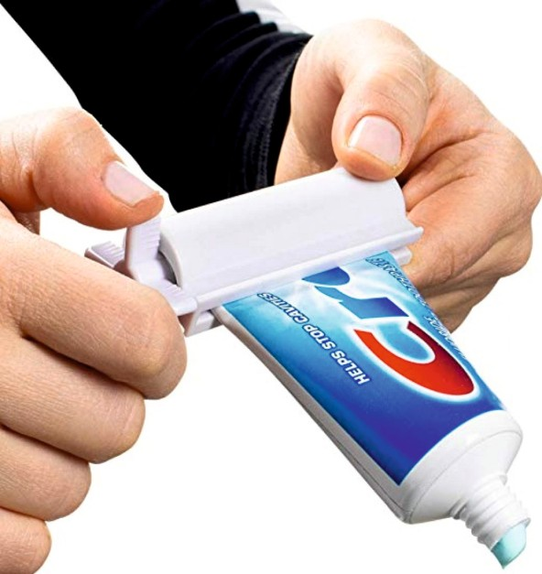
7. TOOTH PASTE SQUEEZER
WORLD ASSOCIATION OF TECHNOLOGY TEACHERS https://www.facebook.com/groups/254963448192823/
www.technologystudent.com © 2018 V.Ryan © 2018
Do you think that people need this product? Explain your answer
When the user ‘rotates’ the handle, the tooth paste tube is drawn between rollers, squeezing ‘out’ the remaining tooth paste. What is Rotary Motion? Include a sketch of another product, that relies on rotary motion.
HELPFUL LINK: https://technologystudent.com/forcmom/motion1.html

Slide 33

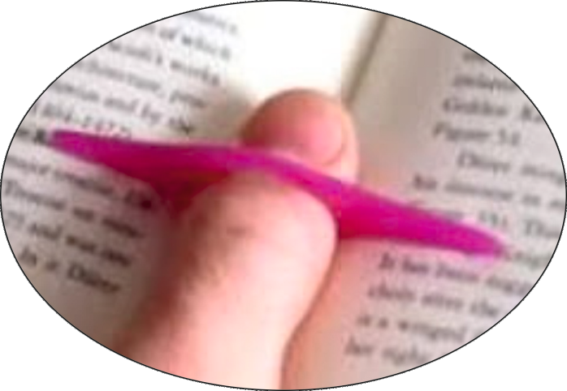
8. PAGE SEPARATOR
WORLD ASSOCIATION OF TECHNOLOGY TEACHERS https://www.facebook.com/groups/254963448192823/
www.technologystudent.com © 2018
V.Ryan © 2018
What do you think of this simple page separator?
Describe ONE problem with the page separator.
Sketch a new page separator, of your own design. Use the thumbnail sketching technique.
_{HELPFUL LINKS:} https://technologystudent.com/despro_ﬂsh/thumbnail1.html https://technologystudent.com/designpro/thumbnail2.html

Slide 34
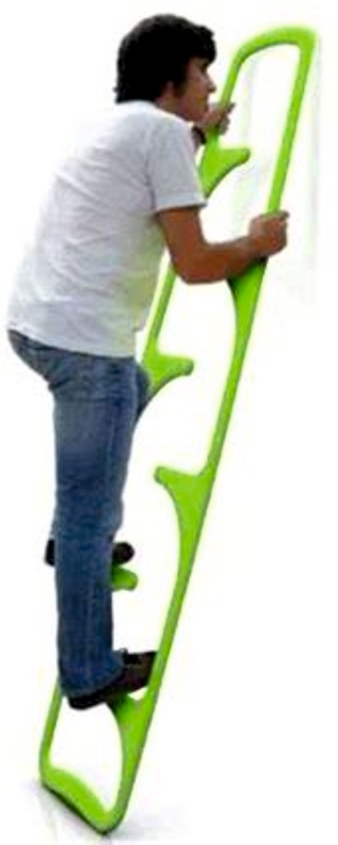
9. SIMPLE LADDER
WORLD ASSOCIATION OF TECHNOLOGY TEACHERS https://www.facebook.com/groups/254963448192823/
www.technologystudent.com © 2018 V.Ryan © 2018
In your opinion, is this ladder safe to use?
Explain your answer fully.
It is manufactured from a polymer. Name a suitable polymer.
HELPFUL LINK: https://technologystudent.com/despro_ﬂsh/mats_plastic1.html
The ladder is manufactured through a process called Rotary Moulding.
Using notes and a sketch, describe the process.
HELPFUL LINK: https://technologystudent.com/prddes1/rotate2.html

Slide 35
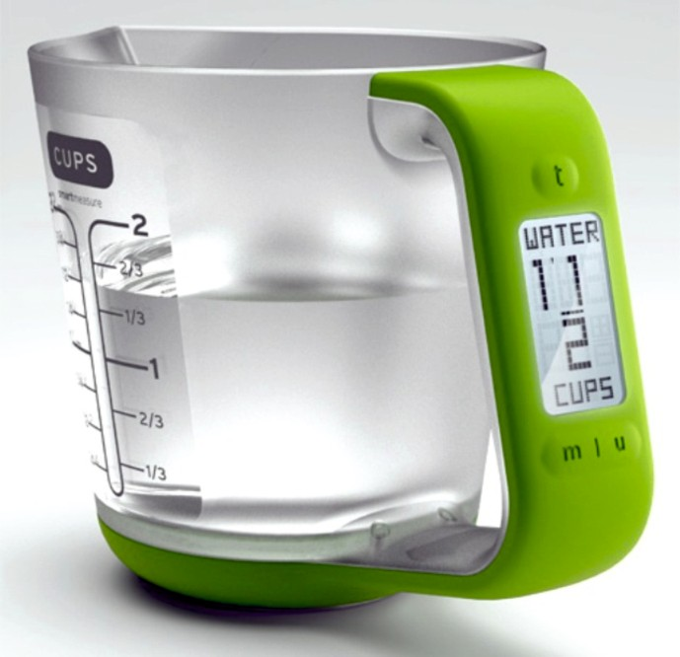
10. ELECTRONIC MEASURING JUG
WORLD ASSOCIATION OF TECHNOLOGY TEACHERS https://www.facebook.com/groups/254963448192823/
www.technologystudent.com © 2018 V.Ryan © 2018
Is there a need for this electronic measuring jug? Explain your answer.
The manufacturer of this electronic measuring jug, claims it can be recycled through ‘closed loop recycling’. What is closed loop recycling?
_{HELPFUL LINKS:} https://technologystudent.com/prddes1/closeloop1.html https://technologystudent.com/prddes1/closeloop2.html
In the space below, design your own symbol, that represents Closed Loop Recycling.

