Slide 1
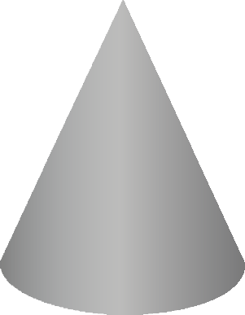
DEVELOPMENTS - CONES
WORLD ASSOCIATION OF TECHNOLOGY TEACHERS https://www.facebook.com/groups/254963448192823/
technologystudent.com © 2024
V.Ryan © 2024
QUESTION
PLAIN CONE
4
3 5
COMPLETE THE DEVELOPMENTS OF THE PLAIN AND TRUNCATED CONES.
TRUNCATED CONE
50mm
4
3
5
2
6
2
6
20º
1
V.Ryan © 2024
7
1
V.Ryan © 2024
7
12
8
12
8
11
10
9
11
10
9
70mm
20º
21mm
V.Ryan © 2024
70mm
HELPFUL LINK
V.Ryan © 2024
50mm
HELPFUL LINK: https://technologystudent.com/despro_3/develp6.html

