Slide 1
WORKING WITH METALS – PART ONE
SECOND SET OF WORKSHEETS
TO ANSWER ALL THE QUESTIONS YOU WILL NEED TO DOWNLOAD THE “WORKING WITH METALS – PART ONE” APP, FROM THE INTERACTIVE MOBILE APP SECTION OF www.technologystudent.com
CLICK ON THE BUTTON
TO DOWNLOAD THE APP
Once you have downloaded the App, you can use it to navigate the website. You may need to follow the links on each page of the App, to research / complete answers to all the questions.
IF YOUR ARE AN EDUCATOR, CONSIDER JOINING US AT FACEBOOK – WORLD ASSOCIATION OF TECHNOLOGY TEACHERS
https://www.facebook.com/groups/254963448192823/

Slide 2
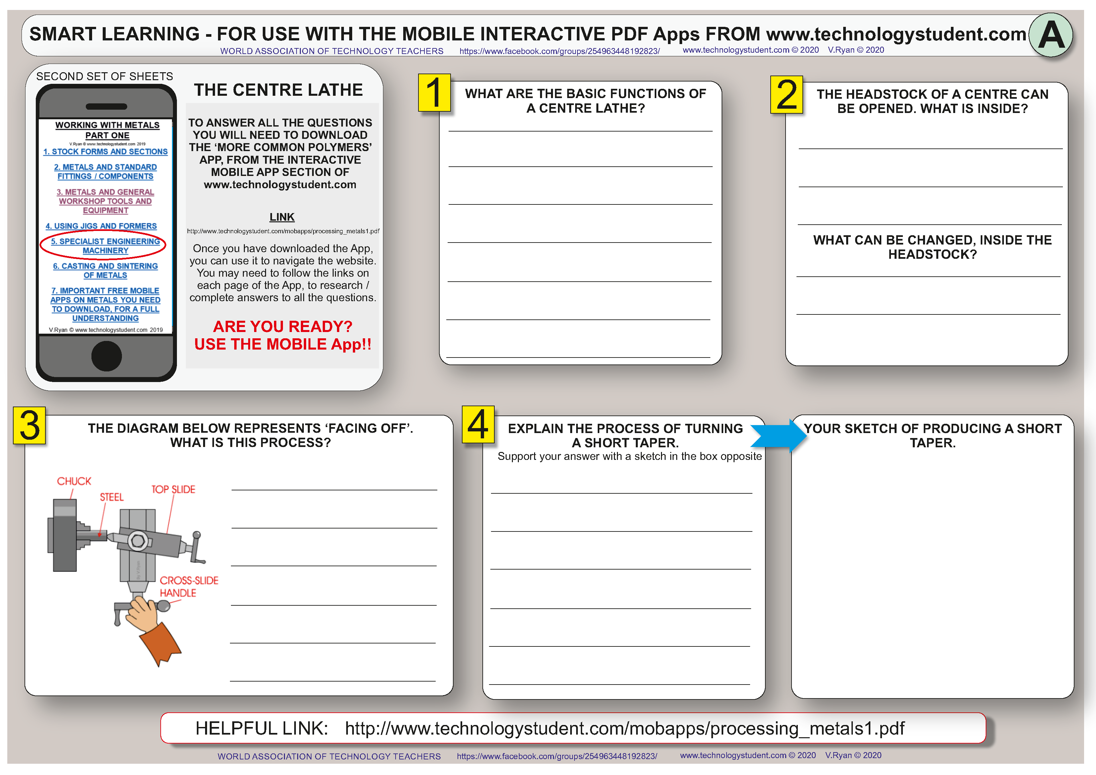

Slide 3
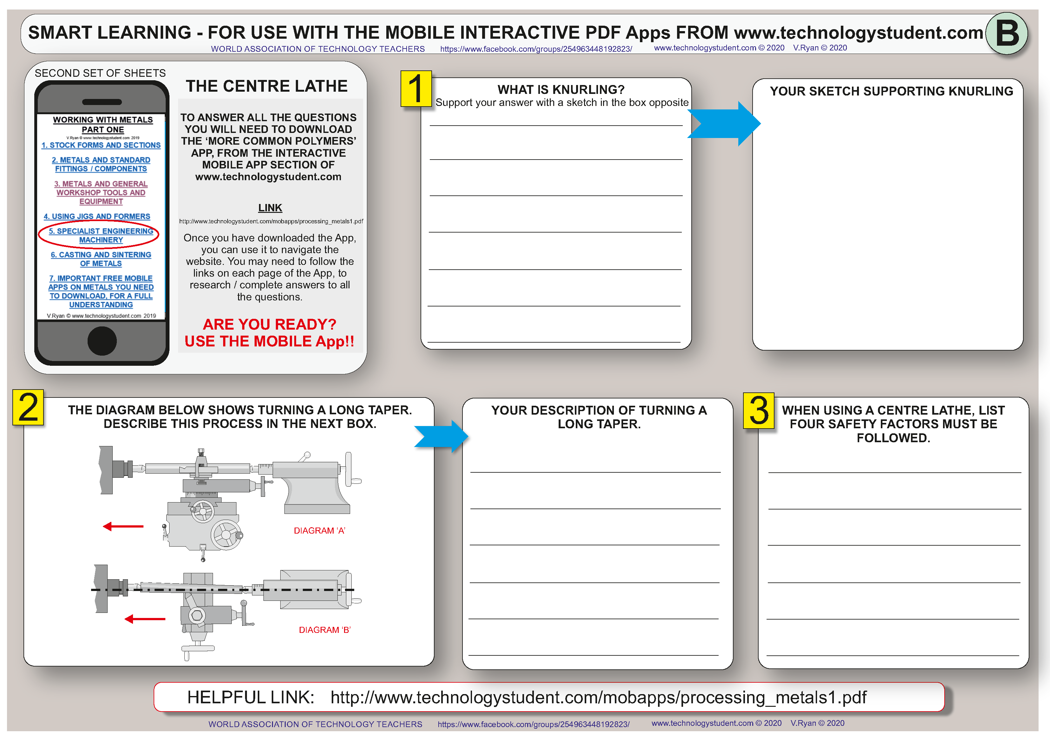

Slide 4
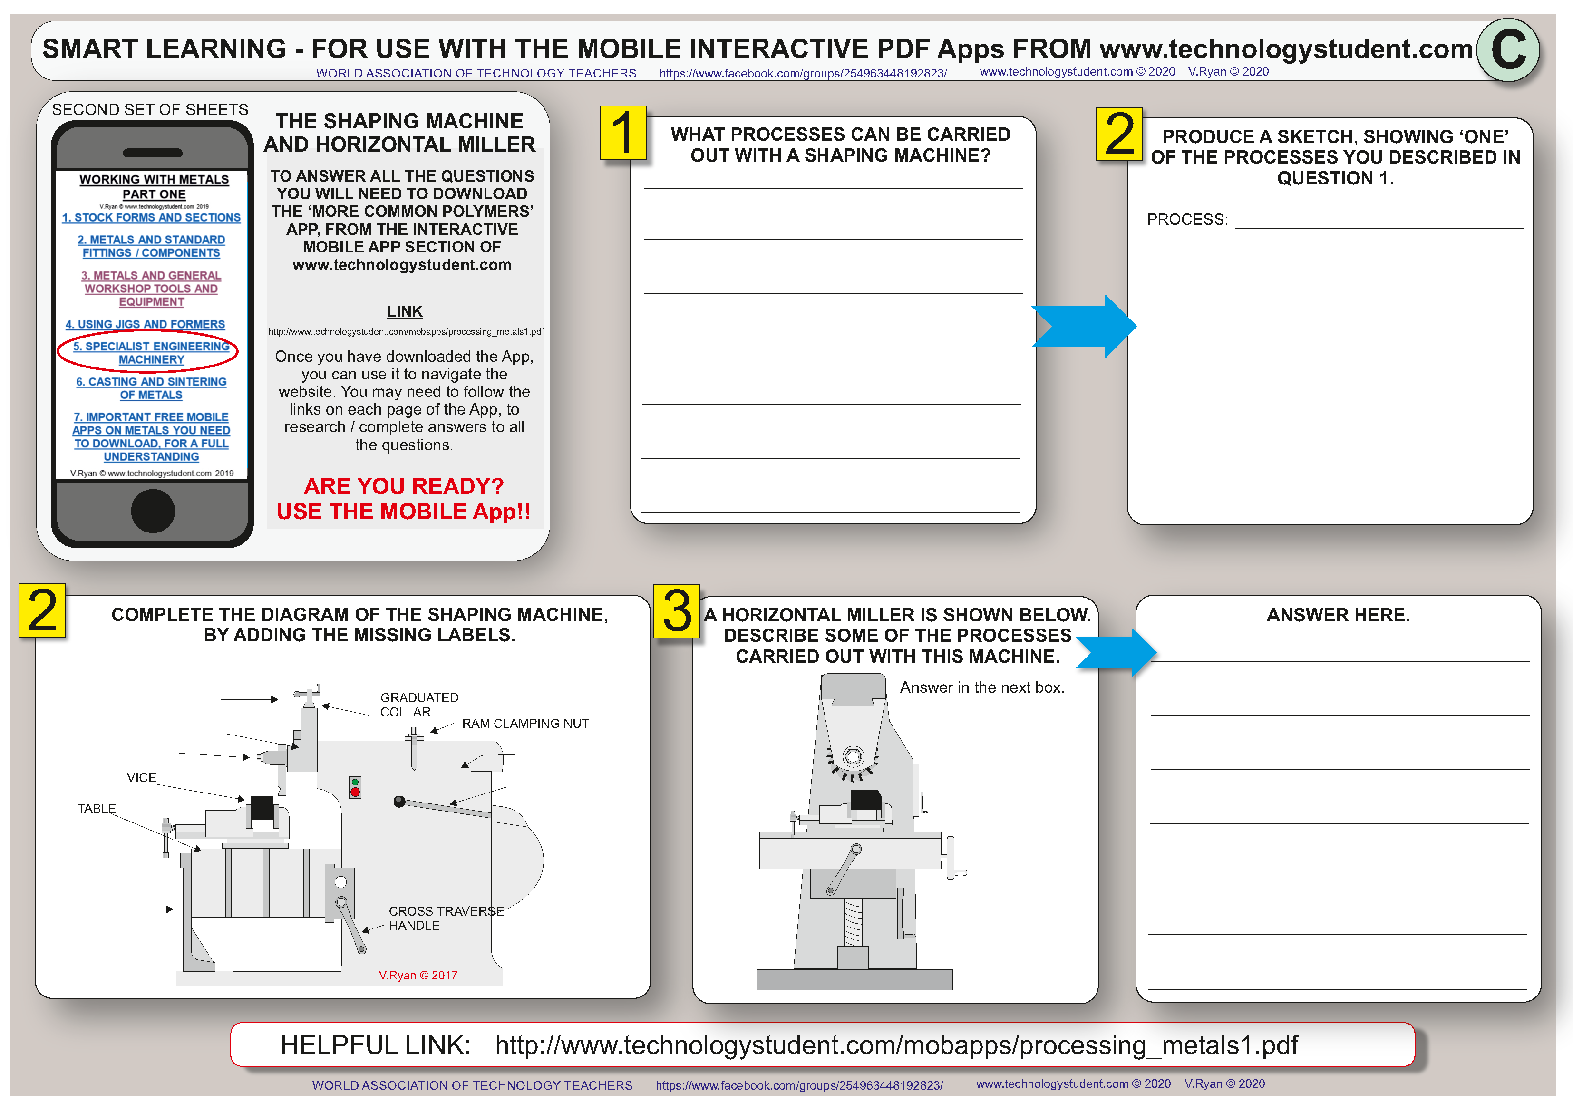

Slide 5
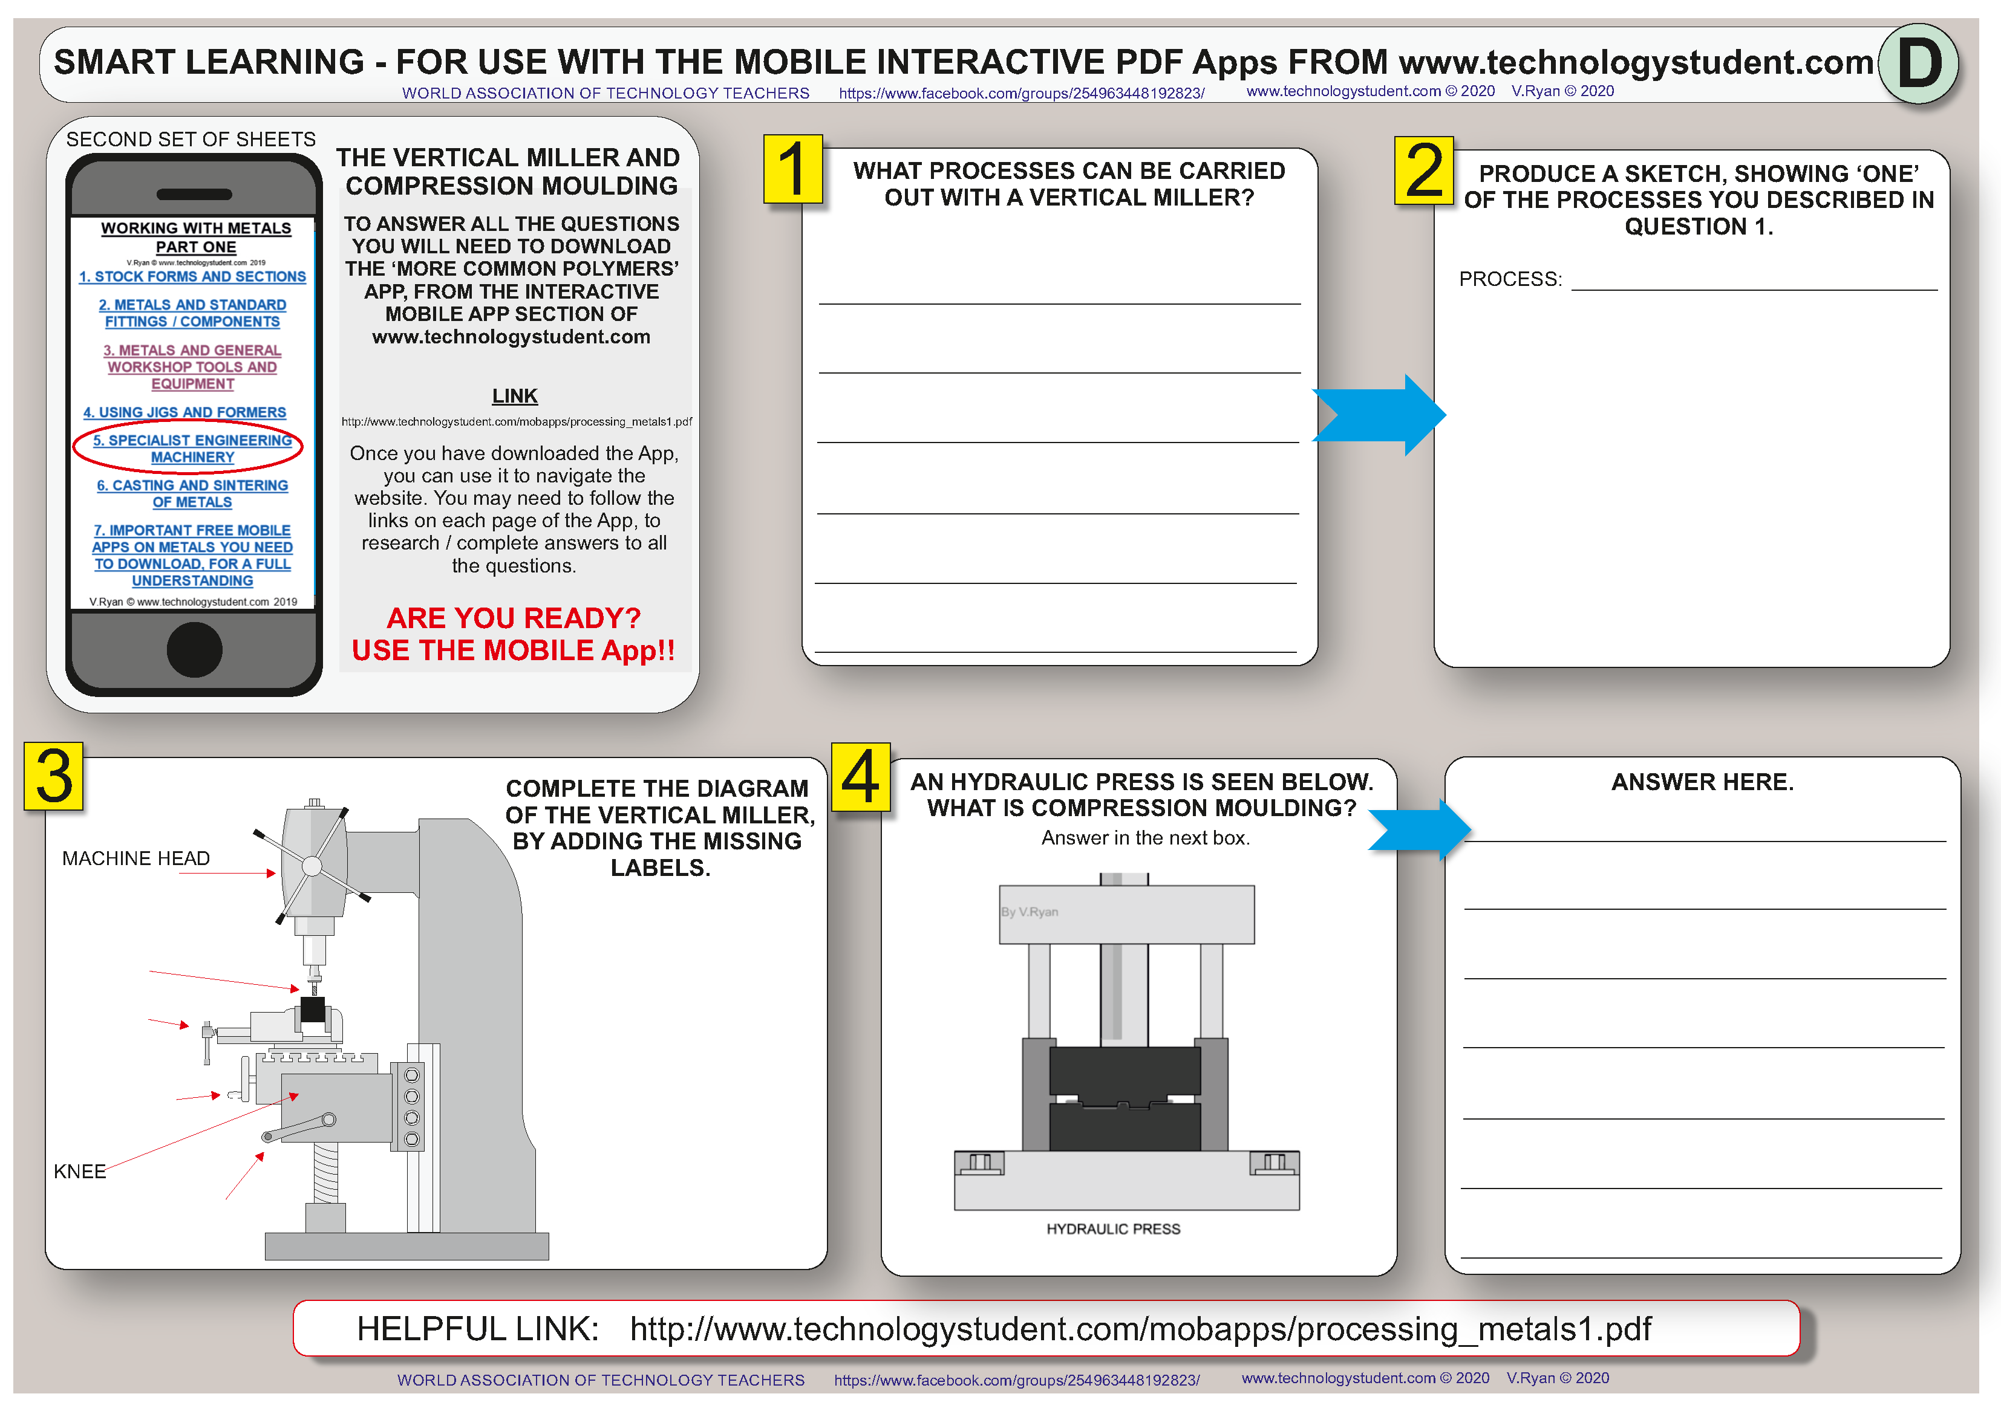

Slide 6
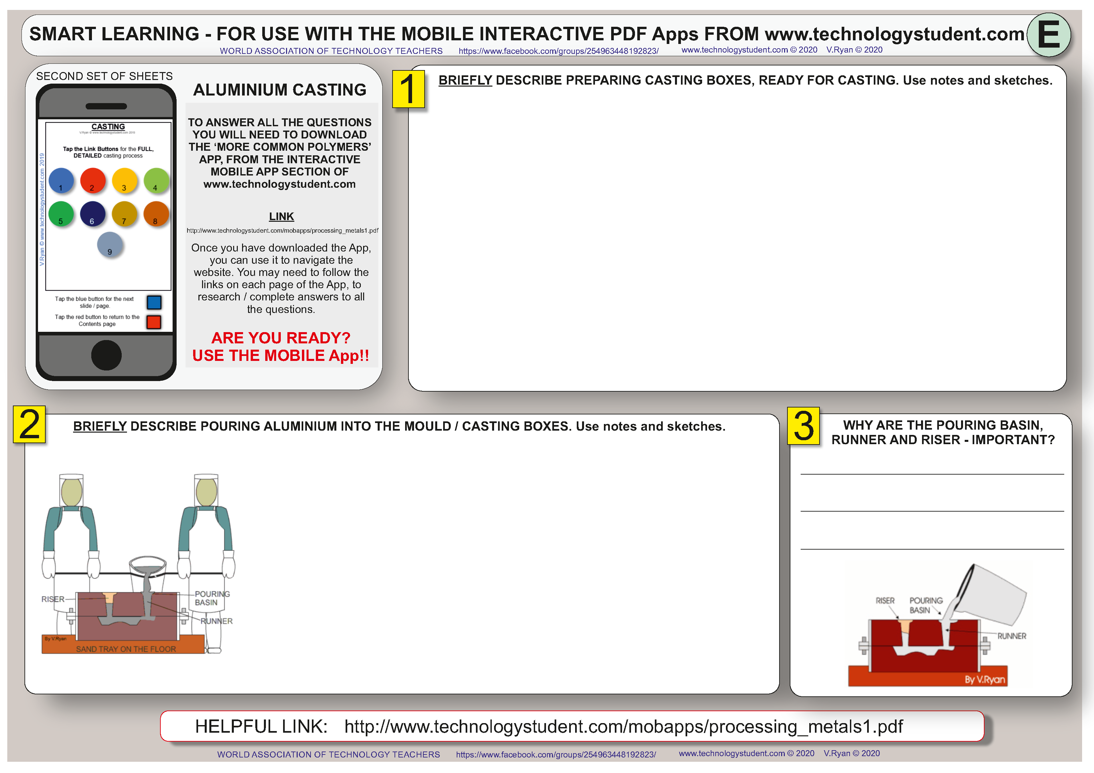

Slide 7
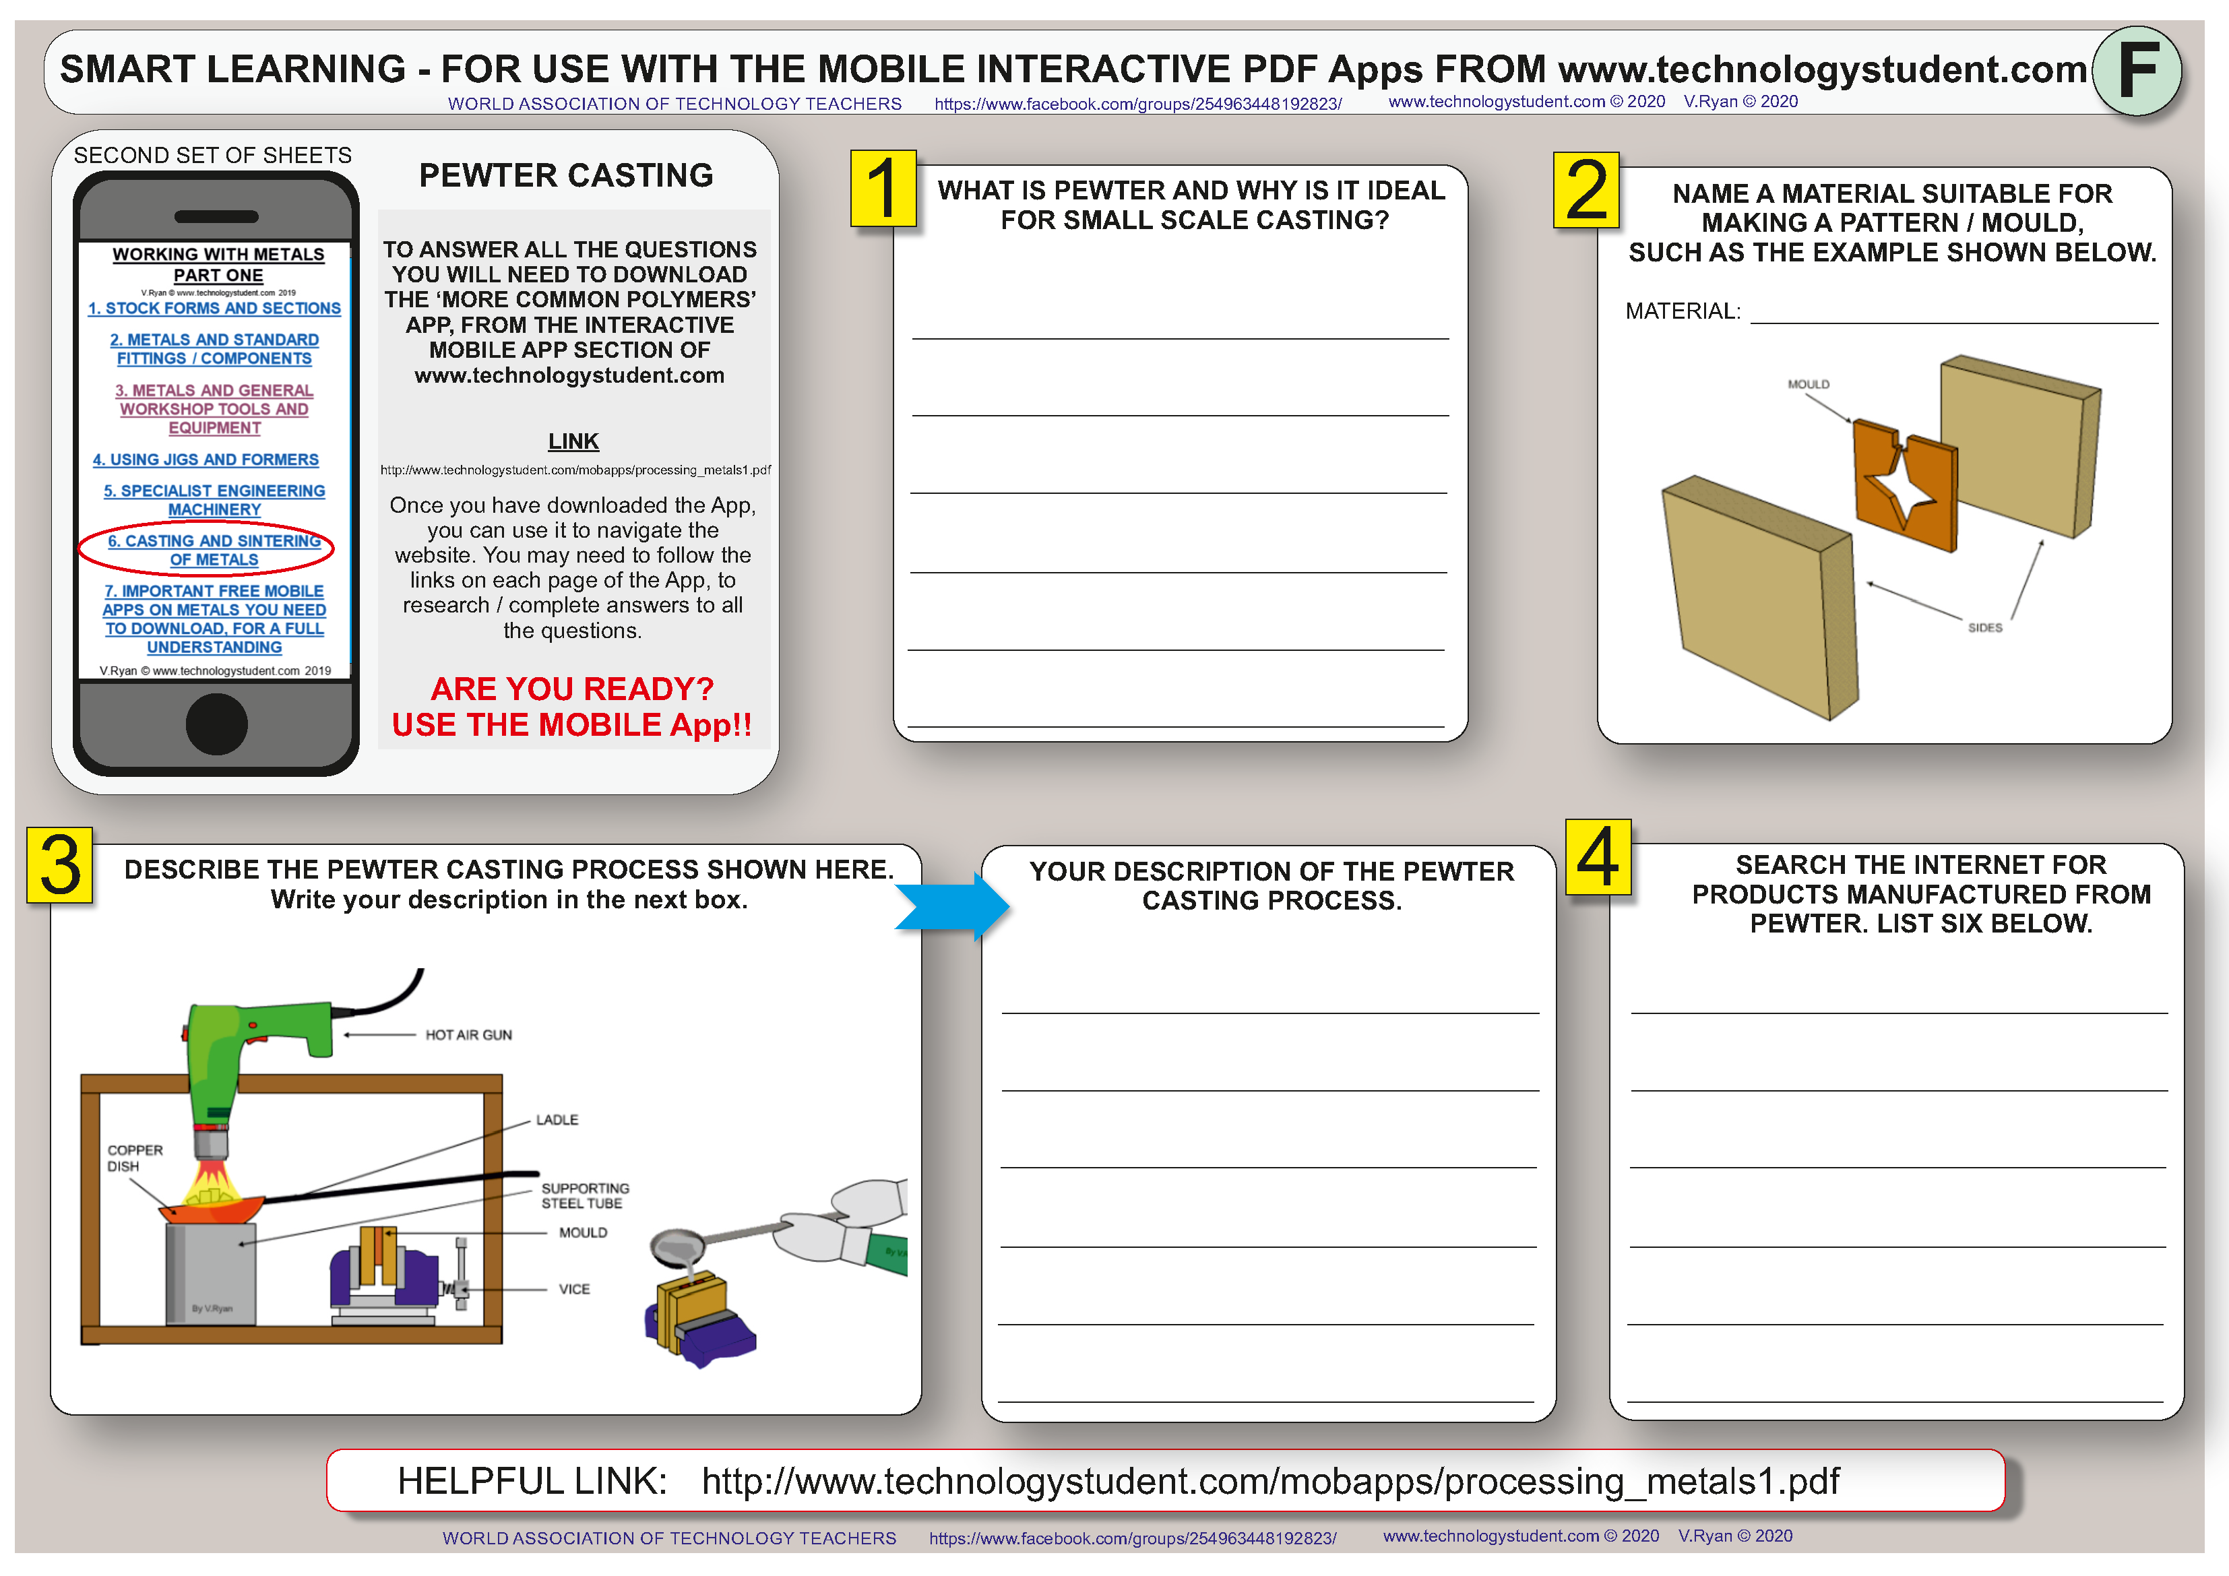

Slide 8
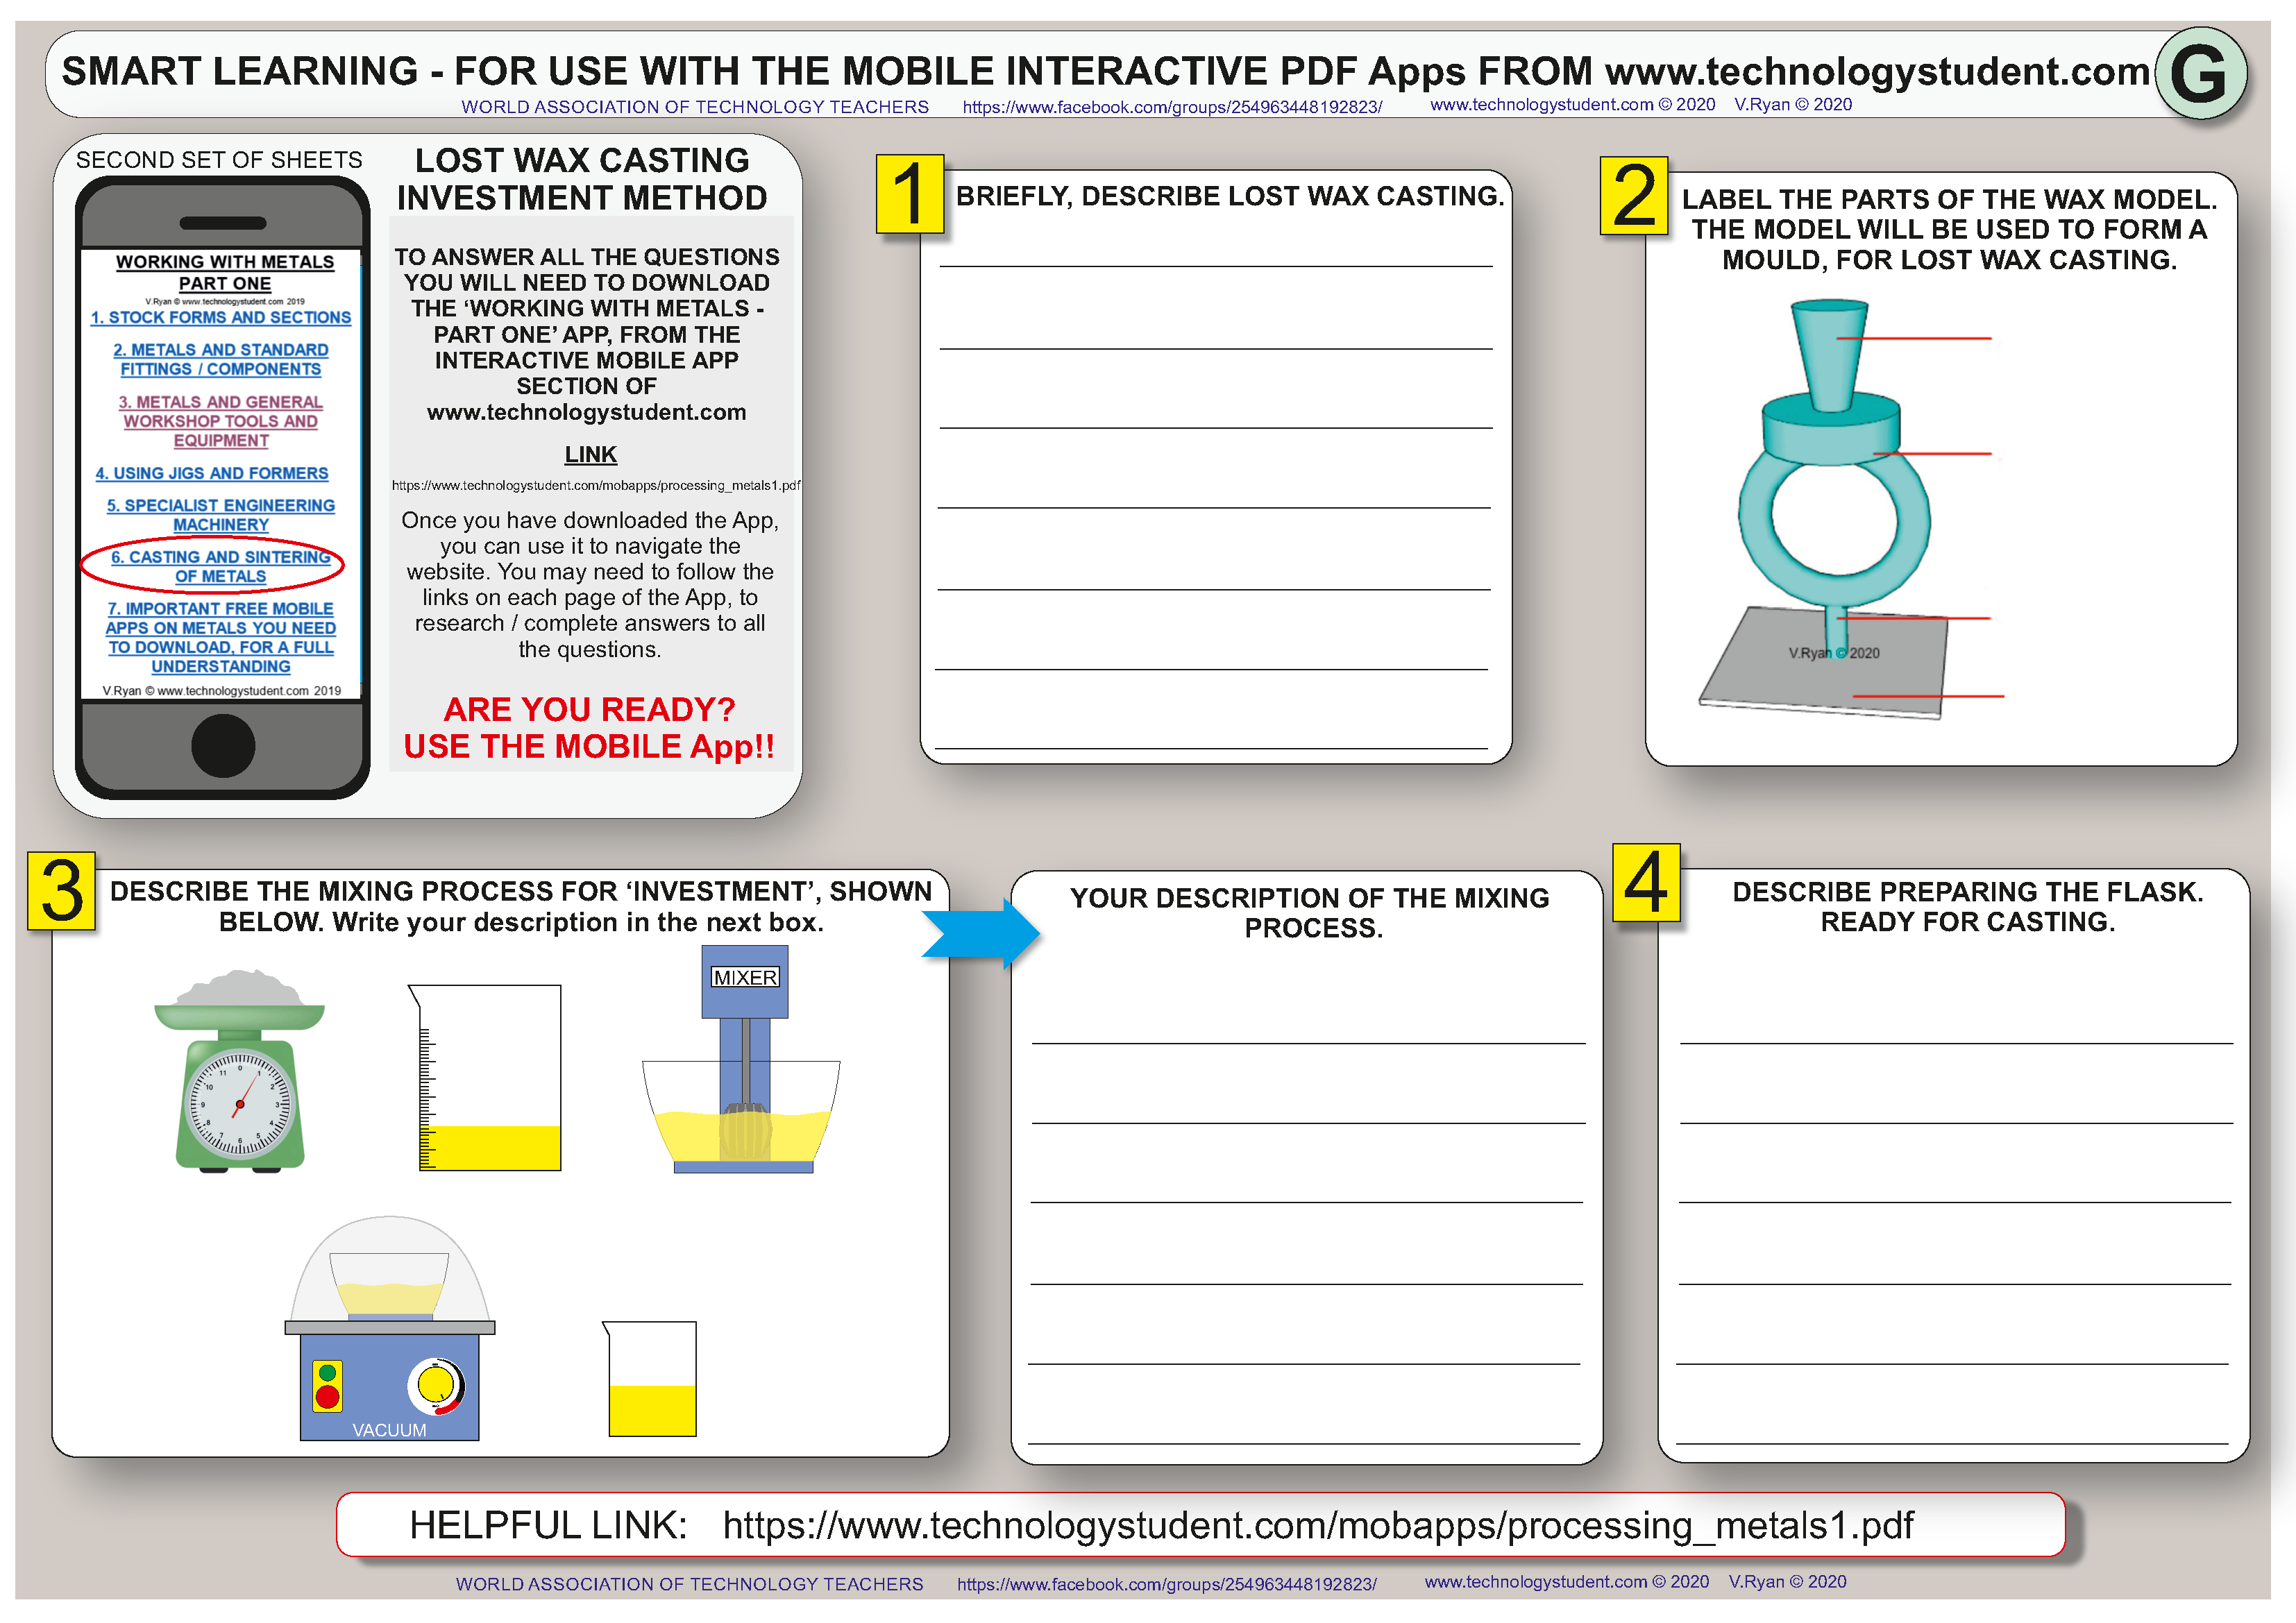

Slide 9
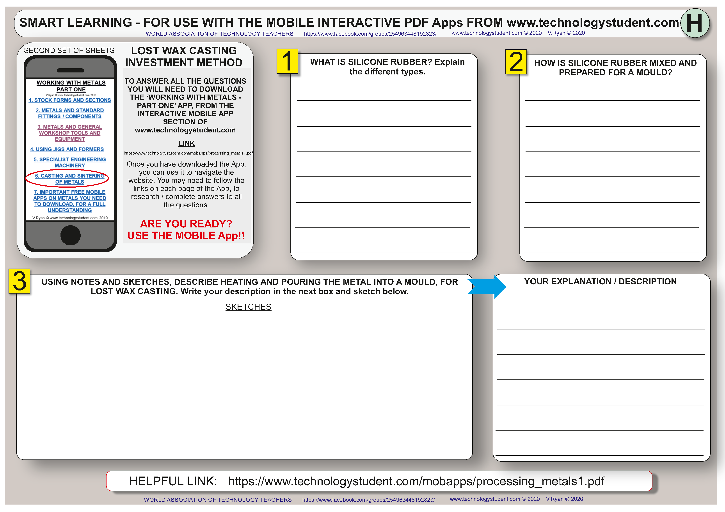

Slide 10
