Slide 1
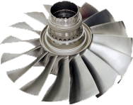
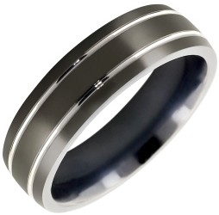
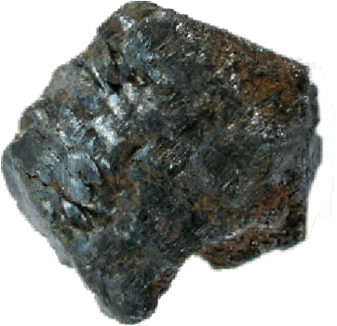
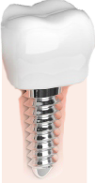
TITANIUM - PROPERTIES AND PRACTICAL APPLICATIONS
WORLD ASSOCIATION OF TECHNOLOGY TEACHERS
https://www.facebook.com/groups/254963448192823/
www.technologystudent.com © 2017 V.Ryan © 2017
WHAT IS TITANIUM?
Titanium (Ti), is a lightweight metal, that has a variety of practical applications. It is normally alloyed with other metals such as, aluminium, iron, vanadium or molybdenum, depending on its potential use. Titanium ore is very common and distributed around the world, being mined in Australia, South Africa, China, India, USA and Canada.
www.technologystudent.com
MACHINED TITANIUM TITANIUM ORE
HELPFUL LINK: https://technologystudent.com/despro_ﬂsh/revcard_titanium1.html
PROPERTIES OF TITANIUM
Half the density of steel, making it a lightweight replacement.
Titanium has a similar tensile strength to steel.
It has a very high melting point, 1670ºC.
Titanium resists corrosion and when exposed to air, it forms an oxide layer, that prevents further corrosion. It is extremely resistant to acids and salt water.
It is non-magnetic.
Titanium is a poor conductor of heat.
HELPFUL LINK: https://technologystudent.com/despro_ﬂsh/revcard_titanium1.html
PRACTICAL APPLICATIONS OF TITANIUM
TITANIUM TITANIUM JET HIP JOINT TURBINE BLADES
www.technologystudent.com
www.technologystudent.com
TITANIUM DENTAL IMPLANT
TITANIUM GOLF CLUB
1. What is titanium and where is it mined from the ground? 4 marks
2. Describe two properties of titanium and two practical applications. 4 marks

