Slide 1
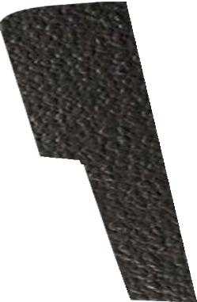
THE SDS DRILL - EXAMINATION QUESTIONS
WORLD ASSOCIATION OF TECHNOLOGY TEACHERS https://www.facebook.com/groups/254963448192823/ www.technologystudent.com © 2023 V.Ryan © 2023
HELPFUL LINK: https://www.technologystudent.com/pwtol/drill4.htm
1. Complete the diagram of the SDS drill, by adding the labels indicated by the arrows.
10 marks
V.Ryan © 2023
RYANMATIC
Special Direct System
Made in Keighley, England.
2. Describe the general purpose / uses of the SDS drill. 4 marks

