Slide 1
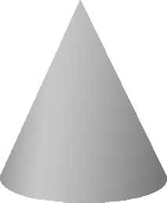
CONIC SECTIONS
https://www.facebook.com/groups/254963448192823/ technologystudent.com © 2023
PLAN VIEW
QUESTION
WORLD ASSOCIATION OF TECHNOLOGY TEACHERS
4
V.Ryan © 2023
3
5
HELPFUL LINK:
https://technologystudent.com/despro_3/conic3.html
2
6
A CIRCULAR CONE IS ‘INTERSECTED’ BY A VERTICAL CUTTING PLANE
(see the three diagrams below).
Complete the front, side and plan views of
V.Ryan © 2023
1
7
the cone, clearly showing the conic section. Include the True Shape of the conic section
12
8
HELPFUL LINK
INTERSECTING PLANE
11
9
10
CIRCULAR CONE
INTERSECTING PLANE
80mm
CIRCULAR CONE
1 2
12
3
11
4
5
9
6 7
8
10
FRONT VIEW
SIDE VIEW
80mm

