Slide 1
INTRODUCTION TO ISOMETRIC DRAWING
WORLD ASSOCIATION OF TECHNOLOGY TEACHERS https://www.facebook.com/groups/254963448192823/ www.technologystudent.com © 2020 V.Ryan © 2020
You will need to print out this page, to complete the exercise. Click on the link, where it appears on this
A
sheet, for guidance and samples.
EXERCISE 1
EXERCISE 2
Using the grid at the bottom of the
What you need to do:
Using a ruler / set square, draw a copy of the isometric cube, alongside the sample.
What you need to do:
page: Draw three isometric cubes, in
line with each other and equally spaced, as shown below.
Link
Link
Link
Link Link
YOUR
SAMPLE
ISOMETRIC CUBE
SAMPLE
EXTENSION WORK
Alongside the example, draw an isometric cube, using a 30 degree set square. If you do not have a set square, use a ruler and estimate the angles. All the sides should be the same size.
YOUR WORK
Link
EXAMPLE

Slide 2
INTRODUCTION TO ISOMETRIC DRAWING
WORLD ASSOCIATION OF TECHNOLOGY TEACHERS https://www.facebook.com/groups/254963448192823/ www.technologystudent.com © 2020 V.Ryan © 2020
You will need to print out this page, to complete the exercise. Click on the link, where it appears on this
B
sheet, for guidance and samples.
EXERCISE 3
What you need to do:
Using the cube at the bottom of the isometric grid as the starting point, construct a pattern of isometric cubes. Each cube must be the same size. A sample pattern is shown alongside the grid. Follow the link for guidance.
Link
SAMPLE PATTERN

Slide 3
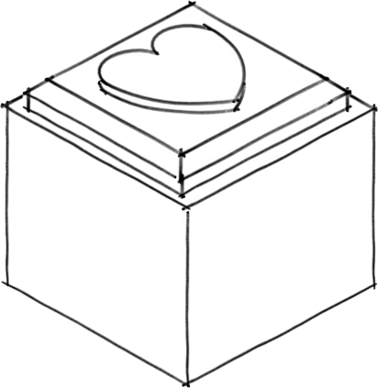
INTRODUCTION TO ISOMETRIC DRAWING
WORLD ASSOCIATION OF TECHNOLOGY TEACHERS https://www.facebook.com/groups/254963448192823/ www.technologystudent.com © 2020 V.Ryan © 2020
You will need to print out this page, to complete the exercise. Click on the link, where it appears on this
C
sheet, for guidance and samples.
EXERCISE 4
What you need to do
A 3D isometric sketch of a typical container is drawn below.
Using the isometric grid, draw your version of the container.
Link

Slide 4
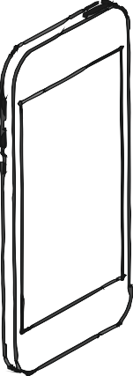
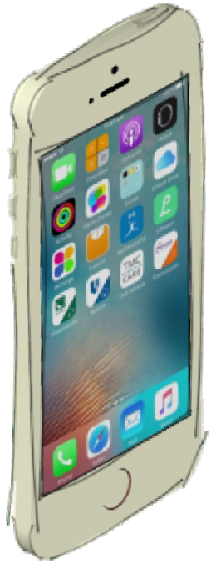
ISOMETRIC SKETCHING
WORLD ASSOCIATION OF TECHNOLOGY TEACHERS https://www.facebook.com/groups/254963448192823/ www.technologystudent.com © 2020 V.Ryan © 2020
You will need to print out this page, to complete the exercise. Click on the link, where it appears on this
D
sheet, for guidance and samples.
EXERCISE 1
EXTENSION WORK
STUDY THE THREE VIEWS OF THE MOBILE PHONE SEEN BELOW. USING THE ISOMETRIC GRID, SKETCH AN ACCURATE 3D OUTLINE VERSION.
THEN, ADD REALISTIC COLOUR AND SHADE
COLLECT A RANGE OF IMAGES OF MUSIC PLAYING DEVICES, FOR USE LATER.
Some examples are shown below.
What you need to do:
Link
YOUR ISOMETRIC SKETCH
EXAMPLE
WORLD ASSOCIATION OF TECHNOLOGY TEACHERS https://www.facebook.com/groups/254963448192823/
www.technologystudent.com © 2020 V.Ryan © 2020

Slide 5
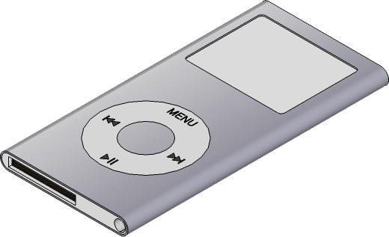
ISOMETRIC SKETCHING
You will need to print out this page, to complete the exercise. Click on the link, where it appears on this
E
sheet, for guidance and samples.
WORLD ASSOCIATION OF TECHNOLOGY TEACHERS https://www.facebook.com/groups/254963448192823/ www.technologystudent.com © 2020 V.Ryan © 2020
EXERCISE 2
USING THE ISOMETRIC GRID, DRAW THE MP3 PLAYER IN ISOMETRIC PROJECTION.
ABLE COLOUR AND SHADE.
ADD ‘THICK LINES’ TO EMPHASISE SOME EDGES.
Link
Link
What you need to do:
ADD SUIT
EXAMPLE
YOUR ISOMETRIC SKETCH
WORLD ASSOCIATION OF TECHNOLOGY TEACHERS https://www.facebook.com/groups/254963448192823/
www.technologystudent.com © 2020 V.Ryan © 2020

Slide 6
ISOMETRIC SKETCHING
You will need to print out this page, to complete the exercise. Click on the link, where it appears on this
F
sheet, for guidance and samples.
WORLD ASSOCIATION OF TECHNOLOGY TEACHERS https://www.facebook.com/groups/254963448192823/ www.technologystudent.com © 2020 V.Ryan © 2020
EXTENSION WORK
What you need to do:
SELECT ONE OF THE IMAGES YOU COLLECTED FOR THE EXTENSION WORK OF PAGE / SLIDE ‘A’.
DRAW / SKETCH IT IN ISOMETRIC, ON THIS PAGE / SLIDE.
Link
PRACTICE ISOMETRIC SKETCH
(if you feel this will help)
ACCURATE ISOMETRIC SKETCH OF YOUR SELECTED MUSIC DEVICE
WORLD ASSOCIATION OF TECHNOLOGY TEACHERS https://www.facebook.com/groups/254963448192823/
www.technologystudent.com © 2020 V.Ryan © 2020

Slide 7
ISOMETRIC PRINTING
WORLD ASSOCIATION OF TECHNOLOGY TEACHERS https://www.facebook.com/groups/254963448192823/ www.technologystudent.com © 2020 V.Ryan © 2020
You will need to print out this page, to complete the exercise. Click on the link, where it appears on this
G
sheet, for guidance and samples.
EXERCISE 3
THE PHRASE ‘THE WORLD’, IS PRINTED AT THE BOTTOM OF THE PAGE / SLIDE. COMPLETE THE ISOMETRIC VERSION, USING THE ISOMETRIC GUIDELINES. THE FIRST FEW VERTICAL DIVIDES BETWEEN LETTERS, HAVE BEEN DRAWN FOR YOU. THESE NEED TO BE CONTINUED AS YOU ADD EACH LETTER.
Link
What you need to do:
EXAMPLE
THE PRINTING SHOWN BELOW, HAS BEEN DRAWN IN ITS NORMAL PLAIN STYLE AND ALSO AS ISOMETRIC LETTERING.
WORLD ASSOCIATION OF TECHNOLOGY TEACHERS https://www.facebook.com/groups/254963448192823/
www.technologystudent.com © 2020 V.Ryan © 2020

Slide 8
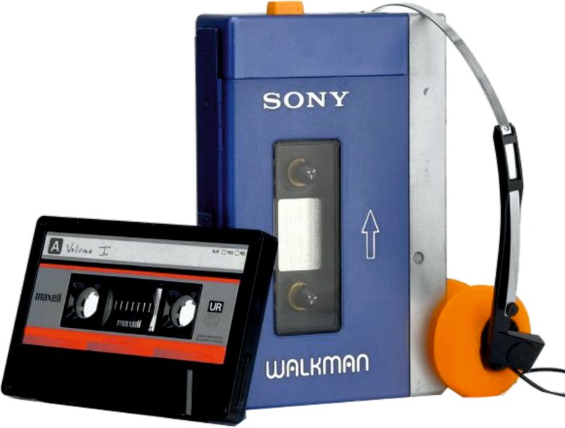
ISOMETRIC DRAWING AND PRINTING
You will need to print out this page, to complete the exercise. Click on the link, where it appears on this
H
sheet, for guidance and samples.
WORLD ASSOCIATION OF TECHNOLOGY TEACHERS https://www.facebook.com/groups/254963448192823/ www.technologystudent.com © 2020 V.Ryan © 2020
EXERCISE 4
The Sony Walkman, introduced in 1978, was the original personal music system and played audio cassette tapes.
It represented the best miniaturised technology of the era and started a revolution in portable music devices. Its equivalent today is the iPod.
Draw the personal stereo with the help of the isometric grid.
What you need to do:
Link
EXAMPLE
Link
AUDIO CASSETTE TAPE
EXTENSION WORK
DESIGN YOUR OWN MUSIC DEVICE.
What you need to do:
SKETCH A ROUGH VERSION / A NUMBER OF ROUGH VERSIONS. SELECT YOUR BEST DESIGN AND DRAW IT ACCURATELY IN ISOMETRIC
WORLD ASSOCIATION OF TECHNOLOGY TEACHERS https://www.facebook.com/groups/254963448192823/
www.technologystudent.com © 2020 V.Ryan © 2020

Slide 9
ISOMETRIC - CIRCLES
WORLD ASSOCIATION OF TECHNOLOGY TEACHERS https://www.facebook.com/groups/254963448192823/ www.technologystudent.com © 2020 V.Ryan © 2020
You will need to print out this page, to complete the exercise. Click on the link, where it appears on this
I
sheet, for guidance and samples.
EXERCISE 1
EXERCISE 2
What you need to do:
USING THE ‘COMPASS TECHNIQUE’, COMPLETE THE ISOMETRIC CIRCLE.
Link
DRAW ISOMETRIC CIRCLES IN THE SQUARES, USING THE COMPASS TECHNIQUE. DO NOT ERASE ANY ISOMETRIC GUIDELINES YOU DRAW, TO HELP COMPLETE THE QUESTION.
What you need to do:
Link
3
SAMPLE ISOMETRIC CIRCLES
BUT - YOU MUST INCLUDE ALL THE GUIDELINES
2
1
4
EXTENSION WORK
DRAW THREE ISOMETRIC CIRCLES IN EACH OF THE ISOMETRIC RECTANGLES, USING THE COMPASS TECHNIQUE
Link
What you need to do:
WORLD ASSOCIATION OF TECHNOLOGY TEACHERS https://www.facebook.com/groups/254963448192823/
www.technologystudent.com © 2020
V.Ryan © 2020

Slide 10
ISOMETRIC CYLINDERS
WORLD ASSOCIATION OF TECHNOLOGY TEACHERS https://www.facebook.com/groups/254963448192823/ www.technologystudent.com © 2020 V.Ryan © 2020
You will need to print out this page, to complete the exercise. Click on the link, where it appears on this
J
sheet, for guidance and samples.
EXERCISE 3
EXERCISE 4
BELOW IS A CYLINDER, DRAWN IN ISOMETRIC. DRAW AN EXACT COPY ALONGSIDE THE ORIGINAL. USE THE COMPASS METHOD, WHEN DRAWING THE ISOMETRIC CIRCLES. DO NOT ERASE ANY ISOMETRIC GUIDELINES YOU DRAW, TO HELP COMPLETE THE QUESTION. THE ISOMETRIC RECTANGLES HAVE BEEN DRAWN FOR YOU.
USING THE FAINT CYLINDER OUTLINE BELOW, ADD COLOUR / SHADE AND A BOLD OUTLINE.
Consider using the line technique, combined with ‘dark to light’ shading.
What you need to do:
What you need to do:
SAMPLE
Link
YOUR CYLINDER
WORLD ASSOCIATION OF TECHNOLOGY TEACHERS https://www.facebook.com/groups/254963448192823/
www.technologystudent.com © 2020
V.Ryan © 2020

Slide 11
ISOMETRIC CYLINDERS
WORLD ASSOCIATION OF TECHNOLOGY TEACHERS https://www.facebook.com/groups/254963448192823/ www.technologystudent.com © 2020 V.Ryan © 2020
You will need to print out this page, to complete the exercise. Click on the link, where it appears on this
K
sheet, for guidance and samples.
EXTENSION WORK
What you need to do:
DRAW AN ISOMETRIC CYLINDER, USING THE TWO ISOMETRIC SQUARES, AS THE ‘CIRCULAR ENDS’.
USING THE INTERNET, COLLECT IMAGES OF OBJECTS / PRODUCTS, THAT HAVE BEEN DRAWN IN ISOMETRIC PROJECTION. PASTE THE IMAGES BELOW.
What you need to do:
SAMPLE
Link
WORLD ASSOCIATION OF TECHNOLOGY TEACHERS https://www.facebook.com/groups/254963448192823/
www.technologystudent.com © 2020
V.Ryan © 2020

Slide 12
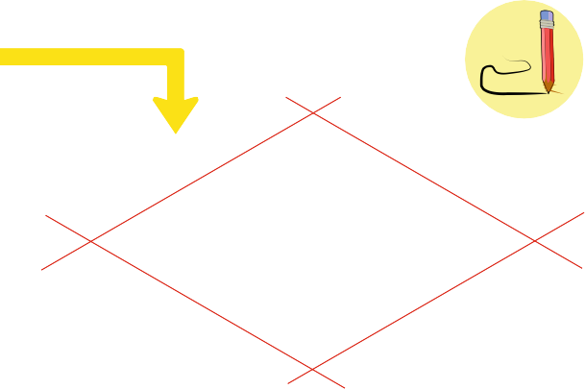
SKETCHING IN ISOMETRIC
WORLD ASSOCIATION OF TECHNOLOGY TEACHERS https://www.facebook.com/groups/254963448192823/ www.technologystudent.com © 2020 V.Ryan © 2020
You will need to print out this page, to complete the exercise. Click on the link, where it appears on this
L
sheet, for guidance and samples.
EXERCISE 5
EXERCISE 6
What you need to do:
THESE QUESTIONS ARE ABOUT ‘SKETCHING’ IN
YOU CAN USE A SET SQUARE
ADDITIONAL QUICK, FAINT GUIDELINES. ALL OTHER LINES SHOULD BE SKETCHED.
SKETCH THE TWO CYLINDERS SHOWN BELOW, IN ISOMETRIC. DO NOT ERASE ANY ISOMETRIC GUIDELINES YOU DRAW, TO HELP COMPLETE THE QUESTION.
ISOMETRIC.
/ RULER TO DRAW
What you need to do:
SKETCH AN ISOMETRIC CIRCLE, USING THE GUIDELINES SHOWN OPPOSITE.
Link
SAMPLE
SKETCH AN ISOMETRIC CUBE, USING THE GUIDELINES SHOWN OPPOSITE. ADD FURTHER GUIDELINES, AS YOU NEED THEM.
WORLD ASSOCIATION OF TECHNOLOGY TEACHERS https://www.facebook.com/groups/254963448192823/
www.technologystudent.com © 2020
V.Ryan © 2020

Slide 13
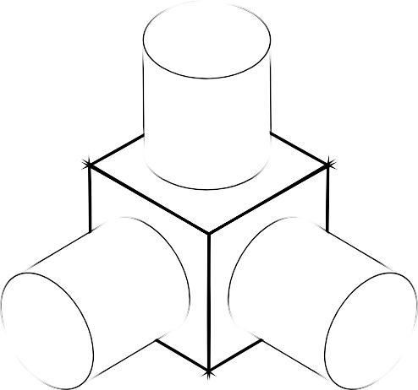
SKETCHING IN ISOMETRIC
WORLD ASSOCIATION OF TECHNOLOGY TEACHERS https://www.facebook.com/groups/254963448192823/ www.technologystudent.com © 2020 V.Ryan © 2020
You will need to print out this page, to complete the exercise. Click on the link, where it appears on this
M
sheet, for guidance and samples.
EXERCISE 7
EXERCISE 8
What you need to do:
ACCURATELY SKETCH THE OBJECT SHOWN BELOW, IN ISOMETRIC. DO NOT ERASE ANY ISOMETRIC GUIDELINES YOU DRAW, TO HELP COMPLETE THE QUESTION.
SKETCH THE SHAPES, IN ISOMETRIC. DO NOT ERASE ANY ISOMETRIC GUIDELINES YOU DRAW.
INCLUDE THE ‘SIMPLE’ SHADING.
What you need to do:
Link
EXTENSION WORK
ADD APPROPRIATE COLOUR / SHADE TO YOUR ISOMETRIC SKETCH. CONSIDER USING A COMBINATION OF THE LINE TECHNIQUE AND LIGHT TO DARK SHADING.
Link
WORLD ASSOCIATION OF TECHNOLOGY TEACHERS https://www.facebook.com/groups/254963448192823/
www.technologystudent.com © 2020
V.Ryan © 2020

Slide 14
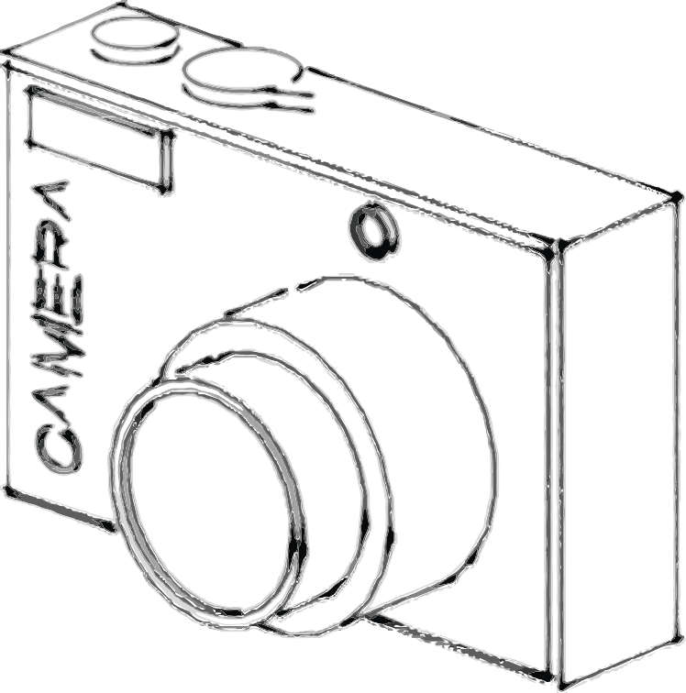
SKETCHING IN ISOMETRIC
WORLD ASSOCIATION OF TECHNOLOGY TEACHERS https://www.facebook.com/groups/254963448192823/ www.technologystudent.com © 2020 V.Ryan © 2020
You will need to print out this page, to complete the exercise. Click on the link, where it appears on this
N
sheet, for guidance and samples.
EXTENSION WORK
What you need to do:
STUDY THE SKETCH OF THE CAMERA. IN THE SPACE OPPOSITE, SKETCH AN ACCURATE ISOMETRIC COPY. DO NOT ERASE ANY ADDITIONAL ISOMETRIC GUIDELINES YOU DRAW, TO HELP YOU COMPLETE THE QUESTION. ADD APPROPRIATE COLOUR / SHADE.
SAMPLE YOUR WORK
Link
FURTHER EXTENSION WORK
What you need to do:
TRY DRAWING SOME OF THE PREVIOUS EXERCISES REGARDING CIRCLES AND CYLINDERS, USING THE ‘ORDINATE’ TECHNIQUE. THIS IS AN ALTERNATIVE WAY OF DRAWING ISOMETRIC CIRCLES AND CURVES ACCURATELY.
Link
WORLD ASSOCIATION OF TECHNOLOGY TEACHERS https://www.facebook.com/groups/254963448192823/
www.technologystudent.com © 2020
V.Ryan © 2020

