Slide 1
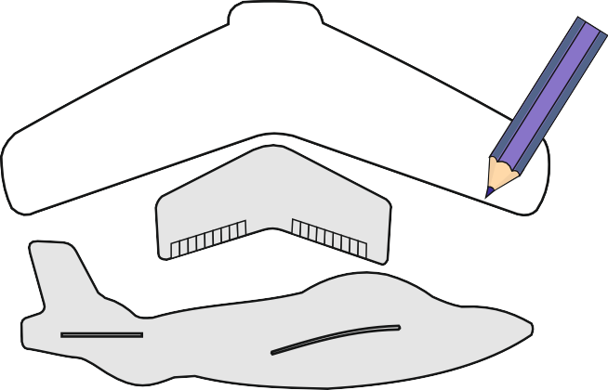
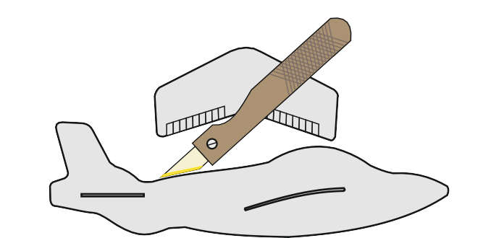
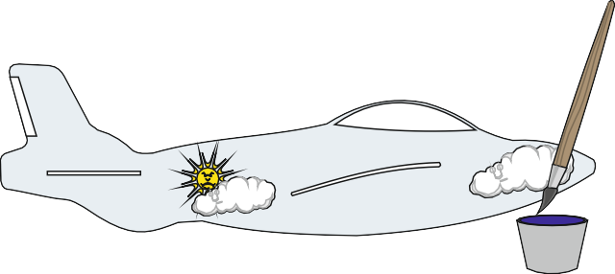
QUALITY CONTROL EXERCISE - MAKING A MODEL GLIDER BY HAND
HELPFUL LINKS: https://technologystudent.com/prddes1/qual3.html
A model glider is manufactured by hand. For each of the stages listed below add a Quality Control Check. The checks should ensure that the final product is as perfect as possible.
1. A card template is drawn accurately and then placed on the modelling making material (zepron, depron or balsa wood).
A china graph pencil or water based felt pen or even a pencil is used to draw accurately round the template.
QUALITY CHECK 1:
2. A craft knife is used to cut out the shapes of the fuselage and wings. Great care must be taken as craft knives are dangerous if used carelessly. Alternatively, a fretsaw or a fine toothed modelling saw can be used.
QUALITY CHECK 2:
3. After the parts are smoothed with glass paper or went and dry paper, they are painted by hand. Before painting balsa wood must be sealed using PVA. However, depron and zepron can be painted straightaway with water based paints.
UK1252
QUALITY CHECK 3:

Slide 2
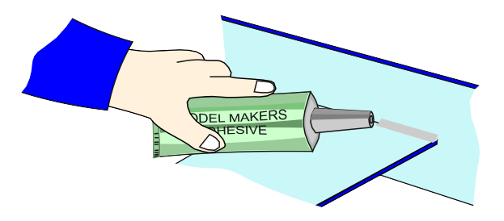
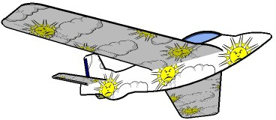
QUALITY CONTROL EXERCISE - MAKING A MODEL GLIDER BY HAND
HELPFUL LINKS: https://technologystudent.com/prddes1/qual3.html
4. Glue guns or solvent free glues are used to join the parts. Glues such as UHU POR or POLY ZAP are amongst the most suitable.
QUALITY CHECK 4:
5. The final quality check:
QUALITY CHECK 5:

