Slide 1
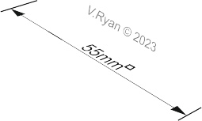
DRAWING TRUE SHAPES - ORTHOGRAPHIC DRAWING
WORLD ASSOCIATION OF TECHNOLOGY TEACHERS https://www.facebook.com/groups/254963448192823/ technologystudent.com © 2023 V.Ryan © 2023
HELPFUL LINK: https://technologystudent.com/despro_3/truelength1.html
SQUARE PYRAMID
APEX
DIA15mm
35mm
70mm
HELPFUL LINK
NOTE: The hole drilled through the front face is at 90 degrees to the surface.
DRAW FRONT, SIDE AND SECTIONAL PLAN ELEVATION OF THE SQUARE PYRAMID SHOWN ABOVE
PLEASE ESTIMATE WHERE THEY ARE NOT STATED
BASE LINE
THIRD ANGLE PROJECTION

