Slide 1
METAL FOAMS AND THEIR PRACTICAL APPLICATION QUESTIONS
WORLD ASSOCIATION OF TECHNOLOGY TEACHERS https://www.facebook.com/groups/254963448192823/ www.technologystudent.com © 2018 V.Ryan © 2018
HELPFUL LINKS:
https://technologystudent.com/joints_ﬂsh/metalfoam1.html https://technologystudent.com/joints_ﬂsh/metalfoam2.html
1. What is the structure of a metal foam? Use notes and a diagram / sketch in your answer. 6 marks
NOTES SKETCH
2. Brieﬂy, Describe / explain the physical properties of metal foams. 4 marks
3. Describe two practical applications of metal foams. Use notes and sketches.
NOTES SKETCHES

Slide 2
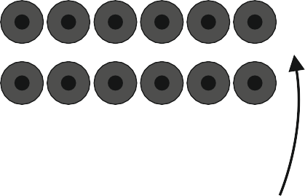
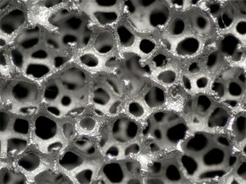
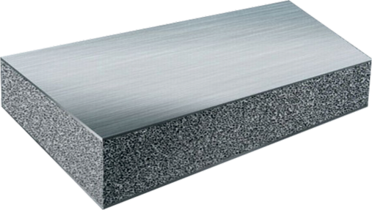
PRODUCTION OF FOAM METALS - QUESTIONS
WORLD ASSOCIATION OF TECHNOLOGY TEACHERS https://www.facebook.com/groups/254963448192823/ www.technologystudent.com © 2018 V.Ryan © 2018
1. Complete the explanatory notes, diagram a d labels, showing the manufacture of Aluminium Metal Foam. 14 marks
PRIMARY TANK
SECONDARY TANK
ROLLERS
ROLLERS COMPRESS METAL FOAM TO A UNIFORM THICKNESS
GAS GAS GAS
GAS INPUT

