Slide 1
SAFETY BOOKLET ONE
This booklet will help introduce you to, Health and Safety in the workshop. It will help you gain an understanding of safety, related to some of the common equipment used in school workshops.
Your teacher will explain / demonstrate the use of equipment, tools and machinery in your workshop.
If you are in any doubt about the use of a machine or equipment, you must ask your teacher for help.
You must not use any machines or equipment, until your teacher is happy with your knowledge of safety and the operation of specific machines. Your teacher will tell you, when you are allowed to use machines.

Slide 3
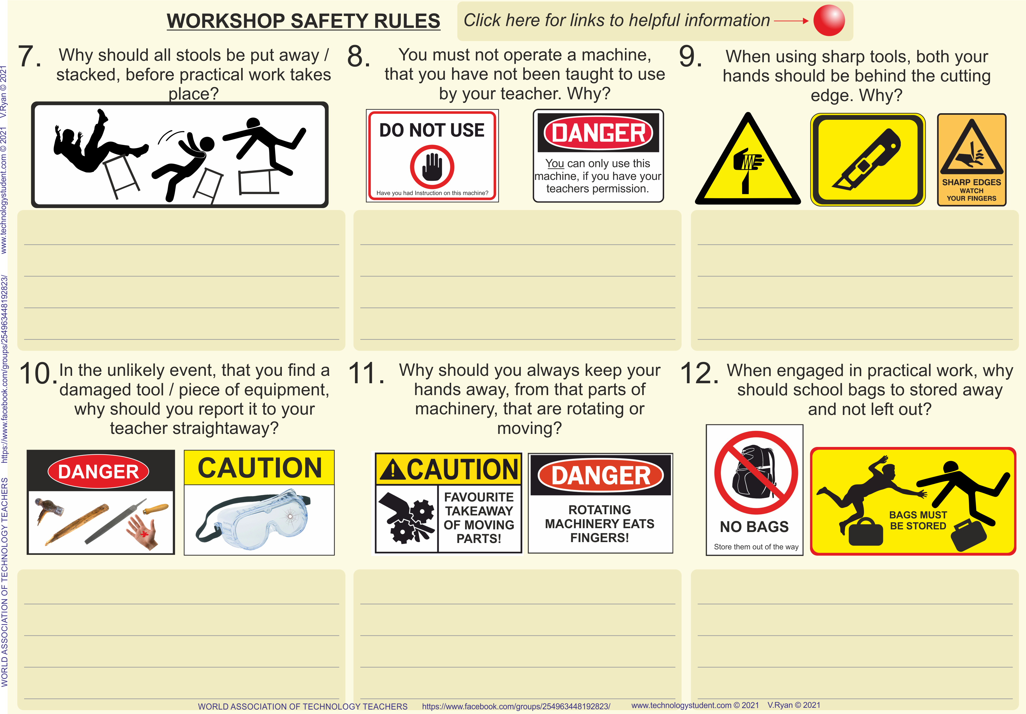

Slide 5
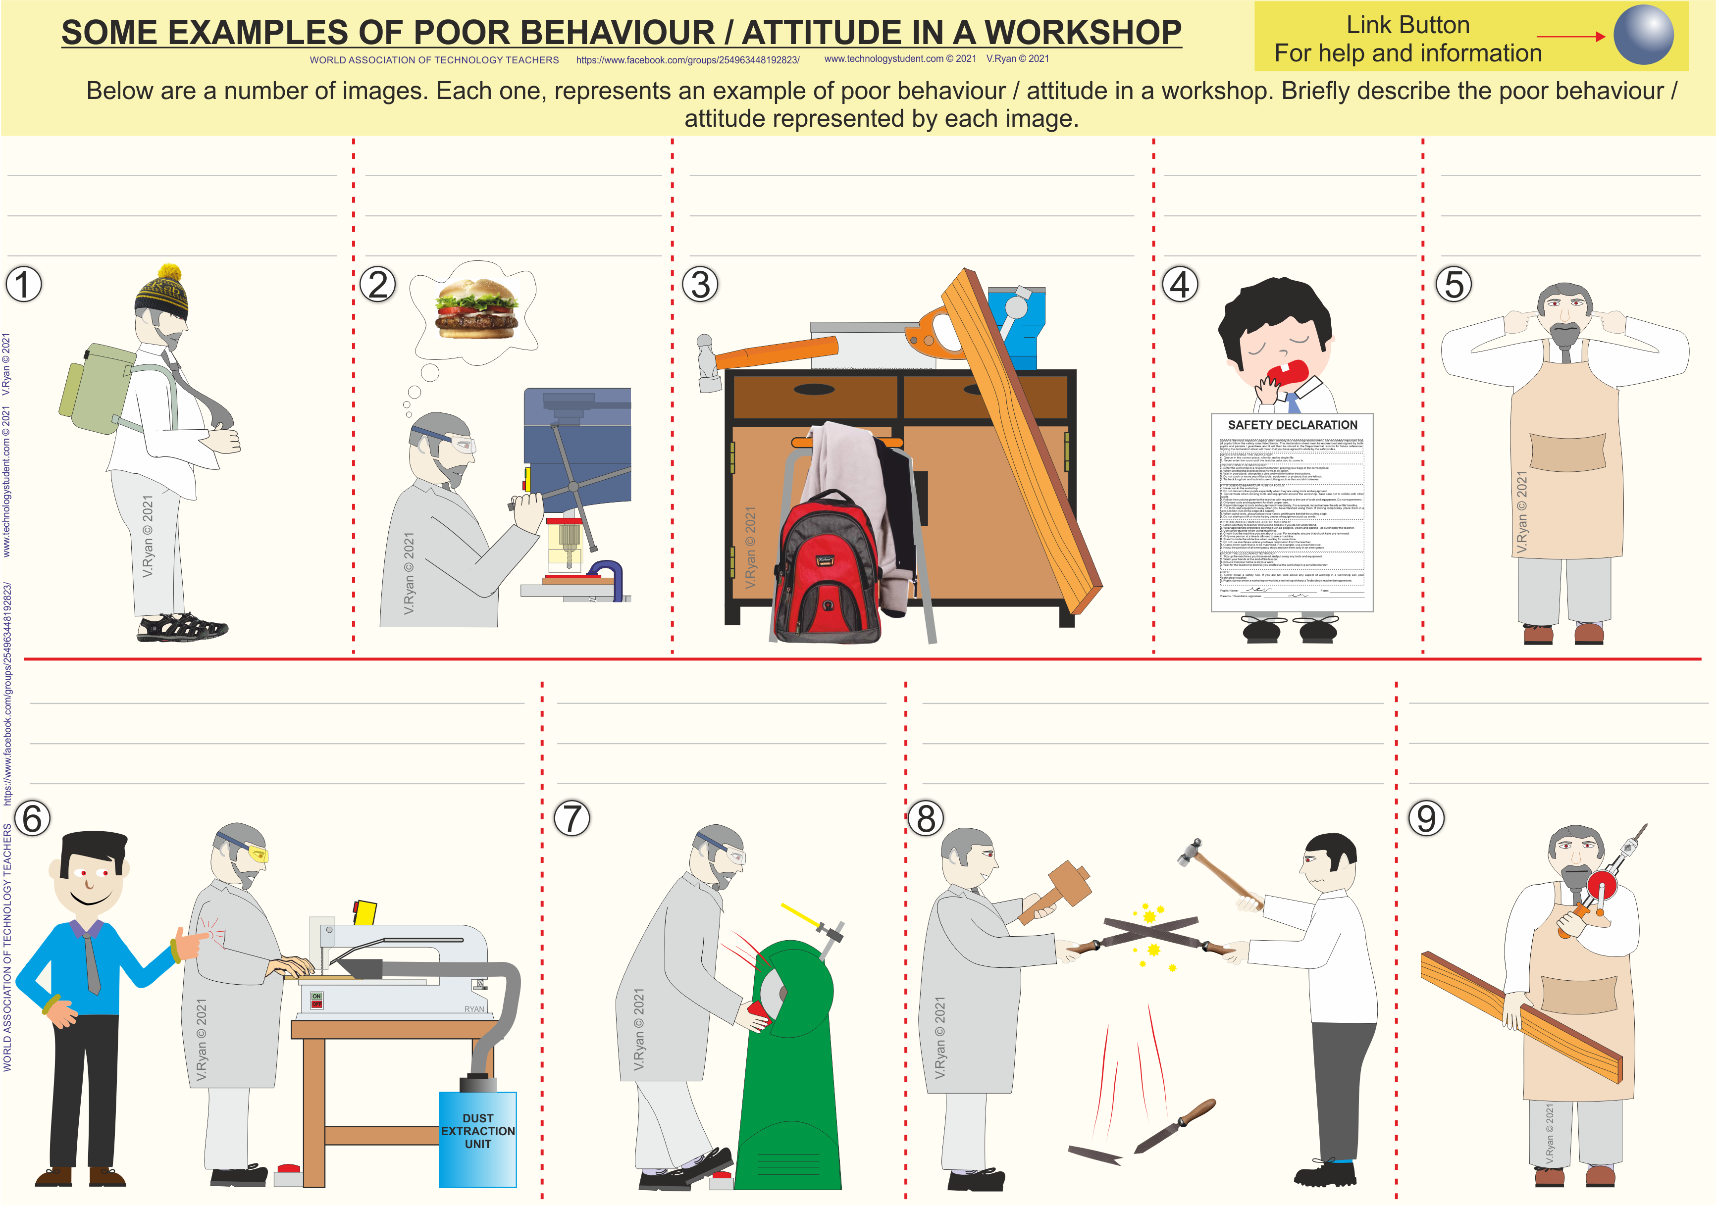

Slide 8
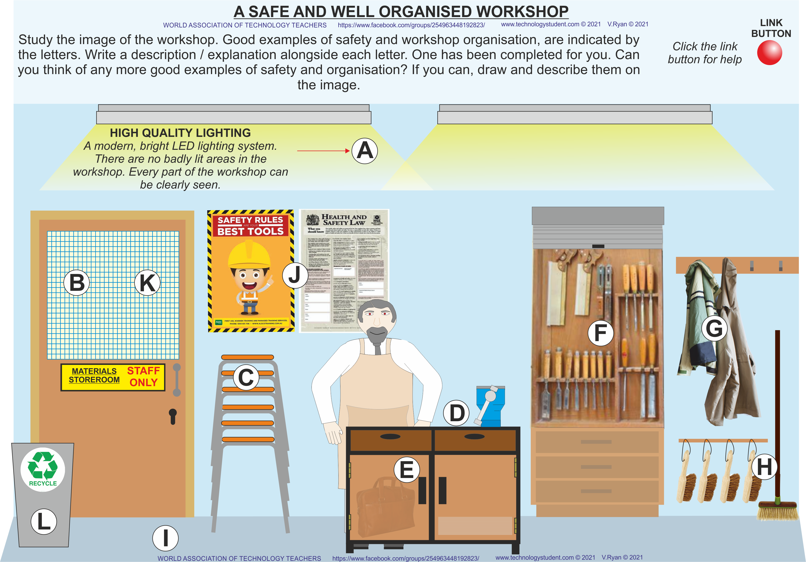

Slide 9
