Slide 1
EXPLODED DRAWING
WORLD ASSOCIATION OF TECHNOLOGY TEACHERS https://www.facebook.com/groups/254963448192823/
technologystudent.com © 2023 V.Ryan © 2023
A disassembled G cramp is shown below (Dia A). There is also an assembled version of the G Cramp (Dia B).
You are to produce a detailed, colour rendered, exploded drawing of the G Cramp, at the bottom of the page (space ‘C). Include labels identifying each component.
A
DISASSEMBLED G CRAMP
B
SWIVEL SHOE
THREAD
RETAINING PIN
ASSEMBLED
G CRAMP
WINGNUT
FRAME
HELPFUL LINK
Link
RYAN
RYAN
C
YOUR EXPLODED DRAWING - DETAILED, COLOURED RENDERED VERSION
https://www.facebook.com/groups/254963448192823/
technologystudent.com © 2023

Slide 2
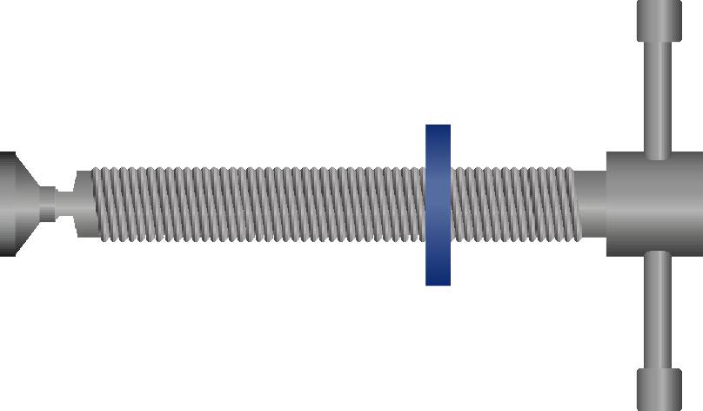
EXPLODED DRAWING
WORLD ASSOCIATION OF TECHNOLOGY TEACHERS https://www.facebook.com/groups/254963448192823/
technologystudent.com © 2023 V.Ryan © 2023
A disassembled G cramp (with Tommy Bar) is shown below (Dia A). There is also an assembled version of the G Cramp (Dia B).
You are to produce a detailed, colour rendered, exploded drawing of the G Cramp, at the bottom of the page (space ‘C). Include labels identifying each component.
A
DISASSEMBLED G CRAMP
B
SWIVEL SHOE
THREAD
ASSEMBLED
TOMMY BAR
G CRAMP
HELPFUL LINK
COLLAR
FRAME
Link
RYAN
RYAN
C
YOUR EXPLODED DRAWING - DETAILED, COLOURED RENDERED VERSION
https://www.facebook.com/groups/254963448192823/
technologystudent.com © 2023

