Slide 1
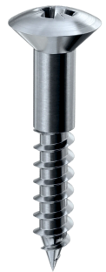
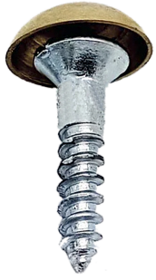
EXAMINATION QUESTIONS - COMMON WOD / METAL SCREWS
USEFUL LINKS
https://technologystudent.com/joints/screws1.htm https://technologystudent.com/joints/screws2.htm
A range of different types of screws are seen below. Name each type of screw and add a short description explaining its use and include any other information you feel is important.
DESCRIPTION
NAME
DESCRIPTION
NAME
DESCRIPTION
NAME
DESCRIPTION
NAME
DESCRIPTION
NAME

Slide 2
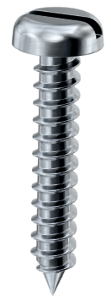
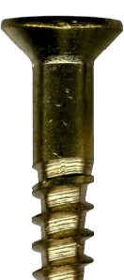
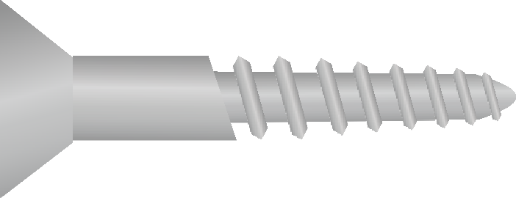
DESCRIPTION
NAME
DESCRIPTION
NAME
V.Ryan © 2022
The diagram opposite shows a type of screw that is used in such a way that the head sinks below the surface of the material.
What is the name of this type of screw?
What is the advantage of this type of screw, in particular the way it is positioned below the material surface?
Complete the diagram below by adding the missing labels.
V.Ryan © 2022

