Slide 1
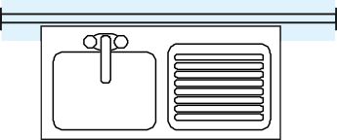
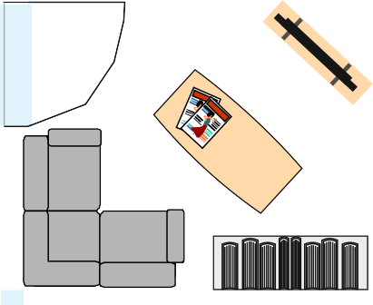
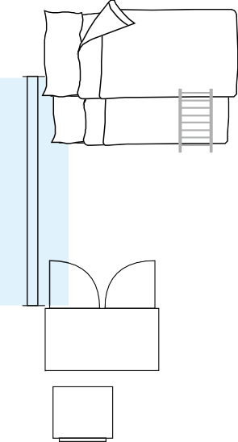
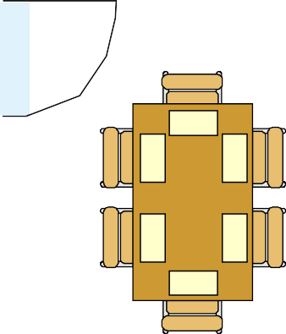
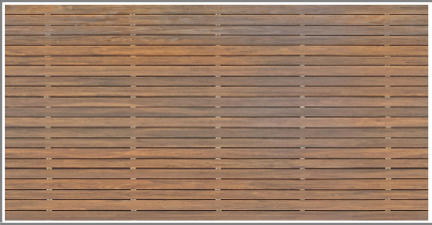
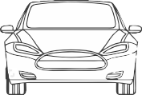
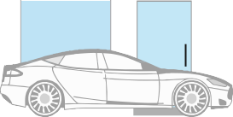
ARCHITECTURAL VIEWS AND PLANS
WORLD ASSOCIATION OF TECHNOLOGY TEACHERS https://www.facebook.com/groups/254963448192823/
technologystudent.com © 2024 V.Ryan © 2024
EXERCISES
KITCHEN
LOUNGE
BUNK BEDS
CORNER BATH
WC
BUILT
IN WARDR
OBE
SINK
TWO SEATER SETTEE
BATHROOM
SHOWER
BEDROOM
GARAGE
HALL
DINING ROOM
BUILT IN WARDROBE
HALL
MASTER BEDROOM
LOUNGE CHAIR
TABLE LAMP
BEDROOM
DOUBLE BED
SINGLE BED
PLAN VIEW
V.Ryan © 2023
V.Ryan © 2024
V.Ryan © 2024
V.Ryan © 2024
V.Ryan © 2024
SIDE VIEW
FRONT VIEW
WORLD ASSOCIATION OF TECHNOLOGY TEACHERS
https://www.facebook.com/groups/254963448192823/
technologystudent.com © 2024
V.Ryan © 2024

Slide 2
SHEET ONE
ARCHITECTURAL STYLES OF HOMES - IMAGES
WORLD ASSOCIATION OF TECHNOLOGY TEACHERS https://www.facebook.com/groups/254963448192823/
technologystudent.com © 2024 V.Ryan © 2024
RESEARCH DIFFERENT ARCHITECTURAL STYLES OF HOMES. PASTE THE STYLES / IMAGES THAT YOU LIKE ON THIS SHEET. NAME EACH STYLE.
NAMES OF SOME HOUSE STYLES
MODERNIST
HUF HOUSE GOTHIC RIVAL
COTTAGE HOUSE STYLE BARN STYLE HOUSE TUDOR
GEORGIAN MODULAR HOME ARTS AND CRAFTS TOWN HOUSE
HELPFUL LINK
HELPFUL LINK: https://technologystudent.com/despro2/architec2.html

Slide 3
SHEET TWO ARCHITECTURAL STYLES OF HOMES - DESCRIPTIONS
WORLD ASSOCIATION OF TECHNOLOGY TEACHERS https://www.facebook.com/groups/254963448192823/
technologystudent.com © 2024 V.Ryan © 2024
NAME AND DESCRIBE THE FEATURES OF EACH STYLE OF HOME THAT YOU RESEARCHED ON THE PREVIOUS SHEET
HELPFUL LINK
HELPFUL LINK: https://technologystudent.com/despro2/architec2.html

Slide 4
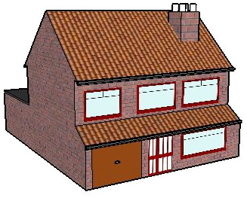
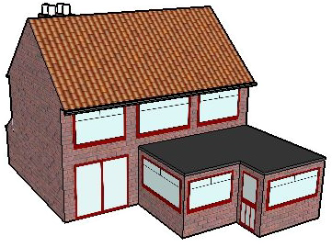
SHEET 1 ARCHITECTURAL PLANS - DESIGN TASK QUESTIONS
THE DESIGN TASK - INITIAL RESEARCH
WORLD ASSOCIATION OF TECHNOLOGY TEACHERS https://www.facebook.com/groups/254963448192823/
technologystudent.com © 2024 V.Ryan © 2024
EXPLAIN THE KEY TERMS LISTED BELOW
You are to design the arrangement of furniture, fixtures and fittings of a typical detached house. The house has two floors with the dining room, kitchen and lounge downstairs.
Bedrooms and bathroom upstairs.
The sample key shows how a variety of furniture, fixtures and fittings look as a plan view (birds eye view). You can use examples from the key or develop your own designs. Think carefully about the style of furniture, fixtures and fittings.
Keep in mind, that there are certain pieces of furniture, fixtures and fittings that are essential in any house. List some that you think are essential:
RENT
LEASE
ARCHITECT
HOUSE
FLAT
REPOSSESSION
ROOF
SUBSIDENCE
SURVEY
ADDRESS
KITCHEN
DOOR
Houses are very expensive in this location. It is said that a house is the most expensive single item a person / couple will ever buy.
Write down what you consider to be the price of the house seen below.
PRICE:
FRONT BACK
Would you prefer to own a detached house in a residential area (a housing estate) or a small flat in an exclusive riverside location? Explain your answer.
HELPFUL LINK
GARAGE
GARDEN
MORTGAGE
HELPFUL LINK: https://technologystudent.com/despro2/architec3.html

Slide 5
SHEET 2
ARCHITECTURAL PLANS - DESIGN TASK
QUESTION
WORLD ASSOCIATION OF TECHNOLOGY TEACHERS https://www.facebook.com/groups/254963448192823/
technologystudent.com © 2024 V.Ryan © 2024
ALL THE INCOMPLETE WORDS BELOW ARE ASSOCIATED WITH BUYING OR OWNING A HOUSE. FILL IN THE MISSING LETTERS.
You can refer to the list of Key Terms.
1. R_ _T
15. ARC_ _ _ _ _ T
2. L_ _SE
3. M_ _ _ _AGE
14. H_U_E
4. G_ _ _ EN
HOME
13. FL_T
5. GAR_ _E
12. RE_ _ _ _ ESSION
6. D_ _ R
11. R_ _ F
10. SUB_ _ _ ENCE
9. S_ _ VEY
HELPFUL LINK:
7. K_ _ _ _ EN
8. A_ _ RESS
HELPFUL LINK: https://technologystudent.com/despro2/architec3.html

Slide 6
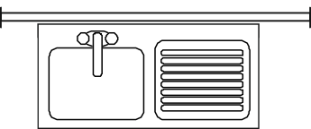
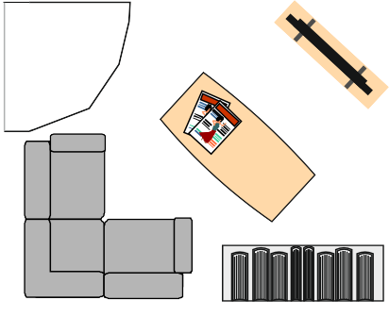
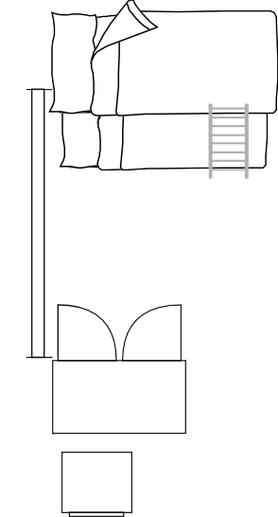
TASK - ARCHITECTURAL PLANS - PLAN / LAYOUT
WORLD ASSOCIATION OF TECHNOLOGY TEACHERS https://www.facebook.com/groups/254963448192823/
technologystudent.com © 2024 V.Ryan © 2024
THE DESIGN TASK
SAMPLE LAYOUTS
SAMPLE - GROUND FLOOR / FIRST FLOOR
You are to design the arrangement of furniture, fixtures and fittings of a typical detached house. The house has two floors with the dining room, kitchen and lounge downstairs. Bedrooms and bathroom upstairs.
The sample key shows how a variety of furniture, fixtures and fittings look as a plan
view (birds eye view). You can use examples from the key or develop your own designs. Think carefully about the style of furniture, fixtures and fittings.
Keep in mind, that there are certain pieces of furniture, fixtures and fittings that are
essential in any house.
KITCHEN
LOUNGE
GARAGE
HALL
DINING ROOM
B
y V
.
R
y
a
n
SECOND FLOOR / UPSTAIRS
BUNK BEDS
CORNER BATH
WC
BUILT
IN WARDR
OBE
SINK
TWO SEATER SETTEE
BATHROOM
SHOWER
BEDROOM
BUILT IN WARDROBE
HALL
MASTER BEDROOM
LOUNGE CHAIR
TABLE LAMP
HELPFUL LINK
BEDROOM
SINGLE BED
DOUBLE BED
HELPFUL LINK: https://technologystudent.com/despro2/architec4.html

Slide 7
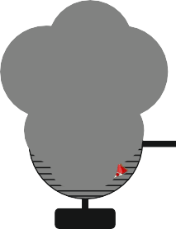
ARCHITECTURAL PLANS - SAMPLE KEY FOR FURNITURE / FITTINGS / GARDEN
WORLD ASSOCIATION OF TECHNOLOGY TEACHERS https://www.facebook.com/groups/254963448192823/
technologystudent.com © 2024 V.Ryan © 2024
DOUBLE DOOR
COMPUTER DESK AND CHAIR
BAR STOOL
BICYCLE AND STAND
BARBEQUE
SLIDING DOOR
SINGLE DOOR
ELECTRIC CHARGING POINT
SUN BED
OUTDOOR TABLE AND CHAIRS
DINING TABLE AND CHAIRS
WINDOW
GRAND PIANO
OUTDOOR UMBRELLA
SINK
WC
STANDARD BATH
PATIO / PAVING SLABS
ELECTRIC PIANO
SHOWER
BOOKCASE
TV
LOUNGE CHAIR
COFFEE TABLE
KITCHEN SINK UNIT
GRASS AREA WITH CURB
TWO SEATER SETTEE
LAMP STAND / TABLE LAMP
PLANT POT
WASHING MACINE
ELECTRIC KETTLE

Slide 8
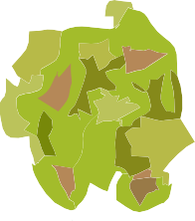
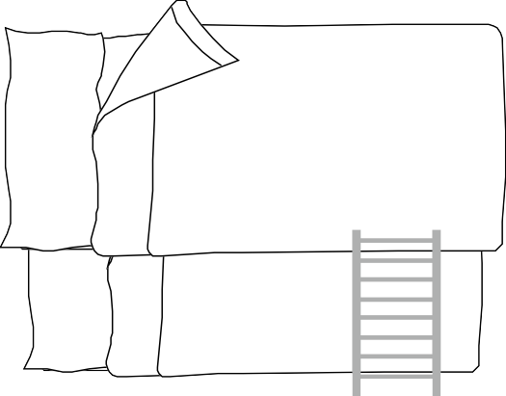
ARCHITECTURAL PLANS - SAMPLE KEY FOR FURNITURE / FITTINGS / GARDEN
WORLD ASSOCIATION OF TECHNOLOGY TEACHERS https://www.facebook.com/groups/254963448192823/
technologystudent.com © 2024 V.Ryan © 2024
PLANTS
ROLLER GARAGE DOOR
BI-FOLDING DOOR
BUSH
DAFODIL
COOKER
KITCHEN
ACCORDION / PARTITION DOOR
SINGLE STOREY STAIRS
WINDER STAIRS
SPIRAL STAIRCASE
CROCUS
IRIS
CORNER SETTEE
ROSE
TULIP
SINGLE BED
DOUBLE BED
BUNK BEDS
DESK LAMP
POND WITH BRIDGE
WOOD STOVE
DOUBLE STORAGE UNIT

Slide 9
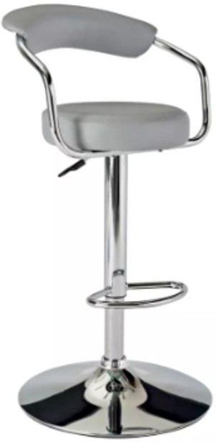
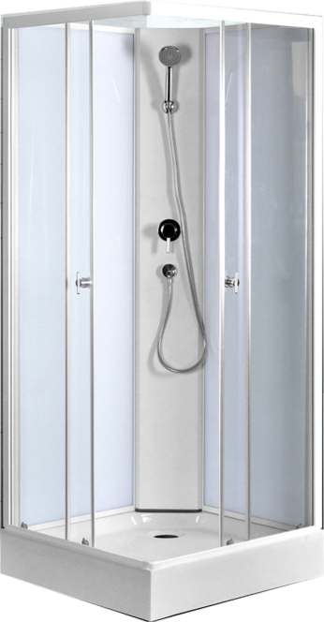
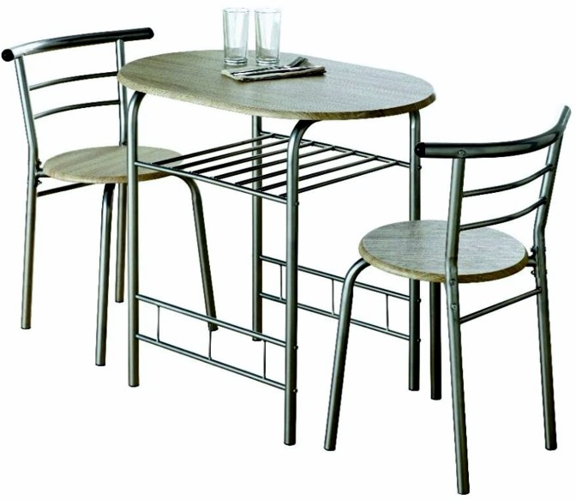
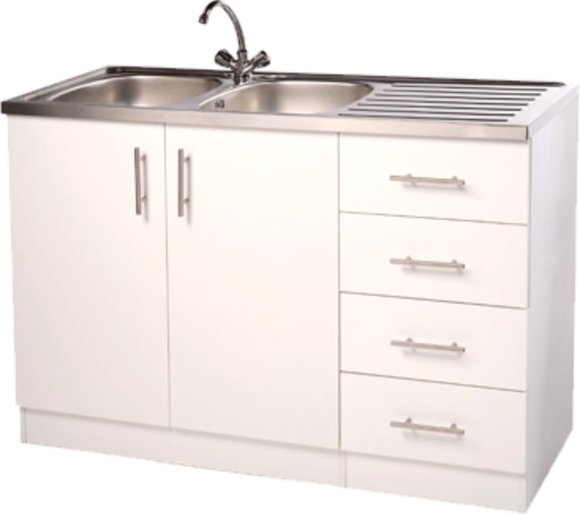
DESIGNING YOUR OWN KEY FOR AN ARCHITECTURAL LAYOUT
BREAKFAST BAR STOOL ^{V. Ryan} | © 2024
TABLE AND CHAIRS
TABLE LAMP
WORLD ASSOCIATION OF TECHNOLOGY TEACHERS https://www.facebook.com/groups/254963448192823/
technologystudent.com © 2024 V.Ryan © 2024
Study the furniture and ﬁttings below. Along side each one, draw a simpliﬁed plan view (architectural view), of your own design. Remember to keep your designs simple, although you could add minor detail. One example has been drawn for you.
_{SHOWER} V. Ryan | © 2024
KITCHEN SINK UNIT
ELECTRIC CHARGING POINT

Slide 10
SHEET 1
ARCHITECTURAL PLANS - GROUND FLOOR / FIRST FLOOR
WORLD ASSOCIATION OF TECHNOLOGY TEACHERS https://www.facebook.com/groups/254963448192823/
technologystudent.com © 2024 V.Ryan © 2024
HELPFUL LINK
HELPFUL LINK: https://technologystudent.com/despro2/architec4.html
YOUR DESIGN / LAYOUT
KITCHEN
LOUNGE
GARAGE
HALL
DINING
ROOM

Slide 11
SHEET 2
ARCHITECTURAL PLANS - UPSTAIRS / SECOND FLOOR
WORLD ASSOCIATION OF TECHNOLOGY TEACHERS https://www.facebook.com/groups/254963448192823/
technologystudent.com © 2024 V.Ryan © 2024
HELPFUL LINK
HELPFUL LINK: https://technologystudent.com/despro2/architec4.html
YOUR DESIGN / LAYOUT
BEDROOM
BATHROOM
MASTER
BEDROOM
HALL
BEDROOM

Slide 12
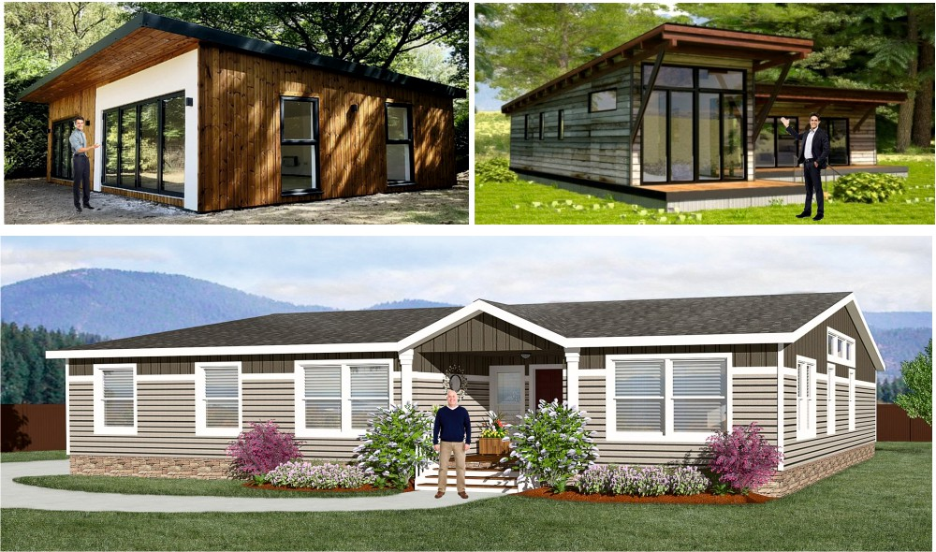
ARCHITECTURAL PICTORIAL VIEW - MODULAR, AFFORDABLE HOUSING
You are to design a small modular home, suitable for two people. It can be regarded as a ‘starter home’, the ﬁrst aﬀordable home that a typical person / couple purchases. Your design must be open plan, with potential use of partitions to isolate areas of ﬂoor space (for example, the sleeping area). Your ‘home’ should have all the essential ﬁxtures and ﬁttings. The building must be constructed sustainably and be environmentally friendly. A parking space and a garden / area of relaxation, are also essential.
EXAMPLES

Slide 13
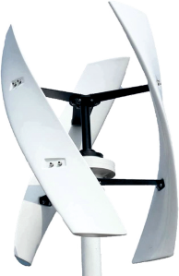
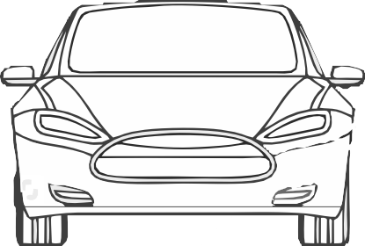
ARCHITECTURAL PICTORIAL VIEW - MODULAR, AFFORDABLE HOUSING
WORLD ASSOCIATION OF TECHNOLOGY TEACHERS https://www.facebook.com/groups/254963448192823/
technologystudent.com © 2024 V.Ryan © 2024
HELPFUL LINK
HELPFUL LINK: https://technologystudent.com/despro2/architec5.html
SAMPLE
THE BUILDING IS SOUTH FACING (NORTHERN HEMISPHERE) TO TAKE ADVANTAGE OF HEAT FROM THE SUN.
THE HOUSE AND SURROUNDING GARDENS ARE CONSTRUCTED ON AN EXISTING ‘BROWN-FIELD’ SITE.
THE BUILDING MATERIALS ALL PASS UP TO DATE SUSTAINABILLITY RATINGS.
THE HOUSE HAS SUPER FAST INTERNET AND SATELLITE COMMUNICATIONS.
A ROOF GARDEN HAS BEEN ADDED FOR AESTHETIC AND ENVIRONMENTAL REASONS. IT ADDS NATURAL ROOF-TOP INSULATION.
AIR CONDITIONING / HEATING SYSTEM / EV VEHICLES ARE SOLAR POWERED,
AN INTERNAL SPIRAL STAIRCASE ALLOWS ACCESS TO THE ROOF.
BACKED UP BY WIND
THE ROOF TOP SPACE OFFERS A LEISURE AND RELAXATION AREA.
RECYCLED AND RECONDITIONED TIMBER CLADDING.
POWER.
V.Ryan © 2023
ALL LED SECURITY LIGHTS ARE SOLAR POWERED, SAVING ENERGY.
EV CHARGER FOR ELECTRIC VEHICLES
SELF
ALL DOOR AND
THE WINDOWS ARE DESIGNED TO RETAIN HEAT WITHIN THE HOUSE IN WINTER.
THEY CAN BE ADJUSTED ELECTRONICALLY, SO THAT DIRECT HEAT FROM THE SUN IS REFLECTED AWAY, HELPING TO KEEP THE HOUSE COOL IN THE SUMMER.
KNOWN AS LOW- EMISSIVITY (LOW-E) WINDOWS.
CLEANING
WINDOW LOCKS
GLASS.
ARE
CONTROLLED BY
A SECURE
V.Ryan © 2024
PERSONALISED
MOBILE APP.
PERMEABLE TARMAC MEMBRANE MATERIAL ALLOWS RAIN WATER TO SOAK THROUGH, REDUCING RAIN RUN OFF.
ALL FLOWER BEDS AND GARDEN PLANTS REQUIRE NO ADDITIONAL WATERING.

Slide 14
YOUR ARCHITECTURAL PICTORIAL VIEW - MODULAR, AFFORDABLE HOUSING
WORLD ASSOCIATION OF TECHNOLOGY TEACHERS https://www.facebook.com/groups/254963448192823/
technologystudent.com © 2024 V.Ryan © 2024
HELPFUL LINK: https://technologystudent.com/despro2/architec5.html
HELPFUL LINK
AN ARCHITECTURAL PICTORIAL VIEW, IS A ‘REALISTIC’ DRAWING OF A BUILDING. IT INCLUDES COLOUR, SHADE, IMAGES OF PEOPLE AND DETAIL. THIS TYPE OF DRAWING IS USED EARLY IN THE DESIGN PROCESS, AS AN INDICATION OF THE DESIGN TO BE DEVELOPED. IT IS VIEWED AND DISCUSSED BY THE ARCHITECT AND CLIENT. ALTERATIONS ARE THEN MADE TO THE DESIGN.
YOUR TASK
ON THIS SHEET DRAW AN ARCHITECTURAL PICTORIAL VIEW (A FRONT VIEW) OF A ‘HOME’ OF YOUR DESIGN. ADD NOTES TO EXPLAIN DIFFERENT ASPECTS OF THE BUILDING.

Slide 15
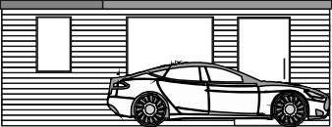
ARCHITECTURAL PLANS - LOW COST, OPEN PLAN, MODULAR AFFORDABLE HOUSING
PLAN VIEW
WORLD ASSOCIATION OF TECHNOLOGY TEACHERS https://www.facebook.com/groups/254963448192823/
technologystudent.com © 2024 V.Ryan © 2024
HELPFUL LINK
HELPFUL LINK: https://technologystudent.com/despro2/architec6.html
Draw the front, side and plan view of your modular house design. You should have a good understanding of orthographic drawing before attempting this. This orthographic drawing has very little shade, typical of architectural outline drawings.
V.Ryan © 2024
V.Ryan © 2024
V.Ryan © 2024
SIDE VIEW
FRONT VIEW

Slide 16
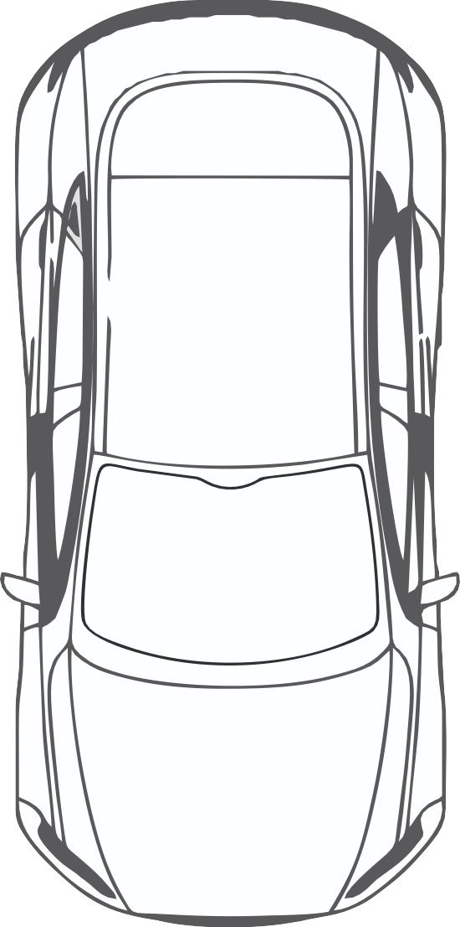
YOUR ARCHITECTURAL PLANS - LOW COST, OPEN PLAN, MODULAR AFFORDABLE HOUSING
WORLD ASSOCIATION OF TECHNOLOGY TEACHERS https://www.facebook.com/groups/254963448192823/
technologystudent.com © 2024 V.Ryan © 2024
YOU ARE TO DESIGN THE LAYOUT TO THE BUILDING, ADDING THE FURNITURE AND ACCESS TO THE ROOF (STAIRCASE).
THINK CAREFULLY ABOUT YOUR DESIGN, AS THERE IS LIMITED SPACE. YOU MAY WISH TO CONSIDER THE USE OF MOBILE PARTITIONS.
SAMPLE
V.Ryan © 2024
HELPFUL LINK: https://technologystudent.com/despro2/architec6.html

Slide 17
YOUR ARCHITECTURAL PLANS - LOW COST, OPEN PLAN, MODULAR AFFORDABLE HOUSING
WORLD ASSOCIATION OF TECHNOLOGY TEACHERS https://www.facebook.com/groups/254963448192823/
technologystudent.com © 2024 V.Ryan © 2024
YOU ARE TO DESIGN THE LAYOUT TO THE BUILDING, ADDING THE FURNITURE AND ACCESS TO THE ROOF (STAIRCASE).
THINK CAREFULLY ABOUT YOUR DESIGN, AS THERE IS LIMITED SPACE. YOU MAY WISH TO CONSIDER THE USE OF MOBILE PARTITIONS.
YOUR FLOOR PLAN
HELPFUL LINK: https://technologystudent.com/despro2/architec6.html

Slide 18
YOUR GARDEN LAYOUT / DESIGN
YOUR GARDEN LAYOUT / DESIGN
WORLD ASSOCIATION OF TECHNOLOGY TEACHERS https://www.facebook.com/groups/254963448192823/
technologystudent.com © 2024 V.Ryan © 2024
WORLD ASSOCIATION OF TECHNOLOGY TEACHERS https://www.facebook.com/groups/254963448192823/
technologystudent.com © 2024 V.Ryan © 2024
HELPFUL LINK: https://technologystudent.com/despro2/architec1.html
HELPFUL LINK: https://technologystudent.com/despro2/architec1.html
1. What are the beneﬁts of a well planned garden? 7 marks
2 Continued
3. Using the internet for research....describe the features of a Japanese Garden.
6 marks
2. Describe the plants, ﬂowers and wildlife you would like to see in a garden of your design. Justify your selection. 8 marks

Slide 19
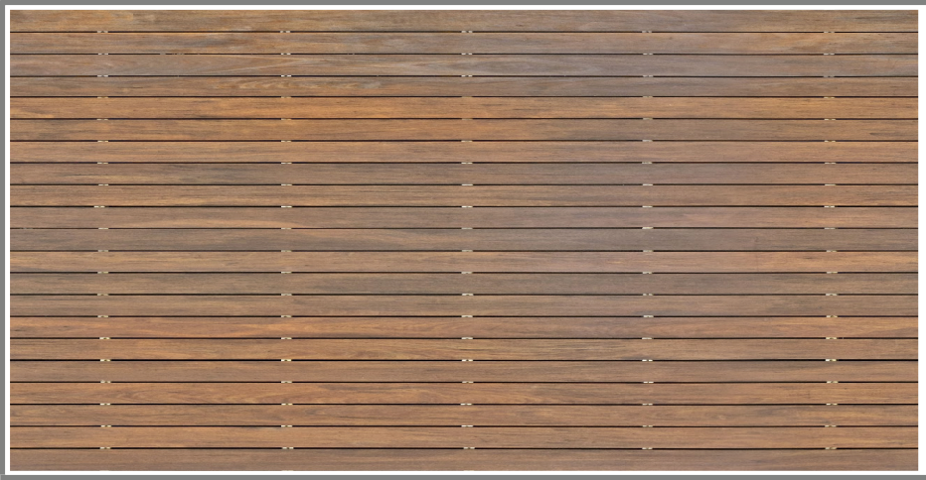
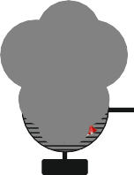
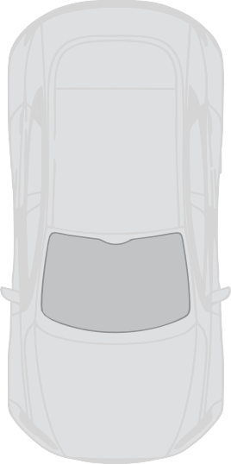
GARDEN LAYOUT / PLAN
WORLD ASSOCIATION OF TECHNOLOGY TEACHERS https://www.facebook.com/groups/254963448192823/
technologystudent.com © 2024 V.Ryan © 2024
HELPFUL LINK:
HELPFUL LINK: https://technologystudent.com/despro2/architec1.html
YOUR GARDEN LAYOUT
KEY
ROSE
IRIS
DAFFODIL
PLANT POT
SHRUBS
ROOF GARDEN LAWN
OUTDOOR TABLE AND CHAIRS
SUN BED
BARBEQUE
POND WITH BRIDGE
V.Ryan © 2024
SUNSHADE AND CHAIRS
TARMAC
PAVED AREA
CURB
BICYCLE AND STAND
V.Ryan © 2024

Slide 20
GARDEN LAYOUT / PLAN
WORLD ASSOCIATION OF TECHNOLOGY TEACHERS https://www.facebook.com/groups/254963448192823/
technologystudent.com © 2024 V.Ryan © 2024
HELPFUL LINK:
HELPFUL LINK: https://technologystudent.com/despro2/architec1.html
YOUR GARDEN LAYOUT
KEY

