Slide 1
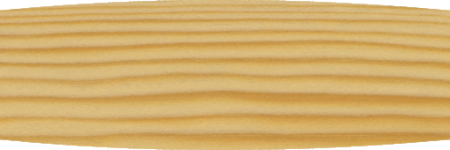
THE MONKEY WRENCH - EXAMINATION QUESTIONS
WORLD ASSOCIATION OF TECHNOLOGY TEACHERS https://www.facebook.com/groups/254963448192823/ www.technologystudent.com © 2024 V.Ryan © 2024
HELPFUL LINK: https://www.technologystudent.com/equip_ﬂsh/monkeyw1.html
1. Complete the diagram of the Monkey Wrench, by adding the missing labels, indicated by the arrows. 9 marks
RYANMATIC
Made in Keighley
2. Describe the history behind the design of the Monkey Wrench and its general use.
6 marks

