Slide 2
THIRD ANGLE ORTHOGRAPHIC DRAWING
WORLD ASSOCIATION OF TECHNOLOGY TEACHERS https://www.facebook.com/groups/254963448192823/
technologystudent.com © 2023
V.Ryan © 2023
HELPFUL LINKS: https://technologystudent.com/despro_flsh/third11.html
THERE IS NO NEED TO DRAW EVERY INDIVIDUAL THREAD OF THE MACHINE SCREW.
See below.
BELOW IS A MACHINE BOLT DRAWN TO ITS EXACT SIZE (SCALE 1:1)
NOTICE HOW THE THREAD OF THE MACHINE BOLT BELOW, HAS BEEN DRAWN. THIS IS THE CORRECT TECHNIQUE AND IT IS EASIER THAN DRAWING EACH INDIVIDUAL THREAD
HELPFUL LINK
V.Ryan © 2022
V.Ryan © 2022
IN THE SPACE BELOW, DRAW THE MACHINE BOLT TO A SCALE OF 2:1

Slide 3
THIRD ANGLE ORTHOGRAPHIC DRAWING
WORLD ASSOCIATION OF TECHNOLOGY TEACHERS https://www.facebook.com/groups/254963448192823/
technologystudent.com © 2023
V.Ryan © 2023
HELPFUL LINKS: https://technologystudent.com/despro_flsh/third11.html
BELOW IS A WOOD SCREW DRAWN TO ITS EXACT SIZE (SCALE 1:1)
HELPFUL LINK
SCALE1:1
V.Ryan © 2022
IN THE SPACE BELOW, DRAW THE WOOD SCREW TO A SCALE OF 2:1
SCALE 2:1

Slide 4
THIRD ANGLE ORTHOGRAPHIC DRAWING - TYPICAL COPING SAW
WORLD ASSOCIATION OF TECHNOLOGY TEACHERS https://www.facebook.com/groups/254963448192823/
technologystudent.com © 2023 V.Ryan © 2023
HELPFUL LINKS: https://technologystudent.com/despro_flsh/third12.html
HELPFUL LINK
COMPLETE THE THIRD ANGLE ORTHOGRAPHIC PROJECTION OF THE COPING SAW. ADD EIGHT
DIMENSIONS ACROSS THE THREE VIEWS. (You ware advised to study and handle a coping saw) Take the measurements / dimensions from the copying saw you have been given to study.
Ryan - Est Keighley 1837
V.Ryan © 2022
PLAN (TOP)
Ryan - Est Keighley 1837
BASE LINE
V.Ryan © 2023
SIDE VIEW
FRONT VIEW
THIRD ANGLE PROJECTION

Slide 5
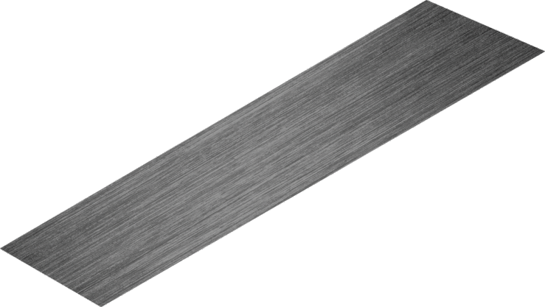
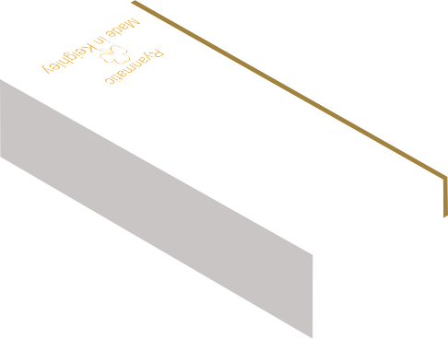
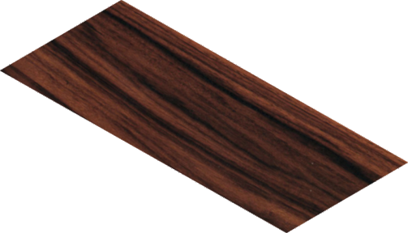
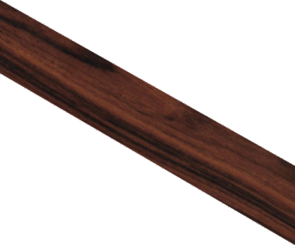
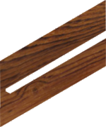
THIRD ANGLE ORTHOGRAPHIC DRAWING - TYPICAL WOODWORKING TRY SQUARE
WORLD ASSOCIATION OF TECHNOLOGY TEACHERS https://www.facebook.com/groups/254963448192823/
technologystudent.com © 2023 V.Ryan © 2023
HELPFUL LINKS: https://technologystudent.com/despro_flsh/third13.html
COMPLETE THE THIRD ANGLE ORTHOGRAPHIC PROJECTION OF THE WOODWORKERS TRY SQUARE. ADD AT LEAST EIGHT DIMENSIONS
(You are advised to study and handle a woodworkers try square)
Take the measurements / dimensions from the try square you have been given to study.
HELPFUL LINK
2
190mm
5
V.Ryan © 2023
50mm
10
25mm
125mm
DIA 8mm
BLADE
STOCK
PLAN VIEW
Ryanmatic
Made in Keighley
BRASS FACE
50mm
3
Ryanmatic
Made in Keighley
BASE LINE
50mm SIDE VIEW
THIRD ANGLE PROJECTION
FRONT VIEW

Slide 6
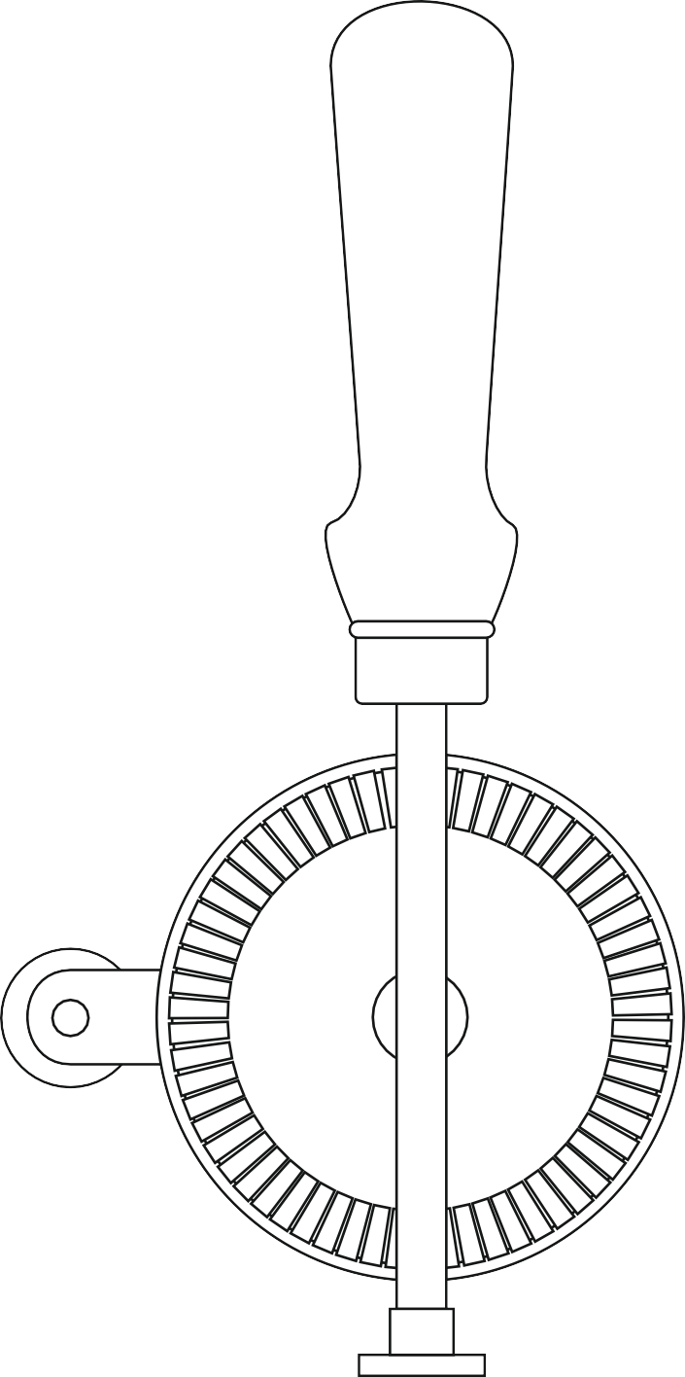
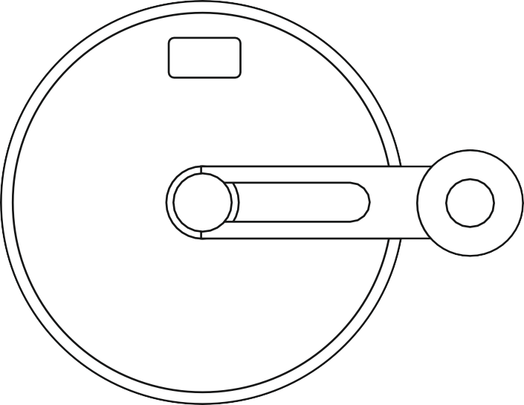
THIRD ANGLE ORTHOGRAPHIC DRAWING - TYPICAL HAND DRILL
WORLD ASSOCIATION OF TECHNOLOGY TEACHERS https://www.facebook.com/groups/254963448192823/
technologystudent.com © 2023 V.Ryan © 2023
HELPFUL LINKS: https://technologystudent.com/despro_flsh/third14.html
HELPFUL LINK
THREE VIEWS OF A TYPICAL HAND DRILL ARE SHOWN BELOW. COMPLETE THE SIDE VIEW BY ADDING THE MISSING PARTS. ADD EIGHT DIMENSIONS, ACROSS ALL THREE VIEWS. SELECT ONE OF THE VIEWS AND APPLY COLOUR AND SHADE.
(You are advised to study and handle a hand drill). Take the measurements / dimensions from the hand drill you have been given to study.
FRONT VIEW BACK VIEW SIDE VIEW
RYAN
Keighley
V.Ryan © 2023
V.Ryan © 2023
V.Ryan © 2023
THIRD ANGLE PROJECTION

Slide 7
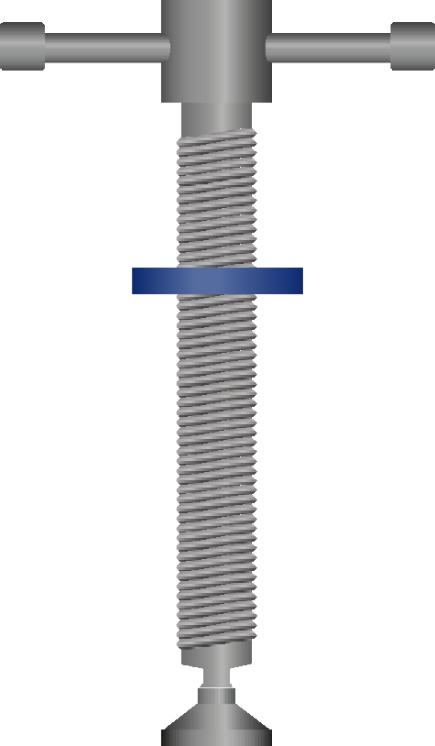
THIRD ANGLE ORTHOGRAPHIC DRAWING - TYPICAL G CRAMP
HELPFUL LINK
WORLD ASSOCIATION OF TECHNOLOGY TEACHERS https://www.facebook.com/groups/254963448192823/
technologystudent.com © 2023 V.Ryan © 2023
HELPFUL LINKS: https://technologystudent.com/despro_flsh/third15.html
THREE VIEWS OF A TYPICAL G GRAMP ARE SHOWN BELOW. COMPLETE THE SIDE VIEW AND PLAN VIEW BY ADDING THE MISSING
PARTS. ADD SIX DIMENSIONS, ACROSS ALL THREE VIEWS. (You are advised to study and handle a G Cramp).
Use the correct drawing technique for the thread. Take the measurements / dimensions from the G Cramp you have been given to study.
COLLAR
TOMMY BAR
PLAN VIEW
RYAN
RYAN
BASE LINE
FRONT VIEW
SIDE VIEW
THIRD ANGLE PROJECTION

