Slide 1
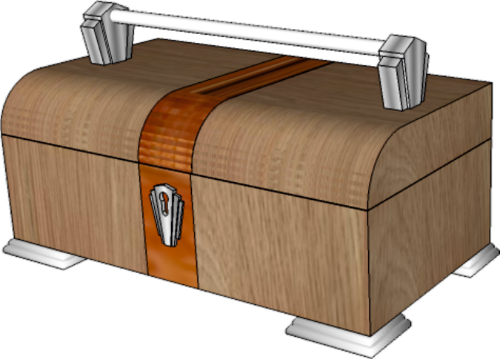
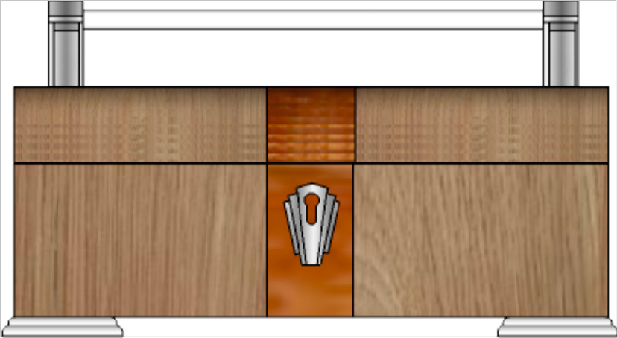
THIRD ANGLE ORTHOGRAPHIC DRAWING
WORLD ASSOCIATION OF TECHNOLOGY TEACHERS https://www.facebook.com/groups/254963448192823/ technologystudent.com © 2023
HELPFUL LINK
V.Ryan © 2023
HELPFUL LINKS: https://technologystudent.com/despro_flsh/third10.html
A 3D drawing of an Art Deco container is seen below.
Draw the plan view, in third angle orthographic projection.
Add four more dimensions, estimate measurements. Some of the guidelines have been drawn already to help you. Add realistic shade / colour.
350 mm
3D DRAWING
150 mm
SCALE 1:2
THIRD ANGLE PROJECTION
PLEASE ESTIMATE ALL MEASUREMENTS
V.Ryan © 2023

