Slide 1
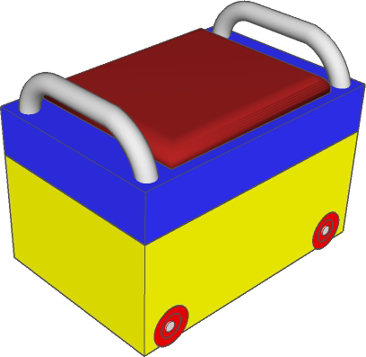
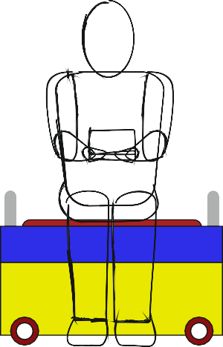
THIRD ANGLE ORTHOGRAPHIC DRAWING
WORLD ASSOCIATION OF TECHNOLOGY TEACHERS https://www.facebook.com/groups/254963448192823/ technologystudent.com © 2023
V.Ryan © 2023
HELPFUL LINKS: https://technologystudent.com/despro_flsh/third10.html
3D DRAWING
SCALE 1:4
THIRD ANGLE PROJECTION
HELPFUL LINK
A 3D drawing of a storage unit is seen opposite.
Draw the side and plan views, in third angle orthographic projection.
Add ﬁve more dimensions, estimate measurements.
PLAN VIEW
500mm
SIDE VIEW
100mm
FRONT VIEW
PLEASE ESTIMATE ALL MEASUREMENTS

