Slide 1
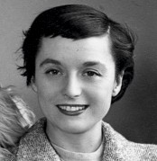
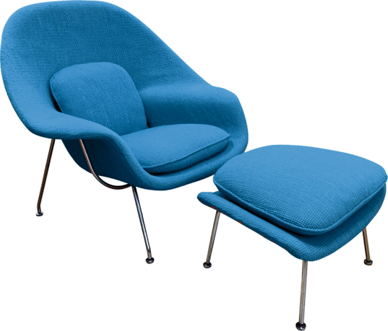
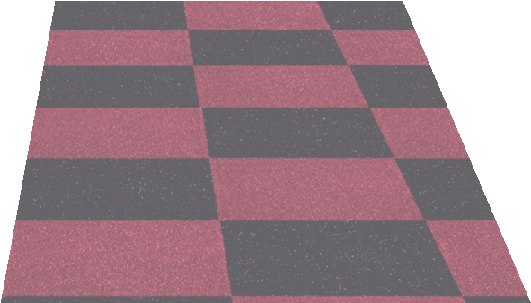
REVISION CARDS - FLORENCE KNOILL
WORLD ASSOCIATION OF TECHNOLOGY TEACHERS https://www.facebook.com/groups/254963448192823/
www.technologystudent.com © 2023 V.Ryan © 2023
LELLA AND MASSIMO VIGNELLI
Florence Knoll (USA) was an architect and product designer, who concentrated on the ‘oﬃce’.
She favoured modernist and functional designs and aimed to make oﬃce work more comfortable and eﬃcient. She worked closely with her husband Hans Knoll. In the 1930s, she studied architecture at Cranbrook Academy of Art and town planning at Columbia University. She was inﬂuenced by Bauhaus design, especially the work of Le Corbusier and Mies van der Rohe. She studied under Mies van der Rohe, at the Illinois Institute of Technology, in the late 1930s.
Knoll Associates furniture design, was inﬂuenced by Florence. She was able to call upon her connections with international designers and some designed furniture for Knoll. She also collaborated with Lella Vignelli.
The Florence Knoll modernist style, became established and popular in post war USA. She is remembered for her collections of designs, “in the style of Florence Knoll”.
She asked Eero Saarinen to design a chair that was like a ‘basket full of pillows’. The iconic Womb Chair was the result. The chair has a ﬁbre glass shell, with chromed steel legs and frame. The small ‘glides’ / ‘feet’ under each leg, are manufactured from stainless steel and allow the chair to be pushed and pulled across the ﬂoor.
WOMB CHAIR, DESIGNED BY EERO SAARINEN, FOR KNOLL
USEFUL LINK SCAN HERE
USEFUL LINK CLICK HERE
Link
1. What style of design did Florence Knoll ‘favour’?
2 marks
2. How did Florence inﬂuence Knoll Associates furniture design?
3 marks
3. Florence Knoll asked Eero Saarinen to design a chair. Name and describe the chair he designed.
3 marks

