Slide 1
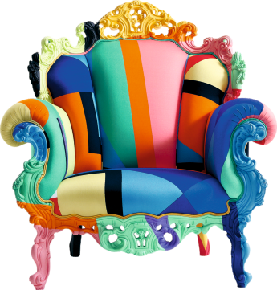
ALESSANDRO MENDINI AND STUDIO ALCHIMIA - REVISION CARDS
WORLD ASSOCIATION OF TECHNOLOGY TEACHERS https://www.facebook.com/groups/254963448192823/
www.technologystudent.com © 2023 V.Ryan © 2023
ALESSANDRO MENDINI
By the 1960s, many designers were becoming disillusioned with the lack of change and progress in architecture and product design.
In 1976, Studio Alchimia was formed by the Italian Architect Alessandro Guerriero. Alessandro Mendini was one of the leading forces, behind the new design movement. The aim was to move away from Modernist design principles to a new style. Studio Alchimia was composed of designers, whose aim was to design and manufacture exhibition pieces, rather than consumer orientated products.
Their products were to be regarded as prototypes / one-oﬀs.
Studio Alchimia products were manufactured from cheap, readily available materials. Their designs included bright colours and decoration, and there was a move away from the symmetry of modernist designs, to asymmetrical characteristics. In many ways, Studio Alchimia was the stepping stone from the Modernist design movement, to the Memphis Group of the 1980s.
The Kandissa Mirror, designed by Mendini, is composed of geometrical shapes, arranged randomly. ‘Eye catching’, vivid colours are also prominent. The Atropo Occasional Table, is another Mendini design. The Proust chair, is a typical colourful Mendini design. A blend of Baroque style and Studio Alchimia.
KANDISSA MIRROR
PROUST CHAIR
USEFUL LINK SCAN HERE
USEFUL LINK CLICK HERE
Link
1. What were the aims of Studio Alchimia ?
4 marks
1. What were the characteristics of Studio Alchimia designs ?
3 marks
3. Name and describe one of Alessandros Mendini’s furniture designs.
3 marks

