Slide 1
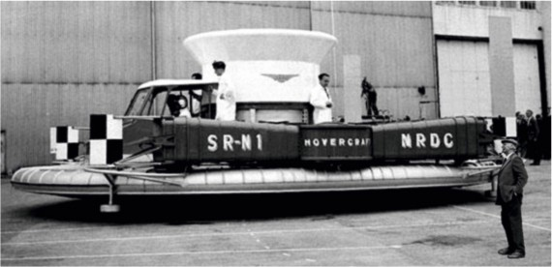
REVISION CARDS - CHRISTOPHER COCKERELL - THE HOVERCRAFT
WORLD ASSOCIATION OF TECHNOLOGY TEACHERS https://www.facebook.com/groups/254963448192823/
www.technologystudent.com © 2023 V.Ryan © 2023
CHRISTOPHER COCKERELL
British inventor Christopher Cockerell carried out experiments during the early 1950s with a device that later became known as the hovercraft.
The basic principle is that a vehicle can rest on a cushion of air and propellers can provide forward motion. He built a prototype in 1955, but the air force claimed it was a ship and the navy claimed it was a plane.
The British Government provided funding and in 1959 a prototype hovercraft was unveiled. A month later the prototype crossed the English Channel, which showed the technical durability of early hovercrafts.
The basic operating principle is as follows; A propeller drives air down a hollow skin. The air inﬂates a rubber skirt with some air escaping through holes to produce a cushion of air underneath the hovercraft. The early prototypes did not have the rubber skirt and this meant they were diﬃcult to direct and they could not get over obstacles greater than ten inches in height.
The SRN4 was the largest passenger hovercraft in the world, capable of carrying over 380 passengers and 40 cars. It was 91 feet wide and 185 feet in length and weighed 300 tons. The propellers were 20 feet in diameter and with its power it could cruise at 70 mph.
It was the fastest ferry in the world.
1950s Prototype
1980s - Military version
USEFUL LINK SCAN HERE
USEFUL LINK CLICK HERE
Link
S R-N1
HOVERCRAFT
N R D C
V.Ryan © 2022
V.Ryan © 2022
1. Who was Christopher Cockerell?
2 mark
2. Name and describe the largest hovercraft in the world.
3 marks
3. Explain the basic operating principles behind the hovercraft? 4 marks

