Slide 1
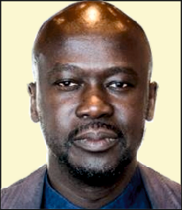
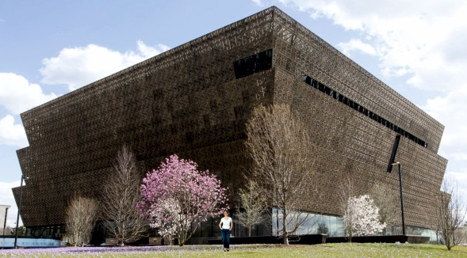
REVISION CARDS - SIR DAVID ADJAYE
WORLD ASSOCIATION OF TECHNOLOGY TEACHERS https://www.facebook.com/groups/254963448192823/
www.technologystudent.com © 2023 V.Ryan © 2023
DAVID ADJAYE
Sir David Adjaye is a Ghanaian, British architect, one the leading architects of his generation. Born in Dar es Salaam, Tanzania, in1966.
He achieved a Bachelor of Architecture degree from the South Bank University, London in 1990, followed by a Master of Architecture degree in 1993, awarded by the Royal College of Art.
He has a reputation for combining imaginative use of materials, innovative use of light and inspired designs, with cultural / historical reference.
He has a reputation for combining an imaginative use of materials, innovative use of light and inspired designs, with cultural / historical reference.
He is an internationally recognised architect, with architectural work spanning several continents. These include; Ruby City Museum in San Antonio, 130 William, in Manhattan, New York, USA and National Museum of African American History and Culture in Washington D.C.
In 2007, Adjaye was awarded an OBE for services to architecture and in 2017 he was Knighted. He became the RIBA Royal Gold Medal winner in 2021, which is recognised as the UK’s most prodigious award for architecture.
NATIONAL MUSEUM OF AFRICAN AMERICAN HISTORY AND CULTURE WASHINGTON D.C.
A Smithsonian museum dedicated to African American life, history, and culture. Opened in 2016, costing ﬁve hundred million dollars. The outer bronze coated decorative framework, represents the iron lattice work of slaves.
USEFUL LINK SCAN HERE
USEFUL LINK CLICK HERE
Link
1. Who is David Adjaye and where did he train as an Architect ?
2 marks
2. He has a reputation in the architectural world for.......?
4 marks
3. Name and describe one of his well-known architectural designs.
4 marks

