Slide 1
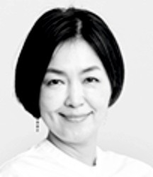
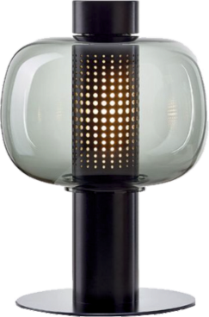
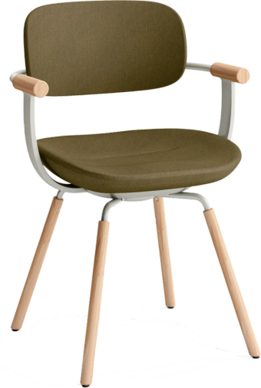
REVISION CARDS - FUMIE SHIBATA
WORLD ASSOCIATION OF TECHNOLOGY TEACHERS https://www.facebook.com/groups/254963448192823/
www.technologystudent.com © 2023 V.Ryan © 2023
FUMIE SHIBATA
Fumie Shibata graduated from Musashino Art University and went on to work for manufacturers of electrical goods, including the Toshiba Design Centre in 1994.
She is a professor at the same university. Fumie founded ‘Design Studio S’, a studio that focusses on industrial design and a broad spectrum of product design. Fumie is known and respected for her design of electrical goods, health care products and capsule hotels. She draws on traditional Japanese design as an inspiration for many of her designs. She prioritises the environment when designing.
THE BONBORI LAMP
The Bonbori Lamp, was inspired by traditional Japanese lamps, found at shrines and temples. The modern version is manufactured from stainless steel and is ‘powered’ by an LED light.
It emits a soft, warm glow, which shines through the laser cut perforations at its centre. The wiring comes through the base and is unseen.
THE VERTEBRA03
The Vertebra03 is a deceptively simple chair. Its ergonomic design, results in a comfortable and functional chair, suitable for a range of environments, from the oﬃce to home.
The back of the seat can be inclined from 0 to 25 degrees. In addition, the seat slides forward, giving more support and promoting a healthy and restful sitting posture.
USEFUL LINK SCAN HERE
USEFUL LINK CLICK HERE
Link
1. Who is Fumie Shibata and what is her design background ?
2 marks
2. Describe the characteristics of Fumie’s designs ?
3 marks
3. Name and describe one more of her well-known designs.
4 marks

