Slide 1
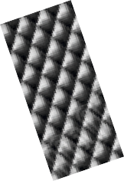
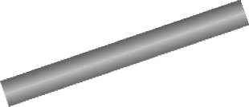
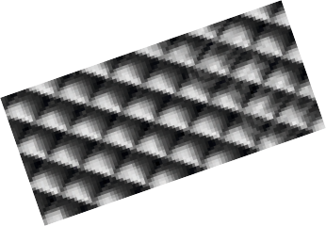
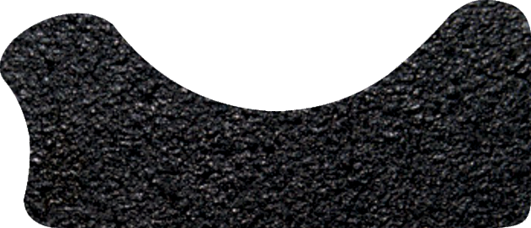
THE SHOULDER PLANE - EXAMINATION QUESTIONS
WORLD ASSOCIATION OF TECHNOLOGY TEACHERS https://www.facebook.com/groups/254963448192823/ www.technologystudent.com © 2024 V.Ryan © 2024
HELPFUL LINK: https://www.technologystudent.com/equip_ﬂsh/shplane1.html
1. Complete the diagram of the Shoulder Plane, by adding the labels as identiﬁed by the arrows. 10 marks
SIDE VIEW
V.Ryan © 2024
RYANMATIC
Made in Keighley
2. What is a shoulder plane and what is its purpose?
6 marks

