Slide 1
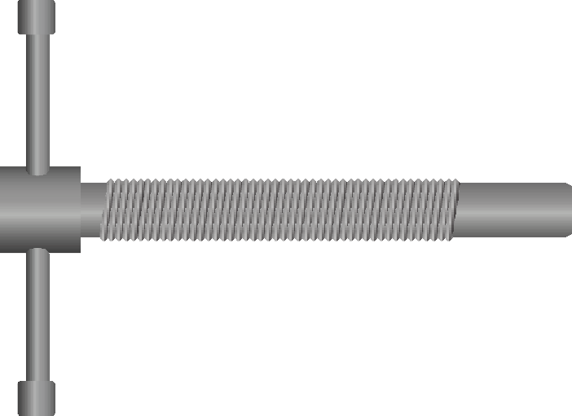
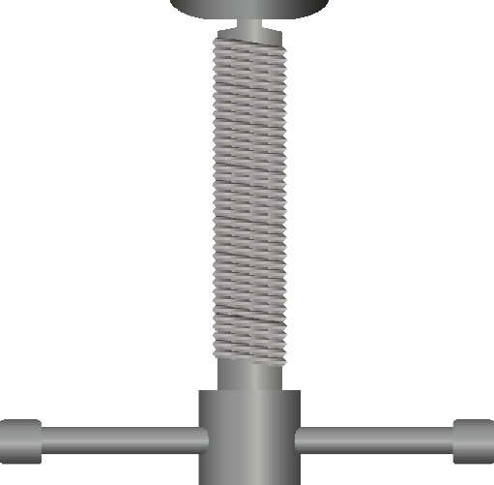
VICE BENCH CLAMP / TABLE VICE - EXAMINATION QUESTIONS
WORLD ASSOCIATION OF TECHNOLOGY TEACHERS https://www.facebook.com/groups/254963448192823/ www.technologystudent.com © 2024 V.Ryan © 2024
HELPFUL LINK: https://www.technologystudent.com/equip_ﬂsh/clampvice1.html
1. Complete the diagram of the Vice Bench Clamp, by adding the labels as identiﬁed by the arrows. 10 marks
RYANMATIC
Made in Keighley
V.Ryan © 2024
2. Describe two typical uses of this type of vice.
4 marks
A:
B:

