Slide 1
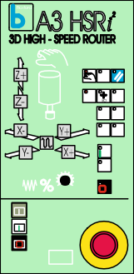
THE BOXFORD A3 HSRI² ROUTER
WORLD ASSOCIATION OF TECHNOLOGY TEACHERS https://www.facebook.com/groups/254963448192823/
www.technologystudent.com © 2020 V.Ryan © 2020
USEFUL LINKS: https://technologystudent.com/cam/cncman1.htm
1. What is the name of the 3D software used to design precise / accurate 3D designs, for the Boxford A3 router? 1 mark
2. List materials, that the Boxford A3 router is designed to machine.
2 marks
3. What is the size of the largest piece of material capable of being machined on the Boxford HSRi² Router. 1 mark
4. A diagram of a Boxford A3 HSRi² Router is drawn below. Name all the identified parts and include a short description of the function of each one. The control panel has been labelled and function described, as an example of the type of labels and descriptions you should add.
8 marks
CONTROL PANEL
THIS ALLOWS MANUAL AND AUTOMATIC CONTROL
By V.Ryan

Slide 2
THE BOXFORD A3 HSRI² ROUTER
WORLD ASSOCIATION OF TECHNOLOGY TEACHERS https://www.facebook.com/groups/254963448192823/
www.technologystudent.com © 2020 V.Ryan © 2020
USEFUL LINKS: https://technologystudent.com/cam/cncman1.htm
5. Describe the type of work/ machining that can be carried out by the Boxford A3 Router. You may wish to describe a project / machining that you have carried out on this CNC machine or a similar one. 3 marks

