Slide 1
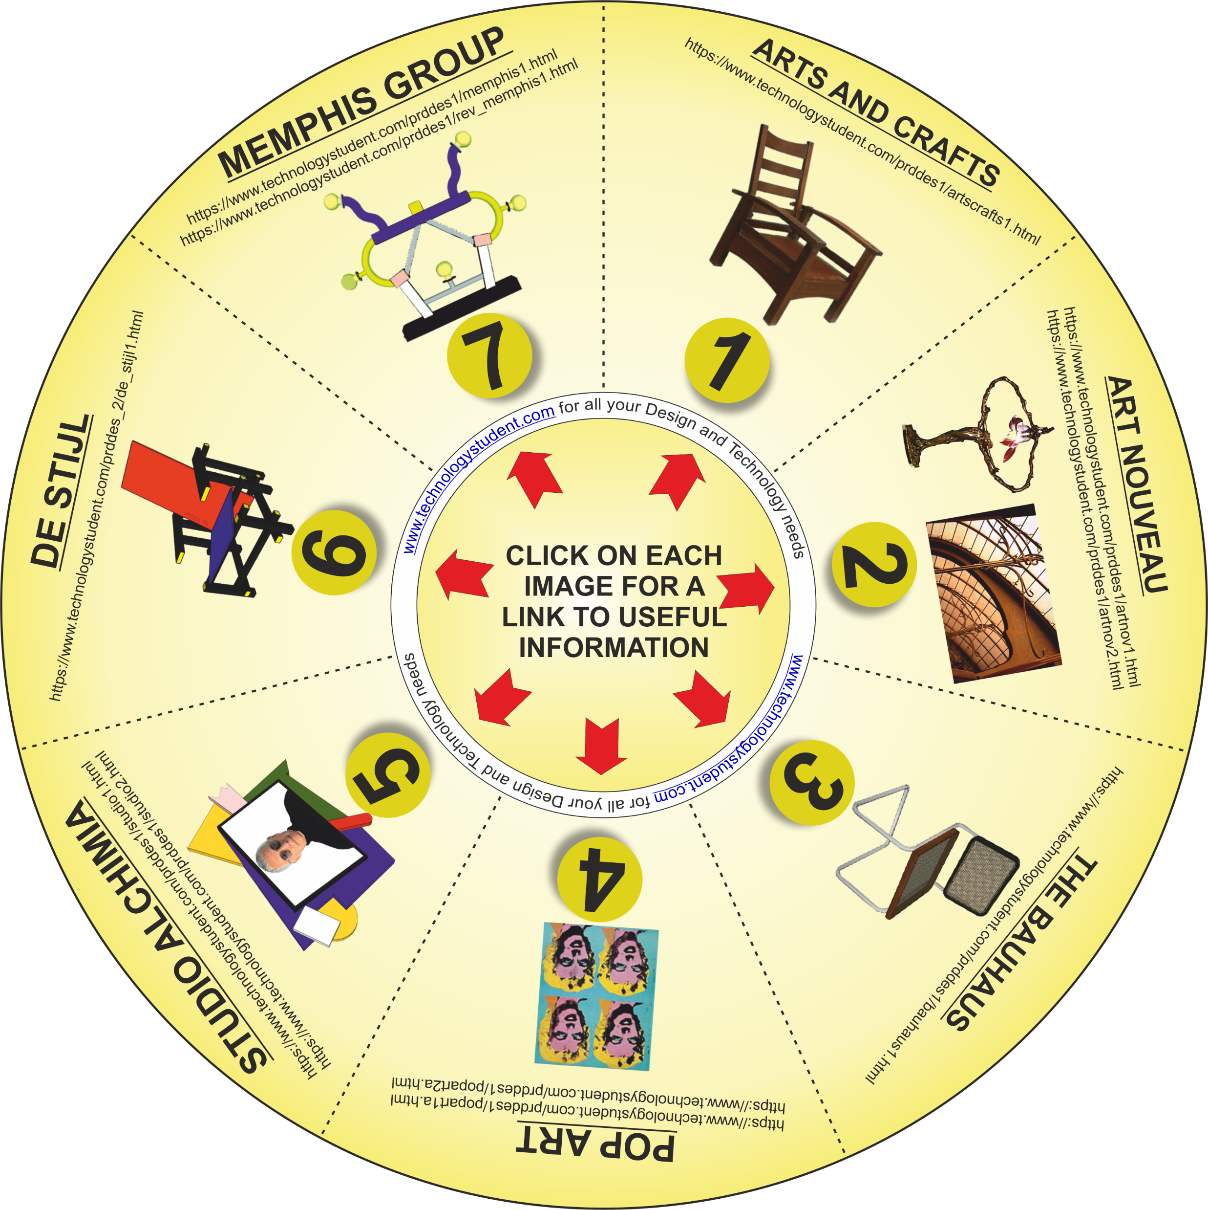
ART MOVEMENTS
‘LEARNING CIRCLE’
The disk includes seven Art Movements.
For each one, write a brief description of the design characteristics of the movement. In addition, identify two designers linked to each Art Movement. (Write your answers on the next two slides).
Click on each symbol, for a link to useful information.
If you click on the circle, you will be able to rotate it, making it easier to read the Art Movement titles.

