Slide 1
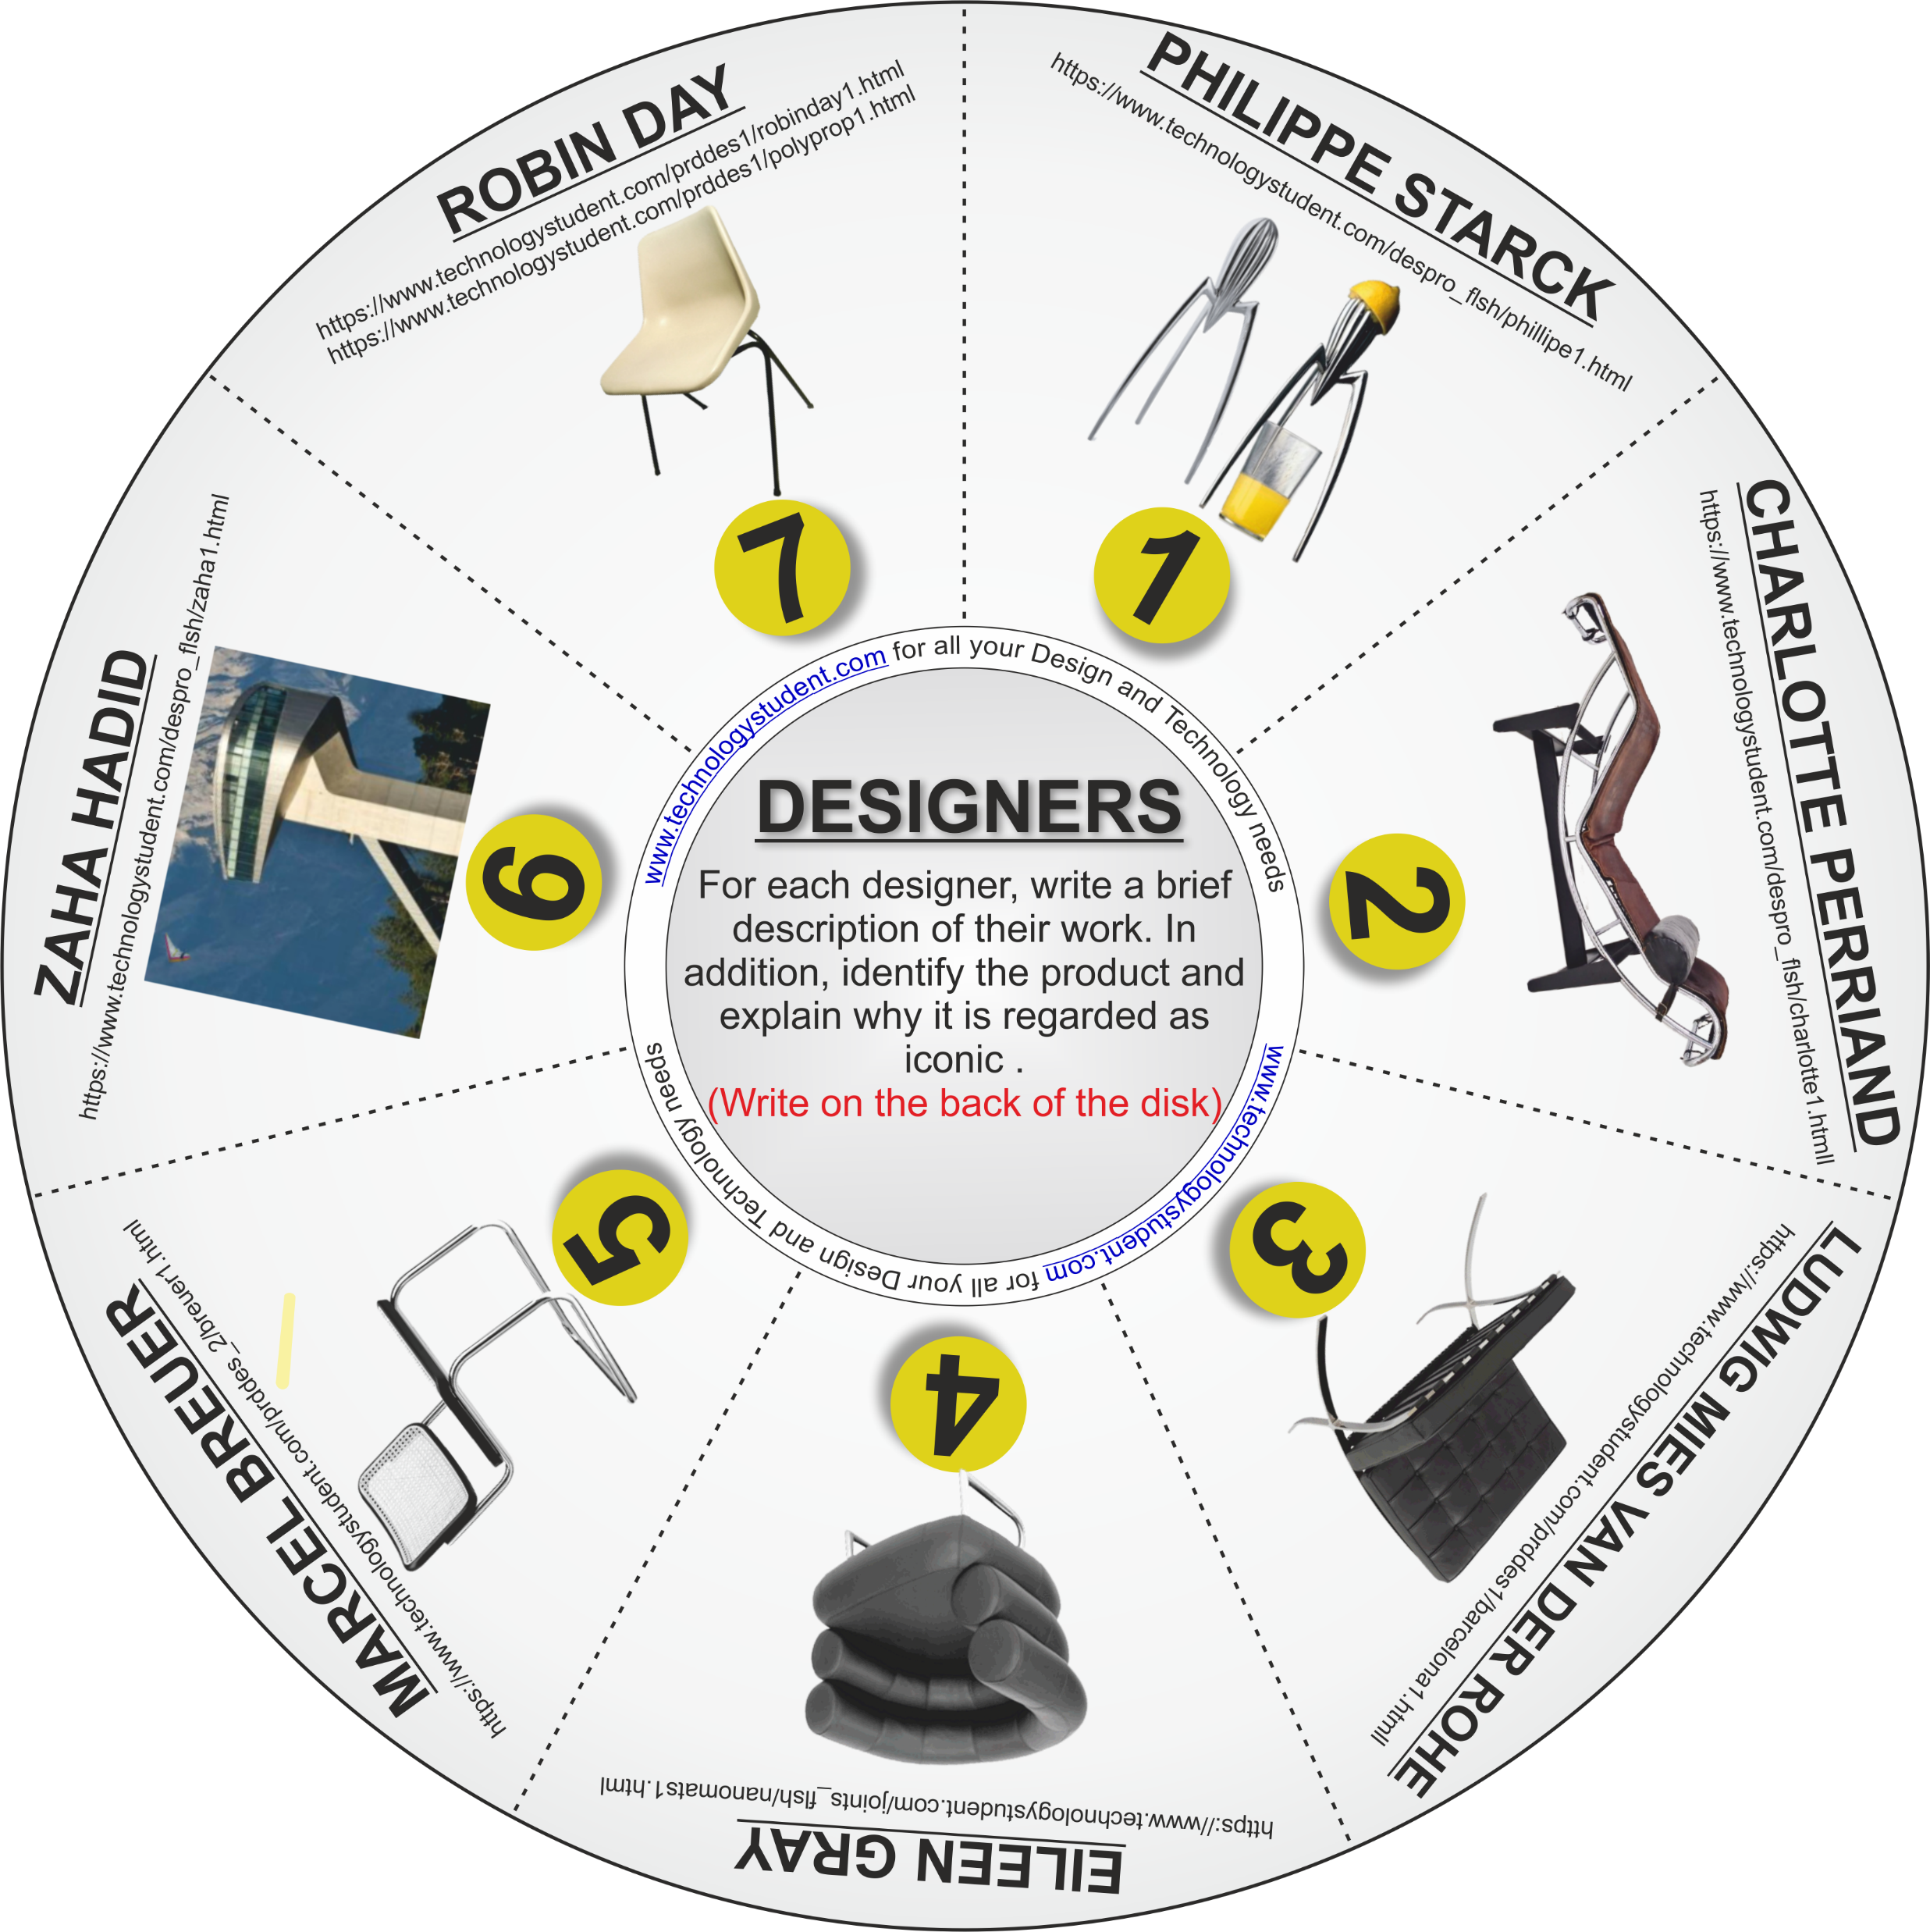
SEVEN INFLUENTIAL DESIGNERS - PART ONE
‘LEARNING CIRCLE’
This disk includes seven influential designers. For each designer, write a brief description of their work. In addition, identify the product and explain why it is regarded as iconic . (Write your answers on the next two slides).
Click on each image, for a link to useful information.
OR Download the ‘Designers’ Interactive Mobile PDF App, from the App section of technolgystudent.com
If you click on the circle, you will be able to rotate it, making it easier to read the Designers names.

