Slide 1
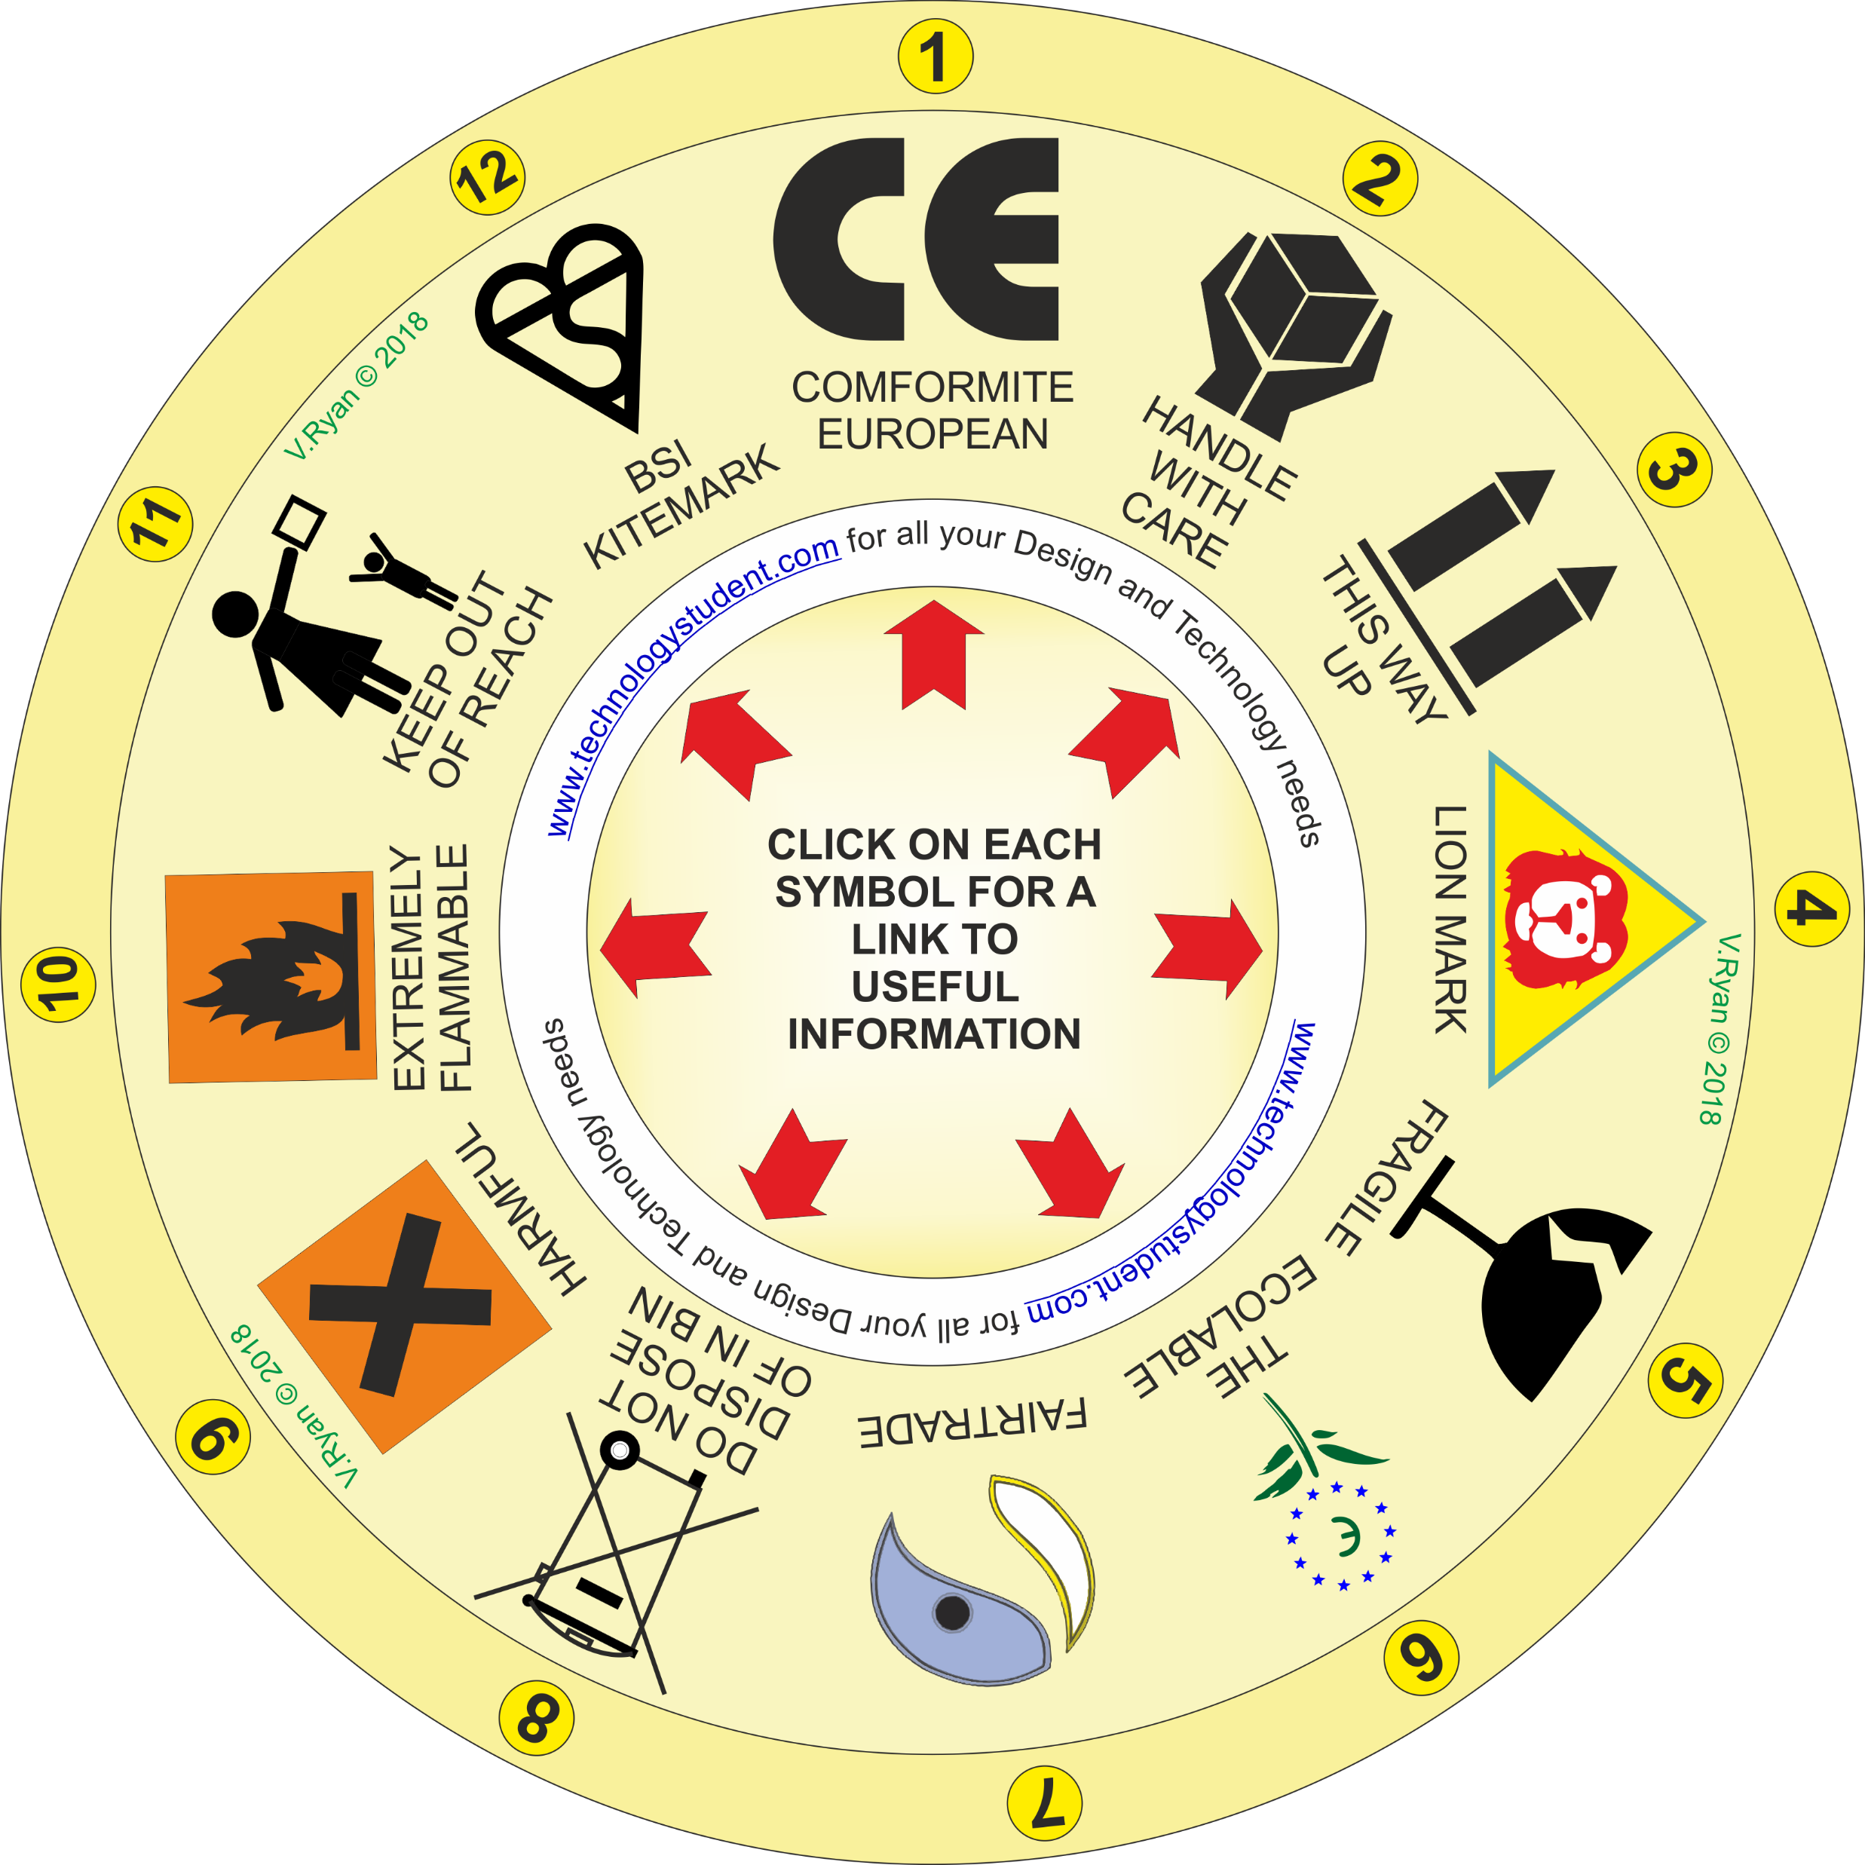
SYMBOLS ‘LEARNING CIRCLE’
This ‘Learning Circle’, includes some important symbols, seen in the outer circle. Each symbol has been numbered.
Describe the meaning of each symbol, on the following slides.
Click on each symbol, for a link to useful information.
OR Download the ‘Packaging Symbols’ Interactive Mobile PDF App, from the App section of https://www.technologystudent.com/
If you click on the circle, you will be able to rotate it, making it easier to read the symbols.

