Slide 1
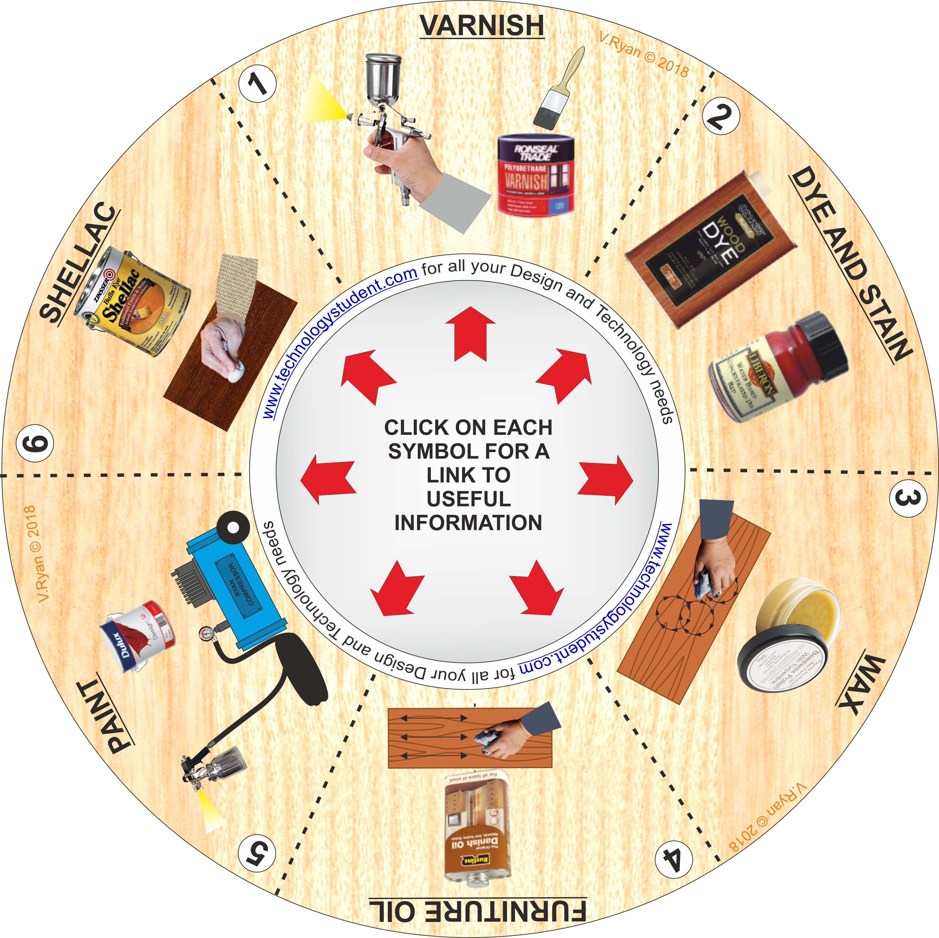
FINISHES FOR WOODS
‘LEARNING CIRCLE’
This ‘Learning Circle’, covers common finishes for woods. Each ‘finish’ has been numbered.
Click on the images, for links to useful information.
Describe each ‘finish and include a practical / real life example.
If you click on the circle, you will be able to rotate it, making it easier to view the images.

