Slide 1
Level 1/Level 2 GCSE (9–1)
DESIGN AND TECHNOLOGY - GCSE SAMPLE PAPER 1
Candidate Name | Centre Number |  |  |  |  | Candidate Number
COMPONENT 1
TIME ALLOWED - 1 hour 45 minutes
EQUIPMENT REQUIRED
Drawing and writing equipment, coloured pencils and a calculator
INSTRUCTIONS
You are to answer all questions.
WORLD ASSOCIATION OF TECHNOLOGY TEACHERS https://www.facebook.com/groups/254963448192823/
www.technologystudent.com © 2018 V.Ryan © 2018
This example examination paper can be duplicated and printed out if required but not edited in any way.
The links to www.technologystudent.com cannot be removed.
The PDF ﬁle can be stored on school / college systems and distributed electronically (NO EDITING ALLOWED)
PLEASE RESPECT THE COPYRIGHT - report infringers to techteacher@technologystudent.com Not be distributed at courses or by course instructors / consultants
WORLD ASSOCIATION OF TECHNOLOGY TEACHERS https://www.facebook.com/groups/254963448192823/
www.technologystudent.com © 2018 V.Ryan © 2018

Slide 2

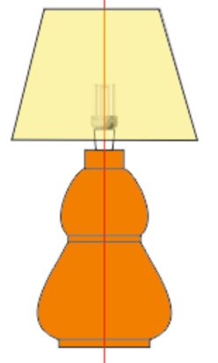
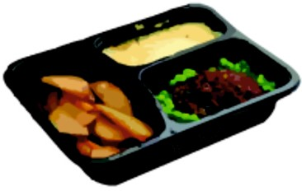
Section A - CORE
Answer all the questions in this section
1a. Materials are selected for the manufacture of products, usually because they exhibit suitable properties.
Complete the table below by adding a description and explain the material’s properties.
The ﬁrst answer has been completed as an example of the layout of the table.
PRODUCT DESCRIPTION PROPERTY
WORLD ASSOCIATION OF TECHNOLOGY T |  | PEWTER CASTING JELLEWERY EACHERS https://www.facebook.com/groups/2549634481928 | Pewter can be cast by at low temperatures, forming detailed shapes. 23/ www.technologystudent.com © 2018 V.Ryan © 2018
 | HELPFUL LINK | http://www.technologystudent.co | m/rmﬂsh1/pine2.html
 |  | PINE WOOD - LAMP | 1 mark
 | HELPFUL LINK | http://www.technologystudent.co | m/joints/pet1.html
 |  | FOOD TRAY POLYETHYLENE TEREPHTHALATE | 1 mark

Slide 3
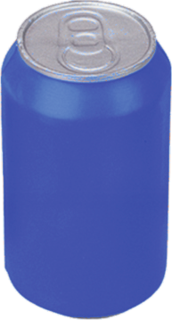

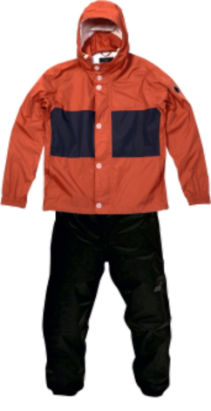
PRODUCT
DESCRIPTION
PROPERTY
 | HELPFUL LINK ht |  | tp://www.technologystudent.co | m/joints/nonferrous1.html
WORLD ASSOCIATION OF TECHNOLOGY |  |  | ALUMINIUM DRINKS CAN TEACHERS https://www.facebook.com/groups/2549634481928 | 1 mark 23/ www.technologystudent.com © 2018 V.Ryan © 2018
 |  | HELPFUL LINK | http://www.technologystudent.c | om/despro2/prneﬀ2.htm
inSIGHT |  |  | POSTER UV VARNISHED QUALITY PAPER | 1 mark
 |  | HELPFUL LINK | http://www.technologystudent.c | om/joints_ﬂsh/nylon1.html
 |  |  | NYLON WATERPROOF CLOTHING | 1 mark

Slide 4
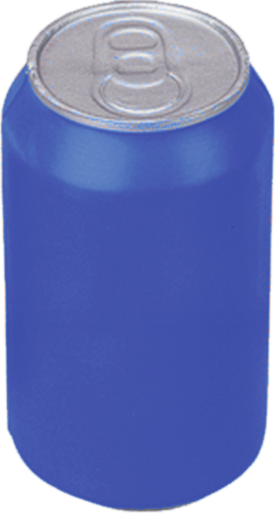
HELPFUL LINK http://www.technologystudent.com/despro_ﬂsh/revise9.html
WORLD ASSOCIATION OF TECHNOLOGY TEACHERS https://www.facebook.com/groups/254963448192823/ www.technologystudent.com © 2018 V.Ryan © 2018
1b. The manufacturer of the can, intend to use a label with thermochromic inks.
LABEL TO BE PLACED HERE
(I) How could thermochromic inks, applied to the label, improve the presentation of the can? 2 marks
HELPFUL LINK http://www.technologystudent.com/prddes1/closeloop1.html
(II) The manufacturers of the aluminium can intend to operate a close loop recycling system. What is this? 2 marks

Slide 5
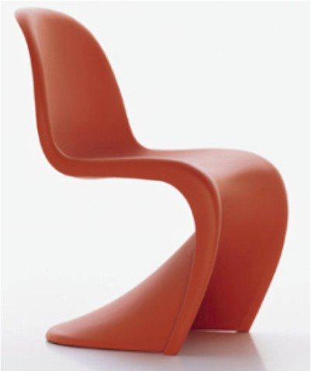
HELPFUL LINK http://www.technologystudent.com/rmﬂsh1/alevq2.html
WORLD ASSOCIATION OF TECHNOLOGY TEACHERS https://www.facebook.com/groups/254963448192823/ www.technologystudent.com © 2018 V.Ryan © 2018
2. The photograph shows a modernist ‘plastic’ chair.
2a. Name a suitable material for the manufacture of this chair? In your answer explain the physical properties that make it suitable. 2 marks
WORLD ASSOCIATION OF TECHNOLOGY TEACHERS
https://www.facebook.com/groups/254963448192823/
www.technologystudent.com © 2017 V.Ryan © 2017
HELPFUL LINK http://www.technologystudent.com/pdf14/maths4.pdf Page 2
2d. A scaled model of the chair has been manufactured and placed in a ‘model’ room. It stands inside the circle shown below. Calculate the area of the circle.
Include your working out and formula. 3 marks
The circle has a radius of 100mm. What is the area of the circle?
Radius 100mm

Slide 6
HELPFUL LINK http://www.technologystudent.com/joints/pet1.html
WORLD ASSOCIATION OF TECHNOLOGY TEACHERS https://www.facebook.com/groups/254963448192823/
www.technologystudent.com © 2018 V.Ryan © 2018
2c. The modernist chair will be supplied with a textile cover manufactured from polyester. List two advantages of using polyester. 2 marks
(i)
(ii)
HELPFUL LINK http://www.technologystudent.com/prddes1/prodline1.html
2d. The chair is to be manufactured on a production line. What is a production line?
2 marks

Slide 7
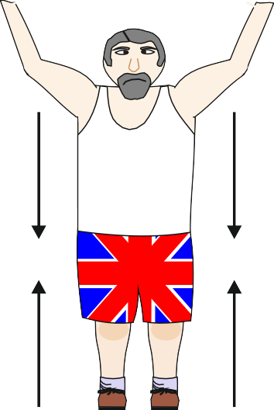
HELPFUL LINK http://www.technologystudent.com/forcmom/force1.htm
WORLD ASSOCIATION OF TECHNOLOGY TEACHERS https://www.facebook.com/groups/254963448192823/
www.technologystudent.com © 2018 V.Ryan © 2018
3a. The diagram below represents a type of force.
(I) Name the force.
1 mark
(I) Describe the force. 1 mark
HELPFUL LINK http://www.technologystudent.com/forcmom/force2.htm
3b. In terms of ‘moments of force, what is a state of equilibrium? 2 marks

Slide 8
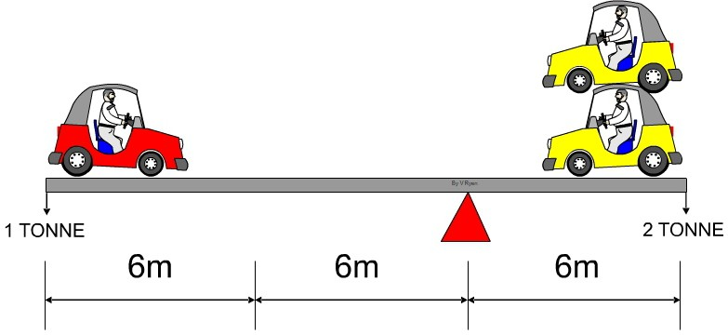
HELPFUL LINK http://www.technologystudent.com/forcmom/force2.htm
3c. The diagram below shows a state of equilibrium. Using the formula below, prove that a state of equilibrium exists. 3 marks
FORMULA: CLOCKWISE MOMENTS = ANTI-CLOCKWISE MOMENTS
WORLD ASSOCIATION OF TECHNOLOGY TEACHERS https://www.facebook.com/groups/254963448192823/
www.technologystudent.com © 2018 V.Ryan © 2018
HELPFUL LINK http://www.technologystudent.com/despro_3/lean2.html
3d. Companies manufacturing cars often work with a system called ‘Lean Manufacturing’. What is Lean Manufacturing? 4 marks

Slide 9


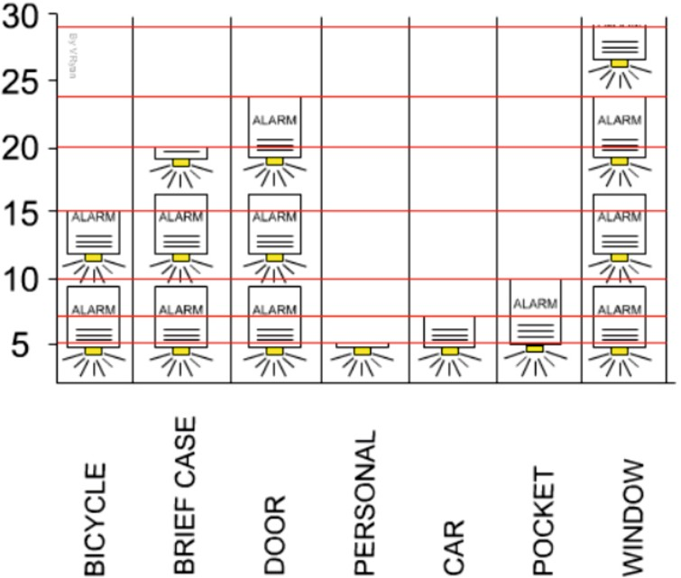
HELPFUL LINK http://www.technologystudent.com/gears1/gears1.htm
4a. The object shown opposite is seen in many mechanical devices. What is its name?
1 mark
WORLD ASSOCIATION OF TECHNOLOGY TEACHERS https://www.facebook.com/groups/254963448192823/
www.technologystudent.com © 2018 V.Ryan © 2018
HELPFUL LINK http://www.technologystudent.com/gears1/gears5.htm
4b. Calculate the Velocity Ratio (Gear Ratio) for the spur gears seen opposite. Include your working out. 4 marks
A
60 TEETH
B
30 TEETH
DRIVEN (LOAD)
DRIVER (EFFORT)
HELPFUL LINK http://www.technologystudent.com/designpro/quest1.htm
4c. Opposite is an example of one way of illustrating a graph.
What is this style of graph called?
1 mark

Slide 10
HELPFUL LINK http://www.technologystudent.com/pdf14/ratios1.pdf Page 12
WORLD ASSOCIATION OF TECHNOLOGY TEACHERS https://www.facebook.com/groups/254963448192823/
www.technologystudent.com © 2018 V.Ryan © 2018
The question is about alternative energy.
4d. A local wind farm produces 4 terawatt hours of electricity over a year. At the same time, a solar farm produced 0.5 terawatt hours of electrical power. What is the ratio - Wind farm : Solar Power ? 3 marks
WIND FARM
4
: SOLAR POWER
: 0.5
EXPLANATION:
HELPFUL LINK http://www.technologystudent.com/energy1/wind8.htm
WORLD ASSOCIATION OF TECHNOLOGY TEACHERS https://www.facebook.com/groups/254963448192823/
www.technologystudent.com © 2017
V.Ryan © 2017
4e. Write three advantages of using wind power to produce electricity.
3 marks

Slide 11
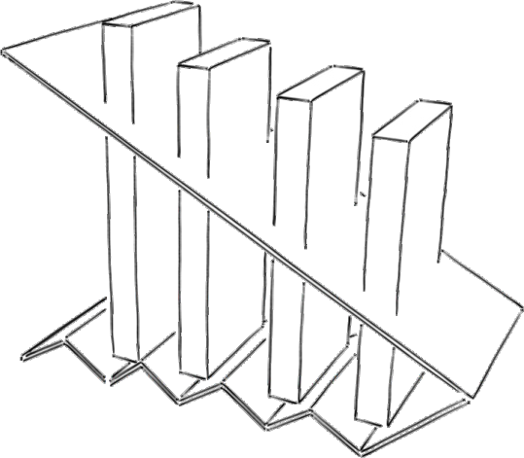
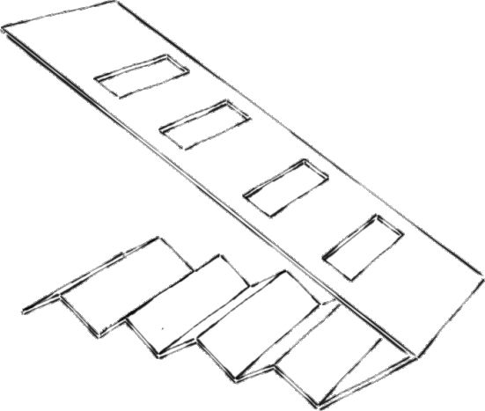
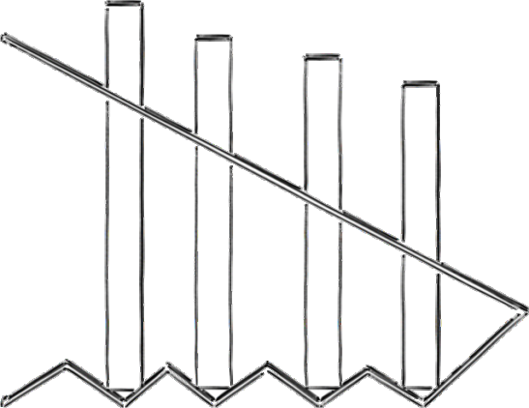
SECTION B – METALS
Answer ALL questions
WORLD ASSOCIATION OF TECHNOLOGY TEACHERS https://www.facebook.com/groups/254963448192823/
www.technologystudent.com © 2018 V.Ryan © 2018
HELPFUL LINK http://www.technologystudent.com/rmﬂsh1/remote16.html
5. The Illustrations show a solution for an aluminium remote control organiser.
CREASES
60mm 55mm
50mm
150mm
200mm

Slide 12
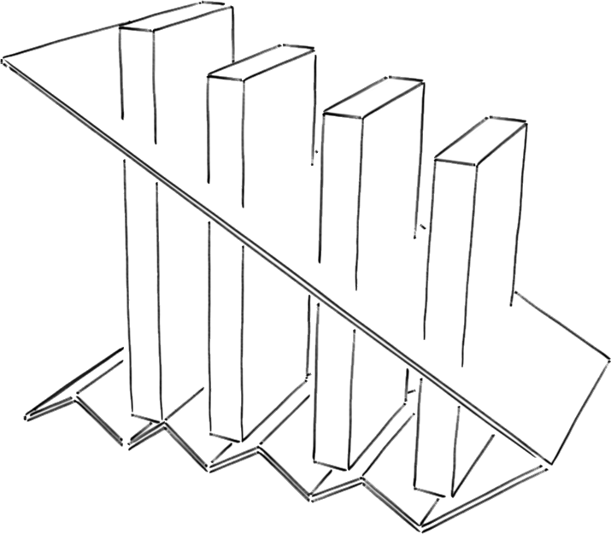
HELPFUL LINK http://www.technologystudent.com/rmﬂsh1/remote16.html
WORLD ASSOCIATION OF TECHNOLOGY TEACHERS https://www.facebook.com/groups/254963448192823/
www.technologystudent.com © 2018 V.Ryan © 2018
5a. The remote control organiser needs to be improved to include the following speciﬁcation points.
The remote controller must:
Have a base that adds stability.
  Be interlockable / stackable with other units of the same design.
(iii) The unit must be easy to pick up, with all the remotes in place.
Use notes and/or sketches to show how the remote control holder could be modiﬁed to satisfy the addition speciﬁcation points, listed above.
Produce clear drawings / sketches, using the outline of the original design to show how a base can be added and the other speciﬁcation points met.
6 marks

Slide 13
_{HELPFUL LINKS} http://www.technologystudent.com/rmﬂsh1/remote16.html http://www.technologystudent.com/joints_ﬂsh/metal2.html
5b. The aluminium remote organiser must be available in a range of durable colours as shown below. This is achieved through an anodised ﬁnish.
SAMPLE ANODISED COLOUR FINISHES
WORLD ASSOCIATION OF TECHNOLOGY TEACHERS https://www.facebook.com/groups/254963448192823/ www.technologystudent.com © 2018 V.Ryan © 2018
In the space below explain / describe the anodising process. 4 marks

Slide 14
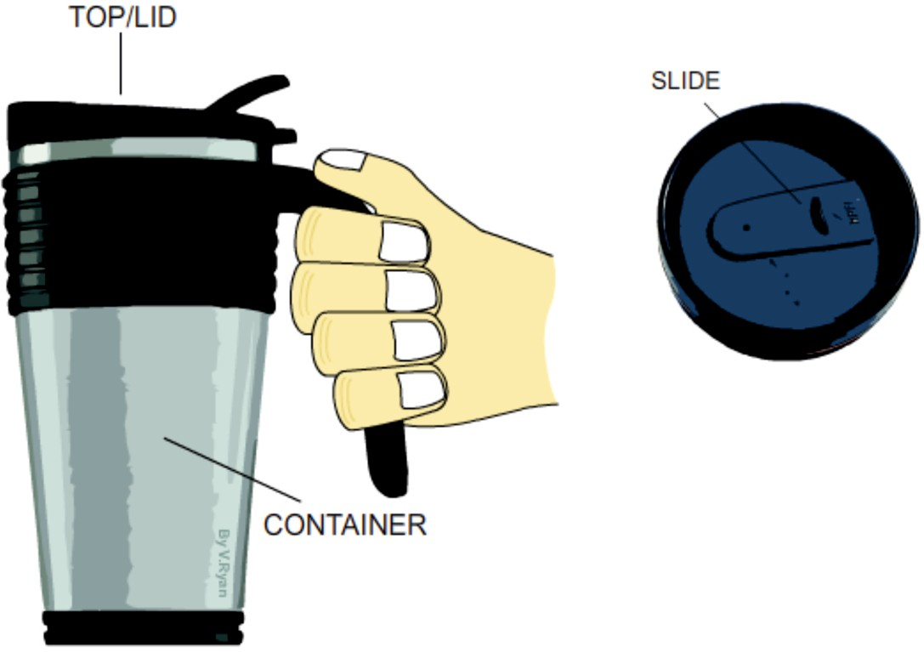
HELPFUL LINK http://www.technologystudent.com/joints/mater2.html
WORLD ASSOCIATION OF TECHNOLOGY TEACHERS https://www.facebook.com/groups/254963448192823/
www.technologystudent.com © 2018 V.Ryan © 2018
6a. Carefully study the ‘Thermo-cup’. This type of cup keeps a hot drink warm for a reasonable amount of time. The lid helps prevent spillage.
The container is manufactured from stainless steel.
Write two reasons why stainless steel is a suitable material for the container.
4 marks
(I)
(II)

Slide 15
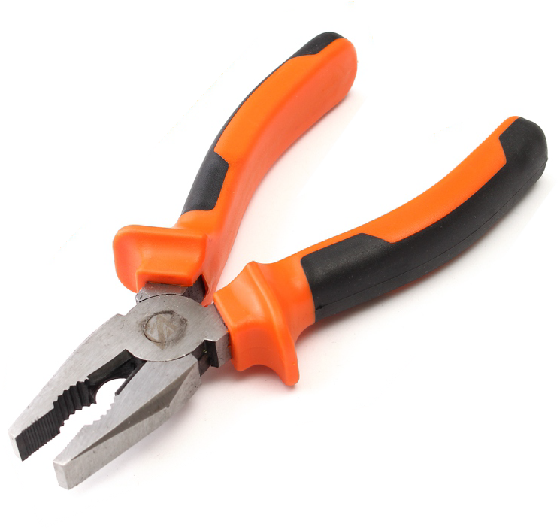
HELPFUL LINK http://www.technologystudent.com/equip1/heat2.htm
WORLD ASSOCIATION OF TECHNOLOGY TEACHERS https://www.facebook.com/groups/254963448192823/
www.technologystudent.com © 2018 V.Ryan © 2018
6b. The pliers seen opposite has case hardened jaws.
Use notes and/or sketches to explain/describe the process of hardening and tempering.
Use clear sketches and notes in your answer.
4 marks

Slide 16
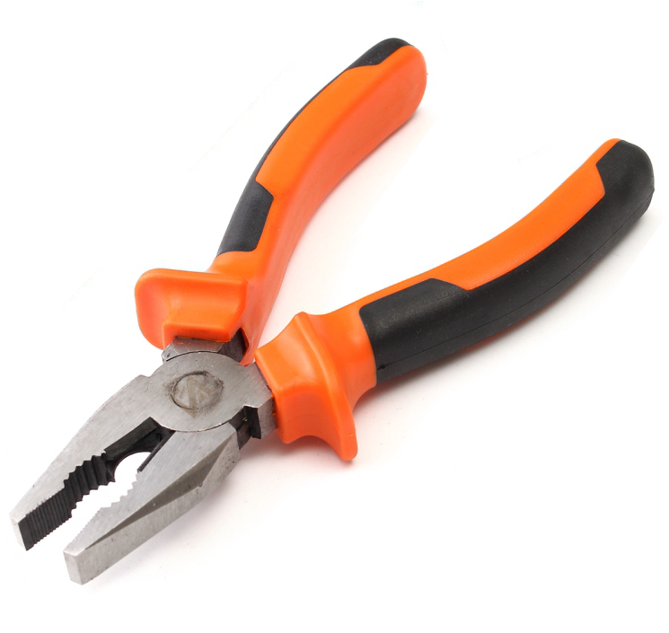
HELPFUL LINK http://www.technologystudent.com/designpro/ergo1.htm
WORLD ASSOCIATION OF TECHNOLOGY TEACHERS
https://www.facebook.com/groups/254963448192823/ www.technologystudent.com © 2018 V.Ryan © 2018
6c. The handles / levers of the pliers have been ergonomically designed to ﬁt the hand, using anthropometric data.
What is anthopometrics ?
2 marks

Slide 17
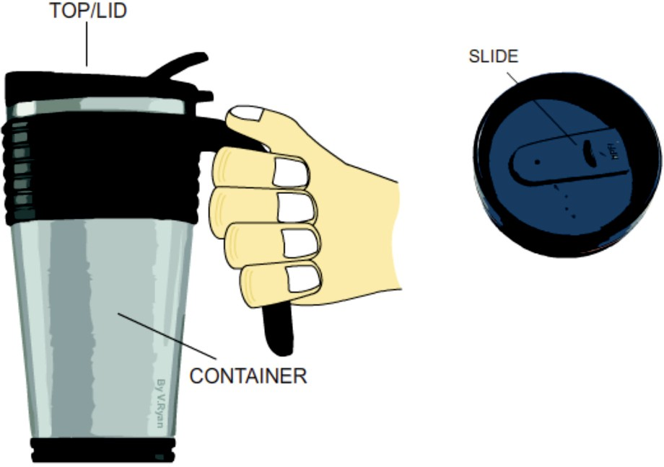
HELPFUL LINK http://www.technologystudent.com/joints/mater2.html
6d. The ‘container’ of the thermo-cup is mass manufactured from stainless steel sheet. In the space below, explain the manufacturing process. Use both notes and sketches. 6 marks
WORLD ASSOCIATION OF TECHNOLOGY TEACHERS https://www.facebook.com/groups/254963448192823/
www.technologystudent.com © 2018 V.Ryan © 2018
The container is manufactured from stainless steel.

Slide 18
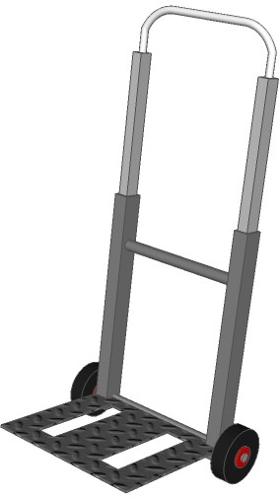
HELPFUL LINK http://www.technologystudent.com/despro_3/metrolly1.html
WORLD ASSOCIATION OF TECHNOLOGY TEACHERS https://www.facebook.com/groups/254963448192823/
www.technologystudent.com © 2018 V.Ryan © 2018
HANDLE (STEEL)
7. The diagram opposite shows a folding trolley. The handle can be adjusted to diﬀerent heights and the steel shelf folds upright.
SIDE (ALUMINIUM)
STRENGTHENING PIECE (STEEL)
SHELF (SHEET STEEL)
7a. Why is tube the most suitable section to be used in the manufacture of the trolley? 4 marks
7b. Why has small diameter of steel rod been used as a strengthening piece?
1 mark

Slide 19
HELPFUL LINK http://www.technologystudent.com/pdf14/maths4.pdf Page 11
WORLD ASSOCIATION OF TECHNOLOGY TEACHERS https://www.facebook.com/groups/254963448192823/
www.technologystudent.com © 2018 V.Ryan © 2018
7c. A student measures the dimensions (measurements) for the ‘round section’ handle of a machine vice, that he intends to manufacture. The student measures the radius of an existing handle and ﬁnds it to be 25mm.
What is the circumference of the handle? What is the area of the end of the handle?
3 marks
2 marks
FORMULA
FORMULA
AREA = πr ²
π (pi) = 3.14
CIRCUMFERENCE = 2 x π x r
π (pi) = 3.14
WORLD ASSOCIATION OF TECHNOLOGY TEACHERS
https://www.facebook.com/groups/254963448192823/
www.technologystudent.com © 2017
V.Ryan © 2017

Slide 20
HELPFUL LINK http://www.technologystudent.com/despro_3/hydaul1.html
WORLD ASSOCIATION OF TECHNOLOGY TEACHERS
HANDLE (STEEL)
https://www.facebook.com/groups/254963448192823/ www.technologystudent.com © 2018 V.Ryan © 2018
An hydraulic press is used to press shapes into sheet steel and also to cut out shapes. This is how the ‘shelf’ has been manufactured.
SIDE (ALUMINIUM)
STRENGTHENING PIECE (STEEL)
7d. The incomplete stages, showing/describing the manufacture of the sheet steel part, are outlined below.
Complete the notes and drawings. Add all the missing parts. 2 marks per stage (6 marks in total)
SHELF (SHEET STEEL)
SHEET STEEL
SHEET STEEL
SHEET STEEL

Slide 21
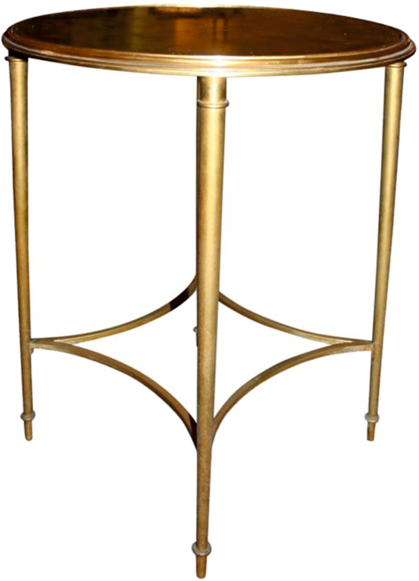
HELPFUL LINK http://www.technologystudent.com/joints_ﬂsh/metal7.html
WORLD ASSOCIATION OF TECHNOLOGY TEACHERS https://www.facebook.com/groups/254963448192823/
www.technologystudent.com © 2018 V.Ryan © 2018
8. The table shown below, has been manufactured from gilded metal and has a lacquered ﬁnish.
8a. Gilded metal is metal, that has been coated with a more precious metal, such as bronze or even silver and gold. Why has clear lacquer been applied as a ﬁnish?
2 marks

Slide 22
HELPFUL LINK http://www.technologystudent.com/joints_ﬂsh/metal8.html
WORLD ASSOCIATION OF TECHNOLOGY TEACHERS https://www.facebook.com/groups/254963448192823/
www.technologystudent.com © 2018 V.Ryan © 2018
8b. The process called ‘electroplating’ has been used to applied a coating of the expensive metal to the cheaper base metal. What is electroplating? Use both notes and a sketch(s) in your answer.
7 marks

Slide 23
HELPFUL LINK http://www.technologystudent.com/joints/ferous1.html
WORLD ASSOCIATION OF TECHNOLOGY TEACHERS https://www.facebook.com/groups/254963448192823/
www.technologystudent.com © 2018
V.Ryan © 2018
8c. Complete the table of ferrous and non-ferrous metals by adding two examples of each. 4 marks
FERROUS METALS - Metals that contain iron.
NON-FERROUS METALS - Metals that do not contain iron.
FERROUS METALS
NON-FERROUS METALS
http://www.technologystudent.com/joints/ferous1.html HELPFUL LINKS http://www.technologystudent.com/joints/fermetal1.html
http://www.technologystudent.com/joints/nonferrous1.html
8d. Either a FERROUS or NON-FERROUS metal from your completed table. Describe a suitable practical application for your chosen metal and explain why each is suitable. Total of 5 marks
METAL:
PRACTICAL APPLICATION:
(1 mark)
WHY SUITABLE:
(4marks)

Slide 24
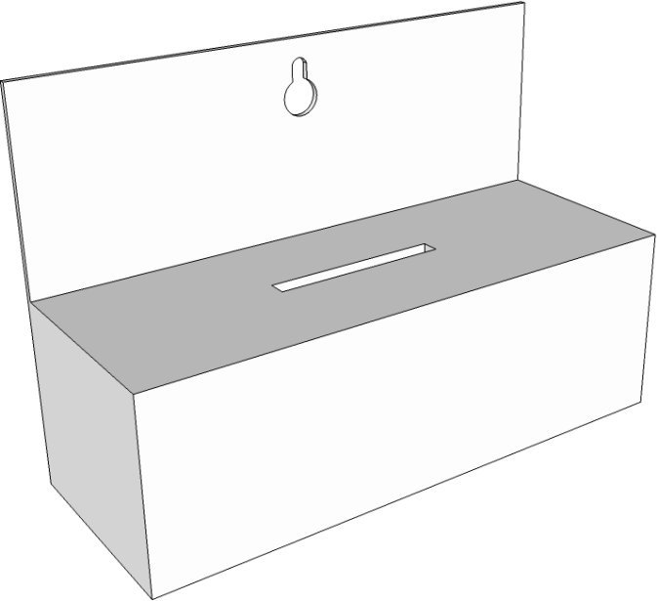

SECTION B – PAPER AND BOARDS
Answer ALL questions
WORLD ASSOCIATION OF TECHNOLOGY TEACHERS https://www.facebook.com/groups/254963448192823/
www.technologystudent.com © 2018 V.Ryan © 2018
5. A design solution for a Charity Collection Box, for a charity called ‘Be Active’ is shown below. The charity aims to promote active life styles to all age groups.
100 % recycleable
Lightweight
Environmentally friendly material.
Materials supplied from a certiﬁed sustainable source.
Supplied in ﬂat sheet form and folded to form the 3D version, when required .
FOLD
FOLD
CUT
CUT
TAB
FOLD
FOLD
TAB
CUT
CUT
FOLD
FOLD
CUT SLOT
CUT SLOT

Slide 25
HELPFUL LINK http://www.technologystudent.com/despro_ﬂsh/graphics_charity.html
WORLD ASSOCIATION OF TECHNOLOGY TEACHERS https://www.facebook.com/groups/254963448192823/
www.technologystudent.com © 2018 V.Ryan © 2018
5a. The charity collection box for the charity ‘Be Active’, needs to be improved to include the following speciﬁcation points.
The charity collection box must:
(I) Have an appealing logo applied to the back, that reﬂects ‘be active’.
(I) Appeal to all age groups.
(iii) The unit must be easy to pick up and must have a simple handle.
Use notes and/or sketches to show how the collection box could be modiﬁed to satisfy the addition speciﬁcation points, listed above
Produce clear drawings / sketches, using the outline of the original design to show how the additional speciﬁcation points can be met.
6 marks
BACK

Slide 26
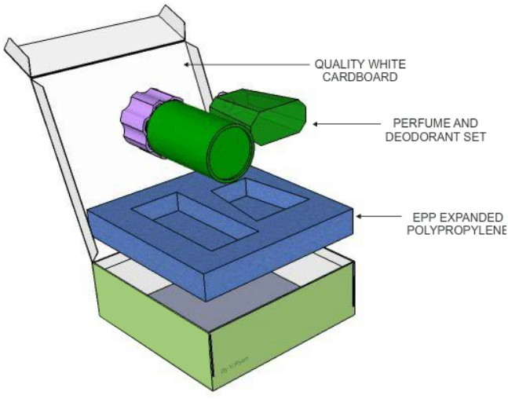
_{HELPFUL LINKS} http://www.technologystudent.com/prddes1/perfpk3.html http://www.technologystudent.com/prddes1/perfpk13.html
WORLD ASSOCIATION OF TECHNOLOGY TEACHERS https://www.facebook.com/groups/254963448192823/ www.technologystudent.com © 2018
5b. The drawing below shows the packaging for perfumed products.
V.Ryan © 2018
Explain why the materials identiﬁed on the diagram, are suitable for the packaging.
4 marks
MATERIAL: EXPLANATION:
MATERIAL:
EXPLANATION:

Slide 27


HELPFUL LINK http://www.technologystudent.com/despro_3/vinylquest1.html
6a. The free car park sign has been produced by the Design and Technology Department of a school, for an Open Evening.
WORLD ASSOCIATION OF TECHNOLOGY TEACHERS https://www.facebook.com/groups/254963448192823/ www.technologystudent.com © 2018 V.Ryan © 2018
Explain why a vinyl cutter is the most appropriate way of cutting the ‘vinyl lettering’.
2 marks
HELPFUL LINK http://www.technologystudent.com/despro_ﬂsh/laminate1.html
6b. Drinks cartons such as those manufactured by Tetra Pak, are manufactured from laminated card. Why is this? 2 marks

Slide 28
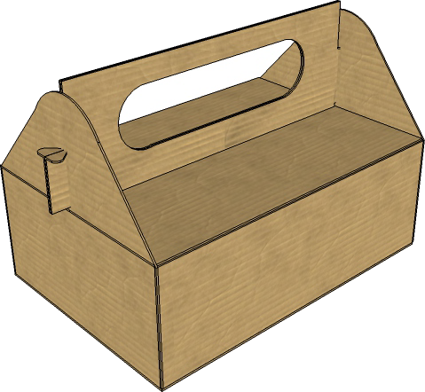


HELPFUL LINK http://www.technologystudent.com/despro_ﬂsh/charity9.html
WORLD ASSOCIATION OF TECHNOLOGY TEACHERS https://www.facebook.com/groups/254963448192823/
www.technologystudent.com © 2018 V.Ryan © 2018
6c. The corrugated card charity collection box shown opposite, is manufactured from recycled card, processed into Corrugated card.
Corrugated board is supplied in diﬀerent thicknesses.
On the diagram below, 4 thicknesses of corrugated card are shown. One has been labelled for you.
Add labels to the other three thicknesses.
3 marks
SINGLE FACE
6d. Corrugated board can be recycled. In the space opposite, draw / sketch the recycling symbol that applies to corrugated board.
1 mark

Slide 29
_{HELPFUL LINKS} http://www.technologystudent.com/grp08/prnt1.html http://www.technologystudent.com/designpro/prtpro5.htm
6e. The graphics / colour and decoration is to be added to the packaging for perfumed products (question 5b). In the space below, name a suitable printing process, draw a labelled diagram to represent the process and add notes that explain the process.
Total of 8 marks
PROCESS NAME:
(1 mark)
LABELLED DIAGRAM
WORLD ASSOCIATION OF TECHNOLOGY TEACHERS https://www.facebook.com/groups/254963448192823/
www.technologystudent.com © 2018 V.Ryan © 2018
(4 marks)
NOTES: (3 marks)

Slide 30
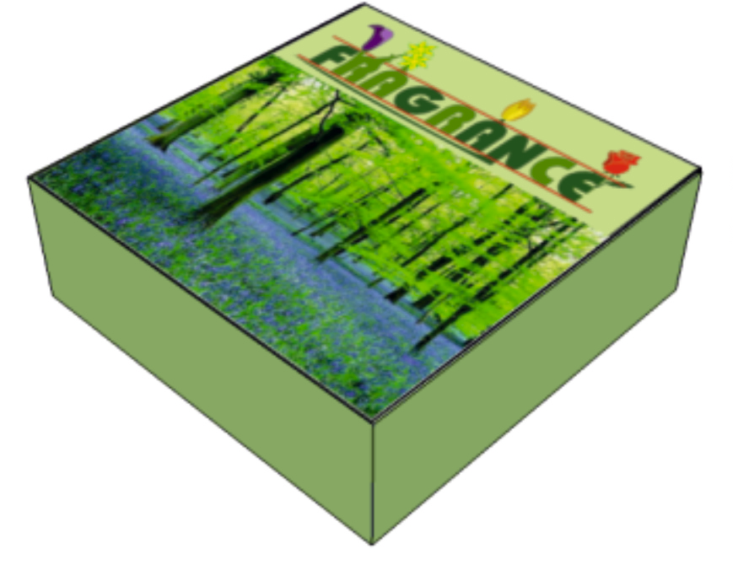
HELPFUL LINK http://www.technologystudent.com/despro_ﬂsh/foilblk1.html
6f. The design team working on the packaging for a perfumed product, have decided to add the name of the product (in gold / silver lettering) through ‘Foil Blocking’. In the space below, explain the foil blocking process. Use notes and sketches in your answer.
Total of 5 marks
WORLD ASSOCIATION OF TECHNOLOGY TEACHERS https://www.facebook.com/groups/254963448192823/
www.technologystudent.com © 2018 V.Ryan © 2018
LETTERING TO BE FOIL BLOCKED
LABELLED SKETCH ( 3 marks)
NOTES (2 marks):

Slide 31
HELPFUL LINK http://www.technologystudent.com/pdf14/maths3.pdf Page 6
WORLD ASSOCIATION OF TECHNOLOGY TEACHERS https://www.facebook.com/groups/254963448192823/
www.technologystudent.com © 2018 V.Ryan © 2018
A new lid has been designed for the packaging (see below). The packaging has been redesigned to suit this shape.
7a. Calculate the area of the material required for the lid, before it is cut to shape (the overall rectangle of material required, before it is cut to an L shape). 2 marks
7b. Calculate the area of the ﬁnal L shaped lid.
3 marks
250mm
200mm
400mm
500mm
WORLD ASSOCIATION OF TECHNOLOGY TEACHERS
https://www.facebook.com/groups/254963448192823/
www.technologystudent.com © 2017 V.Ryan © 2017

Slide 32

HELPFUL LINKS
http://www.technologystudent.com/prddes1/susenv1.html http://www.technologystudent.com/joints/sustain1.html
WORLD ASSOCIATION OF TECHNOLOGY TEACHERS
https://www.facebook.com/groups/254963448192823/
www.technologystudent.com © 2018 V.Ryan © 2018
8a. Manufacturers of the packaging are encouraged to source their materials from sustainable forests.
What is a sustainable forest and why are sustainable forests important? 3marks
HELPFUL LINK http://www.technologystudent.com/joints/sustain1.html
8b. The logo shown opposite is sometimes printed on timber and packaging.
Explain the meaning of this logo. 3 marks

Slide 33
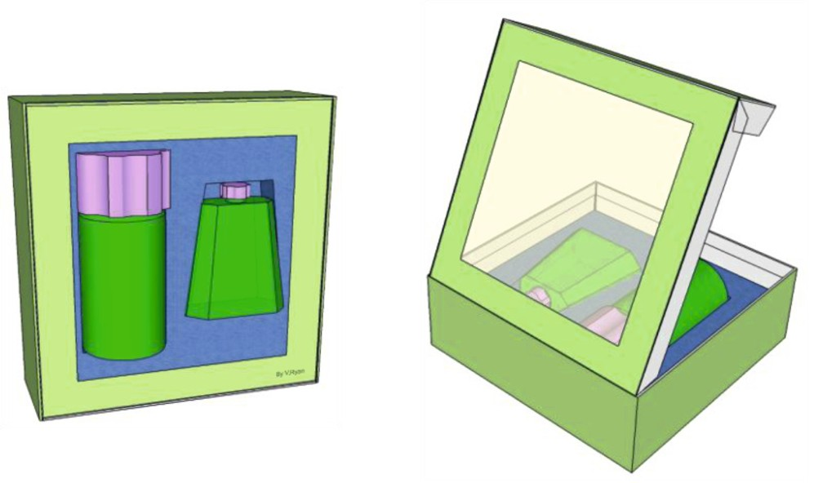
HELPFUL LINK http://www.technologystudent.com/prddes1/perfpk5.html
WORLD ASSOCIATION OF TECHNOLOGY TEACHERS https://www.facebook.com/groups/254963448192823/
www.technologystudent.com © 2018 V.Ryan © 2018
8c. A clear window has been added to the packaging for a perfumed product.
List one advantage of adding a window and one disadvantage. 2 marks
ADVANTAGE:
DISADVANTAGE:
HELPFUL LINKS
http://www.technologystudent.com/prddes1/biopola.html http://www.technologystudent.com/prddes1/biopol3.html
8d. The clear window is manufactured from BIOPOL. Describe / explain three reasons why this material is a good choice. 3 marks

Slide 34
HELPFUL LINKS
http://www.technologystudent.com/prddes1/biopola.html http://www.technologystudent.com/prddes1/biopol3.html
WORLD ASSOCIATION OF TECHNOLOGY TEACHERS https://www.facebook.com/groups/254963448192823/
www.technologystudent.com © 2018 V.Ryan © 2018
8e. In the space below, sketch a labelled diagram that represents the life cycle of Biopol.
4 marks

Slide 35
HELPFUL LINK http://www.technologystudent.com/despro2/packfn1.htm
WORLD ASSOCIATION OF TECHNOLOGY TEACHERS https://www.facebook.com/groups/254963448192823/
www.technologystudent.com © 2018 V.Ryan © 2018
9a. Packaging has a variety of functions. Complete the table below by stating a function, followed by an explanation. The ﬁrst row has been completed for you. Total of 9 marks
FUNCTION | EXPLANATION
To protect a product from damage or contamination by micro-organisms and air, moisture and toxins. | Protected against being dropped, crushed, and the vibration it suﬀers during transport. Delicate products such as fruits need to be protected by a rigid package such as a laminated container. It must also be protected against micro-organisms, chemicals, soil and insects.
1 mark | 2 marks
1 mark | 2 marks
1 mark | 2 marks

Slide 36
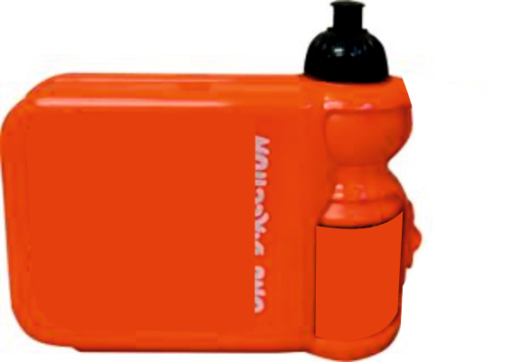

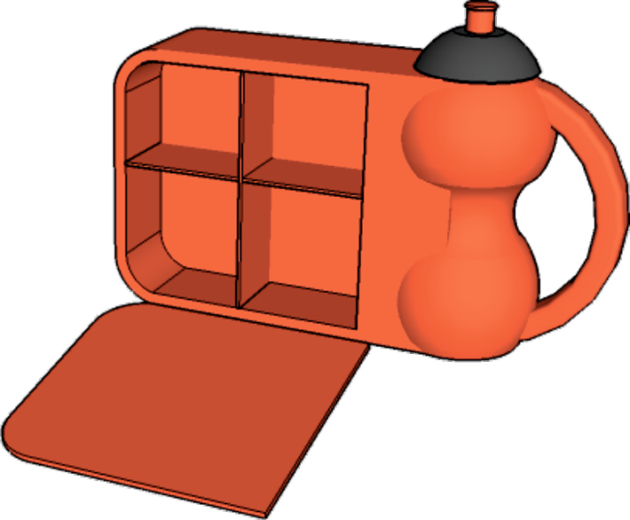
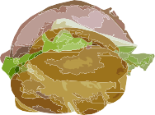



SECTION B – POLYMERS
Answer ALL questions
WORLD ASSOCIATION OF TECHNOLOGY TEACHERS https://www.facebook.com/groups/254963448192823/
www.technologystudent.com © 2018
V.Ryan © 2018
TYPICAL FOOD CARRIER
INTEGRATED
DRINKS COMPARTMENTS CONTAINER
CLIPS
PERSONALISED FRONT/LID
Manufactured from a food safe material. Free from chemicals such as BPA, PVC and Phthalates.
Clips hold the lid tightly shut and contents sealed in. Secure food storage.
Drop resistant, relatively unbreakable.
Integrated drinks container Separate food compartments.
Personalised photographic lid, simple logo/symbol.
Recycling and Healthy Eating symbols.

Slide 37
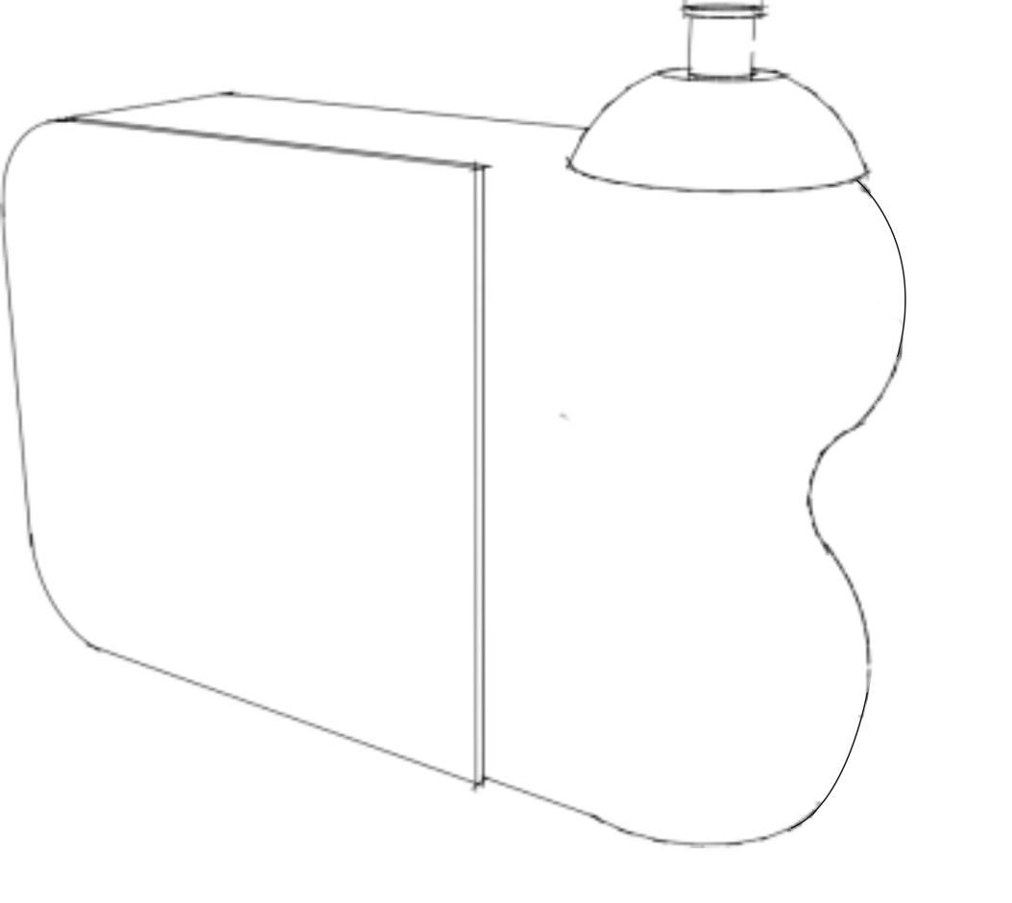
HELPFUL LINKS
http://www.technologystudent.com/prddes_2/carrier14.html http://www.technologystudent.com/prddes_2/carrier6.html http://www.technologystudent.com/prddes_2/carrier1.html
WORLD ASSOCIATION OF TECHNOLOGY TEACHERS https://www.facebook.com/groups/254963448192823/
www.technologystudent.com © 2018 V.Ryan © 2018
5a. The Food Carrier, needs to be improved to include the following speciﬁcation points.
The food carrier must:
(I) Have an ergonomically designed handle.
(I) Have an area that includes a logo, representing healthy eating.
(iii) The drinks container must be detachable, so that it can be used separately.
Use notes and/or sketches to show how the food carrier could be modiﬁed to satisfy the addition speciﬁcation points, listed above
Produce clear drawings / sketches, using the outline of the original design to show how the additional speciﬁcation points can be met.
6 marks

Slide 38
HELPFUL LINK http://www.technologystudent.com/prddes_2/carrier6.html
WORLD ASSOCIATION OF TECHNOLOGY TEACHERS https://www.facebook.com/groups/254963448192823/
www.technologystudent.com © 2018 V.Ryan © 2018
5b. Name a suitable material for the manufacture of the food carrier.
1 mark
HELPFUL LINK http://www.technologystudent.com/prddes_2/carrier20.html
5c. The food carrier is manufactured through a process called Blow Moulding. Describe blow moulding. 3 marks
HELPFUL LINK http://www.technologystudent.com/prddes_2/carrier20.html
5d. In the space below, draw a labelled diagram that represents the Blow Moulding process. 4 marks

Slide 39
HELPFUL LINK http://www.technologystudent.com/prddes1/lunch5.html
WORLD ASSOCIATION OF TECHNOLOGY TEACHERS https://www.facebook.com/groups/254963448192823/
www.technologystudent.com © 2018 V.Ryan © 2018
5e. Why is the material you named in question 5b, suitable for the manufacture of this food carrying product. 2 marks
HELPFUL LINK http://www.technologystudent.com/prddes1/lunch5.html
5f. Name another material that would be suitable for the food carrier and explain why it is suitable. 2 marks
NAME:
WHY SUITABLE:
HELPFUL LINK http://www.technologystudent.com/prddes_2/carrier6.html
5g. in the space opposite, sketch the recycling symbol for material you named in question 5b. 2 marks

Slide 40
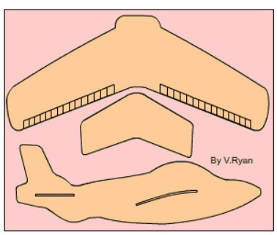
HELPFUL LINK http://www.technologystudent.com/rmprp07/glidr2.html
WORLD ASSOCIATION OF TECHNOLOGY TEACHERS https://www.facebook.com/groups/254963448192823/
www.technologystudent.com © 2018 V.Ryan © 2018
6a. The lunch carrier has proved popular with young children, because it comes with the free gift of a model glider. The parts of the glider push out of a polystyrene sheet and ﬁt together.
Name and describe the industrial process that is capable of producing the free gift.
You must include notes and a sketch(s) in your answer.
6 marks
PROCESS NAME:
(1 Mark)
SKETCH
NOTES ( Marks) :

Slide 41
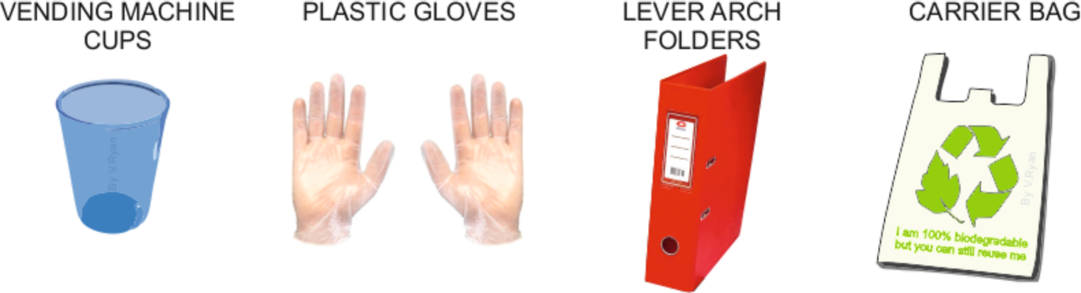
HELPFUL LINK http://www.technologystudent.com/joints_ﬂsh/oxodegrad1.html
WORLD ASSOCIATION OF TECHNOLOGY TEACHERS https://www.facebook.com/groups/254963448192823/
www.technologystudent.com © 2018 V.Ryan © 2018
7a. The products seen below are manufactured from oxo-degradable polymers
(i) What are Oxo-degradable Polymers?
1 mark
(ii) Although oxo-degradable polymers decay over several months, when buried in soil, they are derived from crude oil. What is it that allows them to decay?
2 marks
(iii) Describe two products that are often manufactured from oxo-degradable polymers.
2 marks

Slide 42
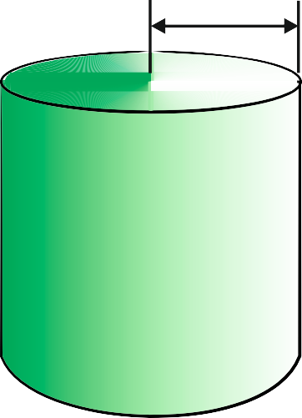
HELPFUL LINK http://www.technologystudent.com/pdf14/maths_cylinder1.pdf Page 3
WORLD ASSOCIATION OF TECHNOLOGY TEACHERS https://www.facebook.com/groups/254963448192823/
www.technologystudent.com © 2018 V.Ryan © 2018
8a. An engineering company has manufactured a ‘plastic / polymer’ cylinder. This is for a company that will machine the part for the automotive industry.
R= 60mm
What is the volume of the cylinder?
5 marks
HEIGHT = 120mm
FORMULA
v = πr ²h
volume = pi x radius² x height
π (pi) = 3.14

Slide 43
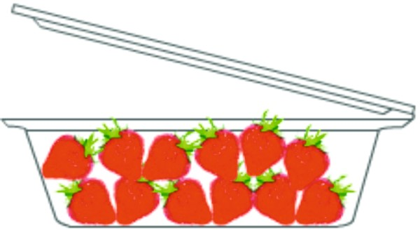
HELPFUL LINK http://www.technologystudent.com/joints/pet1.html
WORLD ASSOCIATION OF TECHNOLOGY TEACHERS https://www.facebook.com/groups/254963448192823/
9a. The food container seen opposite, is manufactured from polyethylene terephthalate, pet, pete, (polyester).
www.technologystudent.com © 2018
V.Ryan © 2018
Write two reasons why this material is suitable for the food container.
Total of 4 marks
(i)
(ii)
(iii) List two other products that are manufactured from polyethylene terephthalate.
2 marks
HELPFUL LINK http://www.technologystudent.com/joints/petevac1.html
(iv) Name and describe the process used to manufacture the food container.
2 marks

Slide 44
HELPFUL LINK http://www.technologystudent.com/joints/petevac1.html
WORLD ASSOCIATION OF TECHNOLOGY TEACHERS https://www.facebook.com/groups/254963448192823/
www.technologystudent.com © 2018 V.Ryan © 2018
9b. Produce a labelled sketch(s) that represents the manufacturing process you named and describe in the previous question (5k (iv)) 3 marks
HELPFUL LINK http://www.technologystudent.com/prddes1/quality1.html
9c. The food container undergoes Quality Control and Quality Assurance during the manufacturing process. What is the diﬀerence between Quality Control and Quality Assurance? 4marks

Slide 45
http://www.technologystudent.com/joints_ﬂsh/oxodegrad1.html http://www.technologystudent.com/joints/pla1.html
HELPFUL LINKS http://www.technologystudent.com/prddes1/closeloop1.html
http://www.technologystudent.com/prddes1/closeloop2.html http://www.technologystudent.com/despro_ﬂsh/morals2.pdf Page 5 onwards
10. Describe how ‘polymers’ can signiﬁcantly contribute to the sustainability of our use of materials. 9 marks
WORLD ASSOCIATION OF TECHNOLOGY TEACHERS https://www.facebook.com/groups/254963448192823/
www.technologystudent.com © 2018 V.Ryan © 2018

Slide 46
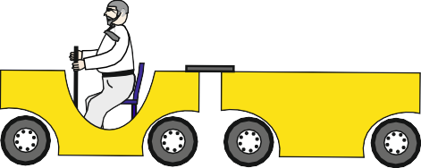

SECTION B – SYSTEMS
Answer ALL questions
WORLD ASSOCIATION OF TECHNOLOGY TEACHERS https://www.facebook.com/groups/254963448192823/
www.technologystudent.com © 2018 V.Ryan © 2018
An engineer has designed a barrier system for a roller coaster. The specification drawn up by the client says - “As a carriage approaches the platform, it breaks a light beam and the barrier is lowered, stopping excited and unruly riders getting too close to the stopping carriages.
The engineer has decided to use a PIC microcontroller, to control the motor that raises and lowers the barrier. The student uses outputs 1 and 2 to control the motor. Output 1 will turn the motor on and off. Output 2 changes the direction of the motor.
RYAN RAIL SYSTEMS
LIGHT SENSOR
A/D 0 A/D 1 A/D 2 D6 D7
INPUTS
Q7 Q6 Q5 Q4 Q3 Q2 Q1 Q0
- +
OUTPUT 1
16 15 14 13 12 11 10 9
1 2 3 4 5 6 7 8
18 17 16 15 14 13 12 11 10
GENIE E18
1 2 3 4 5 6 7 8 9
ULN2803
OUTPUTS
OUTPUT 2
 | RL
M
0v

Slide 47



HELPFUL LINKS
http://www.technologystudent.com/sysprp7/sysq08a.html http://www.technologystudent.com/sysprp08/quest5.html
WORLD ASSOCIATION OF TECHNOLOGY TEACHERS
https://www.facebook.com/groups/254963448192823/
www.technologystudent.com © 2018 V.Ryan © 2018
5a. The circuit, needs to be improved to include the following speciﬁcation points.
The circuit must:
(I) The relay must have diode protection.
(I) The motor must lift and lower the barrier.
(iii) The circuit must have a simple on/oﬀ switch, that can be used in event of an accident / emergency situation.
Use notes and/or sketches to show how the circuit could be modiﬁed to satisfy the addition speciﬁcation points, listed above
Produce clear drawings / sketches, using the outline of the original design to show how the additional speciﬁcation points can be met.
6 marks
OUTPUT 1
OUTPUT 2
 | RL
M
0v

Slide 48
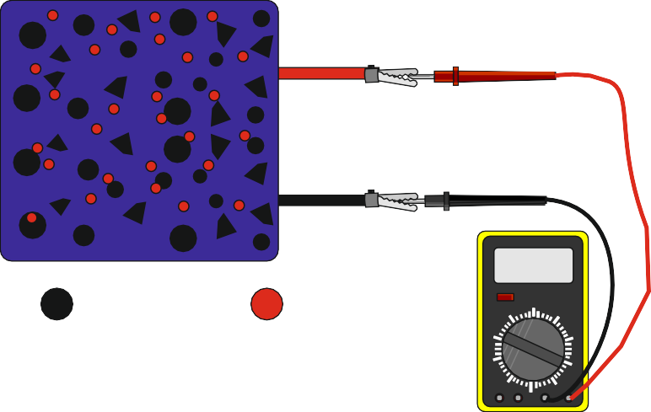
HELPFUL LINK http://www.technologystudent.com/energy1/solar5.htm
5b. Photovoltaics is a form of solar power. Explain, in simple terms, how a photovoltaic panel works. 2 marks
SUNLIGHT
+
_
0.06
SILICON
IMPURITIES
FREE ELECTRONS
WORLD ASSOCIATION OF TECHNOLOGY TEACHERS
https://www.facebook.com/groups/254963448192823/
www.technologystudent.com © 2018
V.Ryan © 2018
HELPFUL LINK http://www.technologystudent.com/energy1/solar6.htm
5c. Describe two practical applications of solar power. 2 marks

Slide 49
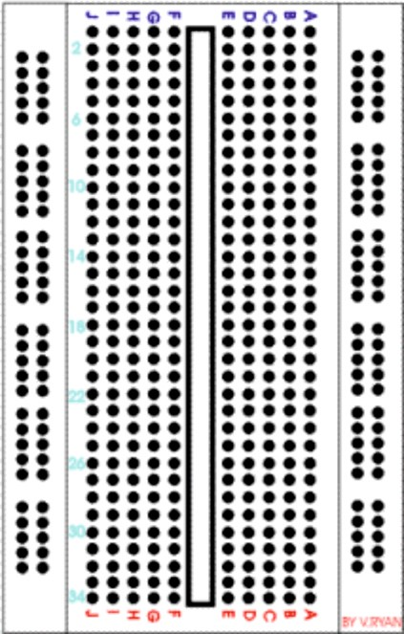
HELPFUL LINK http://www.technologystudent.com/elec1/bread1.htm
WORLD ASSOCIATION OF TECHNOLOGY TEACHERS
https://www.facebook.com/groups/254963448192823/
www.technologystudent.com © 2018 V.Ryan © 2018
6a. The breadboard shown opposite is used to test circuits. Describe one advantage of using a breadboard. 2 marks
HELPFUL LINK http://www.technologystudent.com/pics/picgen1.html
6b. Software can be used to design a circuit and then to simulate the circuit working. What are the advantages of using software to simulate circuits in operation? 2 marks

Slide 50
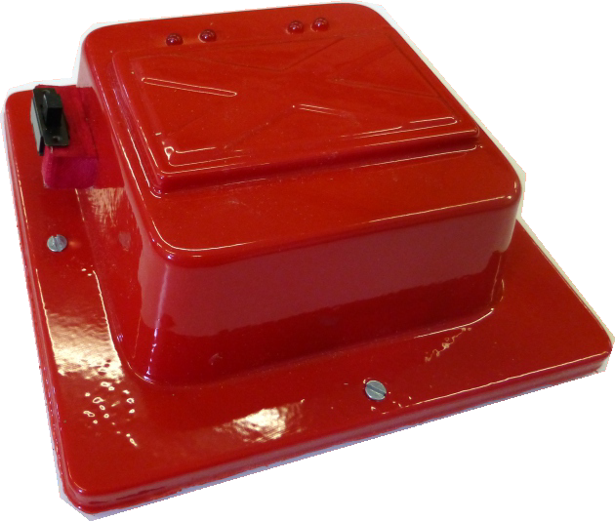
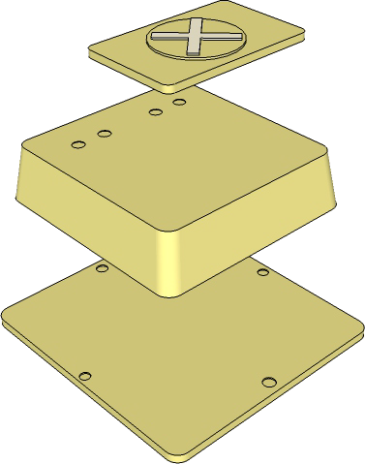
The product seen opposite, is a warning light system, composed of a ‘plastic’ casing and an electronic circuit.
When the switch is ‘on’, the LEDs ﬂash.
WORLD ASSOCIATION OF TECHNOLOGY TEACHERS https://www.facebook.com/groups/254963448192823/
www.technologystudent.com © 2018 V.Ryan © 2018
HELPFUL LINK http://www.technologystudent.com/gprep07/vac2.html
6c. What thermoplastic material, is most suitable for the manufacture of the casing?
1 mark
HELPFUL LINK http://www.technologystudent.com/equip1/vacform1.htm
6d. What is the name of the process, that results in the base being manufactured?
1 mark
6e. The mould for the casing is seen opposite. How is the mould ﬁnished, to ensure that it can be removed from the moulded ‘plastic’, after vacuum forming? 2 marks
LOGO / SYMBOL
MOULD
MDF BACK

Slide 51
HELPFUL LINK http://www.technologystudent.com/gprep07/vac3.html
WORLD ASSOCIATION OF TECHNOLOGY TEACHERS https://www.facebook.com/groups/254963448192823/
www.technologystudent.com © 2018 V.Ryan © 2018
6f. In the space below, explain the stages involved in the vacuum forming process, of the casing of the warning light. Use both labelled sketches and notes in your answer. 8 marks
NOTES SKETCHES

Slide 52
HELPFUL LINK http://www.technologystudent.com/sysprp7/sysq17.html
WORLD ASSOCIATION OF TECHNOLOGY TEACHERS https://www.facebook.com/groups/254963448192823/
www.technologystudent.com © 2018 V.Ryan © 2018
7a. Sliding doors have electromechanical systems to enable them to work. The two doors are shown below. Add to the drawing, a suitable mechanical system, that would allow the doors to be opened and closed, in the event of an electronic / electrical failure. Add explanatory notes and labels. 5 marks
WORLD ASSOCIATION OF TECHNOLOGY TEACHERS https://www.facebook.com/groups/254963448192823/
www.technologystudent.com © 2017 V.Ryan © 2017
NOTES

Slide 53
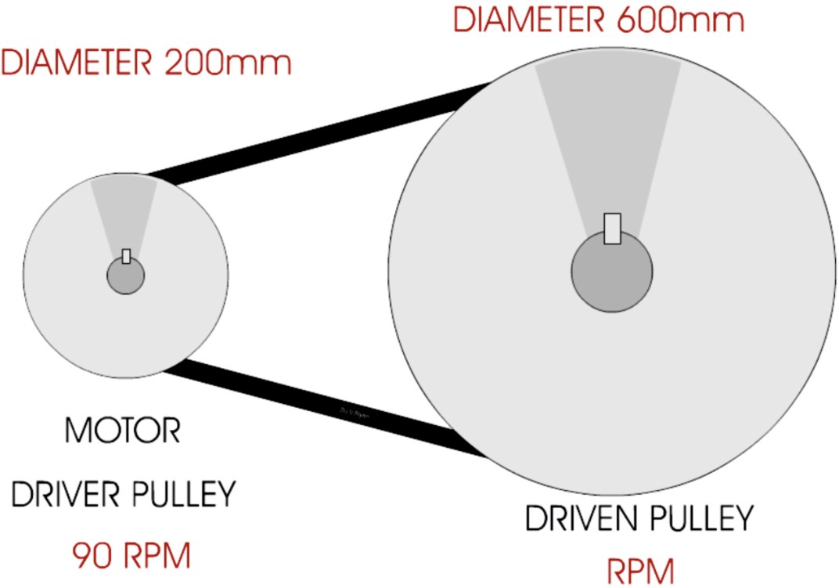
HELPFUL LINK http://www.technologystudent.com/gears1/pulley3.htm
WORLD ASSOCIATION OF TECHNOLOGY TEACHERS https://www.facebook.com/groups/254963448192823/
www.technologystudent.com © 2018 V.Ryan © 2018
7b. The sliding doors are to be updated again, so that they work automatically, the through a system of pulleys (shown in the diagram below).
B
A
(I) Calculate the Velocity Ratio of the pulley system. Include all your working out
2 marks
(ii). Calculate the RPM of pulley ‘B’. Include all your working out.
3 marks

Slide 54

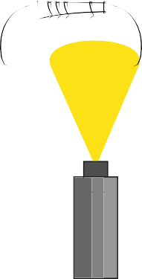
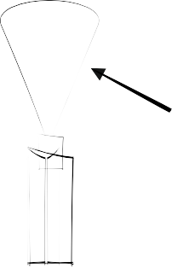
HELPFUL LINK http://www.technologystudent.com/pcb/wave1.html
WORLD ASSOCIATION OF TECHNOLOGY TEACHERS https://www.facebook.com/groups/254963448192823/
www.technologystudent.com © 2018 V.Ryan © 2018
8a. Industrial wave soldering is a process, whereby circuit boards and their components, are solder, on a mass production line. This is the way thousands of circuits are manufactured.
Using the table below, explain each of the stages in the wave soldering process, adding notes and diagrams / sketches. The ﬁrst stage has been completed for you.
6 marks
NOTES / EXPLANATION | DIAGRAM /SKETCH
APPLICATION OF FLUX
The ﬁrst stage is the application of ﬂux. This is a substance that helps keep the circuit board clean, by preventing oxidisation, during the heating process. The ﬂux is sprayed in the form of a ﬁne mist, onto the underneath of the board, covering the tracks and exposed ‘pins’ of the components. | Mist of ﬂux sprayed by ﬂux applicator.
HEATING OF THE CIRCUIT BOARD
THE WAVE SOLDERING TANK

Slide 55
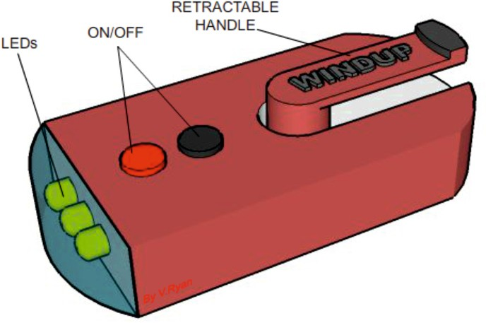
HELPFUL LINK http://www.technologystudent.com/elec1/anadig1.htm
WORLD ASSOCIATION OF TECHNOLOGY TEACHERS https://www.facebook.com/groups/254963448192823/
www.technologystudent.com © 2018 V.Ryan © 2018
8b. The two graphs shown below, visually represent signals. Name each of the graphs with the correct type of signal. 2 marks
SIGNAL: SIGNAL:
ON ON ON
OFF |  | OFF |  | OFF
VOLUME
VOLTS
TIME
TIME
HELPFUL LINK http://www.technologystudent.com/enerﬂsh/ensave1.html
8c. A range of wind-up rechargeable devices exist, such as the torch seen opposite. Give three advantages of modern recharageable torches.
3 marks

Slide 56
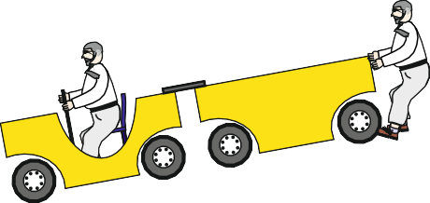
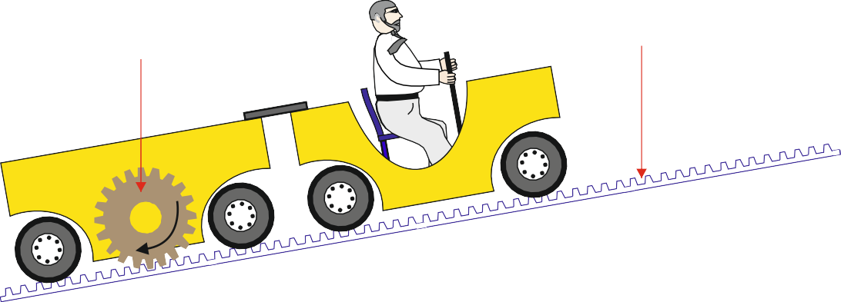
HELPFUL LINK http://www.technologystudent.com/sysprp08/quest1.html
9a. The carriage of a roller coaster seen below is at the top of an incline. At any point it could roll downwards, gathering speed. What is potential energy?
RYAN RAIL SYSTEMS
WORLD ASSOCIATION OF TECHNOLOGY TEACHERS https://www.facebook.com/groups/254963448192823/
www.technologystudent.com © 2018 V.Ryan © 2018
(I) Potential energy is (1 mark):
(II) What is Kinetic Energy (1 mark)?
(iii). The carriage at the bottom of the roller coaster incline has a special gear system. On the diagram, the gear system is marked A and B. What are the correct names for parts A and B ?
A
B
RYAN RAIL SYSTEMS
PART A: 1 mark
PART B:
1 mark

Slide 57
HELPFUL LINK http://www.technologystudent.com/despro_ﬂsh/morals2.pdf Page 5 onwards
WORLD ASSOCIATION OF TECHNOLOGY TEACHERS https://www.facebook.com/groups/254963448192823/
www.technologystudent.com © 2018 V.Ryan © 2018
10. Environmental damage, pollution and climate change, are serious global problems, aﬀecting everyone. Discuss some of the problems we face and potential solutions. 9 marks

Slide 58
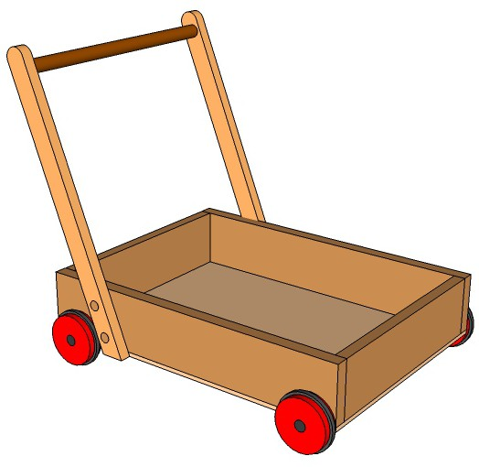

SECTION B – TIMBERS
Answer ALL questions
WORLD ASSOCIATION OF TECHNOLOGY TEACHERS https://www.facebook.com/groups/254963448192823/
www.technologystudent.com © 2018 V.Ryan © 2018
5. The drawing below shows the basic solution to a children’s trolley, which stores building blocks.
HANDLE (DOWEL ROD)
HANDLE SIDE
BASE
WHEEL
SIDE
PINNED AND GLUED JOINTS
The trolley has a ﬁxed handle, that is permanently in one position. The corners of the storage unit are ‘pinned and glued’, for speed of manufacture. The handle is plain, being manufactured from dowel.
The trolley is spray painted in a variety of colours.

Slide 59
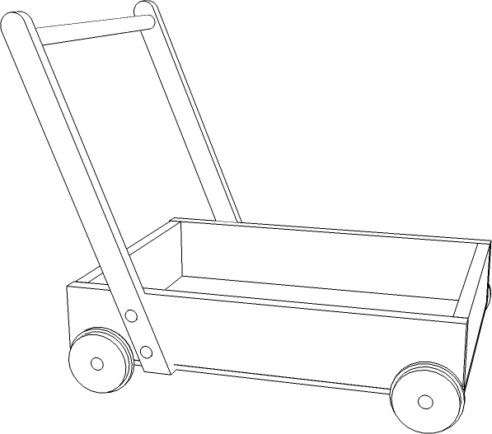
_{HELPFUL LINKS} http://www.technologystudent.com/despro_3/wdjoints1.html http://www.technologystudent.com/despro_3/block1.html http://www.technologystudent.com/despro_3/ergotrol1.html
WORLD ASSOCIATION OF TECHNOLOGY TEACHERS https://www.facebook.com/groups/254963448192823/
www.technologystudent.com © 2018 V.Ryan © 2018
5a. The children’s trolley, needs to be improved to include the following speciﬁcation points.
The trolley must:
(I) Have an ergonomically designed handle.
(I) The handle must fold ﬂat, so that the trolley can be stored, saving space.
(iii) The corner joints of the storage unit, need to be upgraded so that they are strong and can withstand ‘knocks’.
Use notes and/or sketches to show how the children’s trolley could be modiﬁed to satisfy the addition speciﬁcation points, listed above
Produce clear drawings / sketches, using the outline of the original design to show how the additional speciﬁcation points can be met.
6 marks

Slide 60
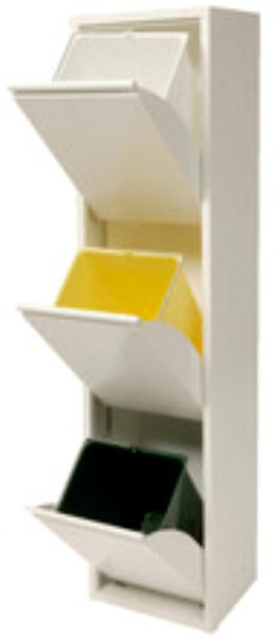
HELPFUL LINK http://www.technologystudent.com/rmprep09/prodal1.html
WORLD ASSOCIATION OF TECHNOLOGY TEACHERS https://www.facebook.com/groups/254963448192823/
www.technologystudent.com © 2018 V.Ryan © 2018
5b. The recycling bin shown opposite is suitable for a kitchen. It has three separate storage bins, for diﬀerent materials.
Describe TWO other ways in which this design meets the design requirements for a recycle bin.
4 marks
(I)
(II)

Slide 61
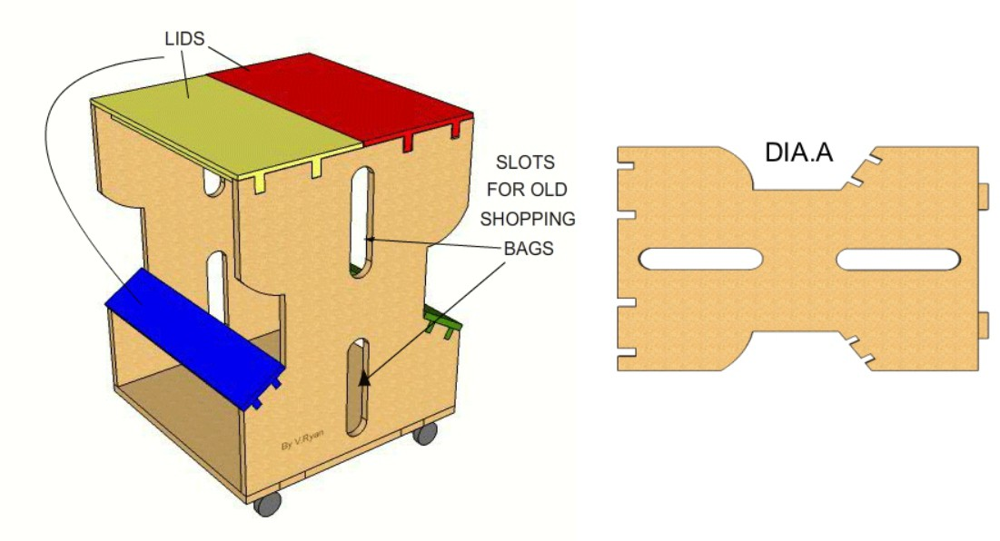
HELPFUL LINK http://www.technologystudent.com/rmprep09/singl1.html
WORLD ASSOCIATION OF TECHNOLOGY TEACHERS https://www.facebook.com/groups/254963448192823/
www.technologystudent.com © 2018 V.Ryan © 2018
5c. The modern recycling bin seen below, is manufactured from MDF or PLYWOOD. Old plastic shopping bags can be ‘hung’ inside each compartment on hooks. There is a central compartment for used shopping bags. It is delivered to the customer as a ﬂat pack and can be assembled within ten minutes. It rests on casters for ease of movement. As it is wood based and can be recycled at the end of its useful working life.
(I) Explain why a ‘template’ is useful when manufacturing a number of these bins.
2 marks
(I) Explain why a fretsaw or bandsaw could be useful when cutting the sides of the bin.
2 marks

Slide 62
HELPFUL LINK http://www.technologystudent.com/despro_ﬂsh/ﬁnish8.html
WORLD ASSOCIATION OF TECHNOLOGY TEACHERS https://www.facebook.com/groups/254963448192823/
www.technologystudent.com © 2018 V.Ryan © 2018
5d. The panels / sides of the bin are to be painted, producing a high quality ﬁnish.
(I) Using notes and sketches, describe the stages involved in preparing the surface of the ‘wood’ panels / sides and the application of a quality paint ﬁnish.
4 marks
(II) Why is the use of water based paints more environmentally friendly, than using oil / solvent based paints? 2 marks

Slide 63
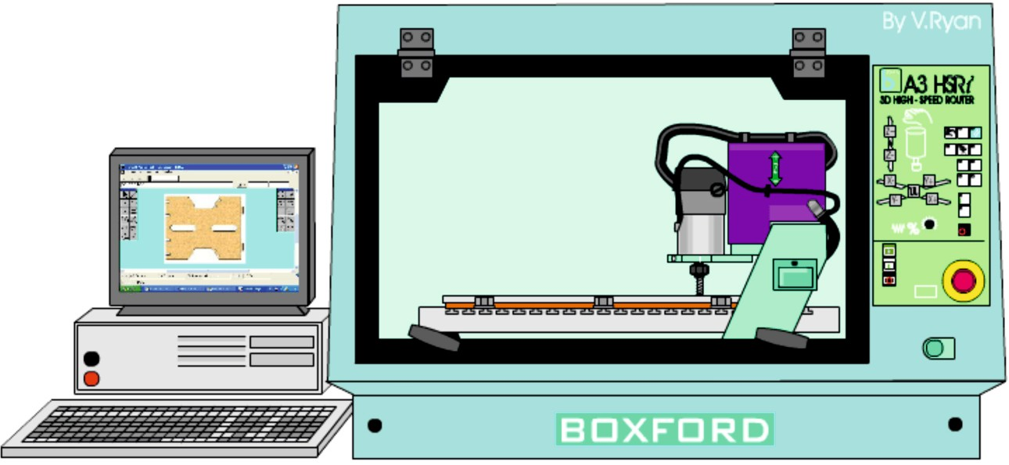
_{HELPFUL LINKS} http://www.technologystudent.com/cam/cncman4.htm http://www.technologystudent.com/rmprep09/shop1.html
6a. A retailer has ordered a large number of the ‘wood’ based recycle bins. It has been decided to manufacture the bins using CAM, such as the CNC Router seen below. To start with, the sides are drawn using CAD software.
WORLD ASSOCIATION OF TECHNOLOGY TEACHERS https://www.facebook.com/groups/254963448192823/
www.technologystudent.com © 2018 V.Ryan © 2018
(I) Describe 6 advantages of using CAD and CAM in the manufacture of large numbers of this design of bin. 6 marks

Slide 64
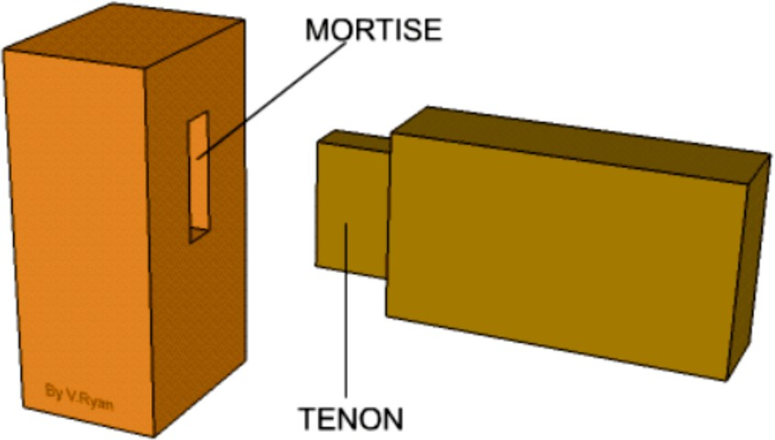
http://www.technologystudent.com/joints/mort1.htm HELPFUL LINKS http://www.technologystudent.com/joints/joints4.htm
http://www.technologystudent.com/joints/mort2.htm
WORLD ASSOCIATION OF TECHNOLOGY TEACHERS https://www.facebook.com/groups/254963448192823/
www.technologystudent.com © 2018
V.Ryan © 2018
7a. The table below has been permanently ﬁxed together using plain mortise and tenon joints, as seen opposite.
The table has been found to be weak. Name and produce a labelled sketch, of a more sophisticated mortise and tenon joint, that is likely to strengthen the table. 5 marks

Slide 65


HELPFUL LINK http://www.technologystudent.com/pdf14/maths3.pdf Page 8
WORLD ASSOCIATION OF TECHNOLOGY TEACHERS https://www.facebook.com/groups/254963448192823/
www.technologystudent.com © 2018 V.Ryan © 2018
The plain table top is to be modiﬁed. A rectangular acrylic window is to be added. The top is now composed of two rectangular pieces, accurately cut to size on a CNC router. They ﬁt perfectly together.
7b. Calculate the total area of piece A, before ‘B’ is removed
7c. Calculate the area of piece B. 2 marks
7d. Calculate the area of A, after ‘B’ is removed. 1 mark
200mm
2 marks
A
B
150mm
300mm
400mm

Slide 66
HELPFUL LINK http://www.technologystudent.com/rmﬂsh1/ebeech1.html
WORLD ASSOCIATION OF TECHNOLOGY TEACHERS https://www.facebook.com/groups/254963448192823/
www.technologystudent.com © 2018 V.Ryan © 2018
7e. European Beech has been selected for the manufacture of the table. Explain why this is a good choice. 4 marks
HELPFUL LINK http://www.technologystudent.com/rmﬂsh1/natwd1.html
7f. Name another natural wood that would be suitable for the manufacture of the table. Explain why you consider it to be suitable. 2 marks
NAME:
WHY SUITABLE:

Slide 67
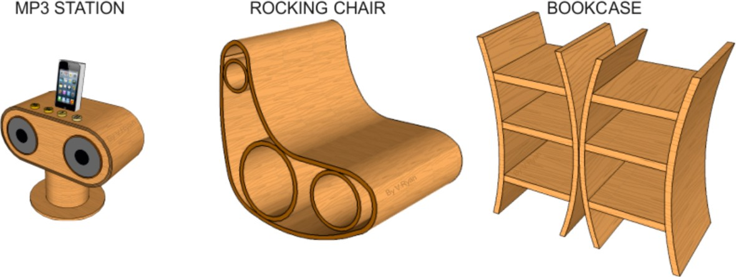
HELPFUL LINK http://www.technologystudent.com/despro_ﬂsh/ﬂexply1.html
8. The products shown below have been manufactured from ﬂexi-ply.
WORLD ASSOCIATION OF TECHNOLOGY TEACHERS https://www.facebook.com/groups/254963448192823/
www.technologystudent.com © 2018 V.Ryan © 2018
(I) Why is ﬂexi-ply a suitable material for these shapes / forms of products? 5 marks
HELPFUL LINK http://www.technologystudent.com/prddes1/eames6.html
(II) Another way of producing curves in woods is to use layers of veneers / plywood and to ‘steam bend’. Describe the process called ‘steam bending’. 4 marks

Slide 68
http://www.technologystudent.com/prddes1/susenv1.html HELPFUL LINKS http://www.technologystudent.com/prddes1/lifecy1.html
http://www.technologystudent.com/despro_ﬂsh/morals2.pdf Page 5 onwards
9. Describe how natural wood can signiﬁcantly contribute to the sustainability of our use of materials. 9 marks
WORLD ASSOCIATION OF TECHNOLOGY TEACHERS https://www.facebook.com/groups/254963448192823/
www.technologystudent.com © 2018 V.Ryan © 2018

Slide 69
ADD YOUR OWN TEXTILES SPECIFIC EXAMINATION QUESTIONS

