Slide 1
DESIGN AND TECHNOLOGY - GCSE SAMPLE PAPER 2
COMPONENT 1
Candidate Name | Centre Number |  |  |  |  | Candidate Number
TIME ALLOWED - 2 HOURS
For examiner's use only
Section A | 1 |  | 10
 | 2 |  | 10
 | 3 |  | 15
 | 4 |  | 20
 | 5 |  | 20
Section B | 6 - 10 |  | 25
Total |  |  | 100
EQUIPMENT REQUIRED
Drawing and writing equipment, coloured pencils and a calculator
INSTRUCTIONS
You are to answer all questions 1 to 5. Select ONE question from Section B
This example examination paper can be duplicated and printed out if required but not edited in any way.
The links to www.technologystudent.com cannot be removed.
The PDF ﬁle can be stored on school / college systems and distributed electronically (NO EDITING ALLOWED)
PLEASE RESPECT THE COPYRIGHT - report infringers to techteacher@technologystudent.com Not be distributed at courses or by course instructors / consultants
WORLD ASSOCIATION OF TECHNOLOGY TEACHERS https://www.facebook.com/groups/254963448192823/
www.technologystudent.com © 2018 V.Ryan © 2018

Slide 2
Section A
Answer all the questions in this section
HELPFUL LINK http://www.technologystudent.com/pdf14/ratios1.pdf Page 15
1. The question is about alternative energy.
1a. The total amount of renewable energy produced in 2016 was 90 Terawatt hours (Twh).
The ratio of hydroelectricity compared to other renewable energy forms was 1:12. What amount of energy was produced through hydroelectricity ? 4 marks
HYDROELECTRICITY : OTHER RENEWABLE FORMS
1 : 12
EXPLANATION:
HELPFUL LINK http://www.technologystudent.com/energy1/hydr2.htm
1b. Write two advantages of using Hydro-power to produce electricity. 2 marks
1c. Write two disadvantages of using Hydro-power to produce electricity.
2 marks

Slide 3
HELPFUL LINK http://www.technologystudent.com/energy1/nuclear1.htm
1d. Nuclear Power is regarded by some, as an alternative and environmentally friendly way of producing electricity. List one advantage and one disadvantage of nuclear power
2 marks

Slide 4
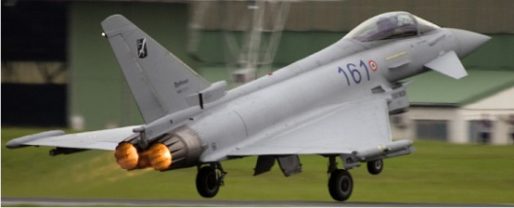
HELPFUL LINK http://www.technologystudent.com/equip1/poly1.htm
2. This question is regarding smart materials.
2a. What is polymorph? Your answer must include a reference to a practical application of polymorph. 3 marks
HELPFUL LINK http://www.technologystudent.com/joints/carﬁb1.html
2b. Explain why carbon ﬁbre is a suitable composite material for the airframe of this jet ﬁghter. Include a description of the structure of carbon ﬁbre in your answer.
2 marks

Slide 5

HELPFUL LINK http://www.technologystudent.com/joints/aroma1.html
2c. When this greetings card is opened and the pigment inside scratched, it emits the scent of pine trees.
Explain how aroma pigments work. Include a diagram and a simple explanation 2 marks
NOTES:
DIAGRAM
HELPFUL LINK http://www.technologystudent.com/joints/aroma1.html
2d. Describe another product that includes aroma pigments. 3 marks
Product:
Description and explanation:

Slide 6
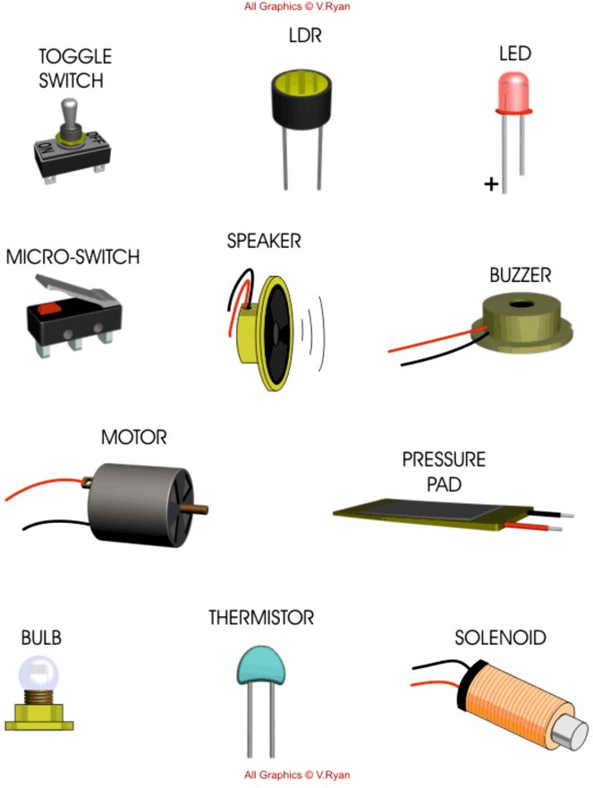
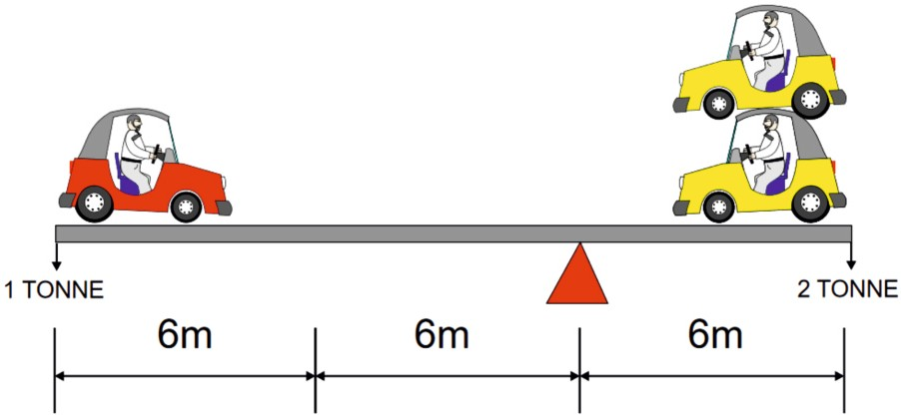
HELPFUL LINK http://www.technologystudent.com/pics/lesstr2.htm
3. This question is regarding electronics, equilibrium and classes of lever.
3a. Study the components below. Using the blank the table, list four inputs that you have identiﬁed. 4 marks
INPUTS
HELPFUL LINK http://www.technologystudent.com/forcmom/force2.htm
3b. The diagram below displays a state of equilibrium. In the space below. show the calculation that conﬁrms this. 4 marks

Slide 7
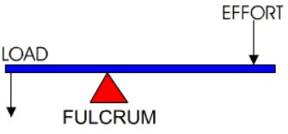
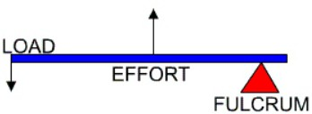
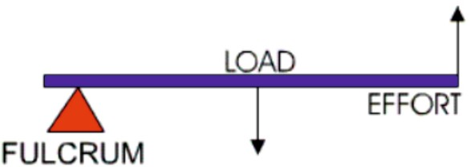
HELPFUL LINK http://www.technologystudent.com/forcmom/lever1.htm
3c. What ‘class’ of lever is this? 1 mark
What ’class’ of lever is this? 1 mark
HELPFUL LINK http://www.technologystudent.com/forcmom/lever1.htm
3d. What ‘class’ of lever does this diagram represent?
1 mark
3e. In the space below, draw a practical application of the class of lever you identiﬁed in 3d (the previous question). 4 marks
NOTES
SKETCH

Slide 8
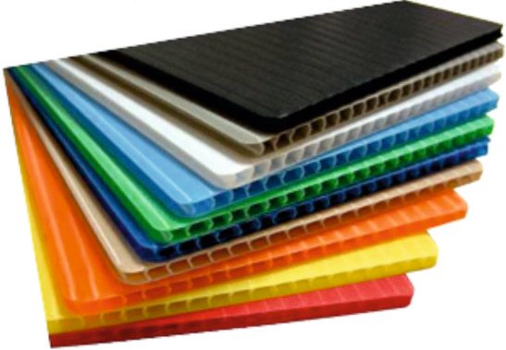
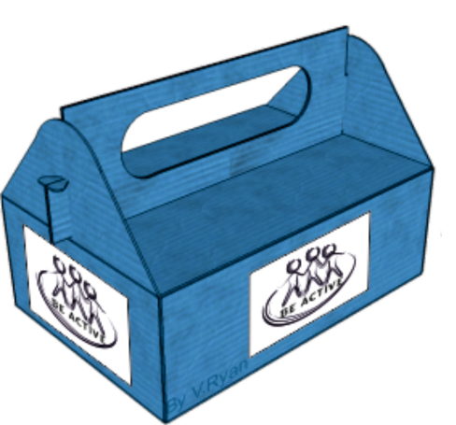
HELPFUL LINK http://www.technologystudent.com/despro_ﬂsh/charity10.html
4. These questions are about materials
4a. The material seen below is CORRUGATED PLASTIC (POLYPROPYLENE). Draw the recycling symbol that represents this plastic. 2 marks
HELPFUL LINK http://www.technologystudent.com/despro_ﬂsh/charity10.html
4b. The charity collection box seen below, is manufactured from corrugated polypropylene. Why is this a suitable material? 3 marks
HELPFUL LINK http://www.technologystudent.com/despro2/crdpap2.htm
4c. What is duplex board? Include a practical use. 2 marks
4d. What is foil lined board ? Include a practical use.
2 marks

Slide 9
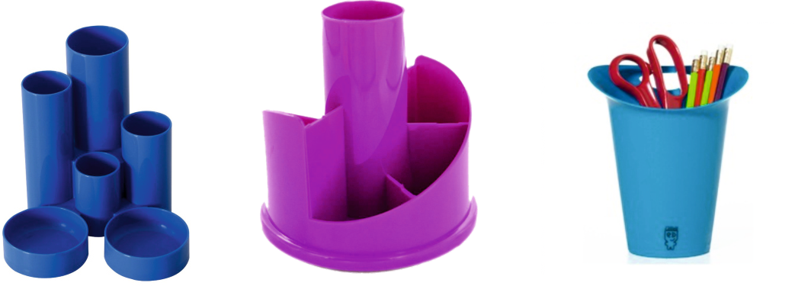
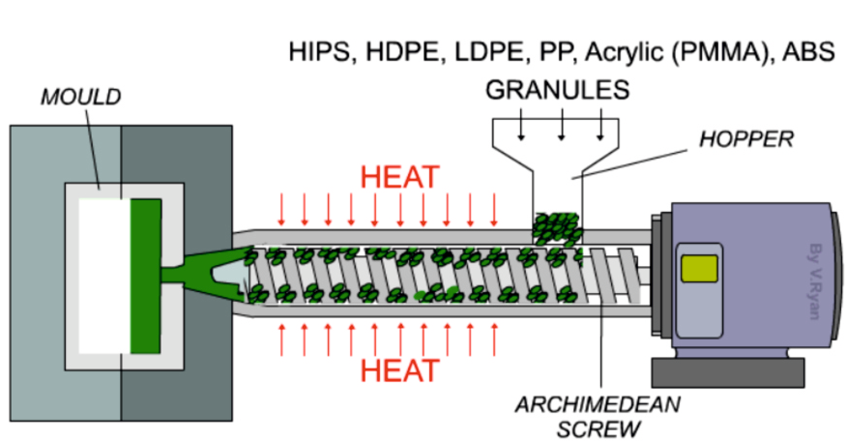
HELPFUL LINK http://www.technologystudent.com/joints/petevac4.html
4. The products shown below have been manufactured from High Density Polyethylene (HDPE).
4e. Why is High Density Polyethylene (HDPE) ideal for their manufacture of the products? 3 marks
HELPFUL LINK http://www.technologystudent.com/equip1/inject1.htm
4f. Describe how the desk tidies can be manufactured by this equipment / process. Name the equipment / process in your answer. 3 marks
EQUIPMENT / PROCESS NAME:
DESCRIPTION:

Slide 10
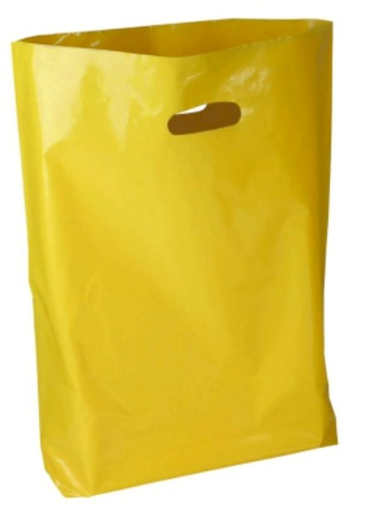
HELPFUL LINK http://www.technologystudent.com/joints_ﬂsh/metal2.html
4g. A desk tidy of a similar design is to be manufactured from aluminium. The surface will have an anodised ﬁnish. Describe the anodising procedure. 3 marks
HELPFUL LINK http://www.technologystudent.com/joints/poly3.html
4h. The photograph shown opposite is of a typical disposable ‘plastic’ carrier bag. Why is polylactide a suitable material? 3 marks

Slide 11
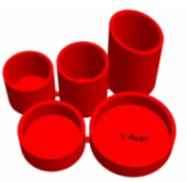

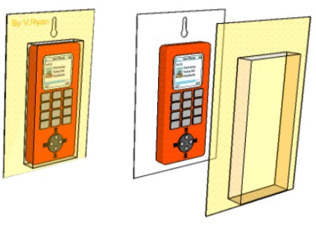
5a. Select one of the products shown below. Then, describe two reasons, for it being suitable for manufacture in large numbers / mass production. 2 x 2 marks
DESKTIDY
INJECTION MOULDING
‘PLASTIC’ TROPHY
ROTATIONAL MOULDING
BLISTER PACKAGING
VACUUM FORMING
TO HELP YOU ANSWER THIS QUESTION
http://www.technologystudent.com/joints/desk8.htm http://www.technologystudent.com/prddes1/rotate2.html http://www.technologystudent.com/gprep07/vac2.html
PRODUCT:
REASON 1:
REASON 2:
HELPFUL LINK http://www.technologystudent.com/prddes_2/crowd1.html
5b. Your chosen product is to be ﬁnanced through a cooperative. What is a cooperative? 2 marks

Slide 12
HELPFUL LINKS
http://www.technologystudent.com/despro_3/lean1.html http://www.technologystudent.com/despro_3/lean2.html
5c. The chosen product will be manufactured through a system called Lean Manufacturing. What is Lean Manufacturing? 4 marks
HELPFUL LINK http://www.technologystudent.com/prddes1/advert2.html
5d. A product such as a desk tidy may need advertising. What is the purpose of advertising? 2 marks
HELPFUL LINKS
http://www.technologystudent.com/prddes1/advert1.html http://www.technologystudent.com/prddes1/advert2.html
5e. Describe one method of advertising, that you think would be successful in promoting a desk tidy. 3 marks.

Slide 13

HELPFUL LINK http://www.technologystudent.com/pdf14/maths5.pdf Page 8
WORLD ASSOCIATION OF TECHNOLOGY TEACHERS https://www.facebook.com/groups/254963448192823/
www.technologystudent.com © 2018 V.Ryan © 2018
VERTEX
Below is a model, typical village church.
The roof of the tower is a square pyramid.
5f. What is the area of one side of the square pyramid?
4 marks
h=300mm
SQUARE PYRAMID
X
Y
b=250mm
CALCULATION
5g. The labels X and Y represent the same part, one side of the square pyramid. Why does Y appear taller than X ? 1 mark
WORLD ASSOCIATION OF TECHNOLOGY TEACHERS
https://www.facebook.com/groups/254963448192823/
www.technologystudent.com © 2017 V.Ryan © 2017

Slide 14

SECTION B
ANSWER ONLY ONE QUESTION
Electronics and Systems
HELPFUL LINK http://www.technologystudent.com/sysprp7/sysq8.html
6. A technology student has developed an automatic traffic control system for a level crossing.
A pressure sensor detects when a car passes over it. The sensor is connected to INPUT 1 of the control system.
A light sensor detects the presence of a train close to the crossing. The light sensor is connected to INPUT 2 of the control system.
When a car is detected the control system checks if a train has passed the light sensor. Then the traffic lights run through a sequence of changes, eventually changing the lights from red to green, raising the barrier and allowing the car to cross the railway line safely.
If a train is present the traffic light stays on red and the barrier remains lowered / closed.
RED
AMBER GREEN
LIGHT SENSOR
PRESSURE SENSOR
6a. The sequence of events are listed below. However, they are in the wrong order. Write the correct sequence of events in the available space. The first three stages have been completed. 4 marks
TRAFFIC LIGHTS - AMBER OFF BARRIER IN CLOSED POSITION CHECK INPUT 2
TRAFFIC LIGHTS GREEN ON TRAFFIC LIGHTS - AMBER AND RED ON
WAIT 5 SECONDS
TRAFFIC LIGHTS RED + AMBER ON
CHECK INPUT 1 BARRIER OPENS WAIT 5 SECONDS
TRAFFIC LIGHTS - GREEN OFF BARRIER LOWERED.
TRAFFIC LIGHTS - AMBER ON WAIT FIVE SECONDS
WAIT 60 SECONDS TRAFFIC LIGHTS - RED + AMBER OFF
TRAFFIC LIGHT - RED
TRAFFIC LIGHT - RED BARRIER IN CLOSED POSITION CHECK INPUT 1

Slide 15
HELPFUL LINK http://www.technologystudent.com/sysprp7/sysq8.html
6b. Convert your sequence into a flow chart using the boxes also shown below. The first four stages have been completed for you. 5 marks
START/FINISH
PROCESS START
INPUT / OUTPUT
DECISION
TRAFFIC LIGHT - RED
BARRIER IN CLOSED
CHECK INPUT 1
NO
YES

Slide 16

HELPFUL LINK http://www.technologystudent.com/gears1/gears7.htm
6. The diagram below shows a gear train, composed of three gear wheels.
B
60T
A
20T
6c. Gear A revolves at 60 revs/min in a clockwise direction.
What is the output in revolutions per minute at Gear C? 3 marks
In what direction does Gear C revolve ? 2 marks
C
10T
60 REVS/MIN
GEAR A | GEAR B | GEAR C
20 teeth | 60 teeth | 10 teeth
60 rpm | ? | ?

Slide 17
HELPFUL LINK http://www.technologystudent.com/prddes1/plannedob1.html
6d. With reference to a product of your choice, explain planned obsolescence.
5 marks
6e. Explain why planned obsolescence can be bad for the environment. 3 marks
6f. ‘Planned obsolescence is sometimes deliberately and openly built into products for safety reasons’. Explain this statement, giving examples. 3 marks

Slide 18
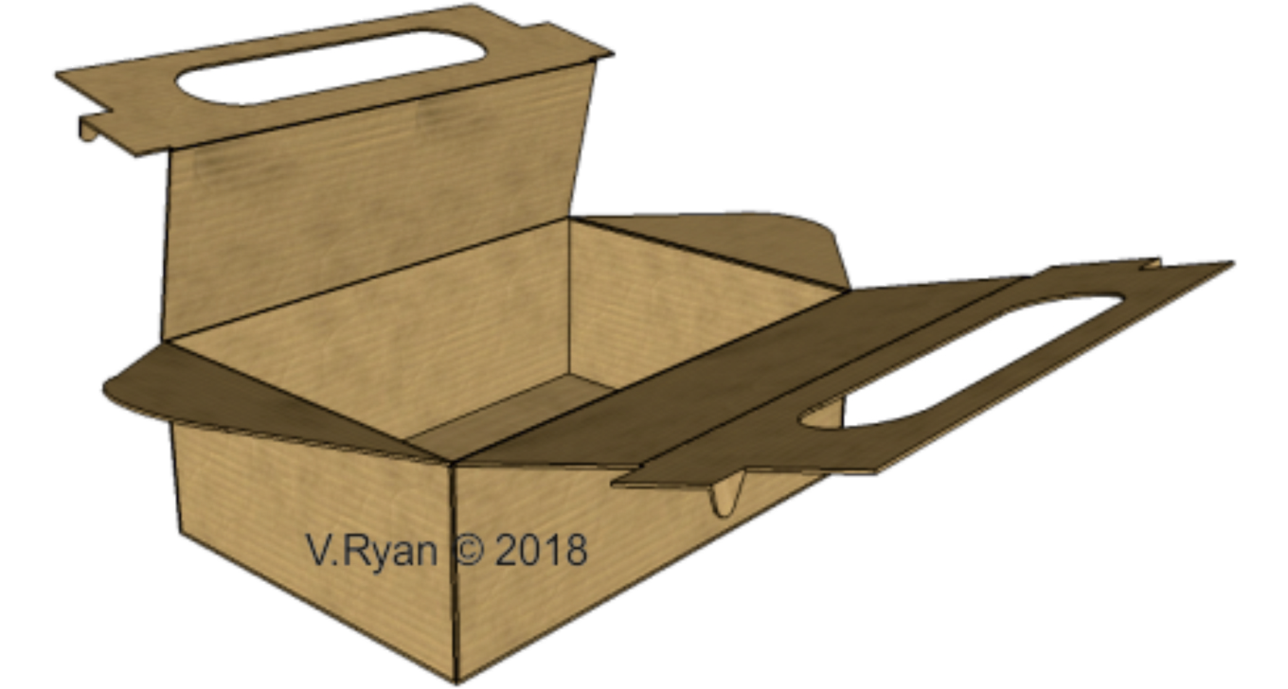
Paper and Boards
7. The photograph shows a disposable food carrier / lunch box.
HELPFUL LINK http://www.technologystudent.com/prddes_2/carrier17.html
7a. Corrugated card has been used for the manufacture of the food carrier shown above. Explain why this material has been used. 2 marks
7b. Sketch the recycling symbol for card 1 mark

Slide 19

HELPFUL LINK hhttp://www.technologystudent.com/despro2/prneﬀ2.htm
7c. The lunch carrier is to have quality graphics, applied to a quality card lid, which will be UV varnished. What is UV varnishing? 2 marks
HELPFUL LINK http://www.technologystudent.com/despro_ﬂsh/subprint1.html
7d. The product will be sold with a free gift, a coﬀee cup (shown below). Sublimation printing has been used to apply graphics to the cup’s surface. What is sublimation printing. Use notes and a sketch(s) in your answer. 4 marks
NOTES
SKETCHES

Slide 20
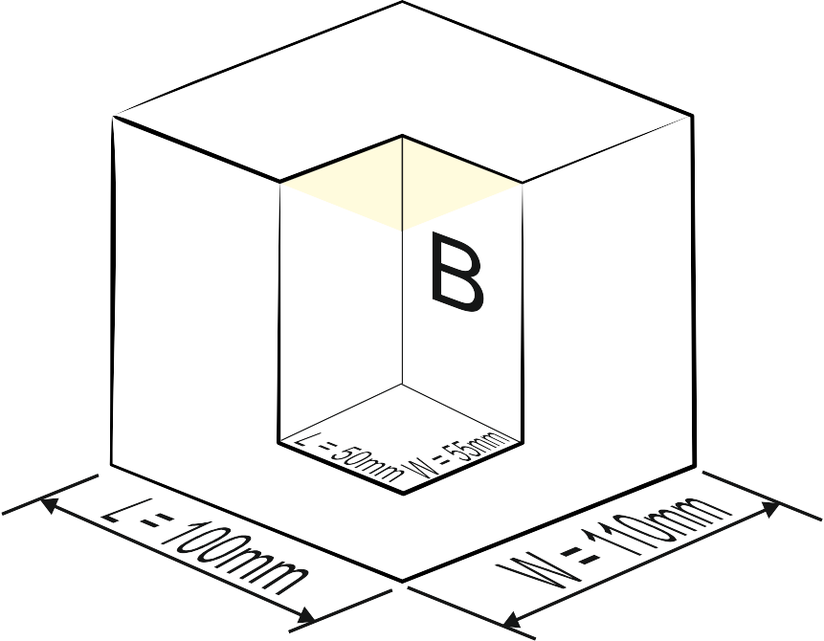
HELPFUL LINK http://www.technologystudent.com/pdf14/maths_rec_prism1.pdf
7. The shape and form of the packaging is to be changed, to the one shown below.
7e. It is based on a rectangular
prism, with a small section folded internally, given the impression that a smaller rectangular prism has been removed.
What is the volume of the ﬁnished 3D shape? Explain your working out.
5 marks
H=120mm
H=80mm
A
WORLD ASSOCIATION OF TECHNOLOGY TEACHERS
https://www.facebook.com/groups/254963448192823/
www.technologystudent.com © 2017 V.Ryan © 2017

Slide 21
HELPFUL LINK http://www.technologystudent.com/prddes1/plannedob1.html
7f. With reference to a product of your choice, explain planned obsolescence.
5 marks
7g. Explain why planned obsolescence can be bad for the environment. 3 marks
7h. ‘Planned obsolescence is sometimes deliberately and openly built into products for safety reasons’. Explain this statement, giving examples. 3 marks

Slide 22
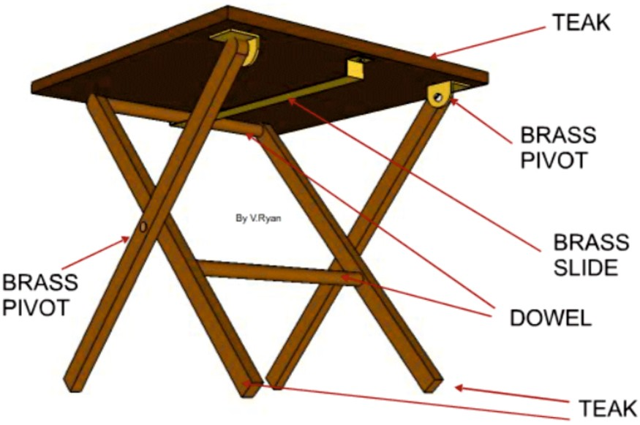
Natural and manufactured timber
8. Study the teak, folding outdoor table / picnic table shown opposite.
HELPFUL LINK http://www.technologystudent.com/rmprep08/prod1.html
8a. Why is teak a suitable material for the outdoor table? 2 marks
HELPFUL LINK http://www.technologystudent.com/despro_ﬂsh/ﬁnish6.html
8b. The outdoor table has been ‘ﬁnished’ with teak oil. Why can this be considered a suitable choice? 2 marks
HELPFUL LINK http://www.technologystudent.com/despro_ﬂsh/ﬁnish6.html
8c. Name one alternative ﬁnish, that could be applied to the table. 1 mark

Slide 23
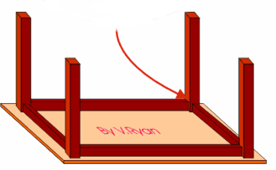
The table design has been updated to a ‘knock-down’ piece of furniture (seen below).
A
3D VIEW - SHOWING UNDERNEATH
SIDE VIEW
HELPFUL LINK http://www.technologystudent.com/joints/tableft1.htm
8d. Name and sketch a suitable KNOCK-DOWN joint for ‘A’, as shown on the drawing above. 4 marks
NAME:
SKETCH

Slide 24


HELPFUL LINK http://www.technologystudent.com/pdf14/maths3.pdf Page 9
WORLD ASSOCIATION OF TECHNOLOGY TEACHERS https://www.facebook.com/groups/254963448192823/
www.technologystudent.com © 2017 V.Ryan © 2017
8e. The table top is to be updated. An acrylic insert, is to be set into the table top. The table top is composed of two rectangular pieces, accurately cut to size on a laser cutter. They ﬁt perfectly together.
Calculate the area of piece A 2 marks
Calculate the area of piece. B 3 marks
200mm
A
B
150mm
300mm
400mm
WORLD ASSOCIATION OF TECHNOLOGY TEACHERS
https://www.facebook.com/groups/254963448192823/
www.technologystudent.com © 2017 V.Ryan © 2017

Slide 25
HELPFUL LINK http://www.technologystudent.com/prddes1/plannedob1.html
8f. With reference to a product of your choice, explain planned obsolescence.
5 marks
8g. Explain why planned obsolescence can be bad for the environment. 3 marks
8h. ‘Planned obsolescence is sometimes deliberately and openly built into products for safety reasons’. Explain this statement, giving examples. 3 marks

Slide 26
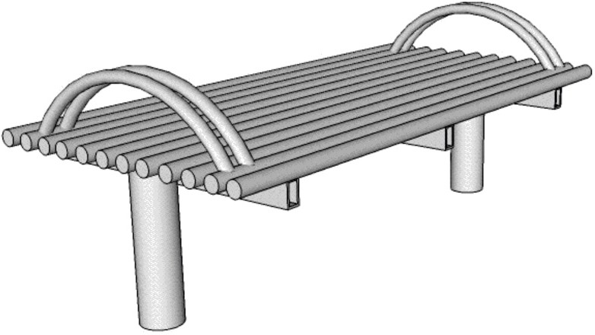
Ferrous and non-ferrous metals
9. This steel bench is manufactured from steel round section tube.
HELPFUL LINK http://www.technologystudent.com/joints/steelbnch1.html
9a. Why is steel tube suitable for the manufacture of the bench? 5 marks

Slide 27
HELPFUL LINK http://www.technologystudent.com/joints_ﬂsh/metal6.html
9b. Describe how the steel bench could be dry powder coated, producing a coloured, protective ﬁnish. Use notes and sketches.
4 marks

Slide 28


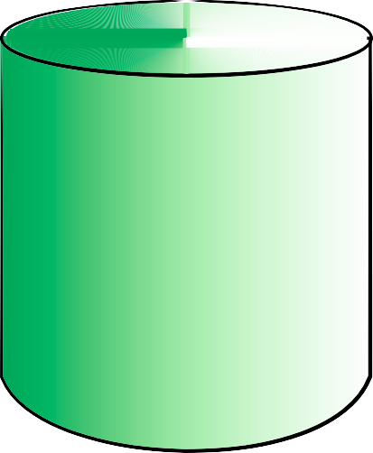
HELPFUL LINK http://www.technologystudent.com/pdf14/maths_cylinder1.pdf Page 5
WORLD ASSOCIATION OF TECHNOLOGY TEACHERS https://www.facebook.com/groups/254963448192823/ www.technologystudent.com © 2017 V.Ryan © 2017
9e. The solid steel object seen below, has been manufactured on an engineering centre lathe. It is one solid piece. Calculate the total volume. 5 marks
HEIGHT= 30mm
RADIUS= 20mm
A
In order to calculate the entire volume of the engineered solid, it is treated as two separate parts. Part A is the smaller cylinder and part B is the larger cylinder.
HEIGHT= 90mm
RADIUS= 40mm
B
WORLD ASSOCIATION OF TECHNOLOGY TEACHERS
https://www.facebook.com/groups/254963448192823/
www.technologystudent.com © 2017 V.Ryan © 2017

Slide 29
HELPFUL LINK http://www.technologystudent.com/prddes1/plannedob1.html
9f. With reference to a product of your choice, explain planned obsolescence.
5 marks
9g. Explain why planned obsolescence can be bad for the environment. 3 marks
9h. ‘Planned obsolescence is sometimes deliberately and openly built into products for safety reasons’. Explain this statement, giving examples. 3 marks

Slide 30
Thermosetting and thermoforming plastics
10. The product seen opposite, is a ‘plastic’ trophy, manufactured through the process called rotational moulding’
HELPFUL LINK http://www.technologystudent.com/prddes1/rotate2.html
10a. Name a material suitable for this industrial process?
1 mark
10b. In the space below, explain the process of rotational moulding. Include a sketch and notes. 3 marks

Slide 31
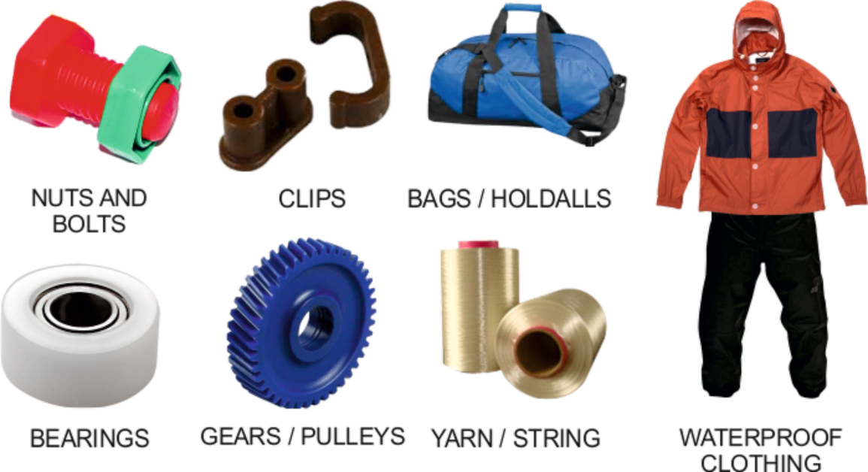
WORLD ASSOCIATION OF TECHNOLOGY TEACHERS https://www.facebook.com/groups/254963448192823/
www.technologystudent.com © 2017
V.Ryan © 2017
10. The products shown below have been manufactured from nylon.
HELPFUL LINK
http://www.technologystudent.com/joints_ﬂsh/nylon2.html
10c. Using notes and a sketch, explain how nylon is manuafctured. 5 marks
SKETCH
NOTES

Slide 32
HELPFUL LINK
http://www.technologystudent.com/pdf14/maths_pyramids1.pdf Page 4
10d. A solid polyethylene square pyramid has been manufactured by rotational moulding. What is the volume of the shape ? 5 marks
WORLD ASSOCIATION OF TECHNOLOGY TEACHERS
https://www.facebook.com/groups/254963448192823/
www.technologystudent.com © 2017 V.Ryan © 2017
HEIGHT
140mm
100mm
FORMULAS
AREA OF BASE = LENGTH²
Using the formulas opposite, calculate the volume of the square pyramid.
Volume = ¹ x Base x Height
3
V = ¹ x B x H
3

Slide 33
HELPFUL LINK http://www.technologystudent.com/prddes1/plannedob1.html
10e. With reference to a product of your choice, explain planned obsolescence.
5 marks
10f. Explain why planned obsolescence can be bad for the environment. 3 marks
10g. ‘Planned obsolescence is sometimes deliberately and openly built into products for safety reasons’. Explain this statement, giving examples. 3 marks

Slide 34
ADD YOUR OWN TEXTILES SPECIFIC EXAMINATION QUESTIONS

