Slide 1


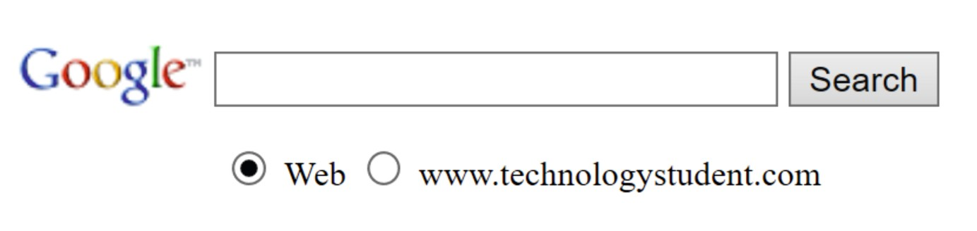


RESEARCH WEBS
MARKETING, ADVERTISING, CONSUMER LAW - SCALES OF PRODUCTION - QUALITY SYSTEMS
USING TECHNOLOGYSTUDENT.COM TO FIND INFORMATION
To help you ﬁnd the information you need, use the ‘search’ function at the bottom of any page of technologystudent.com. The majority of the answers will be found on this website.
For any other information, use a search engine such as Google.
HELPFUL TIP
When using the search function, at the bottom of each page of technologystudent.com, select this option.
WORLD ASSOCIATION OF TECHNOLOGY TEACHERS
https://www.facebook.com/groups/254963448192823/
www.technologystudent.com © 2020 V.Ryan © 2020

Slide 2
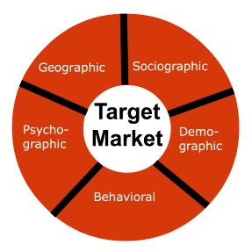


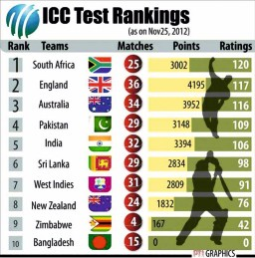






REVISION WEB - MARKETING, ADVERTISING, CONSUMER LAW
WORLD ASSOCIATION OF TECHNOLOGY TEACHERS https://www.facebook.com/groups/254963448192823/ www.technologystudent.com © 2017 V.Ryan © 2017
RESEARCH EACH OF THE KEY WORDS / PHRASES AND WRITE FACTS ON THE REVISION WEB. CONSIDER ADDING AN IMAGE(S) FOR EACH KEYWORD / PHRASE. AN EXAMPLE HAS BEEN COMPLETED FOR YOU.
2015
CONSUMER RIGHTS ACT
TARGET MARKET
POOR SERVICE
FAULTY GOODS
WHEN YOU ARE TREATED UNFAIRLY OR
OMBUDSMAN - INVESTIGATES COMPLAINTS
WHEN THINGS GO WRONG.
RANKING AND RATING TESTS
TRADE DESCRIPTIONS ACT
CONSUMER SURVEY
TRADEMARK
MARKETING STRATEGY
COPYRIGHT
PATENTS

Slide 3


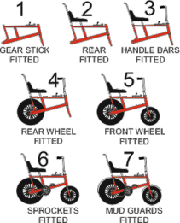
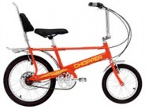
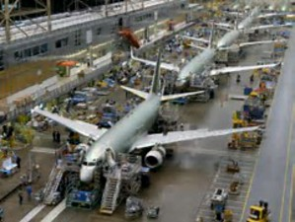

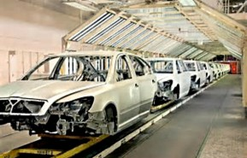
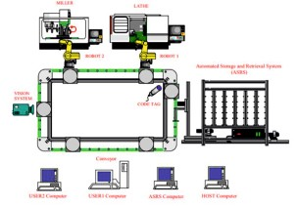
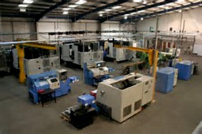
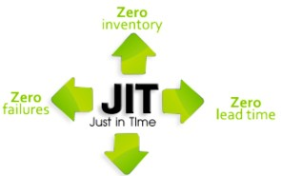
REVISION WEB - SCALES OF PRODUCTION - MANUFACTURING SYSTEMS
WORLD ASSOCIATION OF TECHNOLOGY TEACHERS https://www.facebook.com/groups/254963448192823/ www.technologystudent.com © 2017 V.Ryan © 2017
RESEARCH EACH PRODUCTION SYSTEM AND WRITE FACTS ON THE REVISION WEB. CONSIDER ADDING AN IMAGE(S) FOR EACH SYSTEM. AN EXAMPLE HAS BEEN COMPLETED.
ONE OFF PRODUCTION
GLOBALISATION
BATCHES OF A 1000
SEMI-SKILLED WORKERS
ONE STAGE AT A TIME
BATCH PRODUCTION
ASSEMBLE LINE
PRODUCTION LINE
CONTINUOUS PRODUCTION
REMOTE MANUFACTURING
FLEXIBLE MANUFACTURING
COMPUTER INTEGRATED MANUFACTURE
JUST IN TIME (JIT)

Slide 4




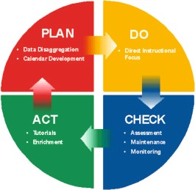




REVISION WEB - QUALITY SYSTEMS
WORLD ASSOCIATION OF TECHNOLOGY TEACHERS https://www.facebook.com/groups/254963448192823/ www.technologystudent.com © 2017 V.Ryan © 2017
RESEARCH EACH QUALITY SYSTEM AND WRITE FACTS ON THE REVISION WEB. CONSIDER ADDING AN IMAGE(S) FOR EACH SYSTEM. AN EXAMPLE HAS BEEN COMPLETED FOR YOU.
QUALITY ASSURANCE
EUROPEAN STANDARD
CONFORMITE EUROPEENNE
PRODUCT MEETS THE REQUIREMENTS
QUALITY CONTROL
MANUFACTURER'S DECLARATION -
EUROPEAN CONFORMITY
SAFETY DECLARATION
CONSUMER TESTING / FOCUS GROUP
CONTINUOUS IMPROVEMENT
RISK ASSESSMENTS
BRITISH STANDARDS INSTITUTE (BSI)
HEALTH AND SAFETY
WITHIN TOLERANCE

