Slide 1
SAMPLE DESIGN AND TECHNOLOGY GCSE EXAMINATION PAPER
WORLD ASSOCIATION OF TECHNOLOGY TEACHERS https://www.facebook.com/groups/254963448192823/
www.technologystudent.com © 2018 V.Ryan © 2018
CENTRE NUMBER CANDIDATE NUMBER
SURNAME
FORENAME(S)
CANDIDATE SIGNATURE
2 HOURS ALLOWED
Materials required for this examination:
normal writing and drawing instruments
a calculator
a protractor.
Instructions to candidates:
Use black ink or black ball-point pen. Use pencil only for drawing.
Fill in the boxes at the top of this page.
Answer all questions.
You must answer the questions in the spaces provided. Do not write on
Do all rough work in this book. Cross through any work that you do not want to be marked.
blank pages.
Information
The marks for questions are displayed.
The maximum mark for this paper is 120.
There are 22 marks for Section A, 32 marks for Section B and 66 marks for Section C.
This example examination paper can be duplicated and printed out if required but not edited in any way.
The links to www.technologystudent.com cannot be removed.
The PDF ﬁle can be stored on school / college systems and distributed electronically (NO EDITING ALLOWED)
PLEASE RESPECT THE COPYRIGHT - report infringers to techteacher@technologystudent.com Not be distributed at courses or by course instructors / consultants
WORLD ASSOCIATION OF TECHNOLOGY TEACHERS https://www.facebook.com/groups/254963448192823/
www.technologystudent.com © 2018 V.Ryan © 2018

Slide 2
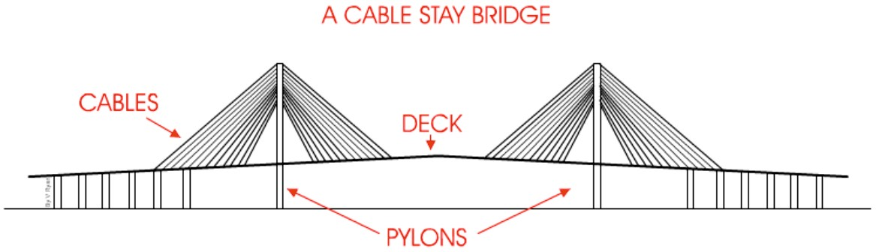
CORE TECHNICAL PRINCIPLES - SECTION A
The questions to follow are multiple choice. Tick one answer for each question.
WORLD ASSOCIATION OF TECHNOLOGY TEACHERS https://www.facebook.com/groups/254963448192823/
www.technologystudent.com © 2018 V.Ryan © 2018
1. A house alarm system has a number of outputs and inputs. Identify an OUTPUT from the selection below.
Movement sensor
Key pad
Siren
Magnetic door sensor
2. The drawing below shows a simple drawing of a bridge. What is the force applied to part X.
X
Tension
Compression
Torsion
Shear
Which of the following metal is a non-ferrous metal?
  Steel
  Copper
  Iron
  Stainless Steel

Slide 3
4. From the list of materials, identify the metal alloy.
WORLD ASSOCIATION OF TECHNOLOGY TEACHERS
https://www.facebook.com/groups/254963448192823/
www.technologystudent.com © 2018 V.Ryan © 2018
Copper
Chromium
Stainless steel
Lead
Which of the following systems, means the production of ONE item?
  Prototype manufacture.
  Continuous Manufacture
  Batch production
  Mass manufacture
Which of the following statements is true?
  Pine is a manufactured material
  Zinc is used to protect metal from corrosion
  MDF means ‘Middle, Density, Foam’
  QC mean ‘Quality Counts’
Which of the statements below is The deﬁnition of the physical property ‘Elasticity’?
  The ability of a material to stand up to forces being applied without it bending, breaking, shattering or deforming in any way.
  The ability of a material to change shape (deform) usually by stretching along its length.
  The ability of a material to stretch without breaking or snapping.
  The ability of a material to absorb force and ﬂex in diﬀerent directions, returning to its original position.

Slide 4
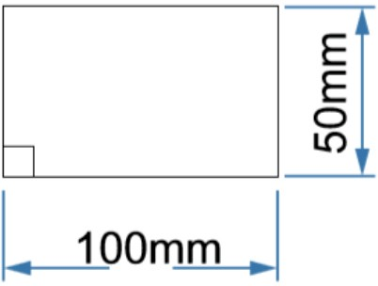
8. Designers consider ‘sustainability’ as one important aspect of design. What is sustainability?
WORLD ASSOCIATION OF TECHNOLOGY TEACHERS https://www.facebook.com/groups/254963448192823/
www.technologystudent.com © 2018 V.Ryan © 2018
A product that is designed to use once.
Materials that can be naturally replenished / regrown.
Finite materials are the only materials used in the manufacture of a product
Sustainability means involving the customer at all stages of design
Which of the following ‘ﬁnishes’ is used for woods.
  Anodising.
  Chemical Blacking.
  Galvanising
  Shellac
10. What is the area of the rectangle shown below?
A. 500mm²
B. 50000mm²
C. 5000mm²
D. 5500mm²

Slide 5
TO HELP YOU ANSWER THIS QUESTION
http://www.technologystudent.com/rmﬂsh1/pine2.html
11. Describe / explain two properties of natural Pine, that makes it ideal for the construction industry. 2 marks
WORLD ASSOCIATION OF TECHNOLOGY TEACHERS https://www.facebook.com/groups/254963448192823/
Property 1:
www.technologystudent.com © 2018 V.Ryan © 2018
Property 2:
TO HELP YOU ANSWER http://www.technologystudent.com/despro_ﬂsh/charity9.html
THIS QUESTION
12. Corrugated card is used extensively in the manufacture of packaging. Why is this the case - list two reasons below. 2 marks
Reason 1:
Reason 2:
TO HELP YOU ANSWER http://www.technologystudent.com/energy1/solar7.htm
THIS QUESTION
13. Solar power is one form of alternative energy, that is becoming popular. Give two reasons for its increase in popularity. 2 marks
Reason 1:
Reason 2:

Slide 6
TO HELP YOU ANSWER http://www.technologystudent.com/energy1/solar7.htm
THIS QUESTION
14. Give two reasons why some people are not in favour of solar energy production.
2 marks
WORLD ASSOCIATION OF TECHNOLOGY TEACHERS https://www.facebook.com/groups/254963448192823/
Reason 1:
www.technologystudent.com © 2018 V.Ryan © 2018
Reason 2:
TO HELP YOU ANSWER THIS QUESTION
http://www.technologystudent.com/pdf14/ratios1.pdf
PAGE 12
15. This question is about alternative energy. A local wind farm produces 4 terawatt hours of electricity over a year. At the same time, a solar farm produced 0.5 terawatt hours of electrical power. What is the ratio Wind farm : Solar Power ? Include an explanation of your working out. 4 marks
WIND FARM
4
: SOLAR POWER
: 0.5
EXPLANATION:

Slide 7
SECTION B - Specialist Technical Principles
WORLD ASSOCIATION OF TECHNOLOGY TEACHERS https://www.facebook.com/groups/254963448192823/
www.technologystudent.com © 2018 V.Ryan © 2018
Natural Pine Board 300mm X 20mm X 3000mm
Steel Round Section 50mm Dia.
Acrylic Round Section 50mm Dia.
16. Select one of the stock forms listed above.
Identify the stock forms primary source (where it comes from) 1 mark
Name of Stock Form
Primary Source (where it comes from)
In the space below, explain how the primary source material is converted to the stock form you have selected. 4 marks
TO HELP YOU ANSWER THIS QUESTION
(Natural Pine)
http://www.technologystudent.com/joints/forest3a.html http://www.technologystudent.com/joints/forest4a.html http://www.technologystudent.com/joints/wdprocess1.html

Slide 8
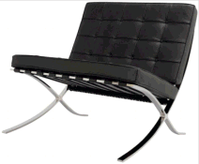
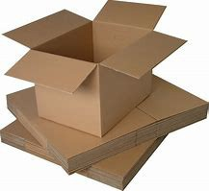
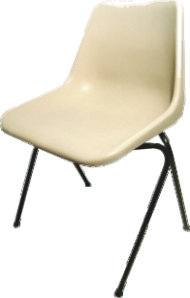
17. Describe two ways in which natural woods are given a ‘ﬁnish’ to enhance and protect their surface. 2 x 2 marks
TO HELP YOU ANSWER THIS QUESTION
http://www.technologystudent.com/despro_ﬂsh/mats_ﬁnish1.html
Finish 1:
WORLD ASSOCIATION OF TECHNOLOGY TEACHERS
https://www.facebook.com/groups/254963448192823/
www.technologystudent.com © 2018 V.Ryan © 2018
Finish 2:
18. Select one of the products shown in the table below. Then, describe two of the features that mean it is suitable for manufacture on a production line. 2 x 2 marks
STEEL CHAIR TO HELP YOU ANSWER THIS QUESTION | PACKAGE TO HELP YOU ANSWER THIS QUESTION | POLYPROP CHAIR TO HELP YOU ANSWER THIS QUESTION
TO HELP YOU ANSWER THIS QUESTION
http://www.technologystudent.com/prddes1/barcelona2.html http://www.technologystudent.com/grp08/pack1.html http://www.technologystudent.com/prddes1/polyprop2.html
PRODUCT:
FEATURE 1:

Slide 9
FEATURE 2:
WORLD ASSOCIATION OF TECHNOLOGY TEACHERS https://www.facebook.com/groups/254963448192823/
www.technologystudent.com © 2018 V.Ryan © 2018
19. For the product you selected in question 18 - name and describe one of the industrial processes used in it’s manufacture. 5 marks
_{TO HELP YOU ANSWER} http://www.technologystudent.com/prddes1/barcelona2.html _{THIS QUESTION} http://www.technologystudent.com/grp08/pack1.html
http://www.technologystudent.com/prddes1/polyprop2.html
INDUSTRIAL PROCESS:
DESCRIPTION OF MANUFACTURING PROCESS INCLUDE NOTES AND A SKETCH(S)

Slide 10
20. Circle one of the materials and its associated product. Then, explain why the material has physical properties, making it suitable for the manufacture of the product 2 x 2 marks
WORLD ASSOCIATION OF TECHNOLOGY TEACHERS https://www.facebook.com/groups/254963448192823/
Plywood - Chair
Steel tube - bench
www.technologystudent.com © 2018 V.Ryan © 2018
PCB (Printed Circuit Board) - Circuit found in electronic products
Metal Foam - Crumple Zone on a train carriage.
Copper - Pipes for domestic water supply
TO HELP YOU ANSWER THIS QUESTION
Follow the links below.
Plywood - Chair - http://www.technologystudent.com/prddes1/eames6.html http://www.technologystudent.com/despro_ﬂsh/ﬂexply1.html http://www.technologystudent.com/joints/plywood1.html
Steel tube - bench - http://www.technologystudent.com/joints/steelbnch1.html
PCB (Printed Circuit Board) - Main circuit found in electronic products - http://www.technologystudent.com/pcb/pcb1a.htm http://www.technologystudent.com/pcb/wave1.html
Metal Foam - Crumple Zone on a train carriage - http://www.technologystudent.com/joints_ﬂsh/metalfoam1.html http://www.technologystudent.com/joints_ﬂsh/metalfoam2.html
Copper - Pipes for domestic water supply - http://www.technologystudent.com/designpro/metals1.htm http://www.technologystudent.com/joints/nonferrous1.html
Propery 1:
Property 2:

Slide 11
21. Designers often select materials based on their environmental impact and the expectations of potential customers. For example, materials that can be recycled, are preferred to those that are non-recyclable.
How are the following materials and strategies regarded as an ethical choice? 10 marks
WORLD ASSOCIATION OF TECHNOLOGY TEACHERS
https://www.facebook.com/groups/254963448192823/
MATERIALS
Sustainable timber Polylactide
Biopol Oxodegradable Polymers
STRATEGIES
www.technologystudent.com © 2018 V.Ryan © 2018
The 6Rs
Recycling - Upcycling - Closed loop recycling Life Cycle Analysis
Replacing the Materials Economy
TO HELP YOU ANSWER THIS QUESTION
Follow the links below.
MATERIALS
Sustainable timber http://www.technologystudent.com/prddes1/susenv1.html
Polylactide http://www.technologystudent.com/joints/pla1.html
Biopol http://www.technologystudent.com/prddes1/biopola.html
Oxodegradable Polymers http://www.technologystudent.com/joints_ﬂsh/oxodegrad1.html
STRATEGIES
Reduce, Reuse, Refuse http://www.technologystudent.com/prddes1/rev_card_three_rs.html
Recycling - Upcycling - Closed loop recycling - http://www.technologystudent.com/prddes1/closeloop1.html http://www.technologystudent.com/prddes1/upcycling1.html
Life Cycle Analysis - http://www.technologystudent.com/prddes1/lifecy1.html
Replacing the Materials Economy - http://www.technologystudent.com/prddes_2/matecon1.html

Slide 13
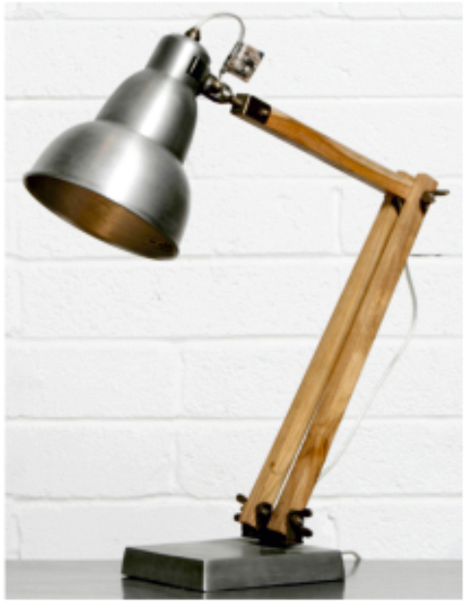
SECTION C - DESIGNING AND MAKING PRINCIPLES
WORLD ASSOCIATION OF TECHNOLOGY TEACHERS https://www.facebook.com/groups/254963448192823/
www.technologystudent.com © 2018
V.Ryan © 2018
A typical task light is shown below
SPECIFICATION
REQUIREMENT 1: The oﬃce / task light must be manufactured from fully recyclable materials.
REQUIREMENT 2: The task / oﬃce light will be based on an Art Movement.
REQUIREMENT 3: The task / oﬃce light must be stable, when adjusted in any possible lighting position.
TO HELP YOU ANSWER THIS QUESTION
Follow the links below.
http://www.technologystudent.com/joints_ﬂsh/oﬃce8.html

Slide 14
TO HELP YOU ANSWER THIS QUESTION
Follow the link below.
http://www.technologystudent.com/joints_ﬂsh/oﬃce6.html
WORLD ASSOCIATION OF TECHNOLOGY TEACHERS https://www.facebook.com/groups/254963448192823/
www.technologystudent.com © 2018 V.Ryan © 2018
22a. Evaluate the task light in terms of the materials you think have been used to manufacture the product. 4 marks
23b. Evaluate the task light in terms of the strength and stability of the product.
4 marks

Slide 15
TO HELP YOU ANSWER THIS QUESTION
Follow the link below.
http://www.technologystudent.com/joints_ﬂsh/oﬃce6.html
WORLD ASSOCIATION OF TECHNOLOGY TEACHERS https://www.facebook.com/groups/254963448192823/
www.technologystudent.com © 2018
V.Ryan © 2018
23c. Evaluate the task light in terms of it’s aesthetics and style. 4 marks
23d. Evaluate the task light in terms of the products functionality.
4 marks

Slide 16
TO HELP YOU ANSWER THIS QUESTION
Follow the links below.
http://www.technologystudent.com/designpro/ergo1.htm http://www.technologystudent.com/despro_ﬂsh/revise11.html http://www.technologystudent.com/despro_ﬂsh/ergorest1.html
WORLD ASSOCIATION OF TECHNOLOGY TEACHERS https://www.facebook.com/groups/254963448192823/
www.technologystudent.com © 2018 V.Ryan © 2018
24a. What is anthropometrics and why do designers regard it as essential, when designing? 4 marks
24a. What is ergonomics and why do designers regard it as essential, when designing? 4 marks

Slide 17
TO HELP YOU ANSWER THIS QUESTION
Follow the link below.
http://www.technologystudent.com/joints_ﬂsh/oﬃce13.html
WORLD ASSOCIATION OF TECHNOLOGY TEACHERS https://www.facebook.com/groups/254963448192823/
www.technologystudent.com © 2018 V.Ryan © 2018
25. With the aid of a sketch and notes, describe two anthropometric measurements that could be applied to an improved task light design. 2 x 4 marks
NOTES SKETCHES
MEASUREMENT 1:
MEASUREMENT 2:

Slide 18
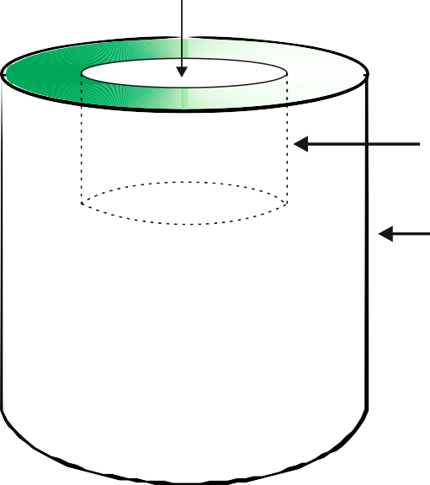

TO HELP YOU ANSWER THIS QUESTION
Follow the link below.
http://www.technologystudent.com/pdf14/maths_cylinder1.pdf
WORLD ASSOCIATION OF TECHNOLOGY TEACHERS https://www.facebook.com/groups/254963448192823/
www.technologystudent.com © 2018 V.Ryan © 2018
26. The solid cylindrical object seen below is being considered as a component for the task light. It is engineered from mild steel, with a large machined ‘blind’ hole, in the top surface.
Calculate the volume of the engineered object.
HEIGHT= 40mm RADIUS= 30mm
5 marks
The cylindrical object is treated as two separate cylinders.
Part A is the ‘Blind’ hole. Part B is the cylinder.
A B
HEIGHT= 130mm
RADIUS= 60mm

Slide 19
TO HELP YOU ANSWER THIS QUESTION
Follow the link below.
http://www.technologystudent.com/joints_ﬂsh/oﬃce8.html
WORLD ASSOCIATION OF TECHNOLOGY TEACHERS https://www.facebook.com/groups/254963448192823/
www.technologystudent.com © 2018 V.Ryan © 2018
27. Three speciﬁcation requirements for the Task Light are written below. Underneath each requirement, write an explanation. The ﬁrst point has been completed for you. 2 x 4 marks
REQUIREMENT 1: The oﬃce / task light must be manufactured from fully recyclable materials.
EXPLANATION: When the oﬃce / task light comes to the end of it's working life, there will be a need to dismantle the light and recycle the materials. The materials can either down- cycled into lower quality products OR reused for spare parts OR up-cycled into higher value products. This will help to protect the environment and attract environmentally conscious customers.
REQUIREMENT 2: The task / oﬃce light will be based on an Art Movement.
REQUIREMENT 3: The task / oﬃce light must be stable, when adjustable to any possible lighting position.

Slide 20
TO HELP YOU ANSWER THIS QUESTION
Follow the link below.
http://www.technologystudent.com/designpro/newspec1.html
WORLD ASSOCIATION OF TECHNOLOGY TEACHERS https://www.facebook.com/groups/254963448192823/
www.technologystudent.com © 2018 V.Ryan © 2018
28. Designers spend time writing a justiﬁed speciﬁcation. What is the purpose of a speciﬁcation? 2 marks
TO HELP YOU ANSWER THIS QUESTION
Follow the link below.
http://www.technologystudent.com/designpro/model1.htm
29. Why do designers make a model, before full production of the product takes place? 2 marks
TO HELP YOU ANSWER THIS QUESTION
Follow the links below.
http://www.technologystudent.com/prddes1/modmat1.html http://www.technologystudent.com/prddes1/modemat2.html
30. Name a material suitable for modelling? 1 marks

Slide 21
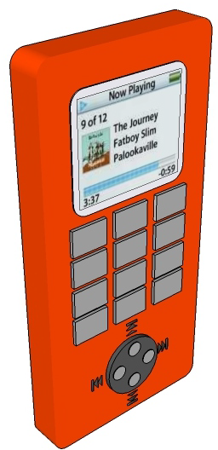
TO HELP YOU ANSWER THIS QUESTION
Follow the links below.
http://www.technologystudent.com/gprep07/phortho4.html http://www.technologystudent.com/gprep07/phortho11.html
WORLD ASSOCIATION OF TECHNOLOGY TEACHERS
https://www.facebook.com/groups/254963448192823/
www.technologystudent.com © 2018 V.Ryan © 2018
31. A typical mobile phone is shown below. This is drawn in perspective (3D).
Complete the orthographic drawing (on the next page) of the same mobile phone, in third angle orthographic projection. Show all your construction lines.
Add five dimensions
Add the symbol for third angle orthographic projection. 8 marks
FRONT VIEW
DIA 40mm
110mm

Slide 22







WORLD ASSOCIATION OF TECHNOLOGY TEACHERS
https://www.facebook.com/groups/254963448192823/
www.technologystudent.com © 2018 V.Ryan © 2018
SCALE 2:1
THIRD ANGLE PROJECTION
50mm

Slide 23


TO HELP YOU ANSWER THIS QUESTION Follow the link below. http://www.technologystudent.com/despro_ﬂsh/smartphone1.html
WORLD ASSOCIATION OF TECHNOLOGY TEACHERS
https://www.facebook.com/groups/254963448192823/
www.technologystudent.com © 2018 V.Ryan © 2018
32. Study the three views of the mobile phone seen opposite. Using the isometric grid at the bottom of the page, sketch an accurate 3D version.
Add realistic colour and detail. 8 marks

