Slide 1
SAMPLE DESIGN AND TECHNOLOGY GCSE EXAMINATION PAPER
WORLD ASSOCIATION OF TECHNOLOGY TEACHERS https://www.facebook.com/groups/254963448192823/
www.technologystudent.com © 2018 V.Ryan © 2018
CENTRE NUMBER CANDIDATE NUMBER
(SAMPLE 5)
SURNAME
FORENAME(S)
CANDIDATE SIGNITURE
2 HOURS ALLOWED
Materials required for this examination:
normal writing and drawing instruments
a calculator
a protractor.
Instructions to candidates:
Use black ink or black ball-point pen. Use pencil only for drawing.
Fill in the boxes at the top of this page.
Answer all questions.
You must answer the questions in the spaces provided. Do not write on
Do all rough work in this book. Cross through any work that you do not want to be marked.
blank pages.
Information
The marks for questions are displayed.
The maximum mark for this paper is 130.
There are 22 marks for Section A, 37 marks for Section B and 71 marks for Section C.
This example examination paper can be duplicated and printed out if required but not edited in any way.
The links to www.technologystudent.com cannot be removed.
The PDF ﬁle can be stored on school / college systems and distributed electronically (NO EDITING ALLOWED)
PLEASE RESPECT THE COPYRIGHT - report infringers to techteacher@technologystudent.com Not be distributed at courses or by course instructors / consultants
WORLD ASSOCIATION OF TECHNOLOGY TEACHERS https://www.facebook.com/groups/254963448192823/
www.technologystudent.com © 2018 V.Ryan © 2018

Slide 2
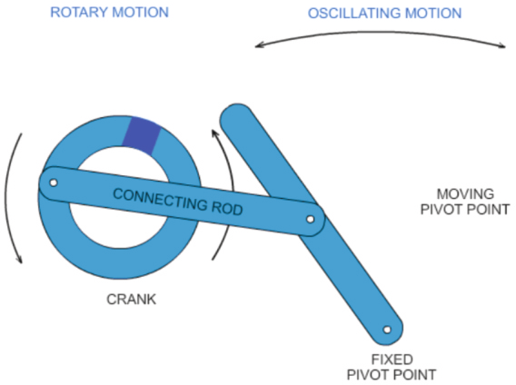
CORE TECHNICAL PRINCIPLES - SECTION A
The questions to follow are multiple choice. Tick one answer for each question.
WORLD ASSOCIATION OF TECHNOLOGY TEACHERS https://www.facebook.com/groups/254963448192823/
www.technologystudent.com © 2018 V.Ryan © 2018
1. Which one of the following manufacturers, initially concentrated on designing and manufacturing ‘metal’ kitchenware ?
Apple
Alessi
Raleigh
Tesla
This link will help you answer this question
http://www.technologystudent.com/prddes_2/alessi1.html
2. Which type of mechanism does the diagram opposite represent?
Cam
Spring
Treadle
Worm Gear
This link will help you answer this question
http://www.technologystudent.com/despro_ﬂsh/treadle1.html
3. Linear Motion is:
Link to potential answer
http://www.technologystudent.com/forcmom/motion1.html
Movement in a straight line and in one direction.
Movement following a circular path, around a ﬁxed point
When an object swings left and then right (or vise-versa), from a ﬁxed point.
A repetitive movement left to right OR up and down.

Slide 3
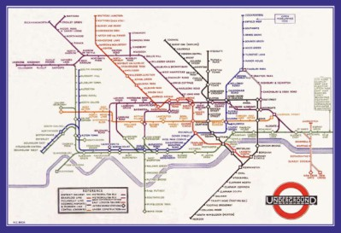
4. Identify the material that is a thin sheet/layer of natural wood
WORLD ASSOCIATION OF TECHNOLOGY TEACHERS
https://www.facebook.com/groups/254963448192823/
www.technologystudent.com © 2018 V.Ryan © 2018
Flexiply
MDF
Veneer
Plywood
Link to potential answer
http://www.technologystudent.com/joints/timber4.html
5. Which of the following designers, designed the London Underground Map?
Philippe Starck
Marcel Breuer
Jorn Utzon
Harry Beck
Link to potential answer
http://www.technologystudent.com/prddes_2/beck1.html
Which of the following statements describing ‘POLYESTER’ is FALSE?
Link to potential answer http://www.technologystudent.com/joints/pet1.html
  It is also called ‘polyethylene terephthalate’.
  It is a thermoplastic polymer.
  It cannot be manufactured as a ﬁbre / textile material.
  It is 100% recycable.
Which of the statements about Graphene is FALSE?
Link to potential answer
http://www.technologystudent.com/despro_ﬂsh/graphene1.html
  Graphene is a nonmetal.
  Graphene has high resistance to the ﬂow of electricity.
  Graphene has the potential to radically change our consumer world.
  Graphene exhibits amazing potential, especially in the electrical and electronics industries.

Slide 4
8. Which of the following statements about nano materials is TRUE?
Link to potential answer http://www.technologystudent.com/joints_ﬂsh/revcard_nano1.html
Nanos are used by the Food Processing industry, to add ﬂavour and taste.
Nano materials are widely used in the construction industry, because of their resistance to corrosion.
A single particle of a nanomaterial, has an average size between 1 to 100 nanometres (nm), which is extremely small.
Nano materials are derived from natural wood.
WORLD ASSOCIATION OF TECHNOLOGY TEACHERS https://www.facebook.com/groups/254963448192823/
www.technologystudent.com © 2018 V.Ryan © 2018
Which of the statements below is accurate regarding ‘wood turning’?
Link to potential answer http://www.technologystudent.com/equip1/woodturn1.html
  Is a method of bending thin layers of wood, forming complicated shapes.
  Is a technique whereby wood is turned around, during the seasoning process.
  A process that creates a ‘reﬂective’ coating on a range of woods.
  Wood is ‘turned’ on a woodworking lathe, producing items such as lamps, table legs and bowls.
10. What is the name of the area of the circle labelled ‘A’, seen below?
Follow the link to a potential answer.
http://www.technologystudent.com/pdf14/maths4.pdf
RADIUS (r)
SECTOR
DIAMETER (d)
A
Segment
Chord
Tangent
Aspect

Slide 5

TO HELP YOU ANSWER THIS QUESTION
http://www.technologystudent.com/prddes1/susenv1.html
11. Describe two ways, in which sustainable forests can contribute to the local economy. 2 marks
WORLD ASSOCIATION OF TECHNOLOGY TEACHERS https://www.facebook.com/groups/254963448192823/
1:
www.technologystudent.com © 2018 V.Ryan © 2018
2:
TO HELP YOU ANSWER THIS QUESTION
http://www.technologystudent.com/joints/sustain1.html
12. The logo shown opposite, is sometimes printed on timber and packaging. Explain the meaning of this logo. 2 marks
TO HELP YOU ANSWER THIS QUESTION
http://www.technologystudent.com/enerﬂsh/coal3.html
13. A number of Power Stations, produce electricity from coal. Give two reasons why some people are against this method of energy production. 2 marks
Reason 1:
Reason 2:

Slide 6
TO HELP YOU ANSWER THIS QUESTION
http://www.technologystudent.com/enerﬂsh/coal3.html
14. Give two reasons why some people are in favour of electricity produce by coal fuelled power stations . 2 marks
WORLD ASSOCIATION OF TECHNOLOGY TEACHERS https://www.facebook.com/groups/254963448192823/
Reason 1:
www.technologystudent.com © 2018 V.Ryan © 2018
Reason 2:
TO HELP YOU ANSWER THIS QUESTION
http://www.technologystudent.com/pdf14/maths5.pdf PAGE 2
15. What is the area of the triangle seen in the diagram.
You will gain marks for each stage of the calculation, written in the space below.
4 marks
CALCULATION:
80mm
60mm
FORMULA
AREA = 1/2 X BASE X HEIGHT
AREA = 1/2 b x h
AREA = ^{b x h}
2

Slide 7
SECTION B - Specialist Technical Principles
WORLD ASSOCIATION OF TECHNOLOGY TEACHERS https://www.facebook.com/groups/254963448192823/
www.technologystudent.com © 2018 V.Ryan © 2018
16. Nylon is one of the most useful of all plastics
Describe the manufacture of nylon. Include notes and a labelled sketch(s)
8 marks
TO HELP YOU ANSWER THIS QUESTION
http://www.technologystudent.com/joints_ﬂsh/nylon2.html

Slide 8
TO HELP YOU ANSWER THIS QUESTION
http://www.technologystudent.com/joints_ﬂsh/nylon1.html
17a. List two properties of nylon? 2 marks
WORLD ASSOCIATION OF TECHNOLOGY TEACHERS https://www.facebook.com/groups/254963448192823/
www.technologystudent.com © 2018 V.Ryan © 2018
17b. Name two products manufactured from nylon? 2 marks
18. Name a product manufactured from kevlar® and explain why this is a suitable material for its production. 4 marks
TO HELP YOU ANSWER THIS QUESTION
http://www.technologystudent.com/joints/kevlar1.html http://www.technologystudent.com/joints/kevlar2.html http://www.technologystudent.com/joints/kevlar3.html http://www.technologystudent.com/joints/kevlar4.html
PRODUCT:
REASONS 1:

Slide 9
WORLD ASSOCIATION OF TECHNOLOGY TEACHERS https://www.facebook.com/groups/254963448192823/
www.technologystudent.com © 2018 V.Ryan © 2018
19. Steel is a very important material, found all around us in buildings, bridges, cars and many other products. Iron is ‘converted’ into steel. In the space below, name and describe the process of conversion, using notes and diagrams.
5 marks
TO HELP YOU ANSWER THIS QUESTION
http://www.technologystudent.com/joints/iron5.html
PROCESS NAME:

Slide 10
20a. Some products are manufactured through a process called ‘compression moulding’. Using notes and a diagram(s), explain this process. 4 marks
WORLD ASSOCIATION OF TECHNOLOGY TEACHERS https://www.facebook.com/groups/254963448192823/
www.technologystudent.com © 2018 V.Ryan © 2018
TO HELP YOU ANSWER THIS QUESTION
Follow the links below.
http://www.technologystudent.com/equip1/hypress1.htm.htm
20b. List four products manufactured through compression moulding. 4 marks
TO HELP YOU ANSWER THIS QUESTION
Follow the links below.
https://www.youtube.com/watch?v=-FxiWMnY4aQ&t=7s

Slide 11
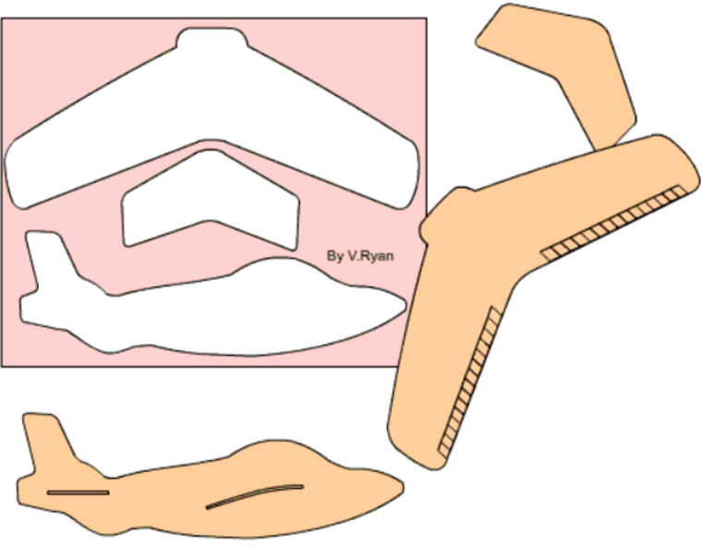
TO HELP YOU ANSWER THIS QUESTION
Follow the links below.
http://www.technologystudent.com/rmprp07/glidr2.html
21a. The toy glider shown below, is ‘batch’ manufactured, through a process called dye cutting. It arrives to the customer on a ﬂat sheet of polystyrene and the three parts are pressed out of the sheet , to form the lightweight glider.
In the space below, explain the process, using notes and a diagram(s). 8 marks

Slide 12
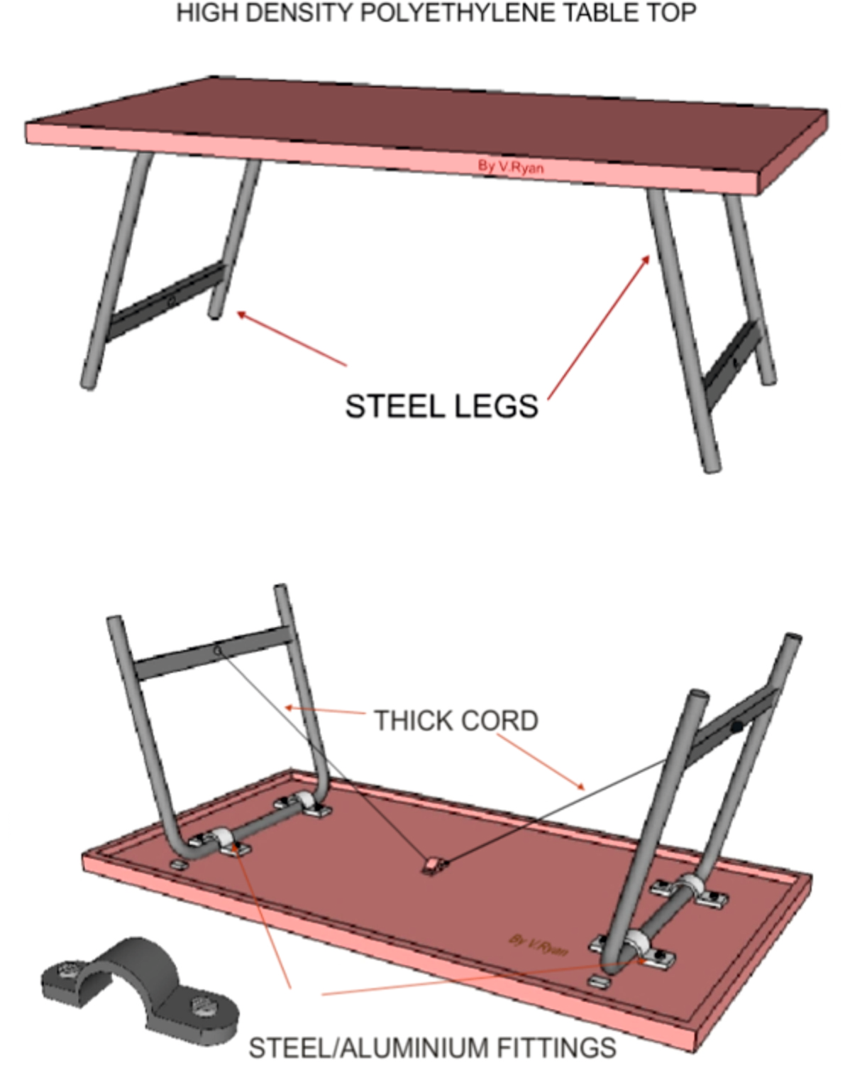
SECTION C - DESIGNING AND MAKING PRINCIPLES
WORLD ASSOCIATION OF TECHNOLOGY TEACHERS https://www.facebook.com/groups/254963448192823/
FOLDING PICNIC TABLE
www.technologystudent.com © 2018 V.Ryan © 2018
This picnic table, has been designed to fold away to a compact form and to be transported with ease.

Slide 13
PICNIC TABLE QUESTIONS
TO HELP YOU ANSWER THIS QUESTION
Follow the links below.
http://www.technologystudent.com/rmprep08/plastab3.html
22a. Why is High Density Polyethylene (HDPE), a suitable material for the table top? 4 marks
WORLD ASSOCIATION OF TECHNOLOGY TEACHERS https://www.facebook.com/groups/254963448192823/
www.technologystudent.com © 2018 V.Ryan © 2018
22c. Describe the stages of manufacturing the table top? Use notes and diagrams
6 marks (Link for help - http://www.technologystudent.com/rmprep08/plastab6.html)

Slide 14
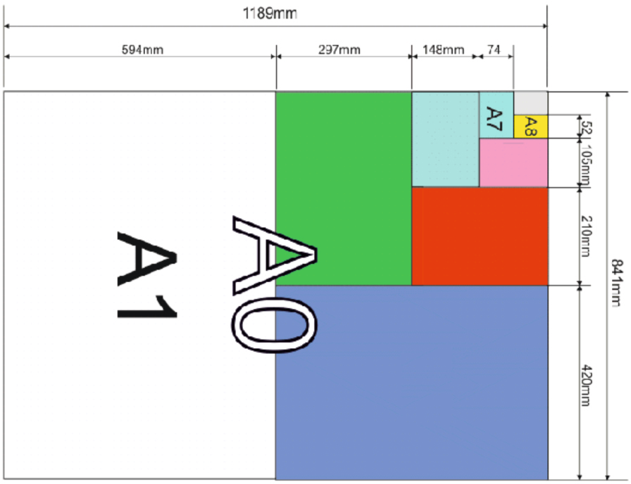

TO HELP YOU ANSWER THIS QUESTION
Follow the link below.
http://www.technologystudent.com/despro_ﬂsh/cardpap1.html
WORLD ASSOCIATION OF TECHNOLOGY TEACHERS https://www.facebook.com/groups/254963448192823/
www.technologystudent.com © 2018 V.Ryan © 2018
23a. The International Standard ISO 216 (International Organization for Standardization), sets out the common paper sizes used around the world? Mark the following paper sizes on the diagram below, in the correct positions . A2, A3, A4, A5
4 marks
23b. What is the meaning of the symbol shown below? 4 marks
TO HELP YOU ANSWER THIS QUESTION
Follow the link below.
http://www.technologystudent.com/despro_ﬂsh/eurosym1.html

Slide 15
TO HELP YOU ANSWER THIS QUESTION
Follow the link below.
http://www.technologystudent.com/despro_ﬂsh/laminate1.html
WORLD ASSOCIATION OF TECHNOLOGY TEACHERS https://www.facebook.com/groups/254963448192823/ www.technologystudent.com © 2018 V.Ryan © 2018
24a. Laminated card packs such as Tetra Paks , are often used to store liquids. Brieﬂy, describe the process of manufacture, of this type of pack. 5 marks.
24b. There are diﬀerent forms of corrugated card. These include: Single Face, Single Wall and Double Wall . Draw a simple diagram representing each the the forms listed. 3 marks
TO HELP YOU ANSWER THIS QUESTION
Follow the link below.
http://www.technologystudent.com/despro_ﬂsh/charity9.html
Single Face
Single Wall
Double Wall

Slide 16
TO HELP YOU ANSWER THIS QUESTION
Follow the link below.
http://www.technologystudent.com/prddes_2/crowd1.html
WORLD ASSOCIATION OF TECHNOLOGY TEACHERS https://www.facebook.com/groups/254963448192823/
www.technologystudent.com © 2018 V.Ryan © 2018
25a. These questions are related to key business terms / phrases (6 marks in total)
What is crowd funding?
2 marks
25b. What is the Fair Trade system?
2 marks
25c. What are cooperatives? 2 marks

Slide 17
TO HELP YOU ANSWER THIS QUESTION
Follow the link below.
http://www.technologystudent.com/prddes1/ictmod1.html
WORLD ASSOCIATION OF TECHNOLOGY TEACHERS
https://www.facebook.com/groups/254963448192823/
www.technologystudent.com © 2018 V.Ryan © 2018
Designers need an understanding of the role ICT, in designing and developing ideas.
26a. What role does ICT play in modelling and developing ideas?
4 marks
26b. What is the meaning of CNC? Include an explanation of the role of coordinates in your answer. 4 marks
TO HELP YOU ANSWER THIS QUESTION
Follow the link below.
http://www.technologystudent.com/cam/cnccut1.html

Slide 18


TO HELP YOU ANSWER THIS QUESTION
Follow the link below.
http://www.technologystudent.com/pdf14/maths2.pdf (page 9)
WORLD ASSOCIATION OF TECHNOLOGY TEACHERS https://www.facebook.com/groups/254963448192823/
www.technologystudent.com © 2017 V.Ryan © 2017
AREA OF A SQUARE - EXAMINATION QUESTION
27. An acrylic window for a school project seen below, is composed of two pieces, accurately cut to size on a laser cutter. They ﬁt perfectly together. 2 x 3 marks (6 marks in total)
a. Calculate the area of piece A
b. Calculate the area of piece. B
200mm
A
B
400mm
200mm
400mm
WORLD ASSOCIATION OF TECHNOLOGY TEACHERS
https://www.facebook.com/groups/254963448192823/
www.technologystudent.com © 2017 V.Ryan © 2017

Slide 19
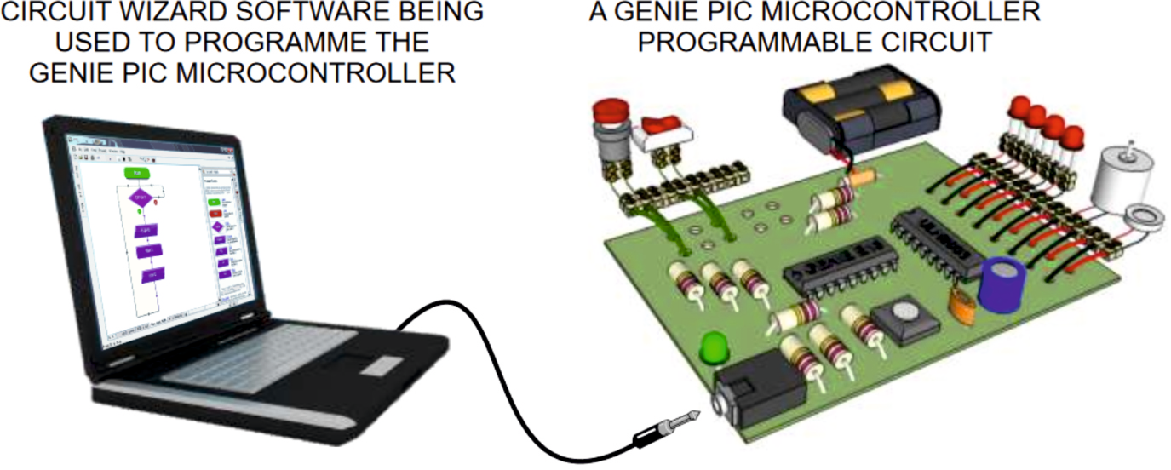
TO HELP YOU ANSWER THESE QUESTION Follow the link below. http://www.technologystudent.com/pics/picgen1.html
WORLD ASSOCIATION OF TECHNOLOGY TEACHERS https://www.facebook.com/groups/254963448192823/ www.technologystudent.com © 2018 V.Ryan © 2018
28a. In general terms, what is a PIC microcontroller? What does it do? 2 marks
28b. Name a piece of programming software, used to program PIC Microcontrollers and to design circuits. 1 mark
28c. The diagram below shows all the necessary equipment for operating a PIC microcontroller. Label the equipment and explain how at works together, to enable the programming of the microcontroller. 5 marks

Slide 20
TO HELP YOU ANSWER THIS QUESTION
Follow the link below.
http://www.technologystudent.com/gears1/gears1.htm
WORLD ASSOCIATION OF TECHNOLOGY TEACHERS
https://www.facebook.com/groups/254963448192823/
www.technologystudent.com © 2018 V.Ryan © 2018
29a. When gears mesh together, what are they called? 1 mark
TO HELP YOU ANSWER THIS QUESTION
Follow the link below.
http://www.technologystudent.com/gears1/gears2.htm
29b. What is a gear train?
1 mark
TO HELP YOU ANSWER THIS QUESTION
Follow the link below.
http://www.technologystudent.com/gears1/gears4.htm
29c. Write a simple description of a rack and pinion gear system. Include a diagram.
4 marks
TO HELP YOU ANSWER THIS QUESTION
Follow the link below.
http://www.technologystudent.com/gears1/bevel1.htm
29d. What is the main purpose of a bevel gear? Include an example of a practical application.
2 marks

Slide 21
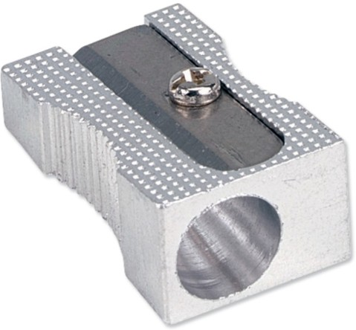
TO HELP YOU ANSWER THIS QUESTION
Follow the link below.
http://www.technologystudent.com/despro2/estper1.htm
WORLD ASSOCIATION OF TECHNOLOGY TEACHERS
https://www.facebook.com/groups/254963448192823/
www.technologystudent.com © 2018 V.Ryan © 2018
30. This is a simple pencil sharpener.
A two point perspective drawing of the sharpener has been started below.
Complete the outline of the sharpener.
3 marks
Add appropriate pencil shading, to enhance the ﬁnal ﬁnish. 3 marks

