Slide 1
DESIGN AND TECHNOLOGY - GCSE SAMPLE PAPER 1
COMPONENT 1
Candidate Name | Centre Number |  |  |  |  | Candidate Number
WORLD ASSOCIATION OF TECHNOLOGY TEACHERS https://www.facebook.com/groups/254963448192823/
www.technologystudent.com © 2017 V.Ryan © 2017
TIME ALLOWED - 2 HOURS
USE THE INSERT PROVIDED HALF WAY THROUGH THIS BOOKLET
EQUIPMENT REQUIRED
Drawing and writing equipment, coloured pencils and a calculator
INSTRUCTIONS
Write in black in,k not pencil.
Answer all the questions.
Use the insert for when answering questions from Section B
Include all working out
TOTAL MARKS FOR THIS PAPER IS 100
This example examination paper can be duplicated and printed out if required but not edited in any way.
The links to www.technologystudent.com cannot be removed.
The PDF ﬁle can be stored on school / college systems and distributed electronically (NO EDITING ALLOWED)
PLEASE RESPECT THE COPYRIGHT - report infringers to techteacher@technologystudent.com Not be distributed at courses or by course instructors / consultants
WORLD ASSOCIATION OF TECHNOLOGY TEACHERS https://www.facebook.com/groups/254963448192823/ www.technologystudent.com © 2018 V.Ryan © 2018

Slide 2
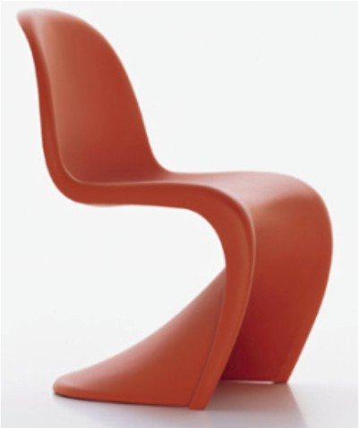
SECTION A
Answer all the questions
HELPFUL LINK http://www.technologystudent.com/rmﬂsh1/alevq2.html
1. The photograph shows a modernist ‘plastic’ chair.
1a. Name a suitable material for the manufacture of this chair? In your answer explain the physical properties that make it suitable. 3 marks
WORLD ASSOCIATION OF TECHNOLOGY TEACHERS
https://www.facebook.com/groups/254963448192823/
www.technologystudent.com © 2017 V.Ryan © 2017
1b. Name and describe a manufacturing process that would be suitable for the industrial production of the chair. 3 mark

Slide 3
HELPFUL LINK http://www.technologystudent.com/rmﬂsh1/alevq2.html
1c. In the space below, sketch the process you have described, adding labels.
4 marks
HELPFUL LINK http://www.technologystudent.com/pdf14/maths4.pdf Page 2
1d. A scaled model of the chair has been manufactured and placed in a ‘model’ room. It stands inside the circle shown below. Calculate the area of the circle.
Include your working out and formula. 2 marks
The circle has a radius of 100mm. What is the area of the circle?
Radius 100mm

Slide 4
HELPFUL LINK http://www.technologystudent.com/prddes1/kite1.html
1e. Designers must consider health and safety when designing a product, such as a chair. Health and Safety in the UK is monitored by the British Standards Institute.
What is the Kite Mark? 2 marks
WORLD ASSOCIATION OF TECHNOLOGY TEACHERS
https://www.facebook.com/groups/254963448192823/
www.technologystudent.com © 2017 V.Ryan © 2017
HELPFUL LINK http://www.technologystudent.com/prddes1/repair1.html
1f. The chair has been designed to be repairable. What are the advantages of a product that can be repaired? 8 marks

Slide 5

HELPFUL LINK http://www.technologystudent.com/pdf14/maths5.pdf Page 8
WORLD ASSOCIATION OF TECHNOLOGY TEACHERS https://www.facebook.com/groups/254963448192823/
www.technologystudent.com © 2017 V.Ryan © 2017
VERTEX
Below is a model a typical village church.
The roof of the tower is a square pyramid.
2a. What is the area of one side of the square pyramid?
4 marks
h=300mm
SQUARE PYRAMID
X
Y
b=250mm
AREA = 1/2 X BASE X HEIGHT
2b. The labels X and Y represent the same part, one side of the square pyramid. Why does Y appear taller than X ? 2 marks
WORLD ASSOCIATION OF TECHNOLOGY TEACHERS
https://www.facebook.com/groups/254963448192823/
www.technologystudent.com © 2017 V.Ryan © 2017

Slide 6
HELPFUL LINK http://www.technologystudent.com/pdf14/maths5.pdf Page 6
WORLD ASSOCIATION OF TECHNOLOGY TEACHERS https://www.facebook.com/groups/254963448192823/
www.technologystudent.com © 2017 V.Ryan © 2017
2c. A piece of waste material is left over, from making the model. What is the area of the waste? 4 marks
h=800
b=600
HELPFUL LINK http://www.technologystudent.com/prddes1/standard1.html
2d. Standard components are often used in the manufacture of products. What is a standard component? 2 marks

Slide 7
HELPFUL LINK http://www.technologystudent.com/prddes1/standard2.html
WORLD ASSOCIATION OF TECHNOLOGY TEACHERS https://www.facebook.com/groups/254963448192823/
www.technologystudent.com © 2017 V.Ryan © 2017
2e. What are the advantages of using standard components, when manufacturing a product. Include an example of a product that includes standard components.
4 marks

Slide 8
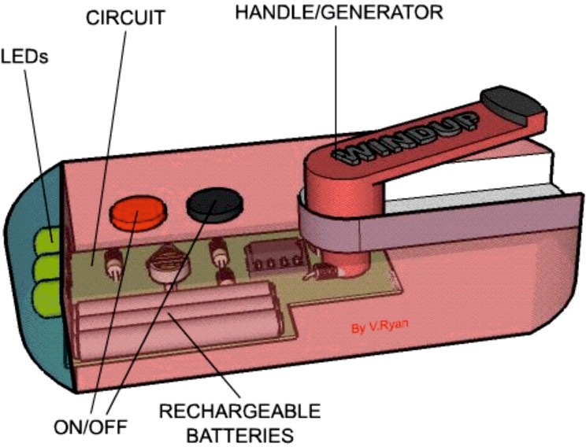

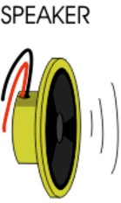

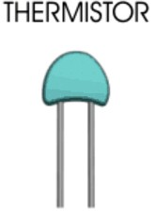
HELPFUL LINK http://www.technologystudent.com/pics/intputs1.htm
3. A ‘wind-up’ torch is shown below. The casing holds a circuit, that includes a range of electronic components, such as those displayed in the table on this sheet.
WORLD ASSOCIATION OF TECHNOLOGY TEACHERS https://www.facebook.com/groups/254963448192823/ www.technologystudent.com © 2017 V.Ryan © 2017
3a. Using a tick or a cross, identify each of the components, as either an ‘input’ or an ‘output’. 4 marks
COMPONENT | INPUT | OUTPUT

Slide 9
HELPFUL LINK http://www.technologystudent.com/enerﬂsh/ensave1.html
WORLD ASSOCIATION OF TECHNOLOGY TEACHERS https://www.facebook.com/groups/254963448192823/
www.technologystudent.com © 2017 V.Ryan © 2017
3b. Compared to conventional torches (those that need batteries), what are the advantages of the ‘wind-up’ version? 4 marks
HELPFUL LINK http://www.technologystudent.com/pdf14/ratios1.pdf Page 12
The question is about alternative energy.
3c. A local wind farm produces 4 terawatt hours of electricity over a year. At the same time, a solar farm produced 0.5 terawatt hours of electrical power. What is the ratio Wind farm : Solar Power ? 3 marks
WIND FARM
4
: SOLAR POWER
: 0.5
EXPLANATION:

Slide 10
HELPFUL LINK http://www.technologystudent.com/energy1/wind8.htm
WORLD ASSOCIATION OF TECHNOLOGY TEACHERS https://www.facebook.com/groups/254963448192823/
www.technologystudent.com © 2017 V.Ryan © 2017
3d. Write two advantages of using wind power to produce electricity. 2 marks
3e. Write two disadvantages of using wind power to produce electricity.
2 marks
HELPFUL LINK http://www.technologystudent.com/prddes1/carenviron5.html
3f. Some car manufacturers regard the use of carbon neutral energy sources (alternative energy) as being important. Describe an example of this approach. 2 marks

Slide 11
PRODUCT INSERTS
Page 1

Slide 12
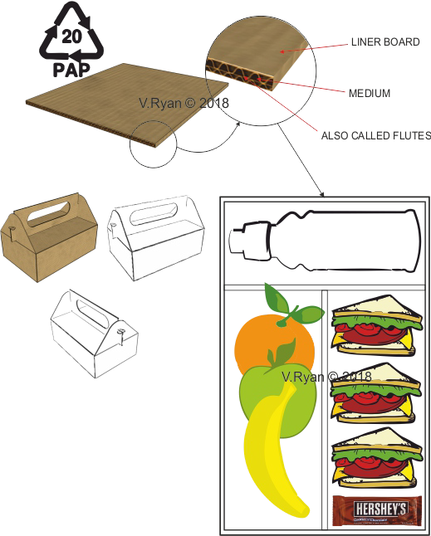
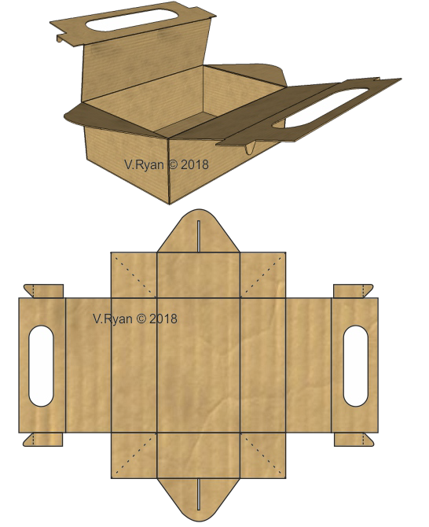
Page 2
WORLD ASSOCIATION OF TECHNOLOGY TEACHERS https://www.facebook.com/groups/254963448192823/
www.technologystudent.com © 2017 V.Ryan © 2017
Product 1 - Disposable Food Carrier (papers and boards)
180mm
300mm
The food carrier is manufactured through mass production. It has been designed to be recycled and to be sturdy, capable of withstanding drops and knocks. It has internal compartments.

Slide 13
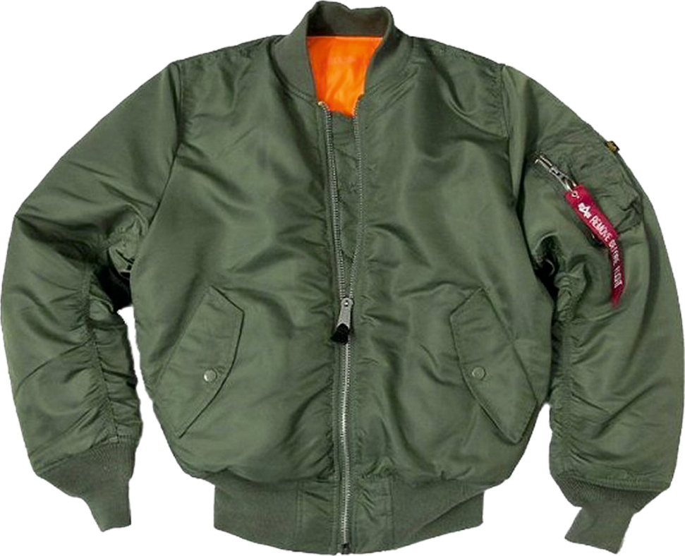
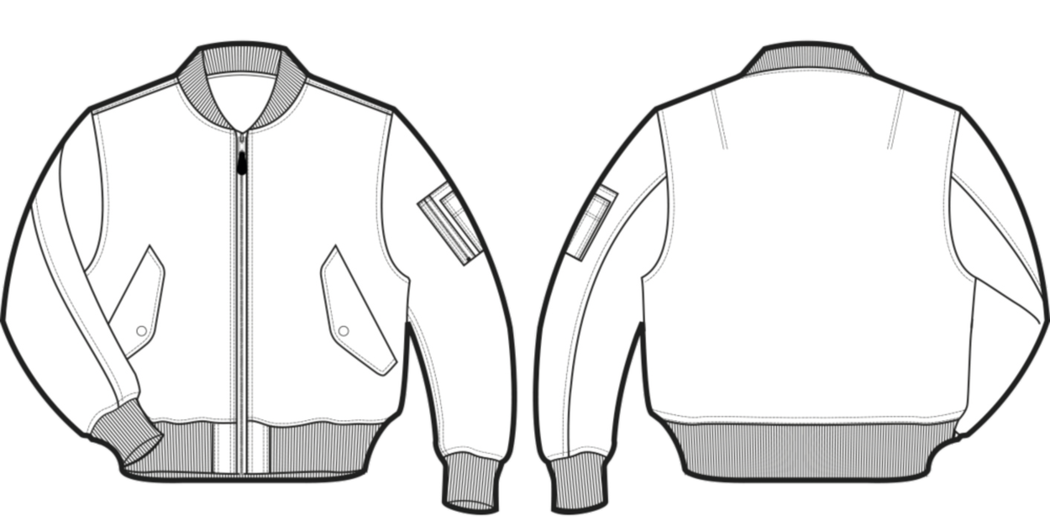
Page 3
Product 2 - TEXTILES - Classic Insulated Unisex Jacket
A classic insulated unisex jacket, for winter. The waist and cuﬀs are to be elasticated. Available in a range of sizes and colours. Suitable for everyday wear.

Slide 14
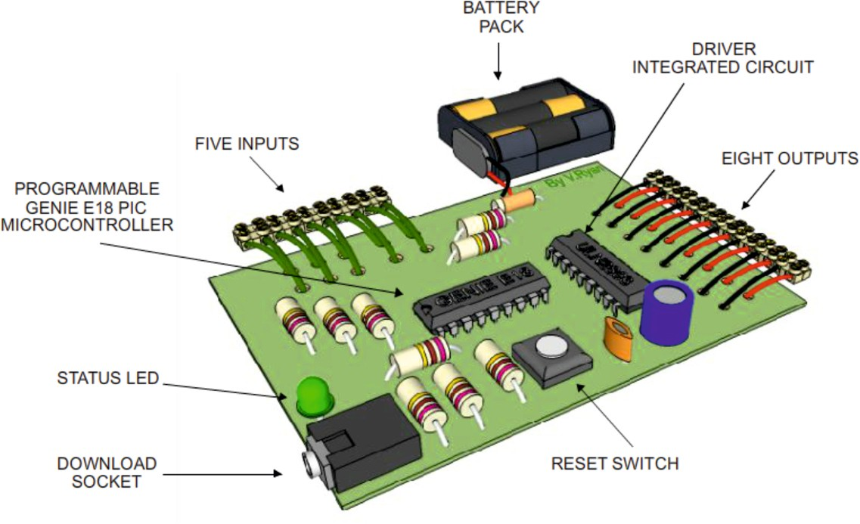
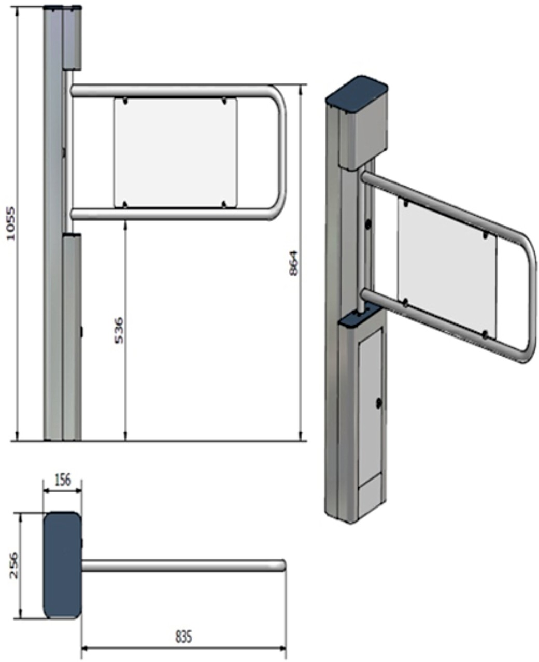
Page 4
Product 3 – Turnstile (design engineering)
The turnstile is connected to a microcontroller, which helps record the number of people entering and exiting the theme park.
The turnstile is manufactured from steel tube.

Slide 15
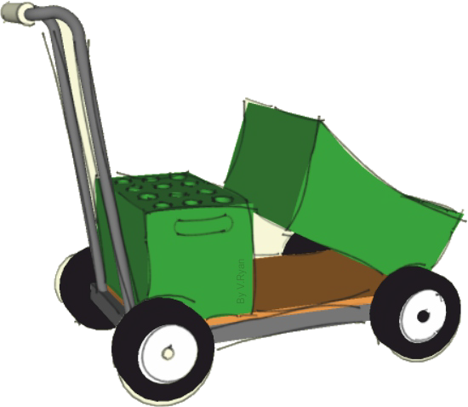
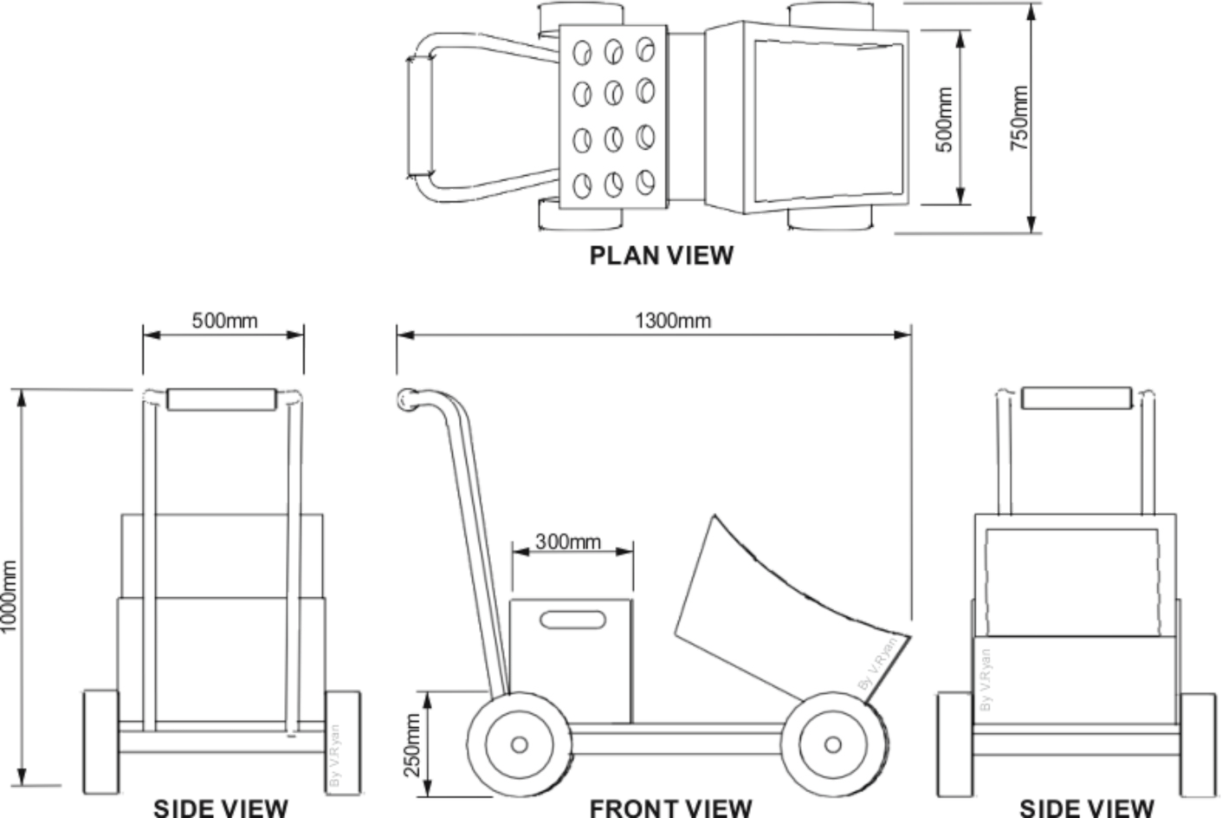
Page 5
WORLD ASSOCIATION OF TECHNOLOGY TEACHERS https://www.facebook.com/groups/254963448192823/
www.technologystudent.com © 2017 V.Ryan © 2017
Product 4 - Transportable Storage for Garden Tools (polymers)
POLYPROPYLENE STORAGE FOR GARDEN TOOLS
ALUMINIUM TUBE HANDLE AND FRAME
The mobile storage unit is used to transport tools around a garden. The frame is aluminium tube and the storage units / boxes are manufactured from a polymer. The wheels are supplied ready made, as a standard component.

Slide 16
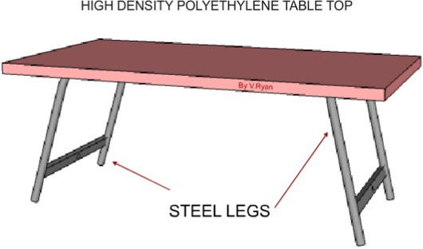
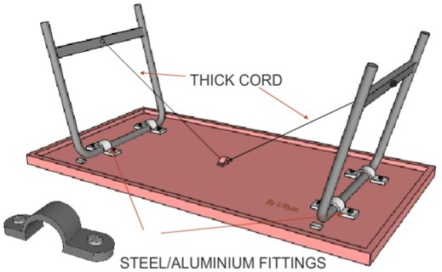
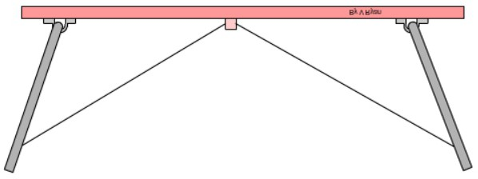
Page 6
WORLD ASSOCIATION OF TECHNOLOGY TEACHERS https://www.facebook.com/groups/254963448192823/
www.technologystudent.com © 2017 V.Ryan © 2017
Product 5 – Folding Table with tubular legs (metals)
1000mm
700mm
500mm
The picnic table is lightweight and foldable. It can be transported and also stored. The legs are aluminium tube, although a version with steel legs is also available.
The product is designed to be completely recyclable, at the end of its life cycle.

Slide 17
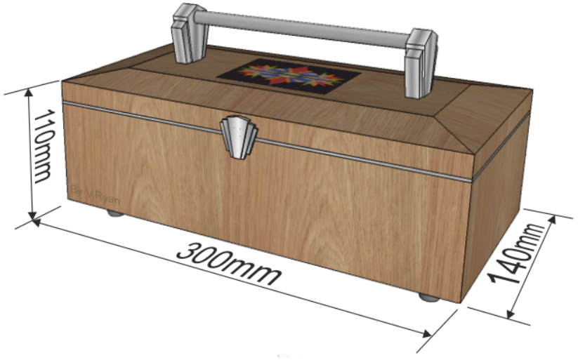
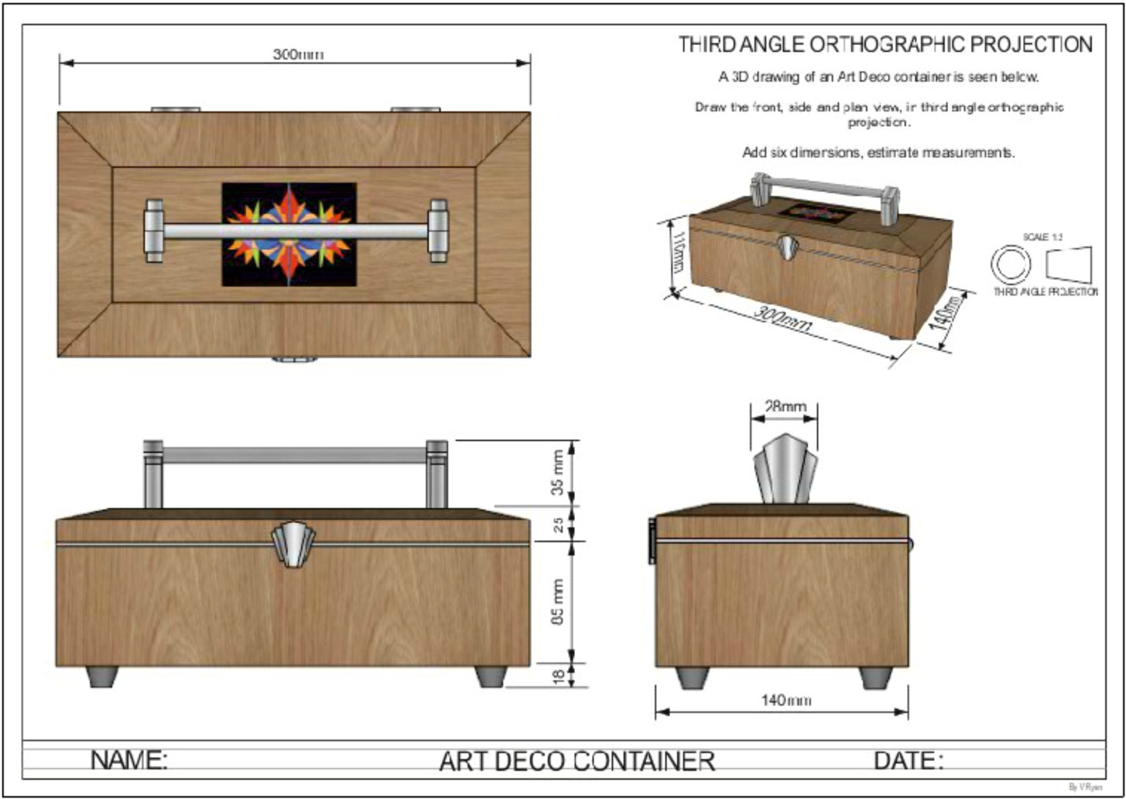
Page 8
www.technologystudent.com © 2017
WORLD ASSOCIATION OF TECHNOLOGY TEACHERS
https://www.facebook.com/groups/254963448192823/
V.Ryan © 2017
Product 6 – Jewellery Storage (timbers)
This storage box is available in a variety of natural woods. Traditional jointing methods have be used during its manufacture. It has a quality ﬁnish and can be locked for security. It is designed in an Art Deco style.

Slide 18
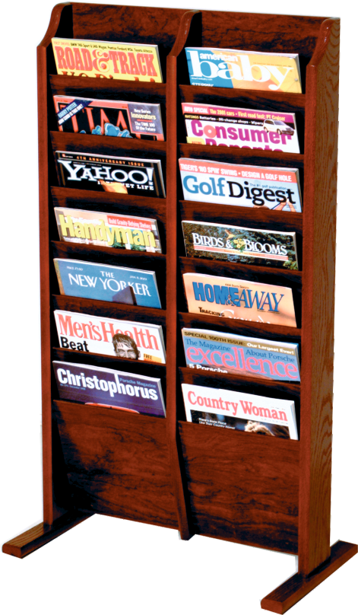
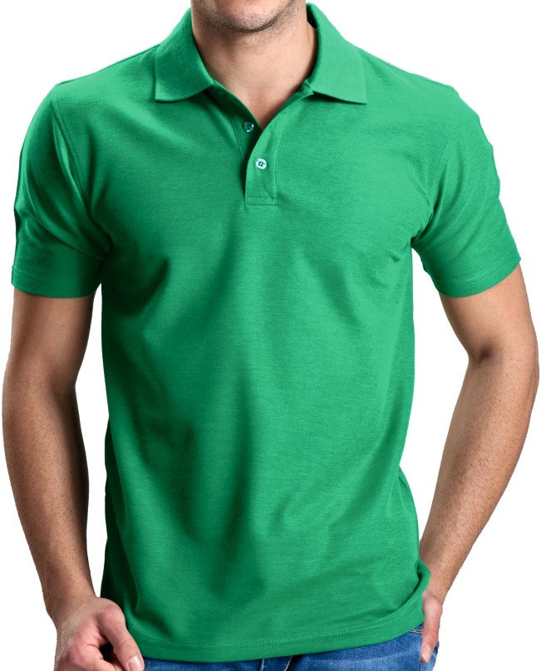

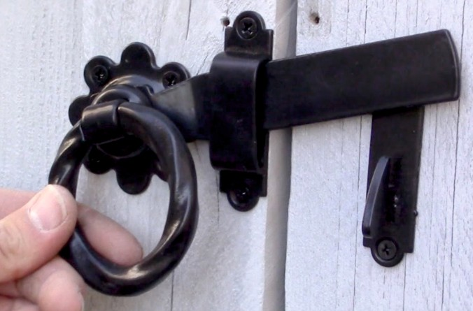
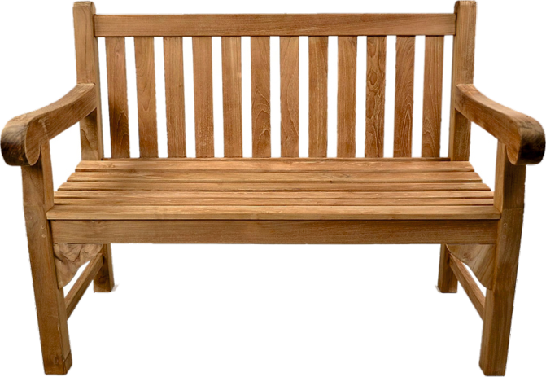
Page 8
Information on this page is required to answer Questions 4 and 5 (c).
IMAGE A
IMAGE B
IMAGE C
IMAGE D

Slide 19
SECTION B
Answer all the questions in this section
The inserts must be used to help you answer all the questions in Section B. These are products that you would ﬁnd in a department store, as a ﬁxture or as a product for sale.
4. Study page 8 of the insert Booklet.
WORLD ASSOCIATION OF TECHNOLOGY TEACHERS https://www.facebook.com/groups/254963448192823/
www.technologystudent.com © 2017 V.Ryan © 2017
HELPFUL LINK http://www.technologystudent.com/despro2/prneﬀ2.htm
4a. The magazines shown in Image A, are composed of paper that has been UV Varnished.
Give two reasons why this printing process is suitable for this product. 2 marks
(I)
(ii)
4b. List one disadvantage of UV Varnishing, as a printing process.
1 mark
HELPFUL LINK http://www.technologystudent.com/joints_ﬂsh/nylon1.html
4c. Image B shows a popular T Shirt manufactured from a synthetic material. Name a suitable synthetic material. 1 mark
(I)
Give two reasons why the material you have named is suitable. 2 marks
(ii)
(iii)

Slide 20
4d. Image C shows a typical latch for a garden gate.
HELPFUL LINK http://www.technologystudent.com/forcmom/lever1.htm
Name the type of mechanism that is represented by the latch. 1 mark
(I)
Why is the mechanism you have named, suitable for this product?
1 mark
(ii)
WORLD ASSOCIATION OF TECHNOLOGY TEACHERS
https://www.facebook.com/groups/254963448192823/
www.technologystudent.com © 2017 V.Ryan © 2017
HELPFUL LINK http://www.technologystudent.com/rmﬂsh1/teak1.html
4e. Image D shows a garden bench manufactured from teak. Explain why teak is a suitable natural wood for this product. 2 marks

Slide 21
You will need to answer both questions 5 and 6, in relation to ONE product selected from below. Keep in mind that you have been studying a specialist area in detail, throughout the course.
It is important that you read questions 5 and 6 before selected the product.
Product 1 - Disposable Food Carrier (papers and boards) Product 2 - Classic Insulated Unisex Jacket (Textiles)
Product 3 – Turnstile (design engineering)
Product 4 - Transportable Storage for Garden Tools (polymers) Product 5 – Folding Table with tubular legs (metals)
Product 6 – Jewellery Storage (timbers)
WORLD ASSOCIATION OF TECHNOLOGY TEACHERS https://www.facebook.com/groups/254963448192823/
www.technologystudent.com © 2017 V.Ryan © 2017
USEFUL LINKS FOR QUESTIONS 5 AND 6
Joining Materials
http://www.technologystudent.com/despro_ﬂsh/mats_join1.html
Wood Based Product
http://www.technologystudent.com/despro_3/trolmanf.html
Metal Based Product
http://www.technologystudent.com/despro_3/altrolley1.html
Polymer Based Product
http://www.technologystudent.com/rmprep09/reman1.html
Design Engineering / Microcontrollers
http://www.technologystudent.com/pics/picdex1.htm
Finishes for Woods and Metals
http://www.technologystudent.com/despro_ﬂsh/mats_ﬁnish1.html
Manufacturing a Card Product by Hand http://www.technologystudent.com/despro2/develp4.htm Manufacturing a Card Product - Small Scale Production
http://www.technologystudent.com/despro2/devman1.htm
Manufacturing a Card Product - Die Cutting
http://www.technologystudent.com/despro2/devman2.htm

Slide 22
Spend no more than 20 minutes on this question
WORLD ASSOCIATION OF TECHNOLOGY TEACHERS https://www.facebook.com/groups/254963448192823/
www.technologystudent.com © 2017 V.Ryan © 2017
5a. After a detailed design process, a ﬁnal product / design is manufactured. In the space below and on the next page, explain / describe how your chosen product is manufactured. Use sketches, labels and notes. 12 marks
Include the following details:
The manufacturing processes. Tools and equipment required. Quality and safety checks.
Finish(s) applied to the completed product.

Slide 24
_{HELPFUL LINKS} http://www.technologystudent.com/prddes1/closeloop1.html http://www.technologystudent.com/prddes1/closeloop2.html
WORLD ASSOCIATION OF TECHNOLOGY TEACHERS
https://www.facebook.com/groups/254963448192823/
www.technologystudent.com © 2017 V.Ryan © 2017
5b. Designers need to consider environmental issues when designing products. Consequently, many products are designed to be recycled, as part of a ‘Closed Loop System’.
6f. What is Closed Loop Recycling? Include reference to how a product of your choice, could be recycled through this system. 5 marks

Slide 25
HELPFUL LINK
http://www.technologystudent.com/prddes_2/crowd1.html
WORLD ASSOCIATION OF TECHNOLOGY TEACHERS
https://www.facebook.com/groups/254963448192823/
www.technologystudent.com © 2017 V.Ryan © 2017
5c. The design and manufacture of a product is sometimes ﬁnanced through Crowd Funding. What is Crowd Funding? 6 marks

Slide 26
http://www.technologystudent.com/joints/htest1.html http://www.technologystudent.com/joints/tensile1.html http://www.technologystudent.com/joints/conduct1.html
http://www.technologystudent.com/joints/toughness1.html
HELPFUL LINKS
WORLD ASSOCIATION OF TECHNOLOGY TEACHERS
https://www.facebook.com/groups/254963448192823/
www.technologystudent.com © 2017 V.Ryan © 2017
6. Considering the product you chose for question 5:
(a) Before and during manufacture, materials need testing.
Select just ONE material, followed by how the material could be tested to ensure quality. Include sketches if required. 4 marks
Material:

Slide 27
HELPFUL LINK http://www.technologystudent.com/despro_ﬂsh/mats_compos1.html
WORLD ASSOCIATION OF TECHNOLOGY TEACHERS
https://www.facebook.com/groups/254963448192823/
www.technologystudent.com © 2017 V.Ryan © 2017
6b. Composite materials are in wide use, in the modern world around us.
Name a composite material, explain why it is regarded as a composite material and give practical examples of its use.
8 marks

