Slide 1
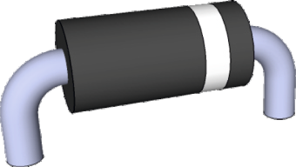
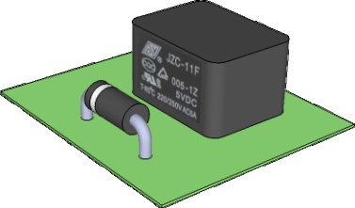
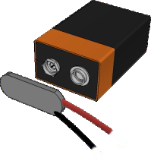
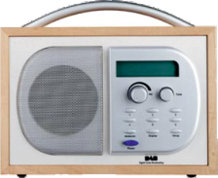
REVISION CARDS - WHAT ARE DIODES?
V.Ryan © 2013 World Association of Technology Teachers
INTRODUCTION - DIODES
DIODES - TRANSIENT PROTECTOR
DIODES - REVERSE POLARITY PROTECTOR
In most circuits, a diode is an essential component . If a battery or power source is connected the wrong way round to the radio (seen above), the diode in the circuit does not allow current to flow, protecting sensitive components.
The circuits of electronic devices can be damaged or even destroyed, if polarity is reversed (positive and negative are connected to the wrong terminals).
www.technologystudent.com
DIODE
RELAY
A diode allows electricity to flow in one direction only and blocks the flow in the opposite direction. They can be regarded as one-way valves. They are common in circuits, as they are used to protect sensitive components. S e n s i t i v e c o m p o n e n t s c a n b e destroyed / damaged by ‘back E.M.F. (electricity flowing round a circuit in the wrong direction).
When a component such as a relay is turned off, high voltage back E.M.F. can be generated for a short time. This voltage ‘spike’ can damage the relay and other components, if it travels round the circuit.
If a diode is placed in parallel with the relay, the circuit is protected against any possible ‘spikes’. The diode prevents back E.M.F. as a diode will only allow electricity to travel round
www.technologystudent.com
SYMBOL
the circuit in the correct direction.
www.technologystudent.com
1. Why are diodes used in electronic circuits?
3 marks
2. How can a diode be used as a transient protector ?
3 marks
3. How can a diode be used as protection against reverse polarity ?
3 marks

