Slide 1
DESIGN AND TECHNOLOGY
NAME: FORM/GROUP:
REVISION BOOKLET
https://www.fa5cebook.com/groups/254963448192823/
WORLD ASSOCIATION OF TECHNOLOGY TEACHERS
www.technologystudent.com © 2017 V.Ryan © 2017
COMPOSITE MATERIALS - SECOND BOOKLET
PLYWOOD
FLEXI PLY ( A FLEXIBLE FORM OF PLYWOOD) KEVLAR®
THERMOPLASTIC ELASTOMERS (TPE)
WORLD ASSOCIATION OF TECHNOLOGY TEACHERS https://www.facebook.com/groups/254963448192823/
www.technologystudent.com © 2017 V.Ryan © 2017
SUITABLE REVISION MATERIAL FOR:
PRODUCT DESIGN RESISTANT MATERIALS GRAPHIC PRODUCTS DESIGN AND TECHNOLOGY
This examination booklet can be duplicated and printed out if required but not edited in any way.
The links to www.technologystudent.com cannot be removed.
The PDF ﬁle can be stored on school / college systems and distributed electronically (NO EDITING ALLOWED)
PLEASE RESPECT THE COPYRIGHT - report infringers to techteacher@technologystudent.com Not be distributed at courses or by course instructors / consultants
WORLD ASSOCIATION OF TECHNOLOGY TEACHERS https://www.facebook.com/groups/254963448192823/
www.technologystudent.com © 2017 V.Ryan © 2017

Slide 2
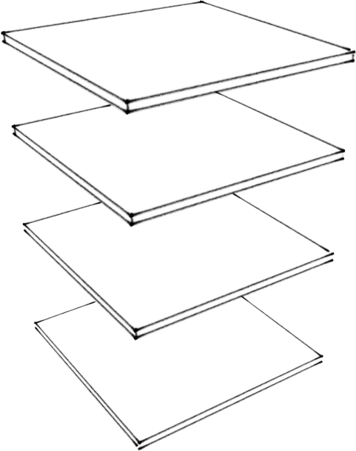
PLYWOOD
https://www.facebook.com/groups/254963448192823/
WORLD ASSOCIATION OF TECHNOLOGY TEACHERS
www.technologystudent.com © 2017 V.Ryan © 2017
LINK TO HELP AND INFORMATION https://www.technologystudent.com/joints/plywood1.html
1a. Explain why plywood can be described as a composite material. 4 marks
1b. The incomplete sketch below shows individual plies, ready for gluing to form plywood. Add the grain to each ply, clearly showing its direction. Using colour/shade will enhance your marks. 4 marks
1c. Explain the importance in the way the grain of each ply is positioned. 2 marks

Slide 3
PLYWOOD - CONTINUED
WORLD ASSOCIATION OF TECHNOLOGY TEACHERS https://www.facebook.com/groups/254963448192823/
www.technologystudent.com © 2017 V.Ryan © 2017
LINK TO HELP AND INFORMATION https://www.technologystudent.com/joints/plywood1.html
1d. What are the advantages of using plywood over other natural woods?
1e. List practical applications of plywood. You may also need to search the internet for examples.

Slide 4
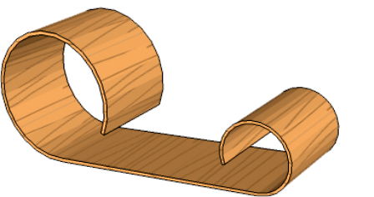
FLEXI PLY ( A FLEXIBLE FORM OF PLYWOOD)
WORLD ASSOCIATION OF TECHNOLOGY TEACHERS https://www.facebook.com/groups/254963448192823/
www.technologystudent.com © 2017 V.Ryan © 2017
LINK TO HELP AND INFORMATION
https://www.technologystudent.com/despro_ﬂsh/ﬂexply1.html
2a. Describe the main advantage of ﬂexi ply, over other forms of manmade boards? Use notes and sketches in your answer. 3 marks notes 3 marks sketche(s)
2b. Describe how the permanent form/shape seen opposite, could be manufactured from several layers of ﬂexi ply. Use labelled sketches and notes.
3 marks notes 3 marks sketch(s)
2c. Using the Internet, collect four images of pieces of furniture, manufactured from ﬂex ply. For each piece of furniture, write your thoughts on the design. 2 x 4 marks

Slide 5
KEVLAR®
https://www.facebook.com/groups/254963448192823/
WORLD ASSOCIATION OF TECHNOLOGY TEACHERS
www.technologystudent.com © 2017 V.Ryan © 2017
LINK TO HELP AND INFORMATION
https://www.technologystudent.com/joints/kevlar1.html https://www.technologystudent.com/joints/kevlar2.html
3a. What is Kevlar®?
3 marks
3b. How is Kevlar® formed into a textile material?
3 marks
3c. List eight products that include the material Kevlar®
8 marks
3d. Kevlar® is one type of Kevlar. Name the two other main types.
2 marks

Slide 6
KEVLAR® - CONTINUED
WORLD ASSOCIATION OF TECHNOLOGY TEACHERS https://www.facebook.com/groups/254963448192823/
www.technologystudent.com © 2017 V.Ryan © 2017
LINK TO HELP AND INFORMATION
https://www.technologystudent.com/joints/kevlar1.html https://www.technologystudent.com/joints/kevlar2.html
4a. Apart from weight and strength, Kevlar® has other advantages. What are they? Refer to products and practical applications in your answer. 5 marks
4b. Kevlar® has a specialist role as a material. It is not used widely because it has certain disadvantages. What are the disadvantages of Kevlar®? Refer to products and practical applications in your answer. 5 marks

Slide 7
CARS AND KEVLAR ®
WORLD ASSOCIATION OF TECHNOLOGY TEACHERS https://www.facebook.com/groups/254963448192823/
www.technologystudent.com © 2017 V.Ryan © 2017
LINK TO HELP AND INFORMATION https://www.technologystudent.com/joints/kevlar3.html
4c. Describe how kevlar ® is currently used in the automotive industry. You should identify parts / components of a vehicle and explain how and why kevlar® is used. The keywords / phrases below may help you answer this question. Use notes and diagrams.
BRAKE PADS BODYWORK CAR BODY ARMOUR HOSES
FORMULA ONE FUEL TANKS CLUTCHES BELTS
TYRES
GASKETS

Slide 8
THERMOPLASTIC ELASTOMERS (TPE) ALSO CALLED THERMOPLASTIC RUBBERS
WORLD ASSOCIATION OF TECHNOLOGY TEACHERS https://www.facebook.com/groups/254963448192823/
www.technologystudent.com © 2017 V.Ryan © 2017
LINK TO HELP AND INFORMATION
https://www.technologystudent.com/despro_ﬂsh/tpe1.html https://www.technologystudent.com/despro_ﬂsh/tpe2.html
5a. What are Thermoplastic Elastomers (TPEs)?
5b. Sketch and name a product manufactured from each of the follow TPEs:
ARNTINEL HYTREL KRATON RITEFLEX STYROFLEX
5c. What are the general properties of TPEs?
5d. List two disadvantages of using of TPEs?

