Slide 1
DESIGNER EXAMINATION
QUESTIONS
TO ANSWER ALL THE QUESTIONS YOU WILL NEED TO DOWNLOAD THE “DESIGNERS” APP AND “ART MOVEMENTS” APP FROM THE INTERACTIVE MOBILE APP SECTION OF www.technologystudent.com
CLICK ON THE BUTTONS
TO DOWNLOAD THE APPS
Once you have downloaded the Apps, you can use them to navigate the website. You may need to follow the links on each page of the App, to research / complete answers to all the questions.
IF YOUR ARE AN EDUCATOR, CONSIDER JOINING US AT FACEBOOK – WORLD ASSOCIATION OF TECHNOLOGY TEACHERS
https://www.facebook.com/groups/254963448192823/

Slide 2
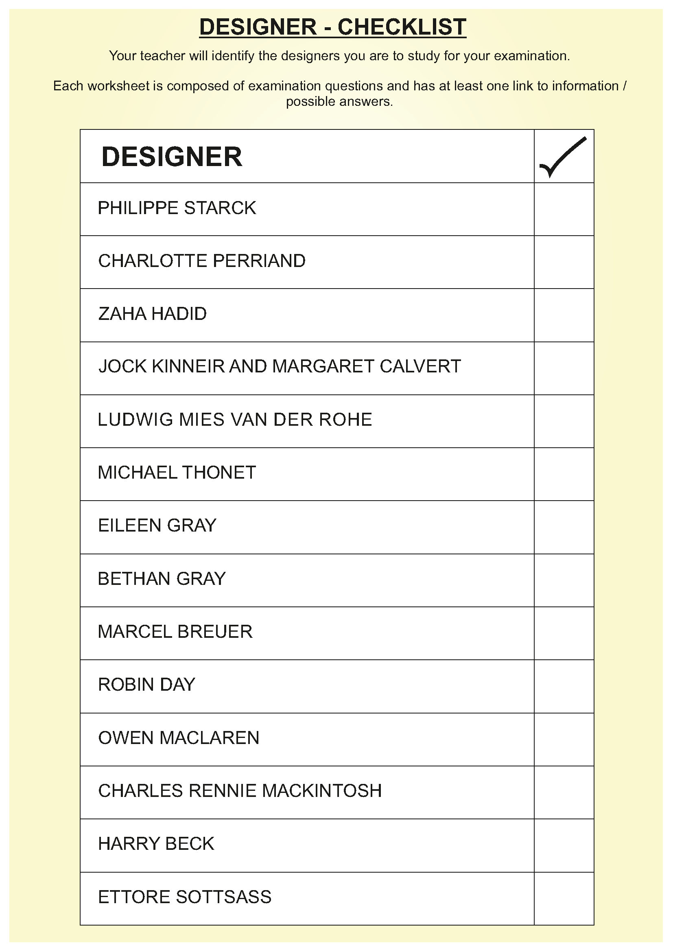

Slide 3
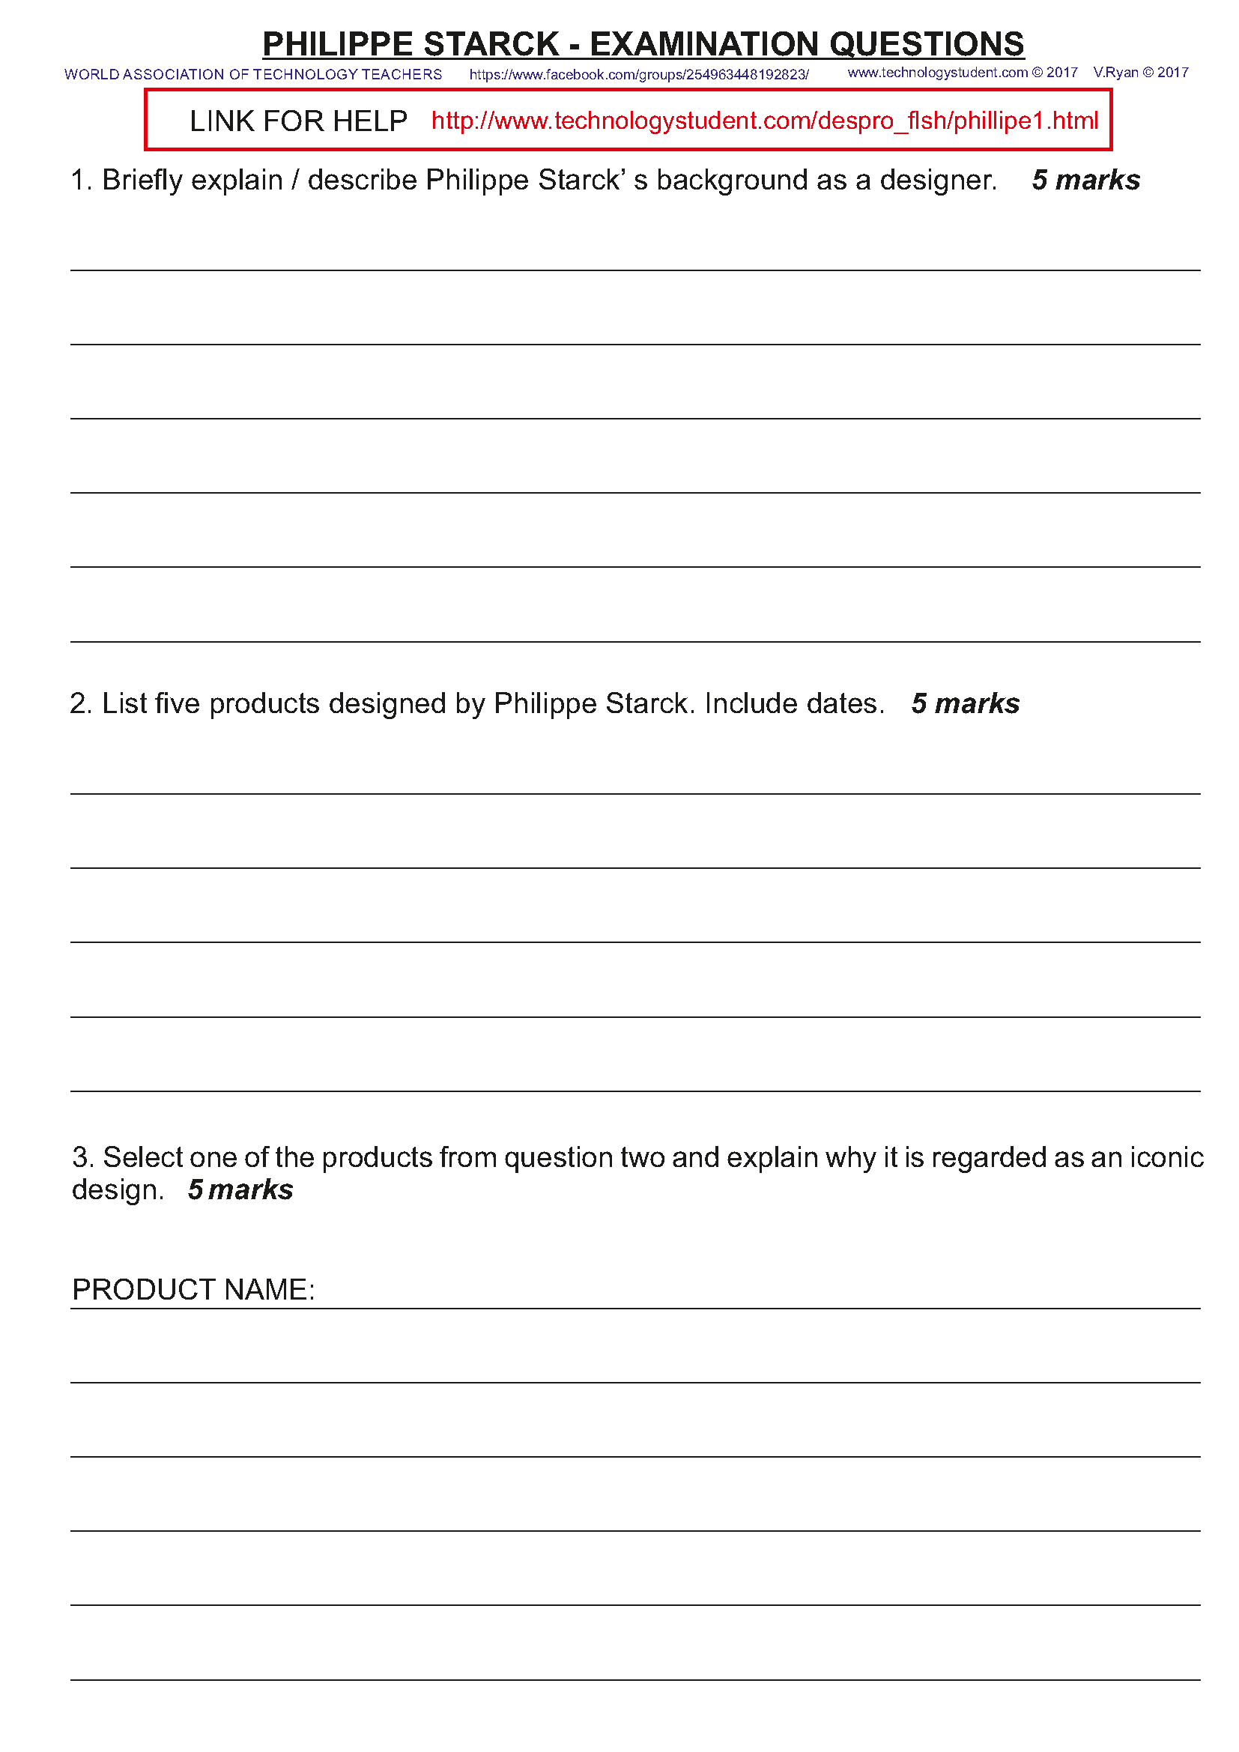

Slide 4
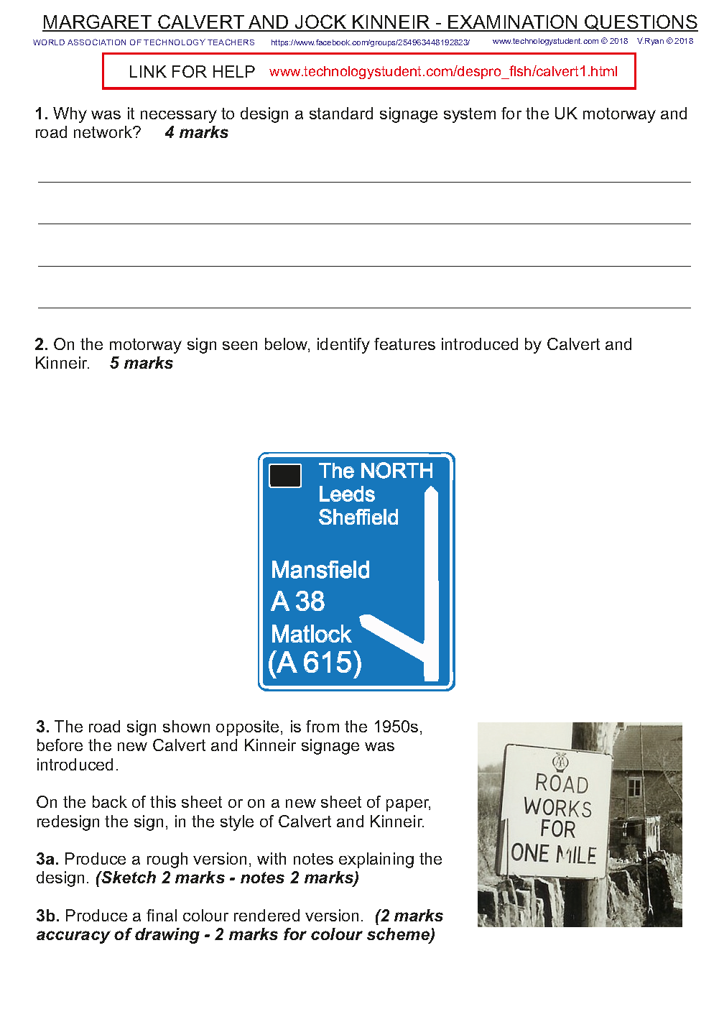
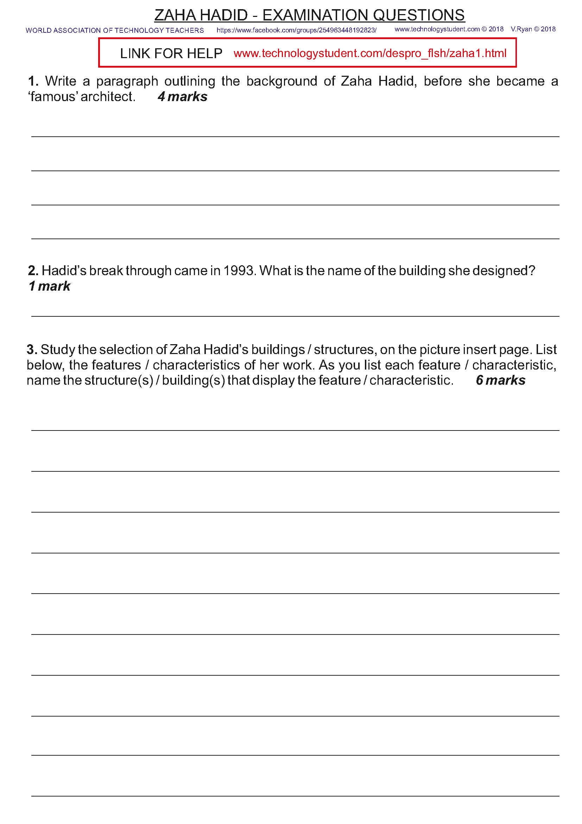

Slide 5
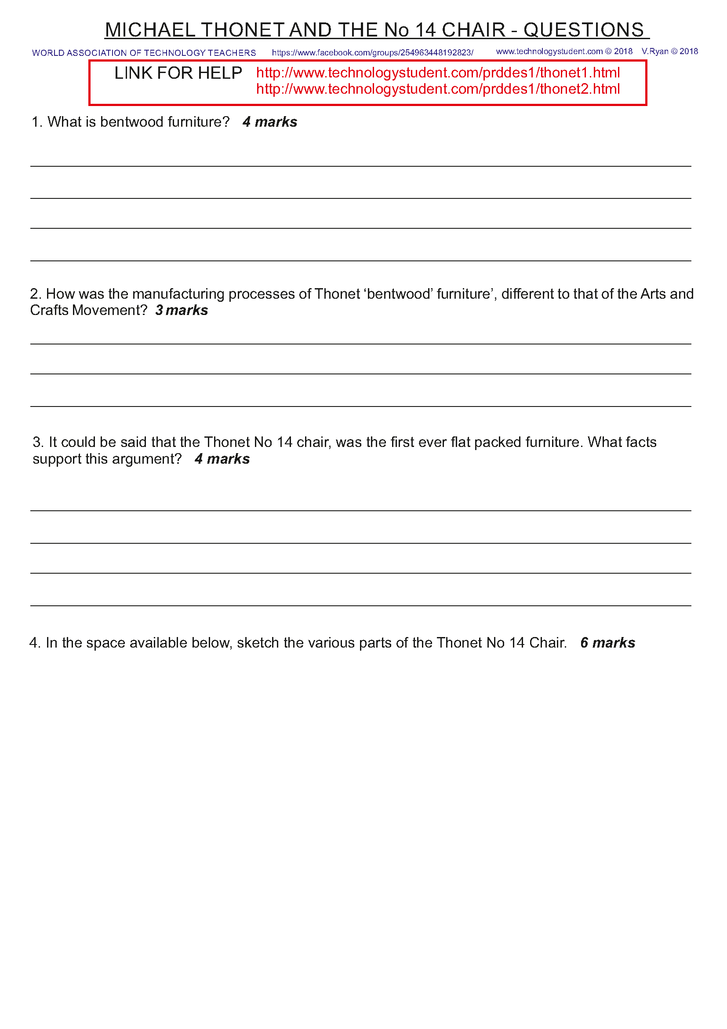
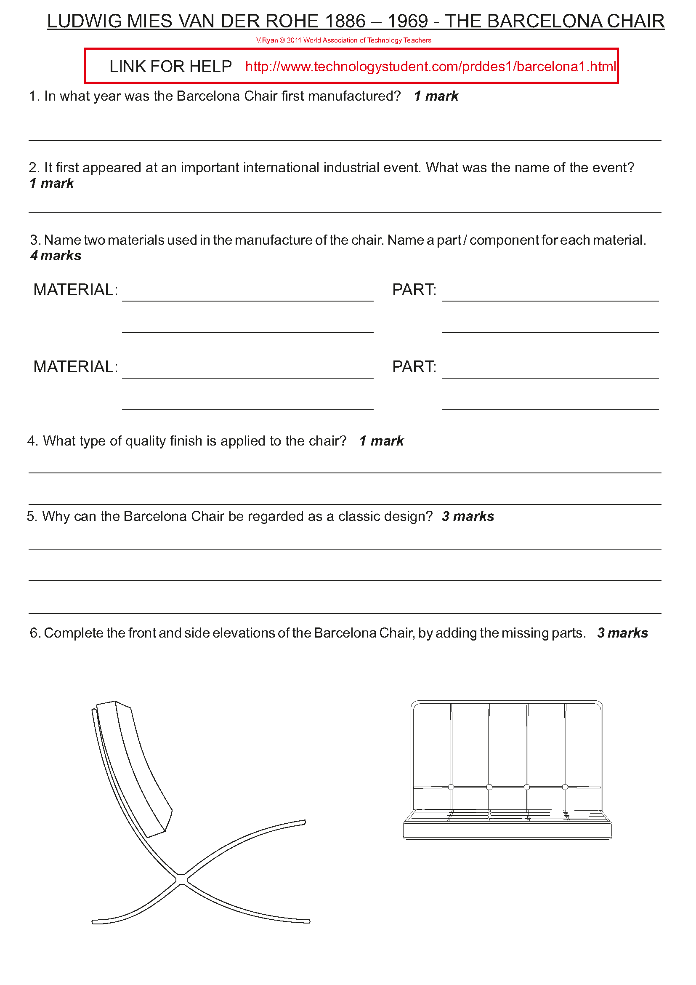

Slide 6
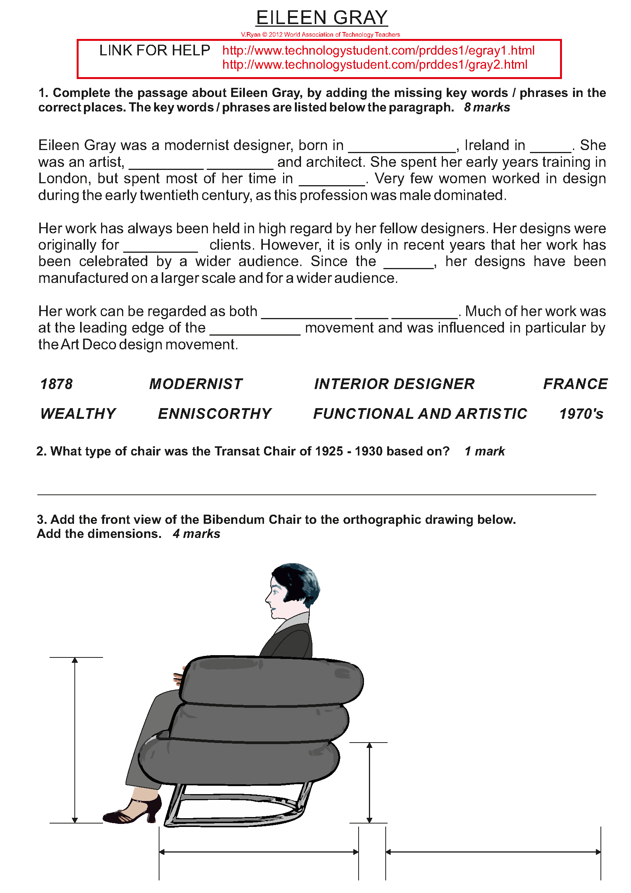
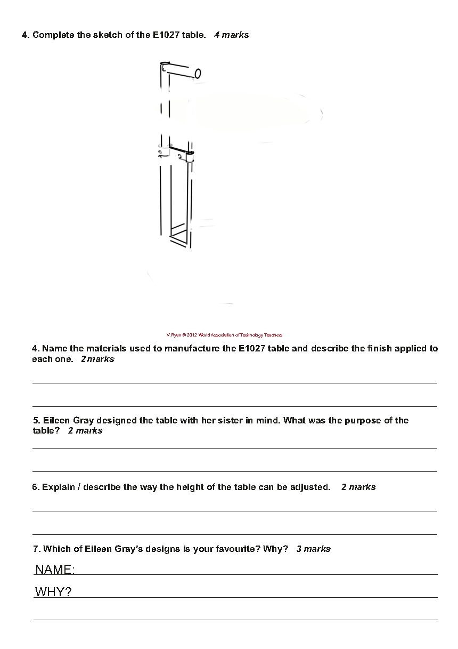

Slide 7
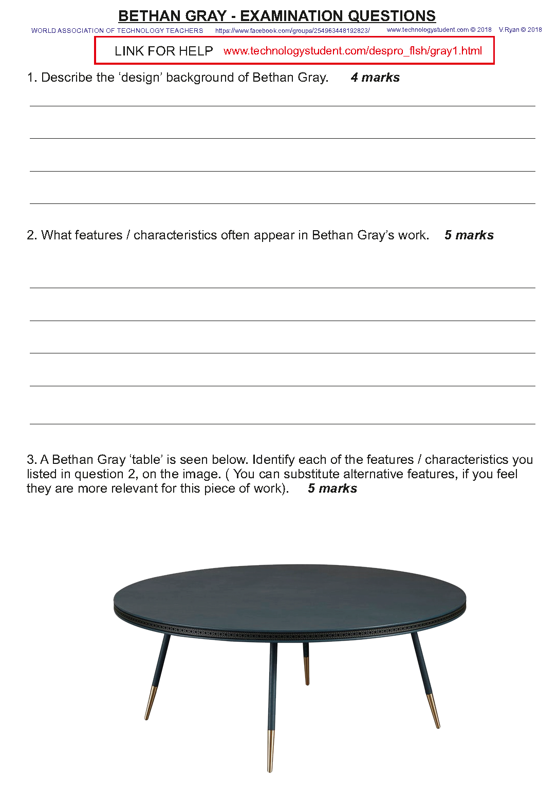

Slide 8
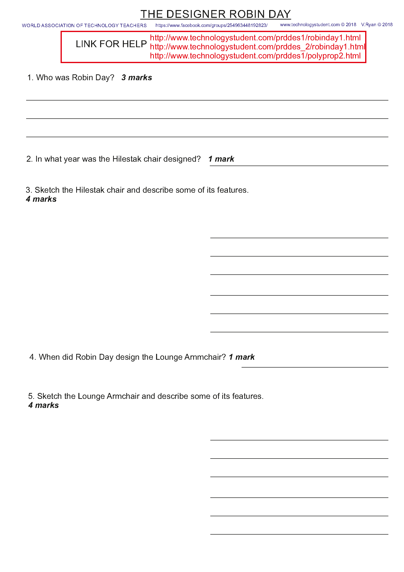
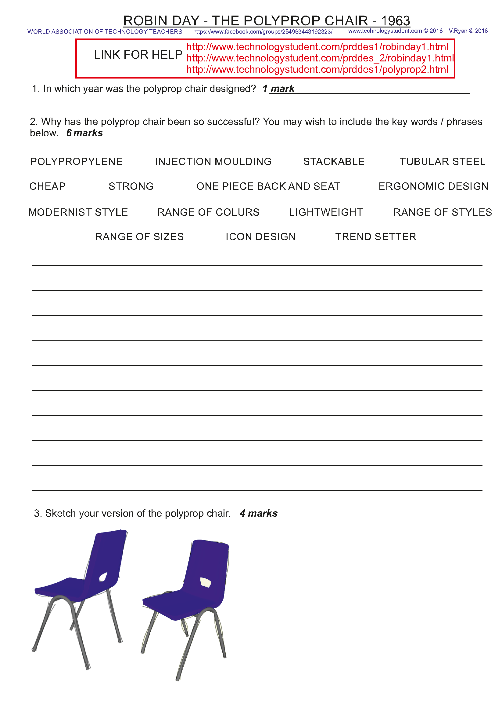

Slide 9
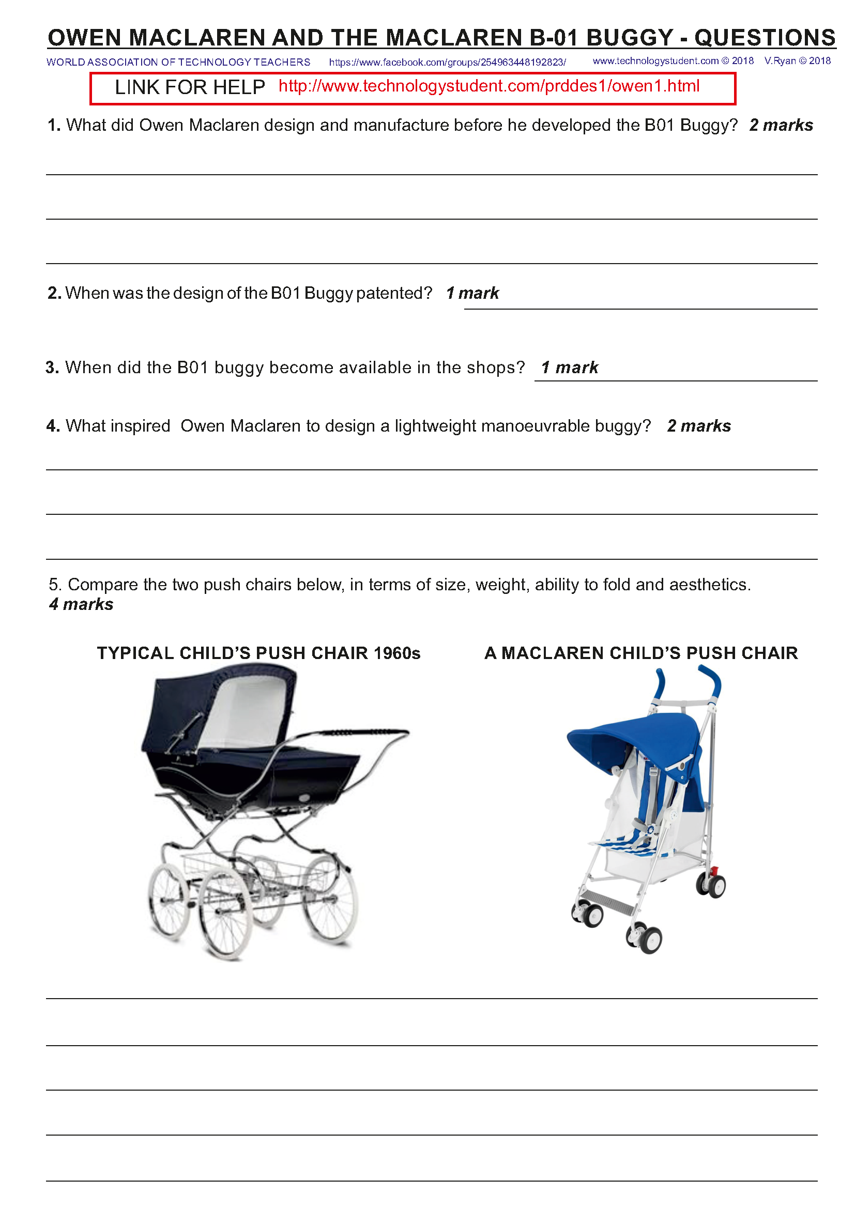
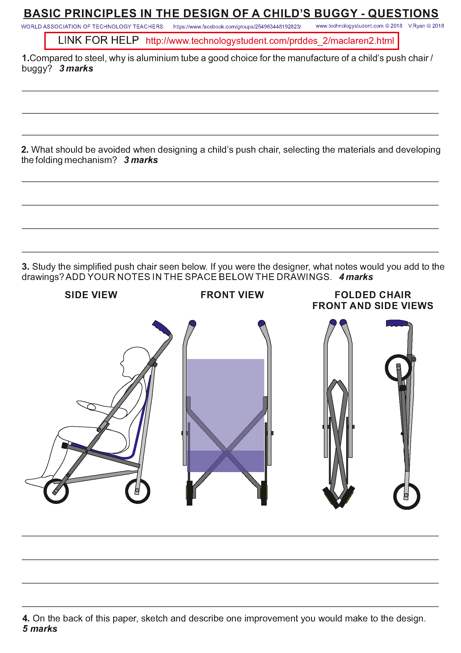

Slide 10
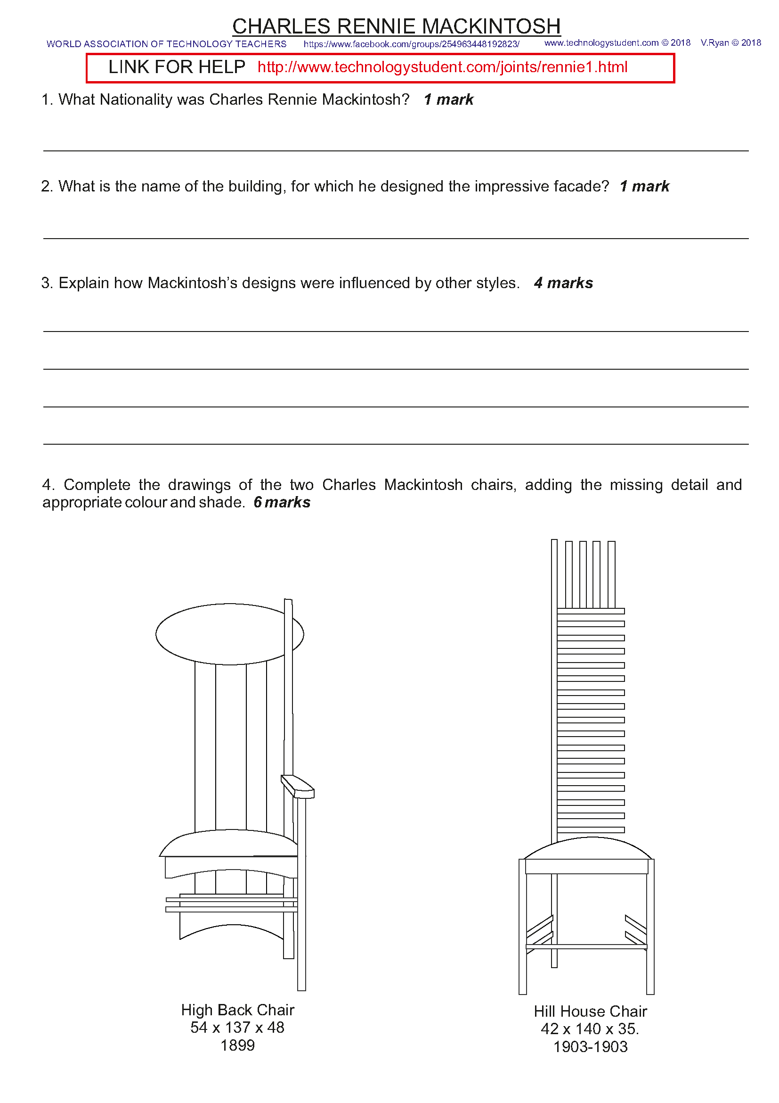

Slide 11
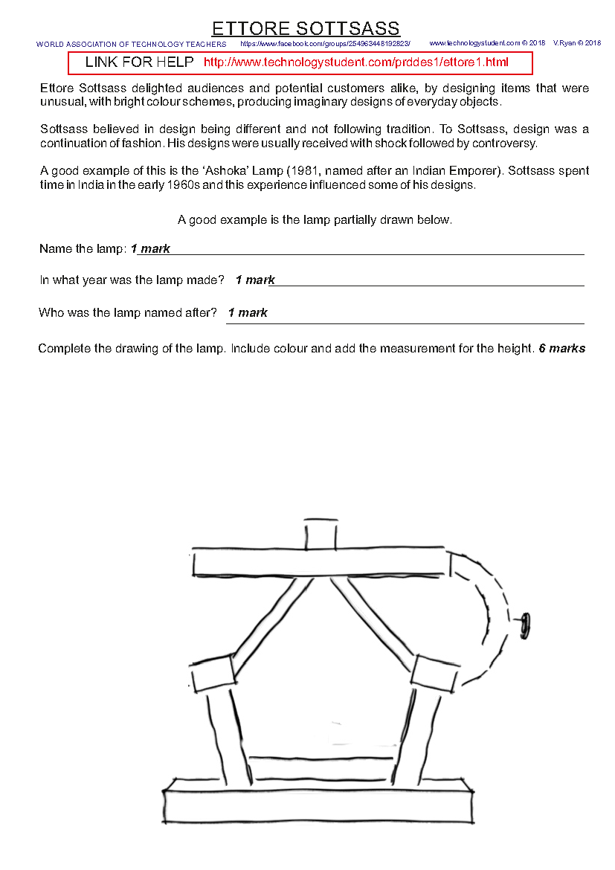

Slide 12
