Slide 1
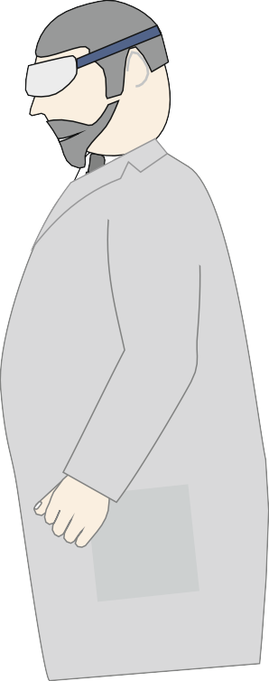
THE MORTISING MACHINE - EXAMINATION QUESTIONS
WORLD ASSOCIATION OF TECHNOLOGY TEACHERS https://www.facebook.com/groups/254963448192823/
www.technologystudent.com © 2021 V.Ryan © 2021
HELPFUL LINK: https://technologystudent.com/equip_ﬂsh/mort1.html
1. Brieﬂy describe the function / purpose of the Mortising Machine. 4 marks
2. Explain the use of the Mortising Machine, with reference to the diagram below.
8 marks
MOR
CLAMP
TABLE
V.Ryan © 2022

Slide 2
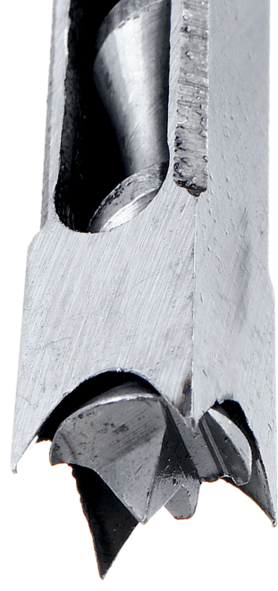
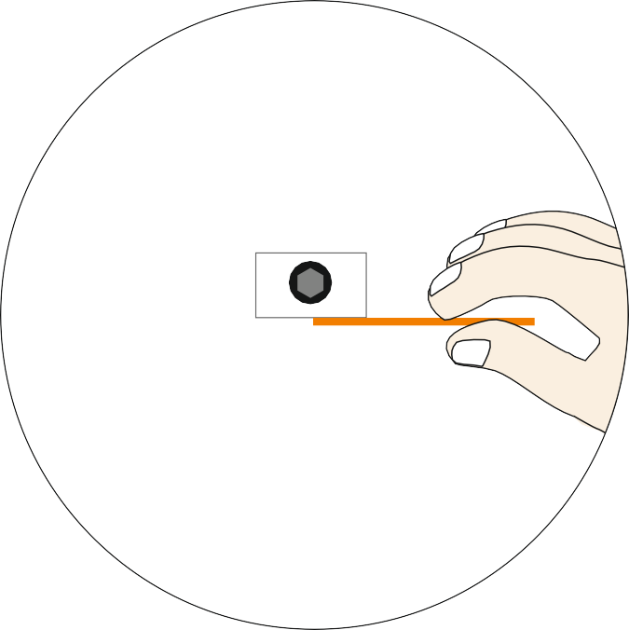
THE MORTISING MACHINE - EXAMINATION QUESTIONS
WORLD ASSOCIATION OF TECHNOLOGY TEACHERS https://www.facebook.com/groups/254963448192823/
www.technologystudent.com © 2021 V.Ryan © 2021
HELPFUL LINK: https://technologystudent.com/equip_ﬂsh/mort1.html
3. What is meant by ‘clearance’, between the auger and the hollow chisel? Why is ‘clearance’ important? 4 marks
4. With reference to the diagrams below, describe how ‘clearance’ between the auger bit and hollow chisel, is set up. 4 marks
V.Ryan © 2022
V.Ryan © 2022

