Slide 1
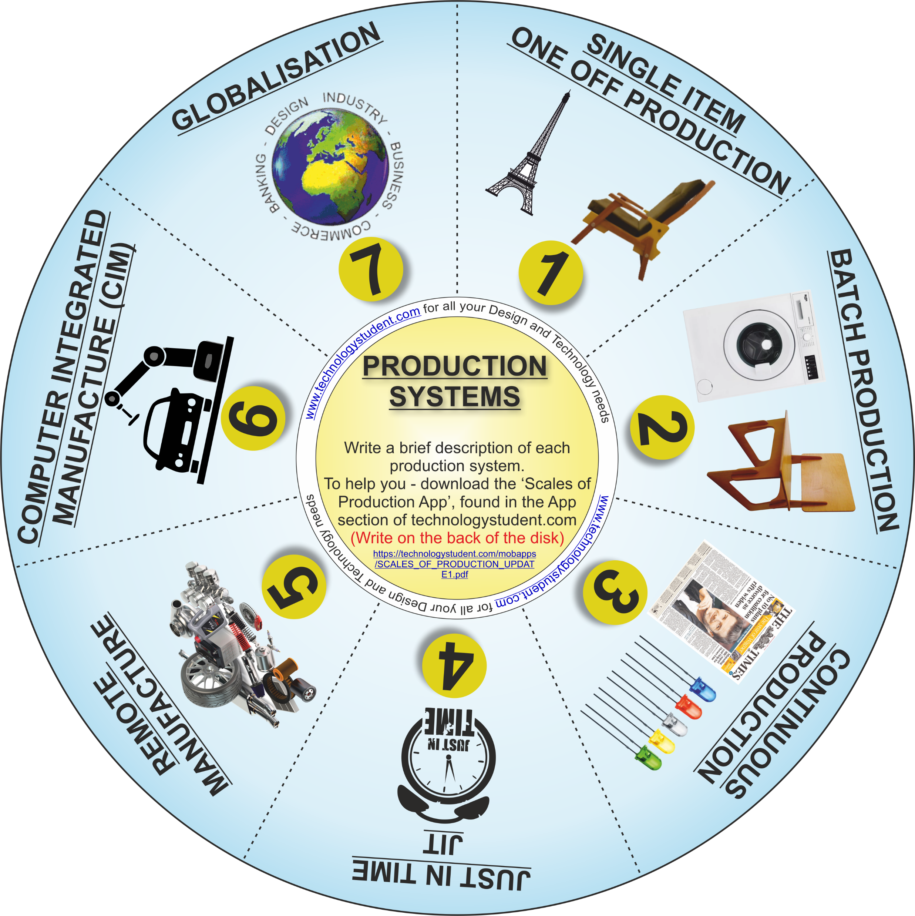
PRODUCTION SYSTEMS
‘LEARNING CIRCLE’
The disk includes seven Production Systems. For each one, write a brief description. In addition, identify a product manufactured by each system.
For help and information, download the ‘Scales of Production’ Interactive Mobile PDF App, from the App section of technologystudent.com
https://technologystudent.com/mobapps/SCALES_OF_PRODUCTION_UPDATE1.pdf
If you click on the circle, you will be able to rotate it, making it easier to read the symbols.

