Slide 1
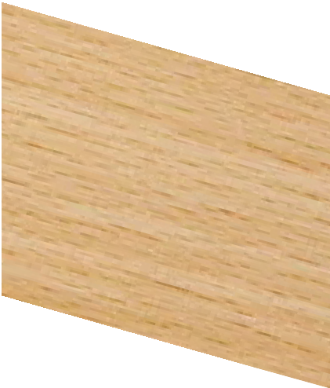
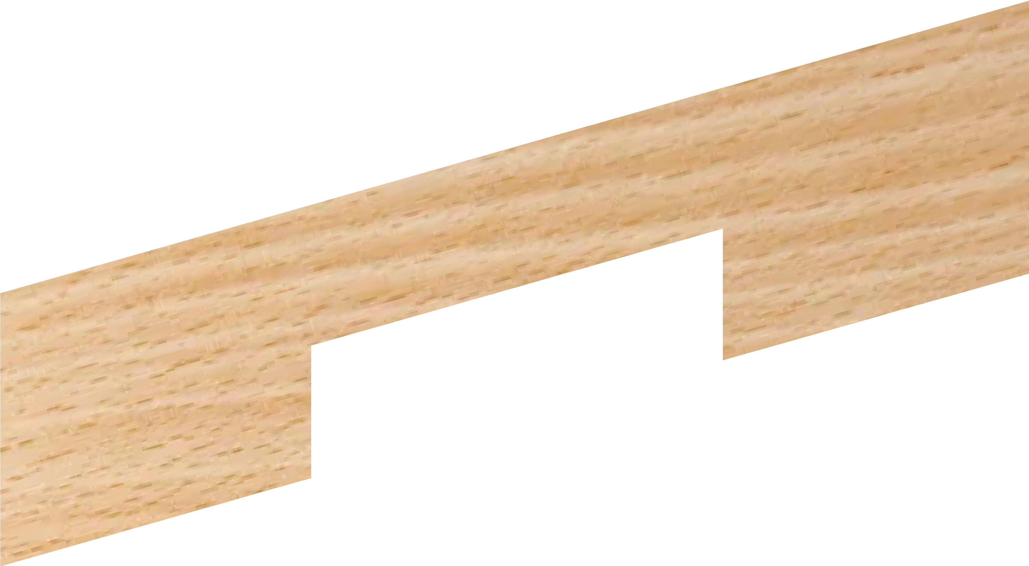
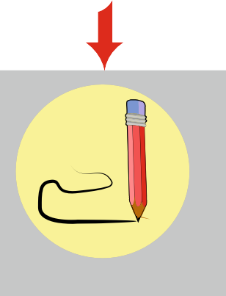
EXPLODED DRAWINGS
WORLD ASSOCIATION OF TECHNOLOGY TEACHERS https://www.facebook.com/groups/254963448192823/
technologystudent.com © 2023
V.Ryan © 2023
Detailed drawings of a common woodworking joint called a cross halving joint, are seen opposite.
Using a ruler and pencil / ink pen OR freehand (without a ruler), complete the sketch of the exploded view.
CROSS HALVING JOINT - ASSEMBLED VIEW
SURFACES LEVEL
YOUR - EXPLODED VIEW
TOP PIECE
BOTTOM PIECE
HELPFUL LINK
Link

Slide 2
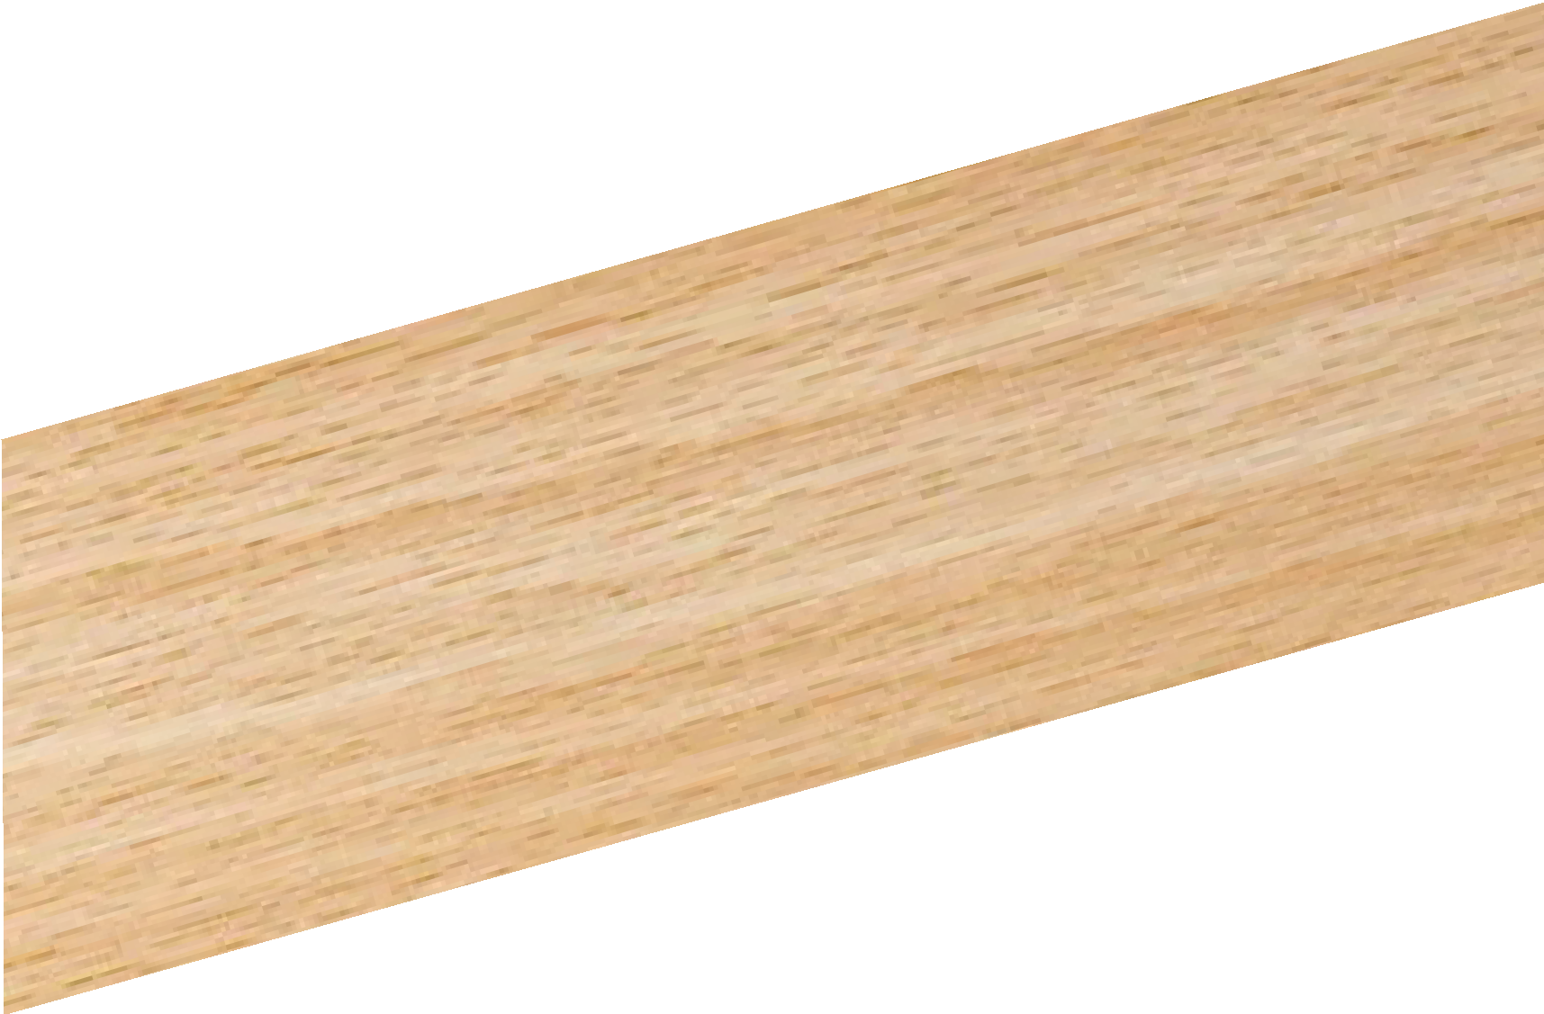
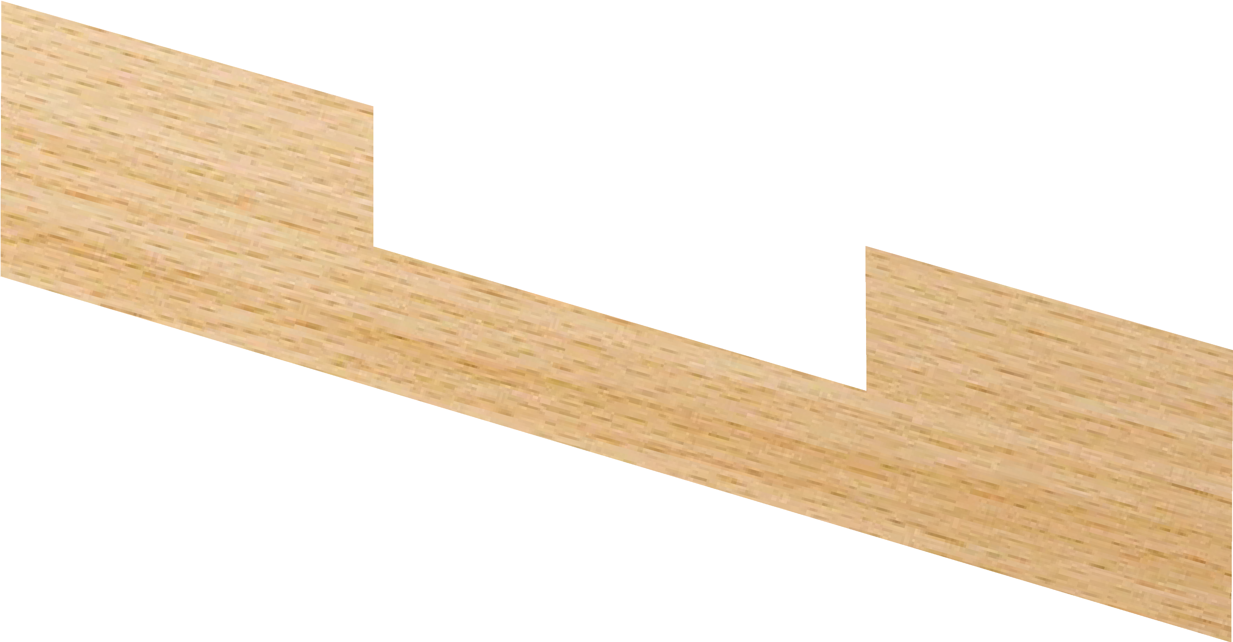
EXPLODED DRAWINGS
WORLD ASSOCIATION OF TECHNOLOGY TEACHERS https://www.facebook.com/groups/254963448192823/
technologystudent.com © 2023
V.Ryan © 2023
TEE HALVING JOINT - ASSEMBLED VIEW
SURFACES LEVEL
Detailed drawings of a common woodworking joint called a tee halving joint, are seen opposite.
Using a ruler and pencil / ink pen OR freehand (without a ruler), complete the sketch of the exploded view.
YOUR - EXPLODED VIEW
HELPFUL LINK
Link

Slide 3
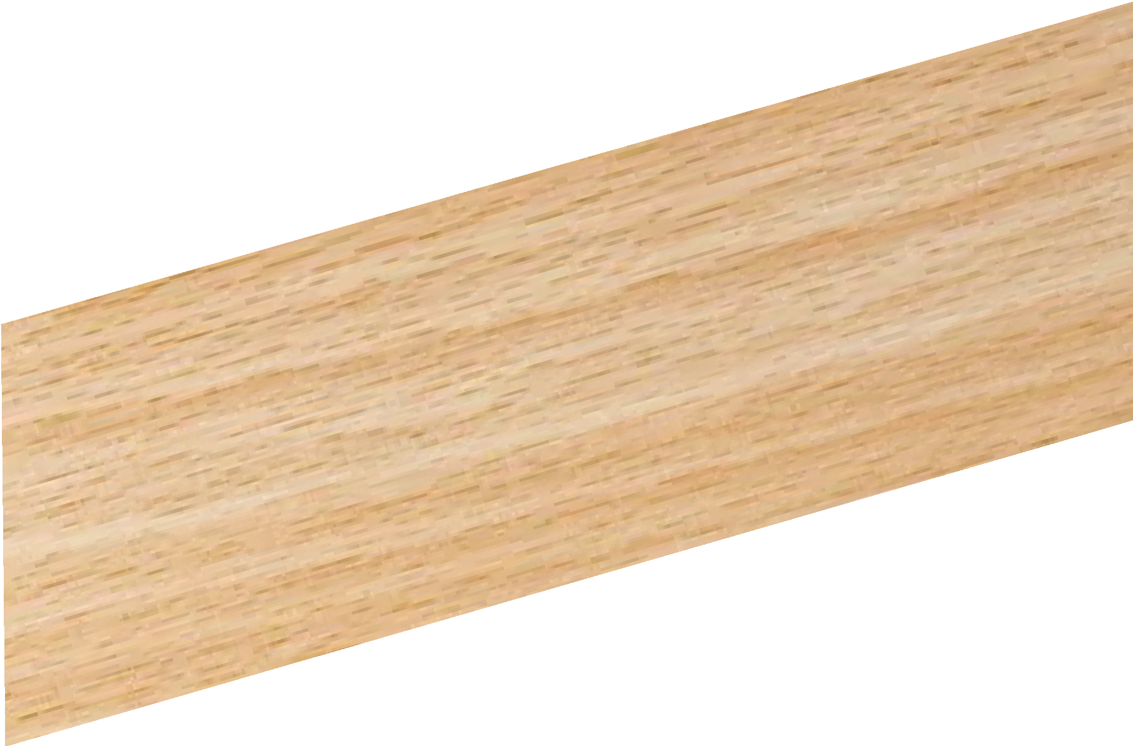
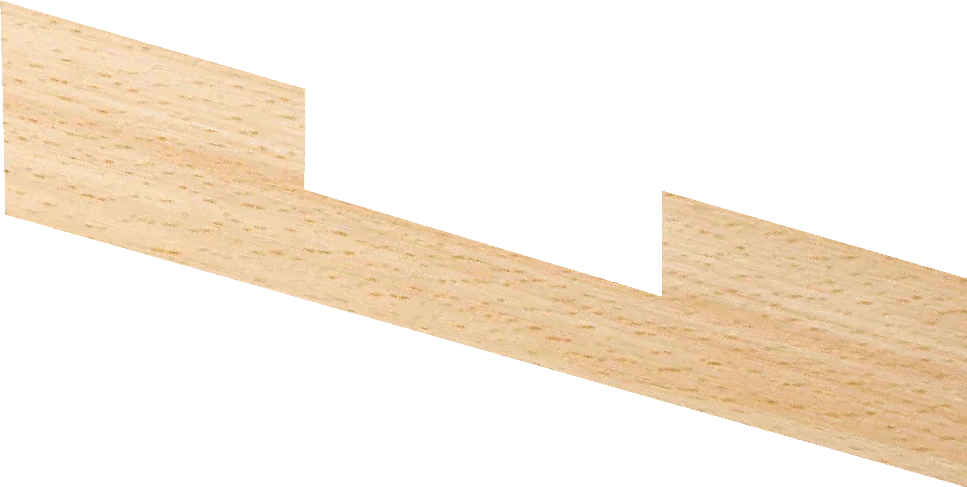
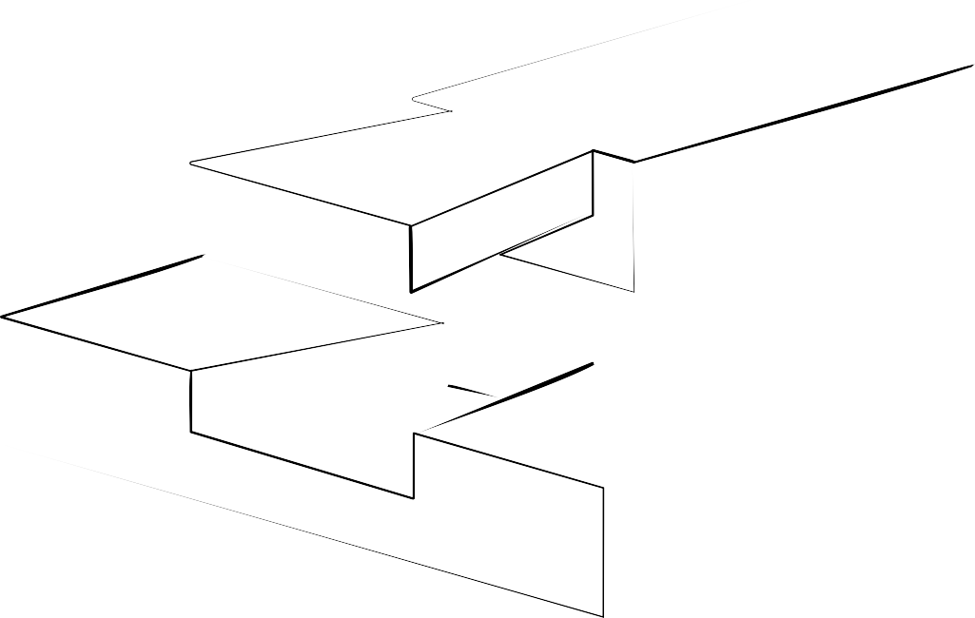
EXPLODED DRAWINGS
WORLD ASSOCIATION OF TECHNOLOGY TEACHERS https://www.facebook.com/groups/254963448192823/
technologystudent.com © 2023
V.Ryan © 2023
DOVETAIL HALVING JOINT
DOVETAIL HALVING JOINT - ASSEMBLED VIEW
SURFACES LEVEL
Detailed drawings of a common woodworking joint called a dovetail halving joint, are seen opposite.
Using a ruler and pencil / ink pen OR freehand (without a ruler), complete the sketch of the exploded view.
YOUR - EXPLODED VIEW
HELPFUL LINK
Link

Slide 4
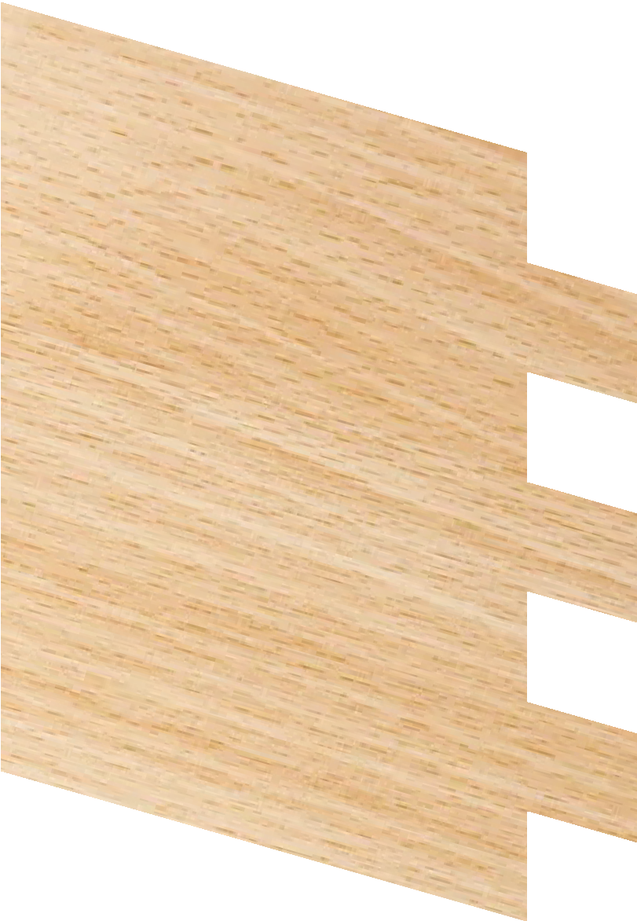
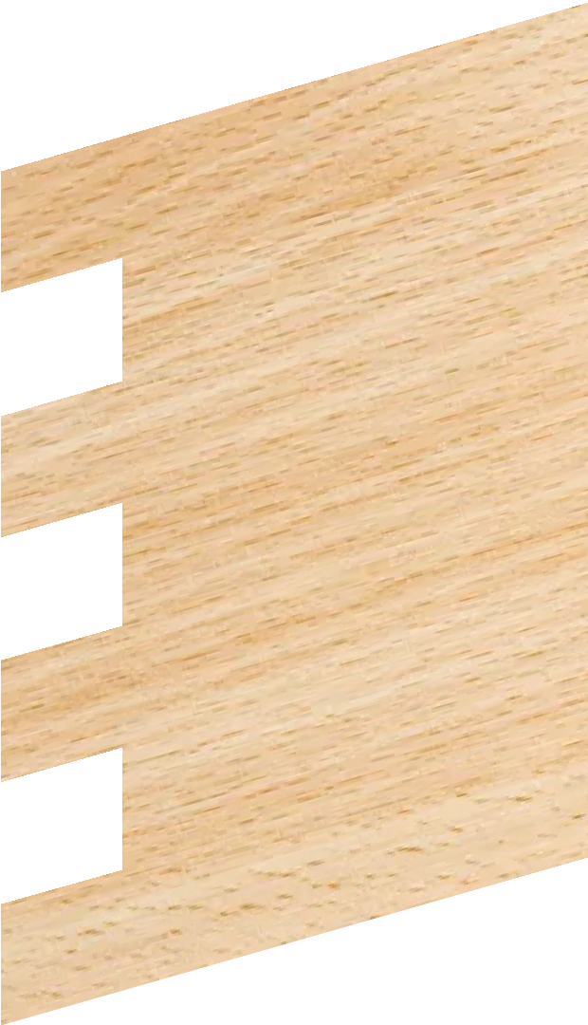
EXPLODED DRAWINGS
https://www.facebook.com/groups/254963448192823/
WORLD ASSOCIATION OF TECHNOLOGY TEACHERS
technologystudent.com © 2023
V.Ryan © 2023
FINGER / COMB JOINT
ASSEMBLED VIEW
Detailed drawings of a common woodworking joint called a ﬁnger / comb joint, are seen opposite.
Using a ruler and pencil / ink pen OR freehand (without a ruler), complete the sketch of the exploded view.
YOUR - EXPLODED VIEW
V.Ryan © 2022
HELPFUL LINK
Link

Slide 5
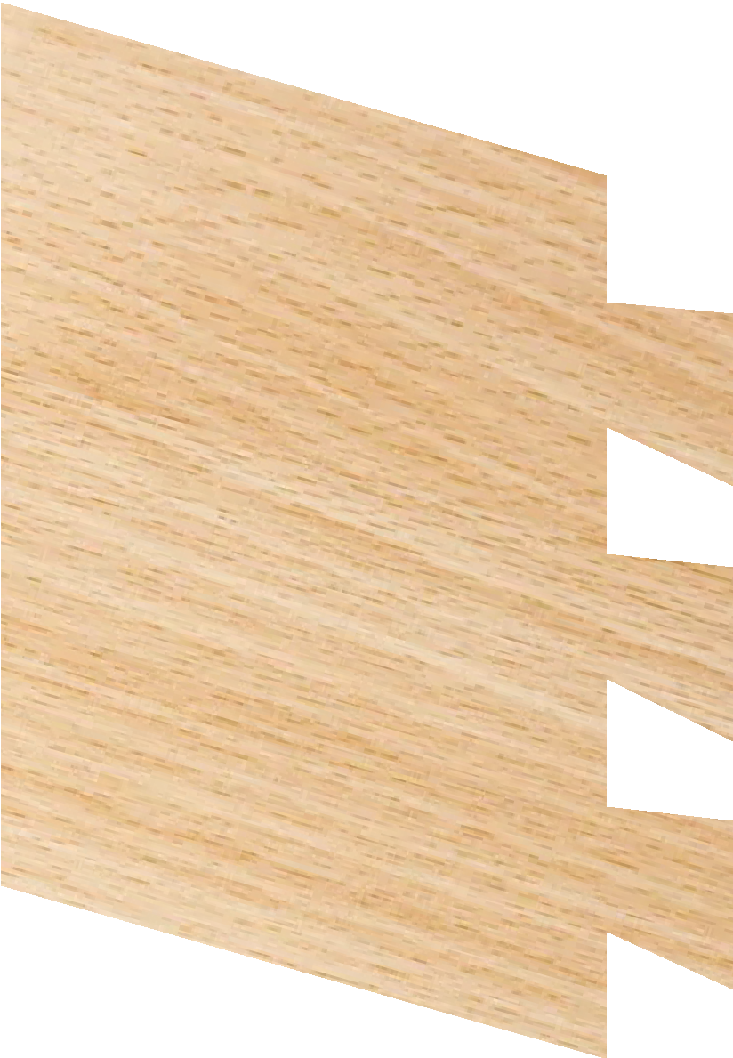
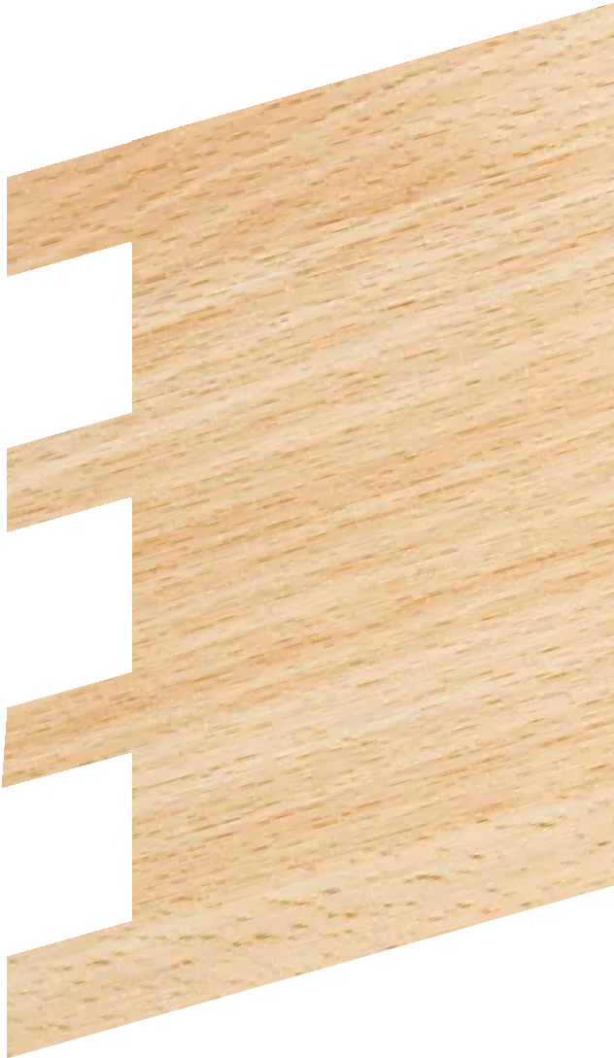
EXPLODED DRAWINGS
https://www.facebook.com/groups/254963448192823/
WORLD ASSOCIATION OF TECHNOLOGY TEACHERS
technologystudent.com © 2023
V.Ryan © 2023
THROUGH DOVETAIL JOINT
ASSEMBLED VIEW
Detailed drawings of a common woodworking joint called a through dovetail joint, are seen opposite.
Using a ruler and pencil / ink pen OR freehand (without a ruler), complete the sketch of the exploded view.
V.Ryan © 2022
YOUR - EXPLODED VIEW
HELPFUL LINK
Link

