Slide 1
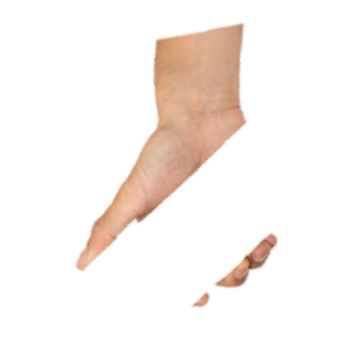
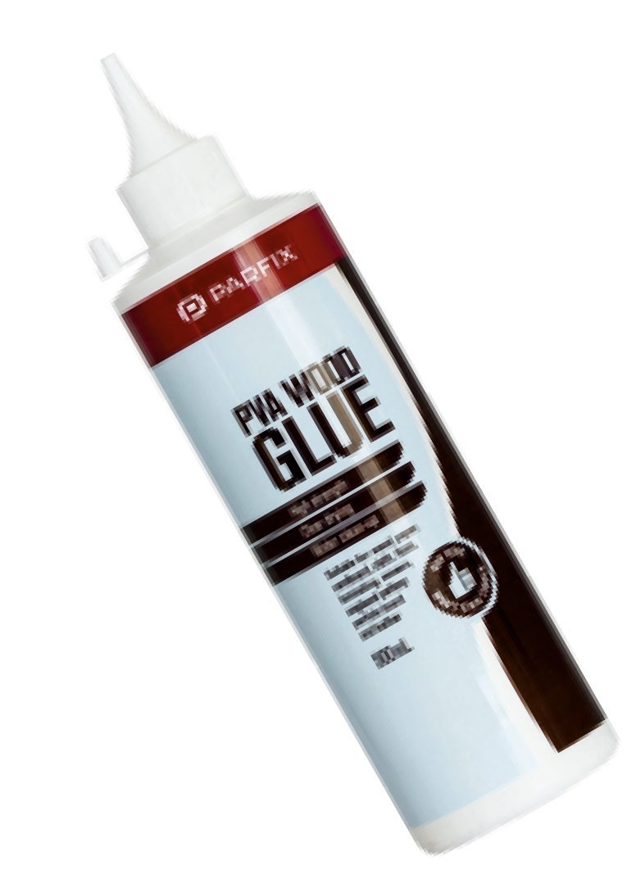
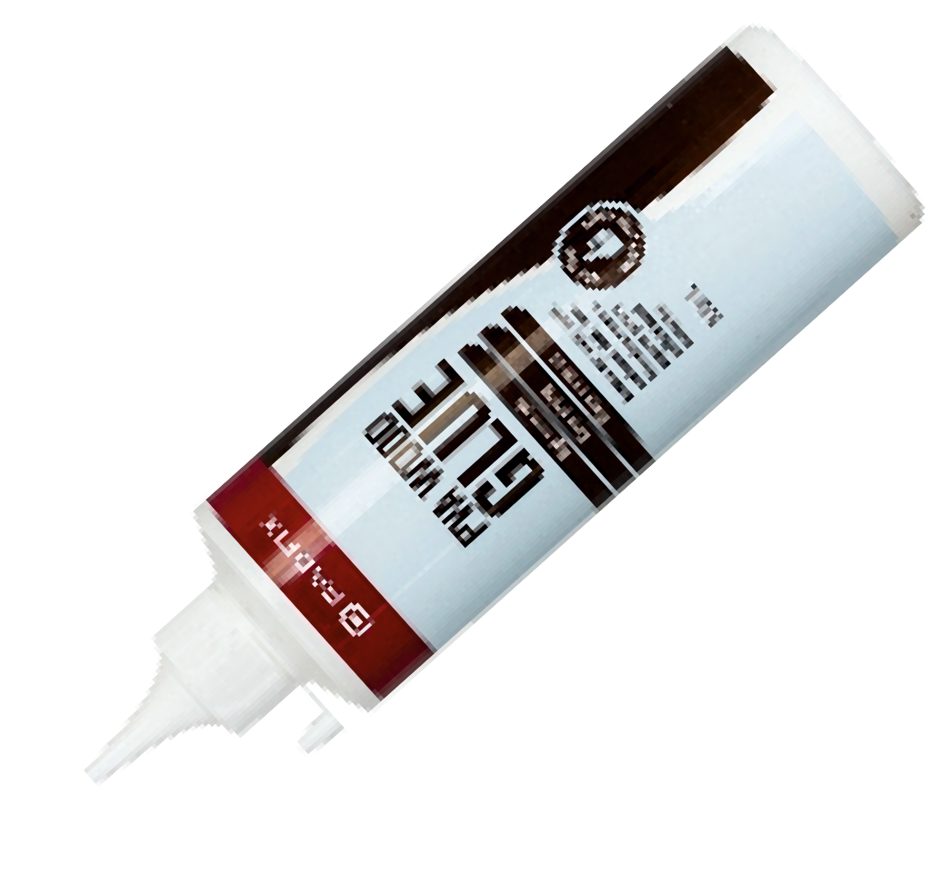
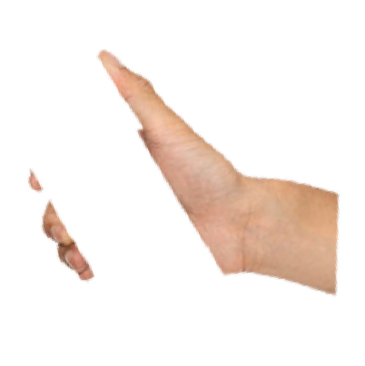
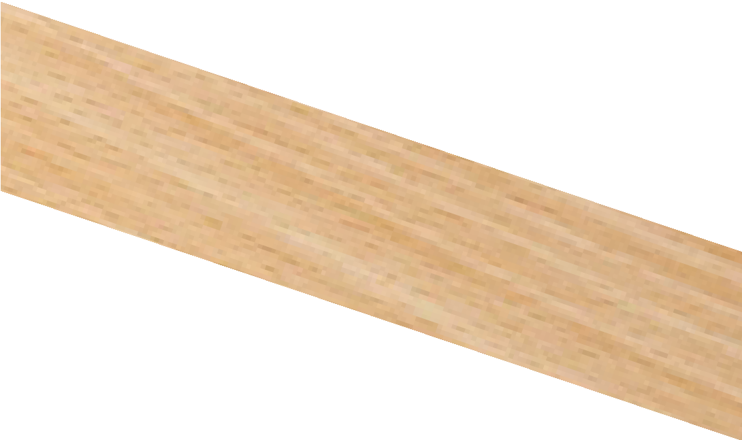
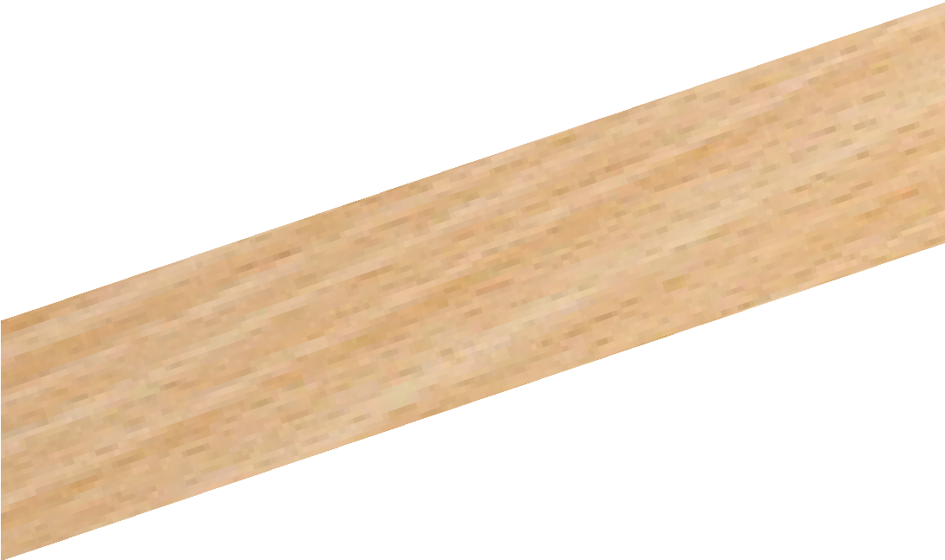
USING CASCAMITE WOODWORKING ADHESIVE
WORLD ASSOCIATION OF TECHNOLOGY TEACHERS https://www.facebook.com/groups/254963448192823/
www.technologystudent.com © 2022 V.Ryan © 2022
HELPFUL LINK: https://www.technologystudent.com/equip1/gluewd1.htm
Complete the sequence drawing, showing the use of PVA, by adding the missing explanations
2. 3.
1.
V.Ryan © 2022
PVA is suitable of a wide variety of woods.
(Polyvinyl Acetate also known as, PVA and PVAc). It is probably the most
common wood glue, used extensively in
furniture manufacture and construction.
4.
Use a plastic spreader or a brush to spread the glue across the surfaces of both pieces. The glue should be spread thinly. Clean up any spills with a damp cloth.
6.
5.
RYAN
RYAN
V.Ryan © 2022
Push the two pieces together, rubbing the
surfaces from side to side. This will ensure that air is not trapped and that the glue has been spread evenly.

