Slide 1
POWER DRILLS - EXAMINATION QUESTIONS
WORLD ASSOCIATION OF TECHNOLOGY TEACHERS https://www.facebook.com/groups/254963448192823/ www.technologystudent.com © 2023 V.Ryan © 2023
HELPFUL LINK: https://www.technologystudent.com/pwtol/drill1.htm
1. Complete the diagram of the corded power drill, by adding the labels indicated by the arrows. 3 marks
6 8 10 12 14
RYANMATIC
Power Hammer Drill
Made in Keighley, England.
V.Ryan © 2023

Slide 2
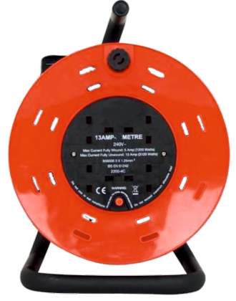
POWER DRILLS - EXAMINATION QUESTIONS
WORLD ASSOCIATION OF TECHNOLOGY TEACHERS https://www.facebook.com/groups/254963448192823/ www.technologystudent.com © 2023 V.Ryan © 2023
HELPFUL LINK: https://www.technologystudent.com/pwtol/drill1.htm
2. Using the diagram below, add notes / labels that identify safety factors relating to the use of the power drill. 9 marks
6 8 10 12 14
RYANMATIC
Power Hammer Drill
V.Ryan © 2023
Made in Keighley, England.
V.Ryan © 2023

