Slide 1
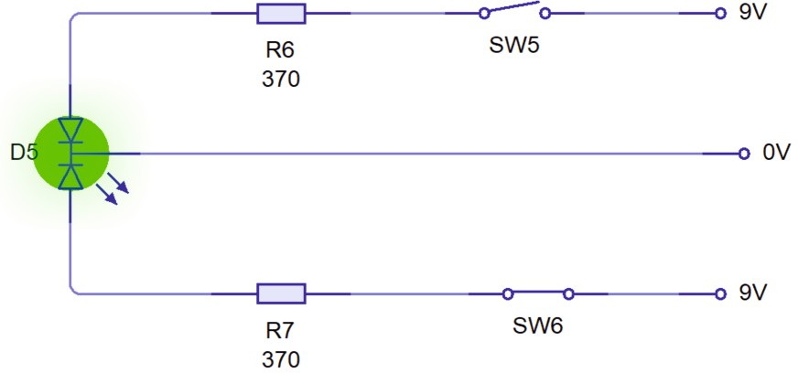
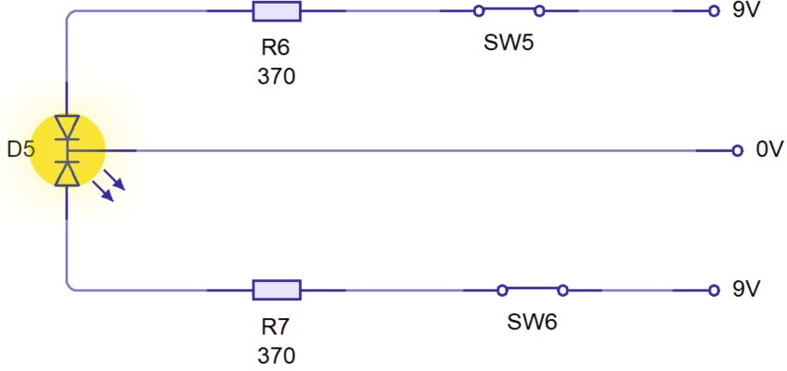
TRICOLOUR LIGHT EMITTING DIODES (LEDs) - EXAMINATION QUESTIONS
WORLD ASSOCIATION OF TECHNOLOGY TEACHERS https://www.facebook.com/groups/254963448192823/
www.technologystudent.com © 2022 V.Ryan © 2022
HELPFUL LINK: https://technologystudent.com/elec_ﬂsh/tricolour1.html
1. What is a tricolour LED? Include a diagram of a tricolour LED to support your answer.
3 marks
NOTES:
DIAGRAM
2. Explain / describe, what is being shown by both the circuits shown below.
4 marks

