Slide 1
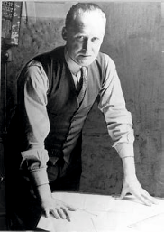
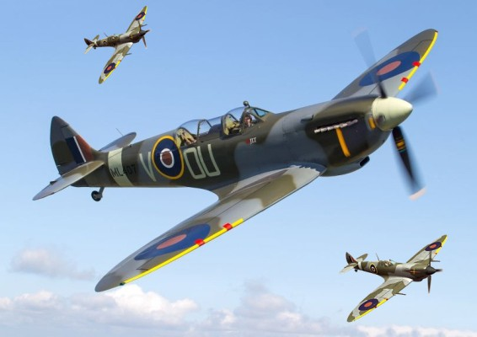
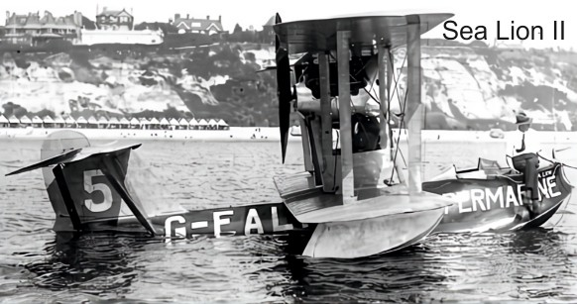
Reginald Joseph Mitchell (1895-1937)
USEFUL LINK: https://technologystudent.com/despro_ﬂsh/reginald1.html
1. Reginald Joseph Mitchell
R. J. Mitchell was one of the most talent aeronautical designers of the Twentieth Century. He excelled in the design of fast sea planes, capable of competing in, and winning the Schneider Trophy, in the 1930s.
He is best remembered for his role, as leader of the team, that designed the legendary Spitﬁre, a ﬁghter aircraft that combined speed, agility and beauty.
As a young boy, he developed an interest in the designing and making model planes. When he left school, he became a locomotive apprentice at ‘Stuart and Company’, in Stoke.
2. Reginald Joseph Mitchell
By 1917, he was an assistant at the ‘Supermarine Aviation Works Limited’, of Southampton. Designing ﬂying boats throughout World War One. The company had a serious interest in winning the Schneider Trophy.
At the age of 27, R.J. Mitchell lead the design team that produced the Sea Lion II, which won the trophy in 1922.
3. Reginald Joseph Mitchell
R.J Mitchell died in 1937, but his innovative work, meant that the ground had been set for the Spitﬁre, a plane that became a design icon, helping to win World War Two. Pilots were amazed at its ﬂying capabilities and the beauty of its design.
1. Who was Reginald Joseph Mitchell and what did he design? 4 marks
2. What was the Schneider Trophy? (you may need to search the internet)
3 marks
3. What was the name of the iconic plane Mitchell designed ? 1 marks

