Slide 1
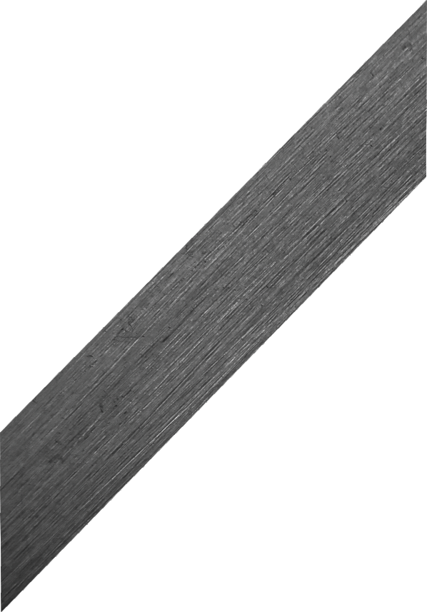
THE MITRE SQUARE - EXAMINATION QUESTIONS
WORLD ASSOCIATION OF TECHNOLOGY TEACHERS https://www.facebook.com/groups/254963448192823/ www.technologystudent.com © 2023 V.Ryan © 2023
HELPFUL LINK: https://www.technologystudent.com/equip_ﬂsh/mitresq1.html
1. Complete the diagram of the Mitre Square, by adding the missing labels.
4 marks
RYAN
Made in Keighley
2. Describe the Mitre Square and explain its common use (include a sketch).
6 marks
NOTES
SKETCH

