Slide 1
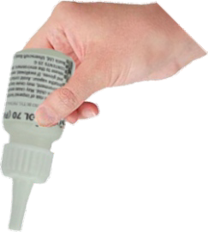
USING TENSOL CEMENT
WORLD ASSOCIATION OF TECHNOLOGY TEACHERS https://www.facebook.com/groups/254963448192823/
www.technologystudent.com © 2022 V.Ryan © 2022
HELPFUL LINK: https://www.technologystudent.com/equip1/glueplas1.htm
Complete the sequence drawing showing the use of Tensol Cement, by adding the missing explanations.
Also, answer the additional questions (6&7).
V.Ryan © 2022
V.Ryan © 2022
V.Ryan © 2022
V.Ryan © 2022
1. 2. 3.
Tensol Cement tends to ‘give oﬀ’ fumes. Why is this a safety issue?
5.
When using Tensol Cement, how would you ensure that the glue is used safely and that the workshop did not suﬀer from a build-up of dangerous fumes?
4.
6.

